Slide 1
GastroHub
Matt Imel
Notes:
Title.

Slide 2
What is GastroHub?
GastroHub is a website that promotes a collaborative and constructive environment around creating and refining recipes.
GastroHub allows users to upload “Variants” to recipes. Variants can be tagged not only by cuisine or type, but by intent.
Possible reasons to build and search for Variants include:
Ethical (Vegan, Vegetarian…)
Health-Related (Low sugar…)
Dietary (Keto-friendly…)
Religious (Non-pork, Kosher…)
Allergenic (Lactose-free, Gluten-free…)
Monetary (“Wine, on my budget?”)
Cultural (“This isn’t a real Texas Chili!”)
Notes:
Overview

Slide 3




Software Used
Notes:
Overview

Slide 4
Sitemap
Home
/
Create
/create
Recipe
/recipes/:rID/:slug
About Us
/aboutus
Login
/login
Post Variant
/recipes/postvariant/:rID/:slug/:pcID
Browse
/browse
Notes:
Overview

Slide 5
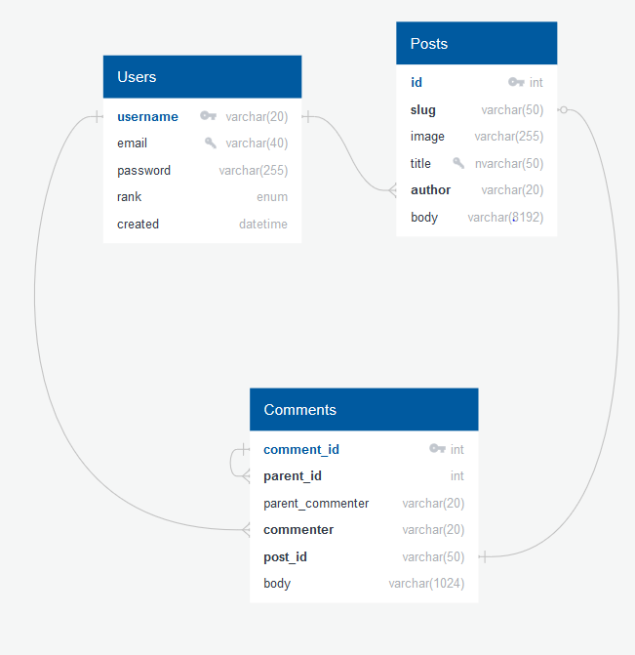
Database Diagram
Courtesy of QuickDBD
Notes:
Overview

Slide 6
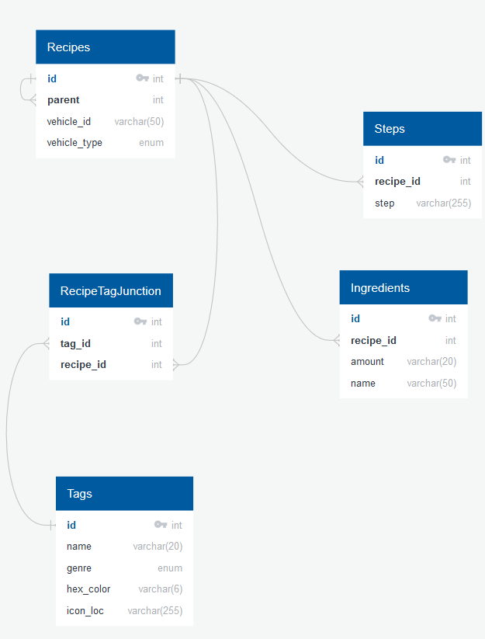
Database Diagram
Courtesy of QuickDBD
Notes:
Overview

Slide 7
Register/Login/Logout
Users can create a profile with a given unique username, unique email address, and password.
Passwords are encrypted using bcrypt; they are never stored as plaintext.
Notes:
Overview

Slide 8
Recipe Creation
Users can create recipes!
Recipes require a title, a description, at least one ingredient amount and name, and at least one step.
Optionally, recipes can have an image and/or zero or more tags.
Notes:
Overview

Slide 9
Commenting
Users can comment on posts, or on other comments.
More powerfully, users can create variants of both base recipes and other variants.
Notes:
Overview

Slide 10
Creating Variants
A variant is an alteration on a base recipe or other variant.
Users can create variants with their comments, and change ingredient names/amounts, steps, and tags.
Notes:
Overview

Slide 11
Browsing
Allows searching all posts by either name, tags, or both.
Does not search for variants.
Notes:
Overview

Slide 12
Notes:
Overview

Slide 13
Future Prospects
This is an ambitious project; there are many improvements that can be made!
Current issues: Form error callbacks, variants on base recipe, deploying
Future additions:
Advanced recipe debugging User profiles Recipe rating, curation CSS overhaul Proper pen/load/UI testing
Notes:
Overview

Slide 14
Questions?
Notes:
Overview

