Slide 1
meme.mp4

Slide 2
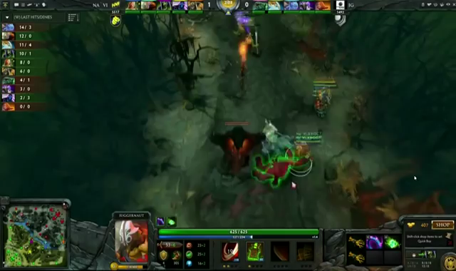
screenshot2.0

Slide 3
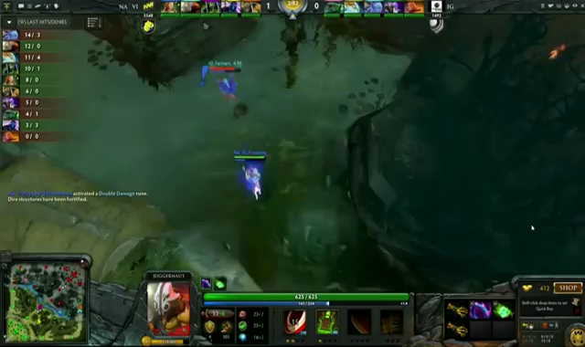
screenshot6.0

Slide 4
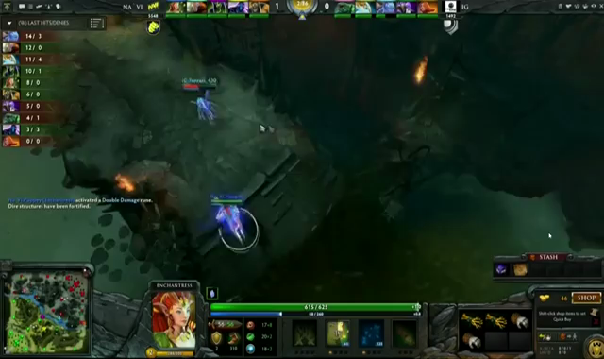
screenshot10.0

Slide 5
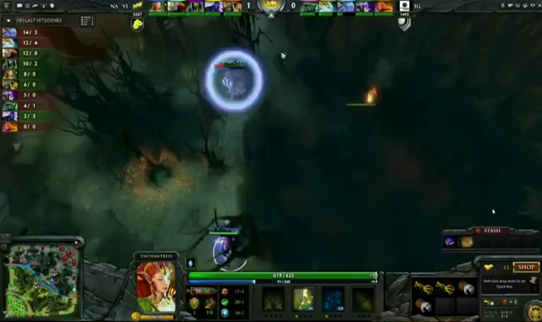
screenshot14.0

Slide 6
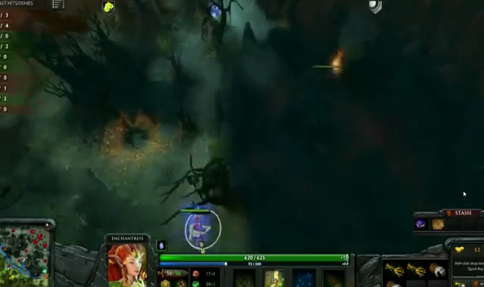
screenshot18.0

Slide 7
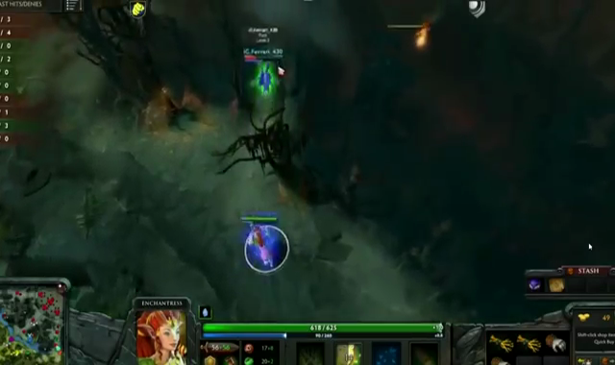
screenshot22.0

Slide 8
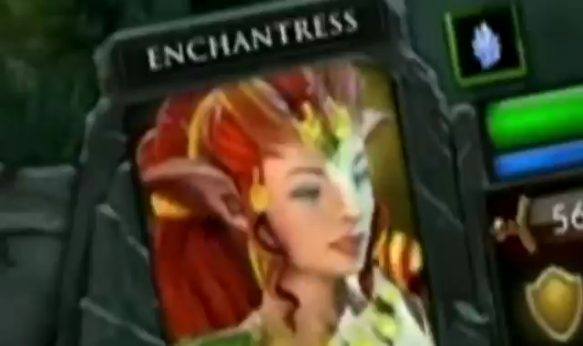
screenshot26.0

Slide 9
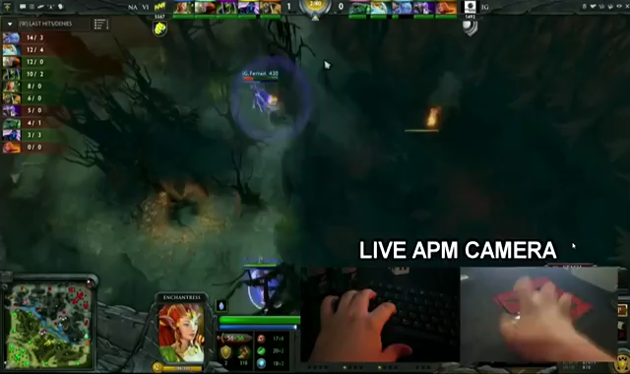
screenshot30.0

Slide 10
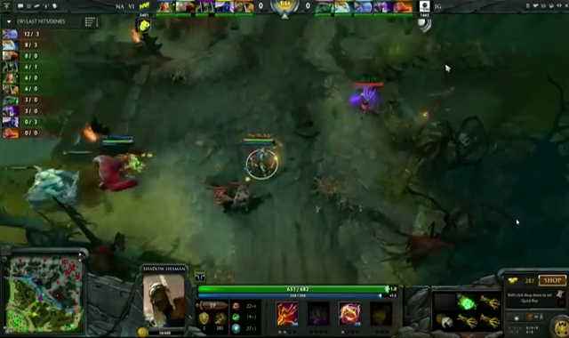
screenshot34.0

Slide 11
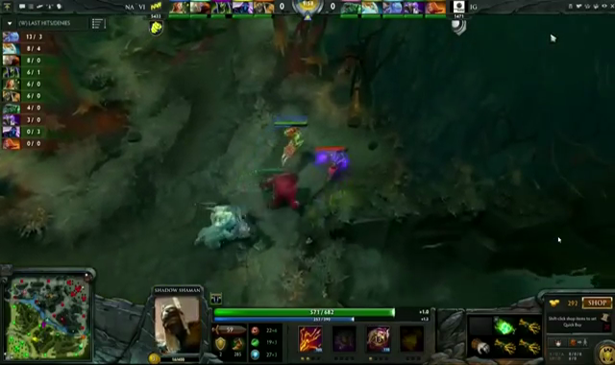
screenshot38.0

Slide 12
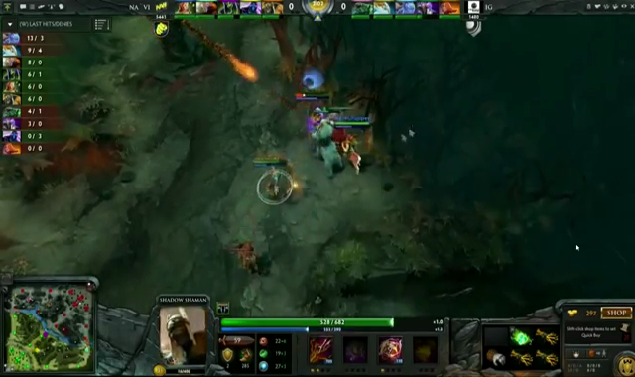
screenshot42.0

Slide 13
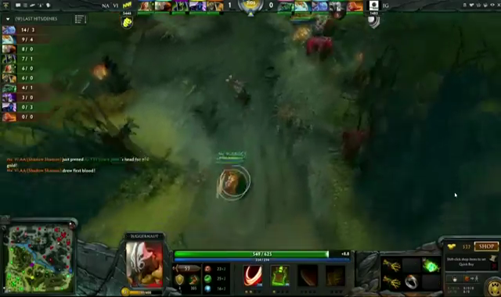
screenshot46.0

