Slide 1
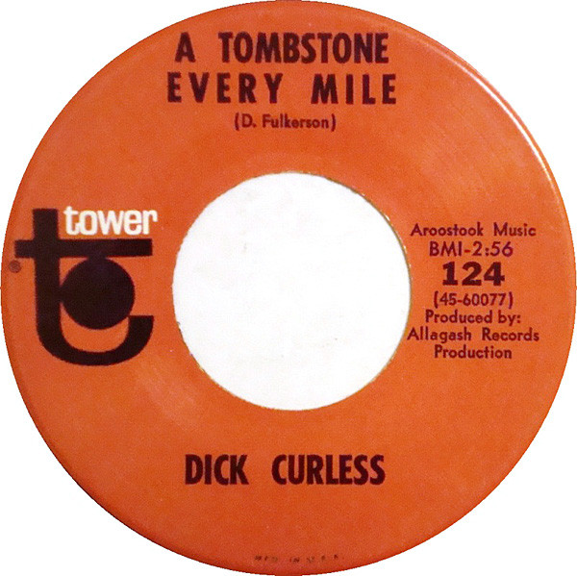






Is there an interaction between age and day of week for motor vehicle deaths?
Specifically:
Do younger people show a stronger tendency toward weekend fatalities?
H₀ in all cases is that there is no effect (whether of age, day of week, or both)
Motivation: Popular culture and high school experience
There's a Wikipedia page…
(https://en.wikipedia.org/wiki/List_of_car_crash_songs)

Slide 2
Levene's test
p = 8.27e-01 (same for stats package and pingouin)
p >= 0.05
▶︎ Sample variances similar enough for ANOVA
ANOVA F_oneway
Statistic = 7.66, p = 6.62e-10 (stats package); p(uncorr.) = 1.11e-14 (pingouin)
p < 0.05
▶︎ Reject the null hypothesis that the sample means are equal
https://docs.scipy.org/doc/scipy/reference/generated/scipy.stats.levene.html

Slide 3
Levene's test
p = 5.79e-09 (pingouin package)
p < 0.05
▶︎ Sample variances too dissimilar for ANOVA
Kruskal-Wallis H-test for independent samples
statistic=183.13, pvalue=6.84e-30 (pingouin package)
p < 0.05
▶︎ Reject the null hypothesis that all group medians are equal
https://docs.scipy.org/doc/scipy/reference/generated/scipy.stats.levene.html
https://docs.scipy.org/doc/scipy/reference/generated/scipy.stats.kruskal.html

Slide 4
Can some age-group effects be attributed to differing cohort sizes?
https://www.census.gov/data/tables/time-series/demo/popest/2010s-national-detail.html

Slide 5
Linear regression of motor vehicle deaths vs. population suggests
there are other factors, particularly for children and young adults
20-24
25-29
5-9
0-4
10-14

Slide 6
Age-group variances are too dissimilar for ANOVA
Can age groups be tested one by one?
Visual impression is that any weekend effect may dissipate with age

Slide 7
Variances within age groups are suitable for ANOVA test of day-to-day differences
One-way ANOVA showed significant differences among days for all but the 65-69 group.
▶︎ At this level of analysis, younger people are not different.
https://pingouin-stats.org/

Slide 8
Post-hoc tests showed significant differences in motor vehicle fatality counts among all pairs of weekdays and age groups, except those shown here.
▶︎ Some tendency for age groups to cluster
▶︎ No evidence yet to cleanly separate weekends from weekdays
Likely next test would be to group (some) weekdays vs. weekends
Analyses to date are easiest with equal sample sizes, so would choose e.g.
Sat/Sun vs. Tue/Wed
https://pingouin-stats.org/

