Slide 1
Analysis of Beijing housing prices Zichuan Huang – Student # 4628 1740
This presentation will make an analysis to the housing prices of Beijing in about 2011 to 2017, and show that what factors affect homebuyers’ choices.

Slide 2
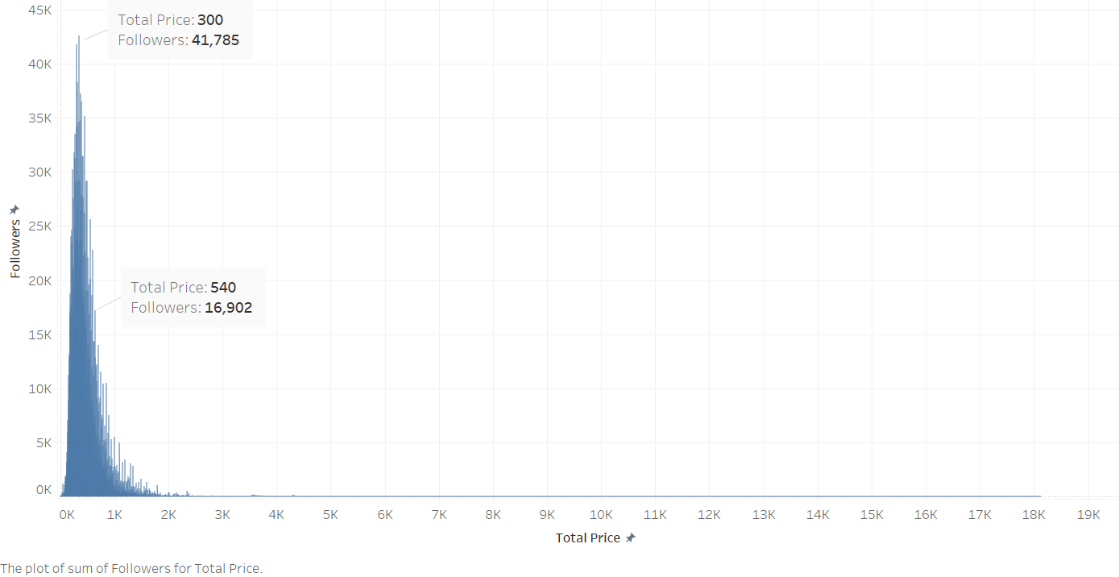
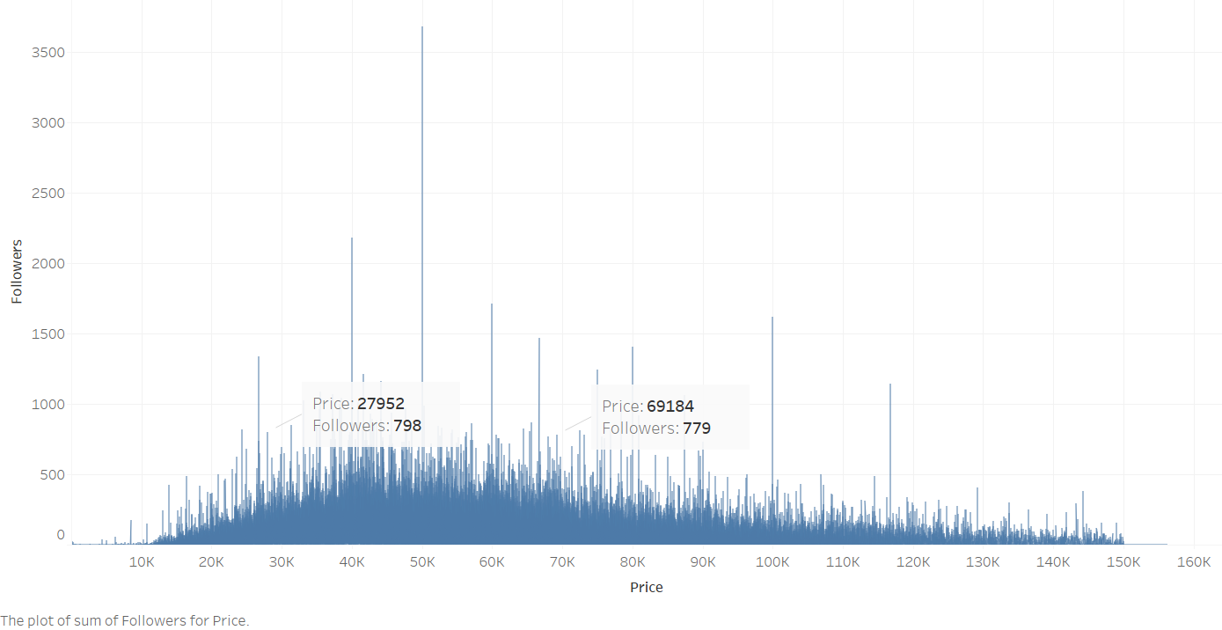
This dataset has recorded housing price of Beijing from 2011 to 2017, fetching from Linajia.com. Most data was traded in 2011 to 2017, some of them are traded in 2018 and some is even earlier.
Most homebuyers in Beijing would like to choose a house which price is around 3 million￥. A higher price like 5.4 million ￥ may be difficult for most citizens to pay, so there are less people follow.
From the perspective of the price per square meter, most homebuyers would like to pay more attention on prices at around 27,000 to 69,000. There are also some houses that have received a lot of attention in the chart. This may be affected by some other reasons.

Slide 3
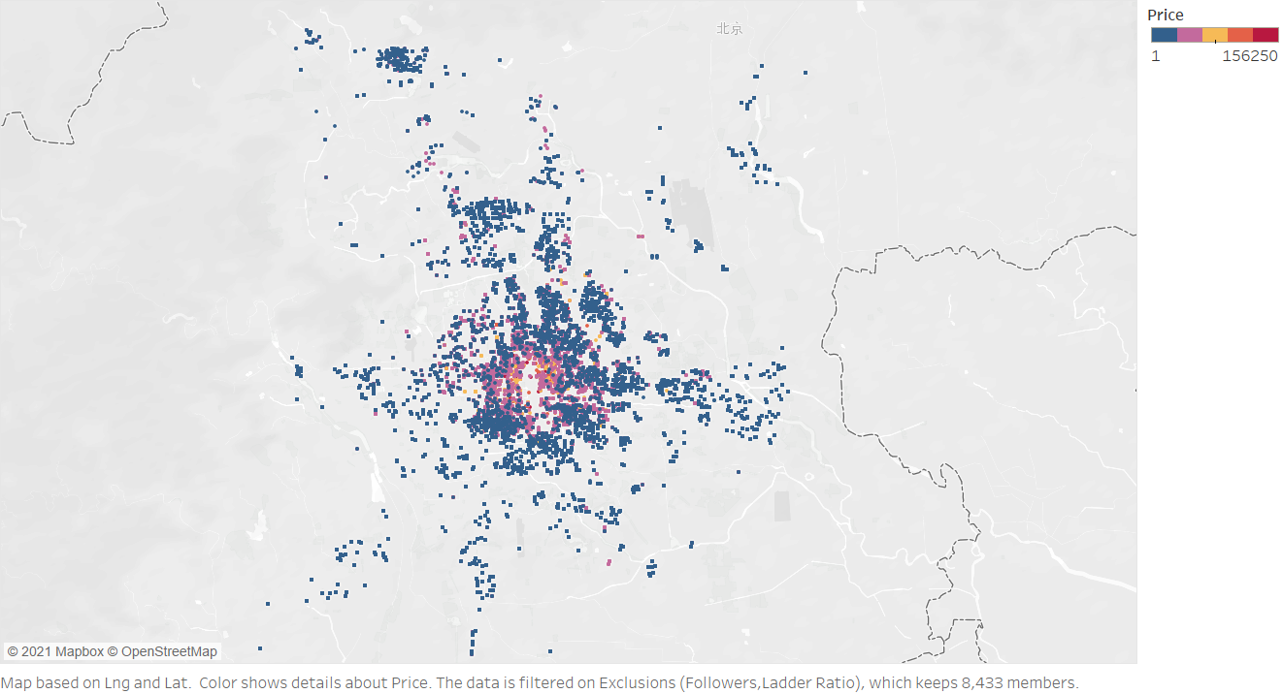
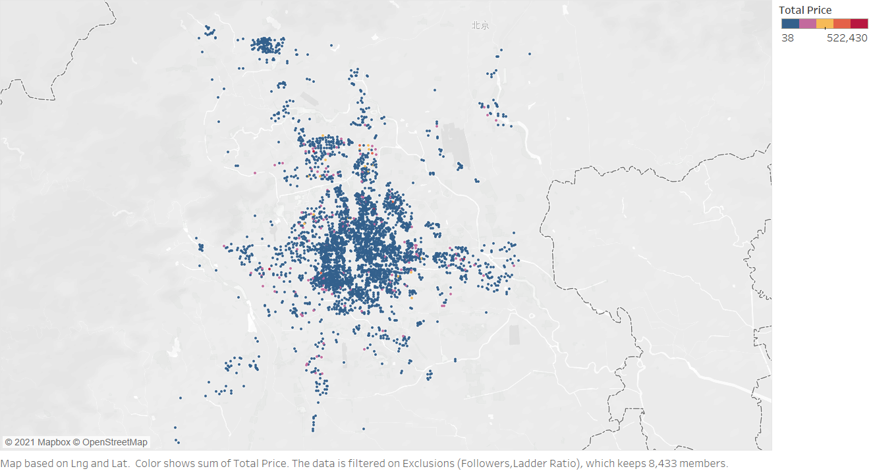
Most people bought there houses in the city center, although the price per square meter is higher as the position of house closing to the center. The other small group of people bought there houses in the northern suburbs because the price there is not so high. However, there is also a group whose houses are far away from the city, which means they can pay less price.
The total price of houses in Beijing is not much different, which leads to a result that those people who live in the downtown will have smaller houses, but the geographical advantage still attracts many buyers to buy houses in the city center.

Slide 4
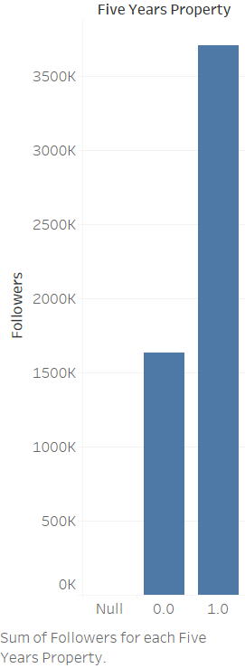
Another significant factor that affects the choice of buyers is whether the house has a Five-year property. A Five-year property rights mean that buyers can avoid some tax expenses. The graph shows that followers pay more attention to those houses, and the number of followers is more than twice that of houses without five-year property rights.

