Slide 1
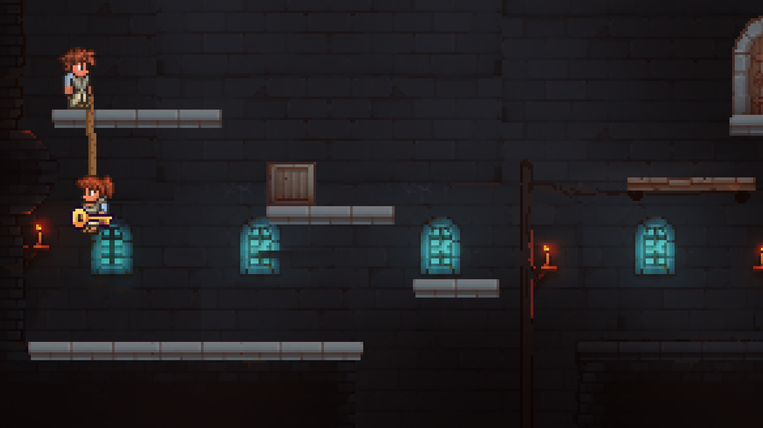
THINK OUTSIDE THE ROOM
by WISA
Senanur Ates
Aiysha Frutiger
Illia Solohub
William Tran

Slide 2
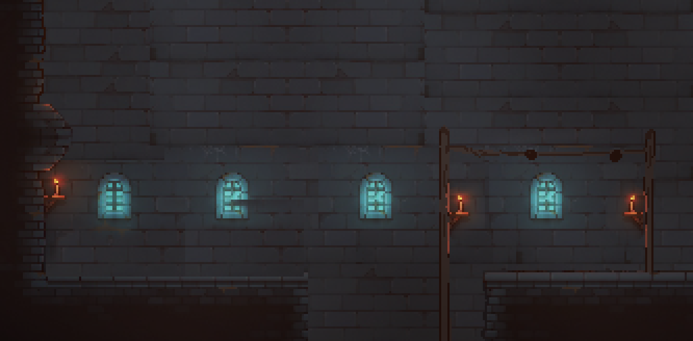




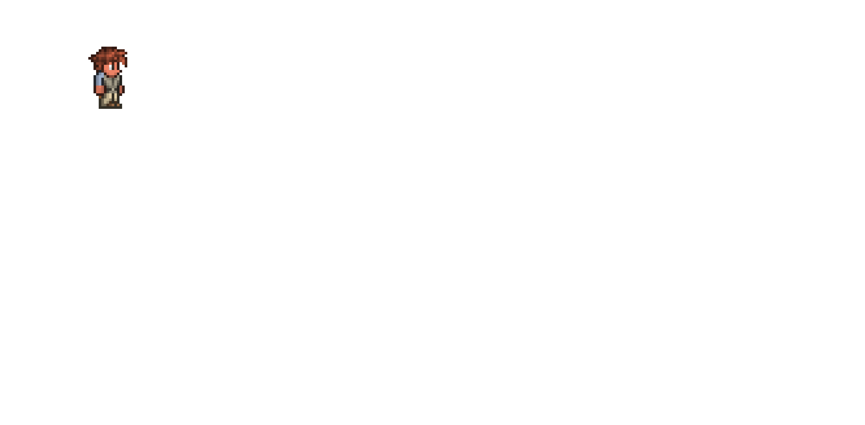

Team
William
Illia
Sena
Aiysha
Game Logic
Sena
GUI
Aiysha
Art & Music
Networking

Slide 3

About the Game
Genre:
2D Jump and run
Puzzles - Platformer
Players:
4 players
Game feature:
2 player per character twist
Goal :
to finish this level through skillful jumping, puzzle solving and cooperation
Notes:
Do you remember the thrill of playing Super Mario or Fireboy and Watergirl? Spending hours at your parents computer , solving puzzles, overcoming levels, and learning the power of teamwork.
These games taught us patience, problem-solving, and trust – and that’s exactly what we wanted to bring back. Our new game captures the nostalgia of those classics but with a new twist!
Our Game is a 2D jump and run Puzzle platformer for four players. But here’s the catch – each character is controlled by two players at the same time. A real challenge that can only be mastered through communication and cooperation.
The goal is to complete the level together – through skillful jumping, puzzle solving and cooperative mechanics.

Slide 4
Level Design
Platform based / moving Platforms
Moving cameras
Items:
Flashlight
Rope
Boxes
Notes:
Our level design is more than just platforms and obstacles. It’s a challenge that forces teamwork.
There are Moving and standing platforms, which require perfect synchronization. With
Interactive Camera Control: so that the perspective dynamically shifts to highlight challenges. and
Items: like A flashlight, a rope, boxes—simple objects that become powerful tools in the right hands.
Each section of the game is designed so that players can only progress by combining their skills and truly acting as a team

Slide 5


Charakters
Player one:
walking
throwing
Player two:
Jumping
grapping
Notes:
One player controls movement and throwing, while the other controls jumping and grabbing. It sounds simple, right? But the moment you start playing, you realize just how much coordination, communication, and trust it requires.

Slide 6
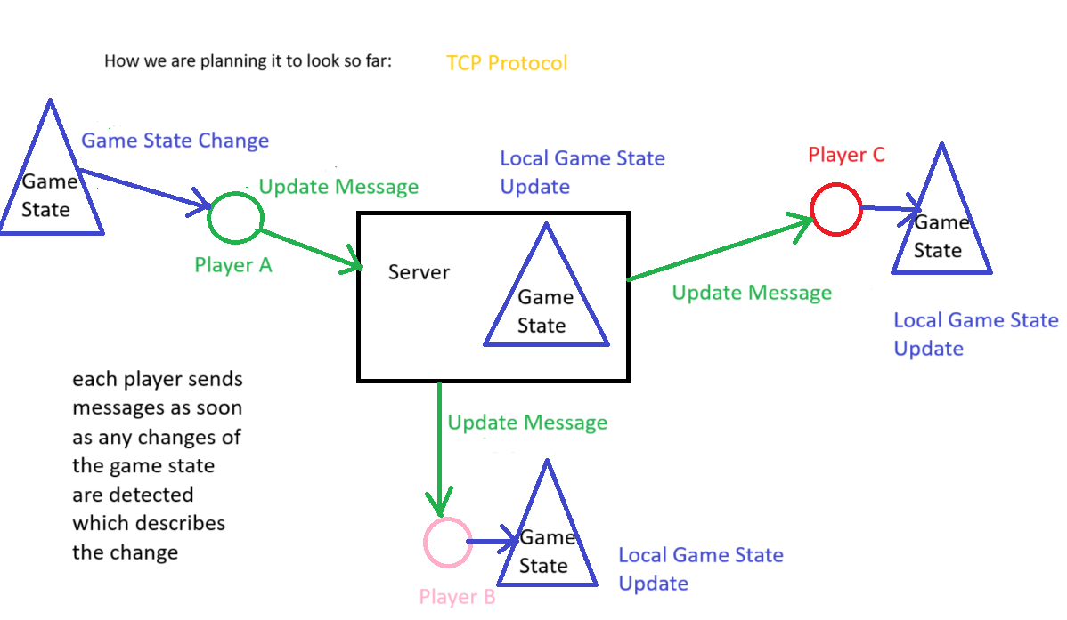
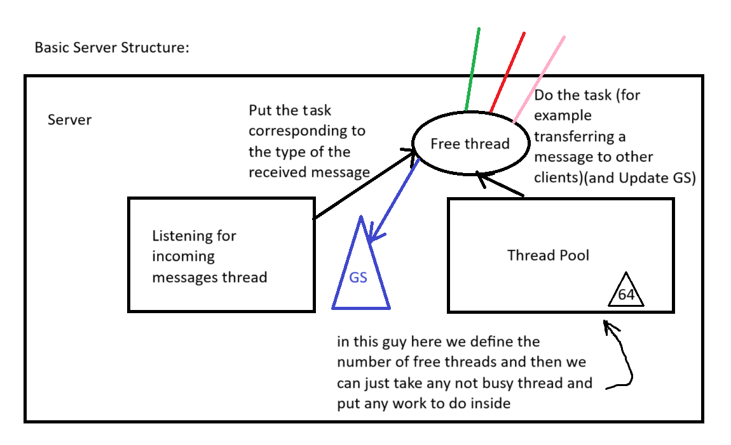

Networking
UDP Protocol

Slide 7

Constraints & Assumptions
Technical and Development
Java 21
text-based network protocol
Designed for standard hardware
No violent content
Assumptions:
Players have stable internet connections.
Game runs on a university-controlled network.
Uses approved external libraries only
Notes:
Our game is built using Java 21 and relies on a text-based network protocol for efficient communication. It is optimized for standard hardware and runs within a university-controlled network. Security is a top priority, with encrypted authentication and communication ensuring a safe multiplayer experience.

Slide 8
Functional Requirements
Main Features of the Game
Client-Server Connection
Real-time Gameplay Synchronization
Obstacle and Puzzle Management
Dynamic Camera System
Game State Management
Chat and Communication
Notes:
To ensure a seamless and immersive gaming experience, our system is built on the following core functionalities:
🎯 Robust Client-Server Architecture (F10) A custom-built client-server connection with an optimized text-based protocol ensures efficient communication and real-time responsiveness.
🔑 User Authentication & Lobby System (F11) Players can securely log in and join game lobbies, allowing smooth matchmaking and session management.
⚡ Real-Time Gameplay Synchronization (F20) Every action is transmitted with minimal latency, ensuring a fluid and responsive multiplayer experience.
🎮 Role-Specific Actions for Escapers (F21) Each player controlling the Escaper has a unique role—requiring precise coordination to navigate the game successfully.
📷 Dynamic Camera System (F22) A smart, adaptive camera system keeps the action in focus, enhancing the player experience by ensuring visibility of critical gameplay elements.
🏆 Game State Management (F30) Real-time handling of collisions, win/loss conditions, and state persistence ensures fair and accurate game mechanics.
💬 In-Game & Lobby Chat Support (F40) A built-in communication system allows players to strategize before and during the game, fostering teamwork and interaction.

Slide 9
Non-Functional Requirements
Performance: 30 FPS
Scalability: concurrent sessions
Security: encrypted authentication and communication
Collision Detection
Notes:
Neben den funktionalen Aspekten muss unser System auch technische und leistungsbezogene Anforderungen erfüllen, um ein reibungsloses und sicheres Spielerlebnis zu garantieren:
🚀 Smooth Performance – 30 FPS Stability Unser Spiel ist für flüssige 30 FPS optimiert, um ein konsistentes und reaktionsschnelles Spielerlebnis zu gewährleisten.
📈 Scalability for Multiple Sessions Die Server-Architektur ermöglicht gleichzeitige Spiele und eine effiziente Ressourcennutzung, um mehrere Spielsessions parallel zu verwalten.
🔒 Secure Authentication & Encrypted Communication Spielerdaten und Kommunikation sind durch verschlüsselte Authentifizierung und gesicherte Netzwerkverbindungen geschützt, um Datenschutz und Sicherheit zu gewährleisten.
🎯 Accurate Collision Detection Eine präzise Kollisionserkennung sorgt für realistische Interaktionen zwischen Charakteren, Hindernissen und der Umgebung.
🖥 Optimized for Standard Hardware Das Spiel ist so konzipiert, dass es auf gängigen Endgeräten problemlos läuft, ohne spezielle Hardware-Anforderungen.
🌐 Stable Network Connection Assumption Für eine zuverlässige Performance setzen wir eine stabile Internetverbindung voraus, insbesondere innerhalb des universitären Netzwerks.
Diese Anforderungen stellen sicher, dass Escape Room Game nicht nur technisch funktioniert, sondern auch ein stabiles, sicheres und zugängliches Spielerlebnis bietet.

Slide 10

Project Planning & Progress
What have we done so far?
Different project ideas were discussed.
A common project idea was agreed upon.
Who is good at what? We analyzed the distribution of tasks.
Everyone did general research on the project and we shared our research with each other.
The roadmap for Milestone 1 has been created.

Slide 11
Project Planning & Progress
What are the future plans?
We will implement the Login & Logout system.
We will handle Ping & Pong message processing.
We will work on Encoding & Protocol Validation
We will develop the Chat feature, enabling client-to-client communication.

Slide 12


Timeline
15.05.2025
27.03.2025
10.04.2025
5
06.03.2025
01.05.2025
1
2
3
4
Mockup
Dokumentation
Client/
Server
Game-logic
Game rules
Protocol
Edit Server
GUI
Game
Last adjustments
Soft-ware
Server
Edit Client
debugging
Client
Testing

Slide 13
THANK YOU FOR YOUR ATTENTION Game Director: Us Music Director: None- because it’s a PowerPoint, not a game Lead Programmer: G Story & Script: Desperation, coffee and looming deadlines Bug Testing: Everyone who corrected a typo Special Thanks to My Laptop for not crashing (yet) The audience for pretending to listen The WiFi for hopefolly staying connected Powered by last minute work

