Slide 1
Progress update
Sanjay Singh Gurjar
Topics covered so far
Image processing
Computer vision

Slide 2
topics
1. cv2 (image plotting, image cropping, resizing, kernels, rgb, grayscale, matplotlib)
2. Image processing
3. Machine vision system coordinate system
4. Intrinsic parameters and extrinsic parameters
5. Euler angles
6.Quaternions
7. Gimble lock
8. Rotation vector
9. Key-point detection
10. 6 degree-of-freedom

Slide 3
topics
CNN/Neural network
Computer vision tasks
linemod dataset

Slide 4
Cv2 and matplotlib
Import cv2 as cv
Img=cv2.imread(“”)
Cv2.imshow()
Cv2.waitkey()
Imgresize=cv2.resize(image, (400,400))
Imgcrop=image[0:200,300:500]
Import matplotlib.pyplot as plt
Figss=plt.figure(figsize=(10,10))
Plt.subplot(1,2,1)
Plt.title(“ data ”)
Plt.imshow(image,cmap=‘gray’)
Plt.axis(‘off’)

Slide 5
Image processing:
Edge detection: sobel filter
sobelx = cv2.Sobel(grayimg,int(cv2.CV_64F),1,0,ksize=3)
Noise remove: gaussian filter
Geometric transformation:
1. warpAffine(2x2)
2. warpPerspective(3x3)
Scaling:
res = cv.resize(img,None,fx=2, fy=2, interpolation = cv.INTER_CUBIC)
translation:
M = np.float32([[1,0,100],[0,1,50]])
dst = cv.warpAffine(img,M,(cols,rows))
Rotation:
M = cv.getRotationMatrix2D(((cols-1)/2.0,(rows-1)/2.0),90,1)
dst = cv.warpAffine(img,M,(cols,rows))
Affine transformation:
Preservers lines and parallelism but not (distance and angles)
Perspective transformation: image alignment

Slide 6
Kernel , rgb, grayscale
Kernel is a small matrix used to apply effects (blurring, sharpening,outlining)
Rgb (height width, color channel) 3 color values for every pixel
Grayscale (height, width, intensity)

Slide 7
Machine Vision system coordinate system
World coordinate system
Image coordinate system
Camera coordinate system
Pixel coordinate system

Slide 8
Conversions:
Camera coordinate system and pixel coordinate system
To determine their relationship, we extend the normal image coordinates (x, y) to homogeneous coordinates (x, y, 1)
World coordinate system and camera coordinate system
The relationship between the two coordinate systems is a rigid body transformation (rigid body transformation: the rotation and translation of a geometric object when the object does not deform
From world coordinates to pixel coordinates
Combining the above derivation processes, the world coordinates (X_{w}, Y_{w}, Z_{w}) -> camera coordinates (X_{c}, Y_{c}, Z_{c}) -> image coordinates (x, y) -> pixel coordinates (u, v).

Slide 9
Intrinsic and extrinsic parameters:
Intrinsic parameters include focal length, decenter coefficient, and skew coefficient.
(1) Focal length
(2) Decenter coefficient
(3) Skew Coefficient
Extrinsic parameters
Extrinsic parameter represents the relative position and orientation between the TOF camera and the RGB camera, consisting of 3D rotation and 3D translation

Slide 10
Various Forms of Extrinsic Parameters
Euler Angles
Gimble lock issue
Quaternions
Don’t face gimble lock issue

Slide 11
Gimble lock
it occurs when the Pitch = +-90 deg. In this orientation, the Roll and Yaw angles will become mathematically unstable.

Slide 12
Quaternions
Quaternions are represented by packs of 4 numbers (a,b,c,d)
Quaternions of the form (a,0,0,0) behave exactly like real numbers a and are identified with them
i,j,k are special quaternions defined by i=(0,1,0,0) j=(0,0,1,0) and k=(0,0,0,1)
Addition and subtraction of quaternions is component-wise

Slide 13
6 dof
Human head

Slide 14
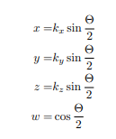
Quaternions
encoding orientation :quaternion.

Slide 15
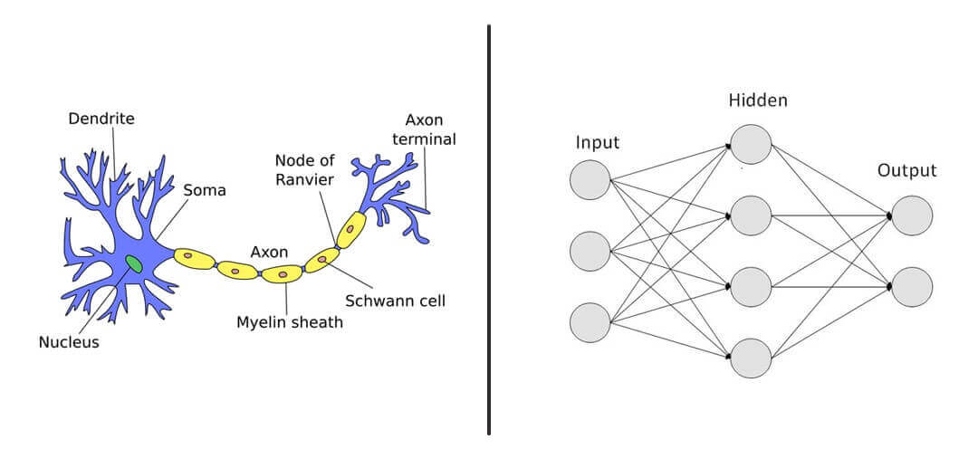
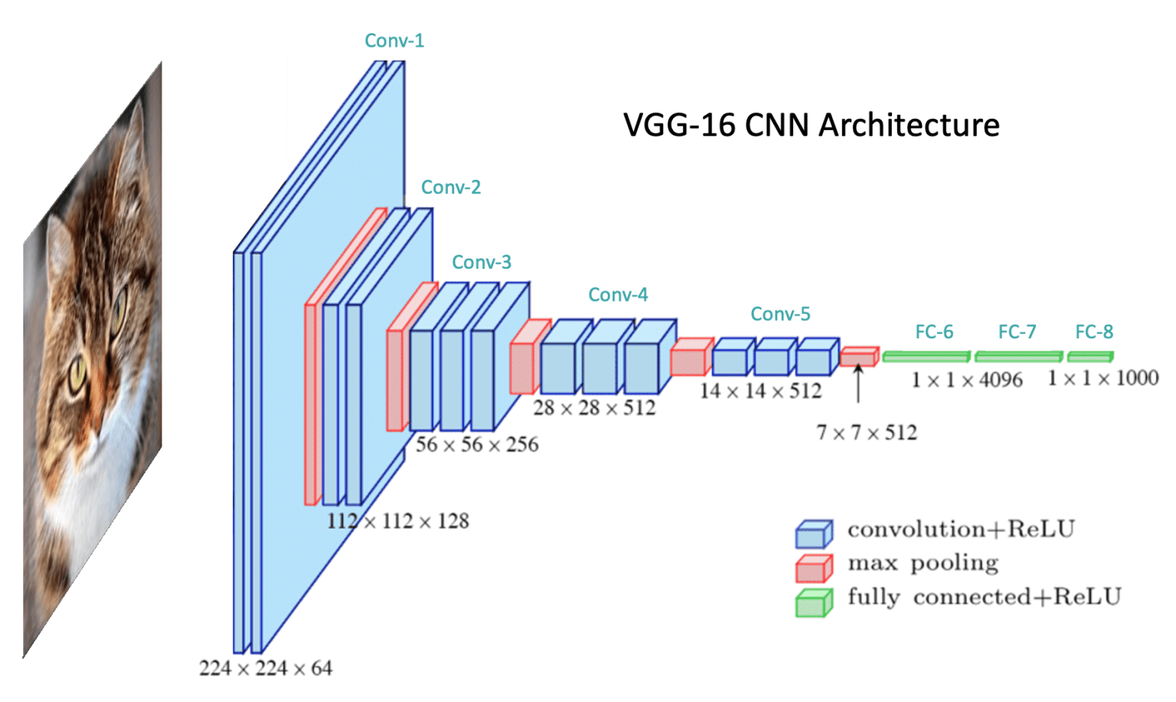
CNN and Neural Network

Slide 16
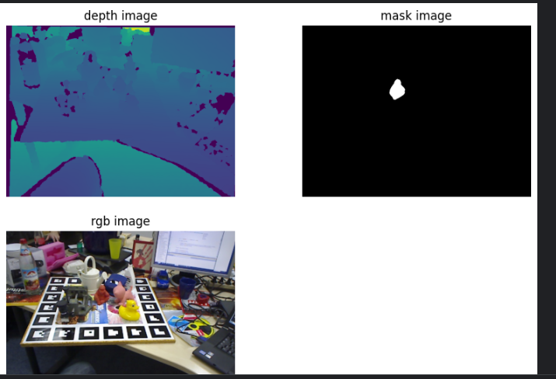
Line-mod dataset
6d pose estimation dataset
15 different objects

