Slide 1
Name: Mimonath Islam
ID: 213100019

Slide 2
FIFA World Cup
This is about the men's association football tournament.

Slide 3
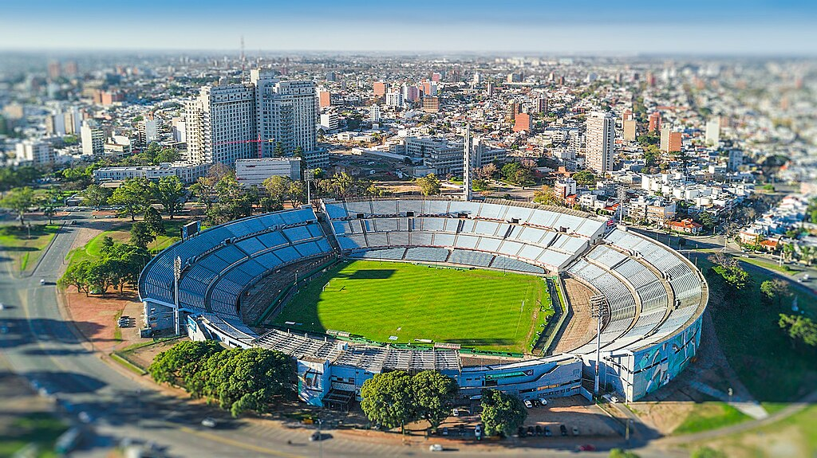
The FIFA World Cup, often called the World Cup, is an international association football competition among the senior men's national teams of the members of the Fédération Internationale de Football Association (FIFA), the sport's global governing body.
The tournament has been held every four years since the inaugural tournament in 1930, with the exception of 1942 and 1946 due to the Second World War. The reigning champions are Argentina, who won their third title at the 2022 tournament.^{[1]}

Slide 4
The contest starts with the qualification phase, which takes place over the preceding three years to determine which teams qualify for the tournament phase. In the tournament phase, 32 teams compete for the title at venues within the host nation(s) over the course of about a month. The host nation(s) automatically qualify for the group stage of the tournament. The competition is scheduled to expand to 48 teams, starting with the 2026 tournament.
As of the 2022 FIFA World Cup, 22 final tournaments have been held since the event's inception in 1930, and a total of 80 national teams have competed. The trophy has been won by eight national teams. With five wins, Brazil is the only team to have played in every tournament.

Slide 5
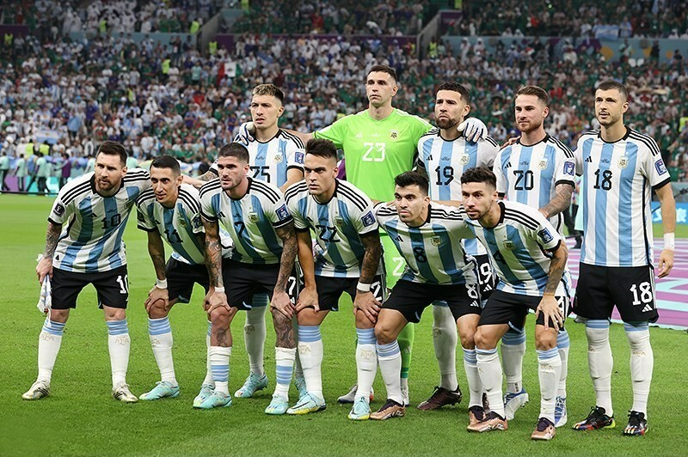
The other World Cup winners are Germany and Italy, with four titles each; Argentina, with three titles; France and inaugural winner Uruguay, each with two titles; and England and Spain, with one title each.
The World Cup is the most prestigious association football competition in the world, as well as the most widely viewed and followed sporting event in the world.^{[2][3]} The viewership of the 2018 World Cup was estimated to be 3.57 billion, close to half of the global population,^{[4][5]} while the engagement with the 2022 World Cup was estimated to be 5 billion, with about 1.5 billion people watching the final match.^{[6]}

Slide 6
History of the FIFA World Cup
The world's first international football match was a challenge match played in Glasgow in 1872 between Scotland and England.^{[7]} The first international tournament for nations, the inaugural British Home Championship, took place in 1884 and included games between England, Scotland, Wales, and Ireland.^{[8]} As football grew in popularity in other parts of the world at the start of the 20th century, it was held as a demonstration sport with no medals awarded at the 1900 and 1904 Summer Olympics; however, the International Olympic Committee has retroactively upgraded their status to official events, as well as the 1906 Intercalated s. Game^{[9]}

Slide 7
After FIFA was founded in 1904, it tried to arrange an international football tournament between nations outside the Olympic framework in Switzerland in 1906. These were very early days for international football, and the official history of FIFA describes the competition as having been unsuccessful.^{[10]}
At the 1908 Summer Olympics in London, football became an official Olympic sport. Planned by The Football Association (FA), England's football governing body, the event was for amateur players only and was regarded suspiciously as a show rather than a competition.

Slide 8
Thank you…

