Slide 1
COMPUTAS × MIMRIS × EQUINOR
OSDU
From OSDU data
to operational work
SYSTEM OF RECORD
Authoritative data
Seismic volumes · velocity cubes
Mimris AI Workspace for modelling processes, roles, information, systems and workplaces around OSDU.
Project space
Interpret · grid · convert · validate
Reusable outputs
TVDSS surfaces · depth-corrected faults
Draft for Computas presentation · 28 August 2026
Mimris models the work around the data.
Notes:
Open with the distinction: OSDU remains the authoritative storage foundation; Mimris makes the surrounding work explicit and operational. Keep this to 30–40 seconds.
[Sources]
- User-provided Equinor OSDU Seismic Interpretation domain definition, 2026-05-13.
[/Sources]

Slide 2
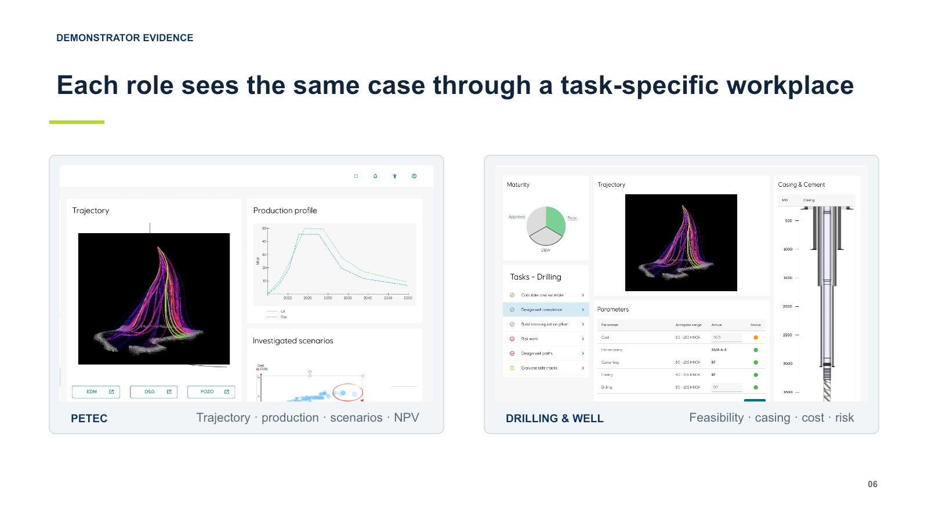
PREVIOUS PROOF
Equinor has already seen the model-based principle work
The Kavca / AMAP accelerator connected outcomes, roles, tasks, information and decisions in one shared model.
Shared outcome
One decision context across disciplines
Visible dependencies
Changing inputs and coupled parameters
Role-specific execution
Each participant saw the right tasks and views
AMAP demonstrator: the same case through task-specific workplaces
02
Notes:
Use the screenshot as evidence, not nostalgia. The key continuity is shared context plus role-specific execution.
[Sources]
- Equinor_AMAP_Accelerator_Case_Study.pptx, slide 6 (user-supplied).
[/Sources]

Slide 3
WHY NOW
The OSDU process has the same collaboration challenge
01
Changing inputs
02
Coupled parameters
Interpretations, seismic volumes and velocity models evolve.
T2D results depend on inputs, assumptions and versions.
03
Role handoffs
04
Fragmented context
Interpreters, velocity specialists and data stewards coordinate.
Authoritative data and execution live in different environments.
The problem is not a missing data platform — it is a missing model of the work.
03
Notes:
Connect the earlier AMAP problem statement directly to the current seismic workflow. Avoid implying OSDU is deficient; the gap is complementary process and workplace modelling.
[Sources]
- Equinor_AMAP_Accelerator_Case_Study.pptx, slide 3 (user-supplied).
- User-provided Equinor OSDU Seismic Interpretation domain definition, 2026-05-13.
[/Sources]

Slide 4
CURRENT EQUINOR PROCESS
OSDU anchors a repeatable extract–work–publish cycle
OSDU · SYSTEM OF RECORD
Seismic volumes (3D/4D) · Imaging velocity cubes
APPLICATION PROJECT SPACE · specialist interpretation and modelling execution
01
02
03
04
05
06
Extract
Interpret
Grid
Convert
Validate
Publish
Select and stage
Horizon picks + faults
in TWT
Continuous time
surfaces
T2D with velocity
model
TVDSS surfaces
+ faults
Version + lineage
Published outputs
Seismic-derived surfaces (TVDSS) · Fault sticks / planes (TVDSS) · provenance
Discoverable and reusable by well planning, reservoir modelling and other downstream workflows
04
Notes:
This is the concrete use case for the live demo. Emphasize TWT-to-TVDSS semantics, versioned velocity input, and publication back to OSDU.
[Sources]
- User-provided Equinor OSDU Seismic Interpretation domain definition, sections 2.1–2.5, 2026-05-13.
[/Sources]

Slide 5
COMPLEMENTARY ROLES
Mimris models the work around OSDU
OSDU manages authoritative data. Mimris connects that data to the processes and workplaces that use and transform it.
Processes
Organization
Products
Systems
Extract · interpret · grid · convert · publish
Interpreter · velocity modeller · data steward
Picks · time surfaces · depth geometries · lineage
OSDU · project space · specialist applications
OSDU
Authoritative, versioned storage foundation
Inputs and validated outputs remain governed in the System of Record.
POPS makes the whole operating context explicit — without moving execution into OSDU.
05
Notes:
This is the architectural boundary slide. POPS is the mechanism: Processes, Organization, Products and Systems. OSDU remains the storage foundation.
[Sources]
- User-provided Equinor OSDU Seismic Interpretation domain definition, 2026-05-13.
- Mimris AKM / POPS method as described in the referenced conversation.
[/Sources]

Slide 6
MIMRIS AI WORKSPACE
Domain knowledge becomes an operational workplace
AI accelerates defined AKM transformations; the connected models preserve structure and traceability.
1
2
3
4
5
6
7
Domain
definition
AI
Domain
ontology
AI
POPS
Process (IDEF0)
AI
IRTV
Detailed
models
Operational
workplace
Scope + language
Concepts + relations
Operating context
Activity model
Workplace model
Connected views
Role-specific work
Human-in-the-loop control
Domain experts review, refine and approve each transformation before it becomes the basis for the next model.
06
Notes:
The AI story is acceleration with control, not ungoverned diagram generation. The live demo should follow this exact sequence.
[Sources]
- Mimris AI Workspace modelling sequence supplied in the referenced conversation.
[/Sources]

Slide 7
EXAMPLE PROCESS
Time-to-Depth becomes a concrete workplace model
I
Information
R
Roles
Time surfaces · TWT faults · velocity cube · parameters
Interpreter · velocity modeller · reviewer · data steward
TIME-TO-DEPTH
Convert TWT interpretations to TVDSS using a versioned velocity model
T
Tasks
V
Views
Select · configure · execute · QC · approve · publish
Inputs · parameters · conversion QC · results · lineage
IRTV links what is needed, who acts, what they do and what they see — all grounded in the selected process.
07
Notes:
Use this as the handoff from process modelling to workplace modelling. It should make IRTV immediately practical for the Computas audience.
[Sources]
- User-provided Equinor OSDU Seismic Interpretation domain definition, 2026-05-13.
- IRTV decomposition proposed in the referenced conversation.
[/Sources]

Slide 8
EVOLUTION
Mimris now shortens the path from knowledge to execution
KAVCA / AMAP
MIMRIS AI WORKSPACE
01 Domain experts
01 Domain knowledge + documents
02 Manual AKM modelling
02 AI-assisted AKM transformations
EVOLVED
03 Connected knowledge model
03 Ontology → POPS → IRTV
04 Role-specific workplaces
04 Connected operational workplace
The method stays disciplined. AI reduces the effort required to create, connect and refine the models.
08
Notes:
This is the strategic continuity slide: same model-based principles, now much faster and more systematic. Do not claim quantified savings without evidence.
[Sources]
- Equinor_AMAP_Accelerator_Case_Study.pptx, slides 9–11 (user-supplied).
- Mimris AI Workspace evolution described in the referenced conversation.
[/Sources]

Slide 9
PROPOSED NEXT STEP
Start with one focused Equinor OSDU process pilot
COMPUTAS
MIMRIS
EQUINOR
Equinor relationship
OSDU and delivery expertise
AKM method
AI modelling workspace
Product and support
Domain knowledge
Requirements and validation
Together: discover → model → validate → improve → operationalize
1
Scope
2
Model
3
Validate
4
Demonstrate
Confirm one process and source material
Definition → ontology → POPS → IRTV
Review with domain and OSDU stakeholders
Show the connected operational representation
Now: show the actual Seismic Interpretation domain in Mimris AI Workspace
09
Notes:
Ask for agreement on a focused workshop/pilot, then transition immediately into the live demo using the actual seismic domain. Suggested wording: Rather than describe how this could work, I will show it.
[Sources]
- Pilot structure proposed in the referenced conversation.
- Equinor_AMAP_Accelerator_Case_Study.pptx, slide 11 (user-supplied).
[/Sources]

Slide 10
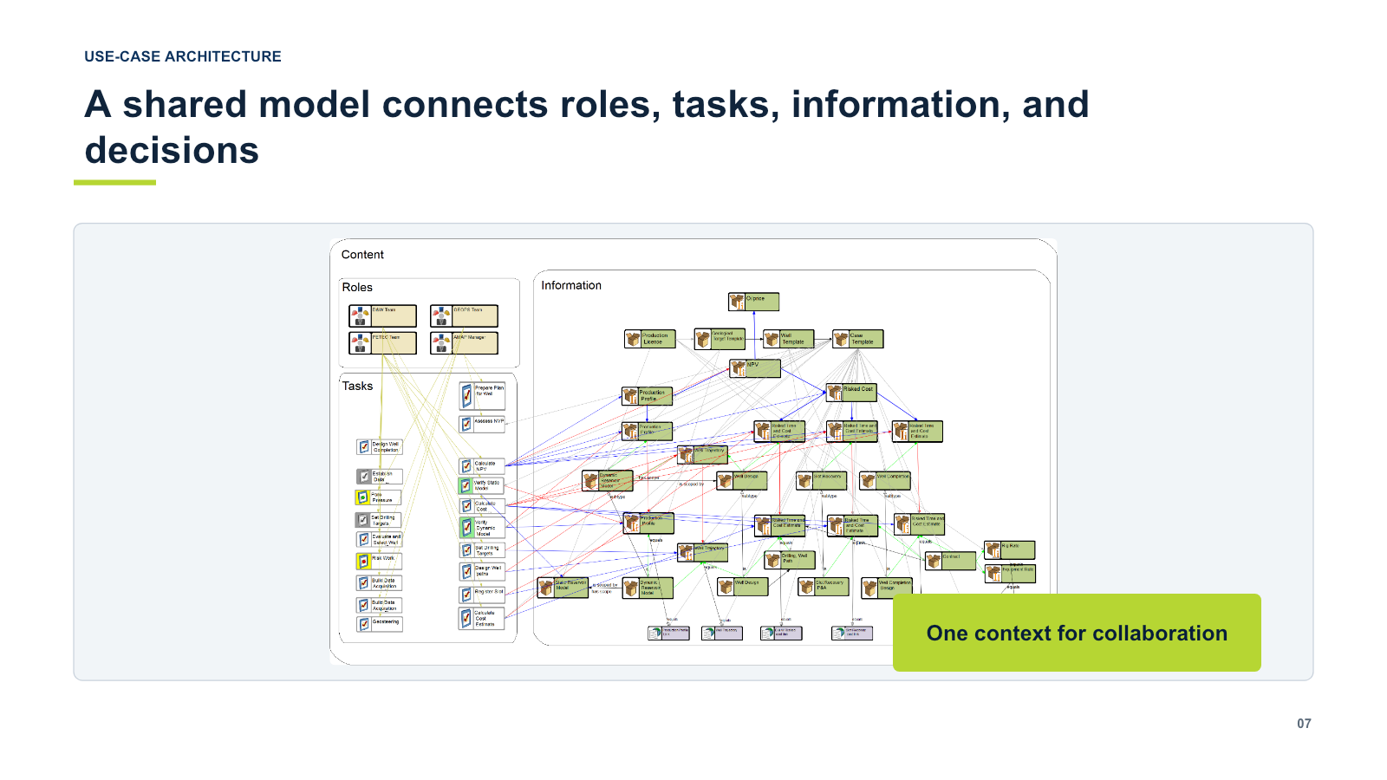
APPENDIX
Earlier Equinor proof: shared model and role-specific work
What it demonstrated
One connected decision context
Roles, tasks and information linked
Different operational views from the same model
Traceability from outcome to action
Continuity: model → workplace
10
Notes:
Backup evidence for detailed questions about the earlier Equinor work.
[Sources]
- Equinor_AMAP_Accelerator_Case_Study.pptx, slide 7 (user-supplied).
[/Sources]

Slide 11
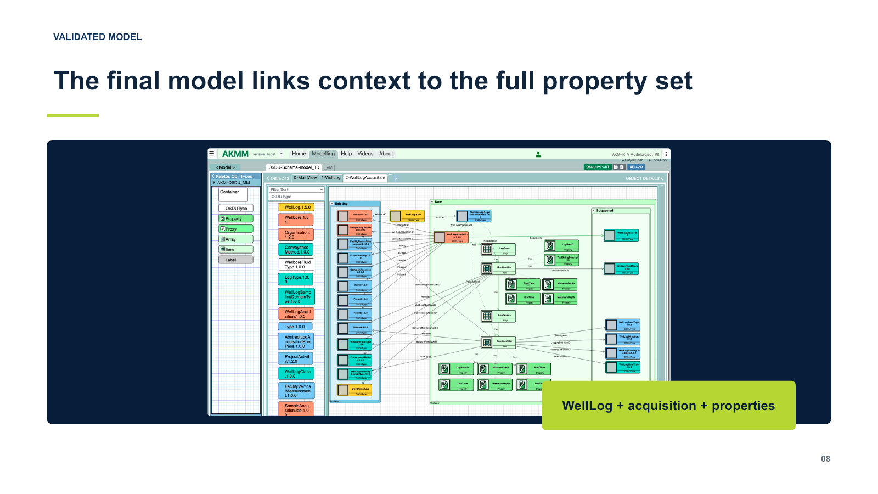
APPENDIX
Mimris already models and extends OSDU structures
The WellLog example imported an existing OSDU type, added acquisition context and preserved the full property set for export.
Import
Start from the known OSDU baseline
Extend
Add acquisition objects and identifiers
Export
Produce an adoption-ready package
Supporting evidence — the present opportunity is broader process modelling around OSDU.
11
Notes:
Keep this as supporting evidence. The current opportunity is not only schema extension; it is modelling the full operating context around OSDU.
[Sources]
- OSDU_WellLog_Acquisition_Refurbished.pptx, slides 6–9; screenshot from slide 8 (user-supplied).
[/Sources]

Slide 12
APPENDIX
AKM connects operating context to workplace detail
POPS
IRTV
The operating context
The selected workplace
P
Processes
What work creates the outcome?
I
Information
What inputs, outputs and context are needed?
O
Organization
Who owns, performs and governs it?
R
Roles
Who participates in this process?
P
Products
What information or deliverables flow?
T
Tasks
What actions and decisions are performed?
S
Systems
Which platforms and applications support it?
V
Views
What must each role see and manipulate?
12
Notes:
Use only if the audience asks for the modelling methodology behind the demonstration.
[Sources]
- AKM POPS and IRTV definitions supplied in the referenced conversation.
[/Sources]

Slide 13
APPENDIX
A pilot can be small, controlled and decision-oriented
Inputs
Outputs
Validation questions
Existing process description
Reviewed domain definition
Does the model match real work?
Representative OSDU types
Domain ontology
Are OSDU boundaries explicit?
Application / project-space context
POPS model
Is lineage and handoff visible?
Named domain reviewers
One detailed IRTV model
Can roles use the representation?
Pilot demonstration
What should scale next?
Pilot decision: prove value on one process before expanding the scope.
13
Notes:
This defines a deliberately bounded pilot without inventing duration or commercial terms. Agree those jointly after scoping.
[Sources]
- Pilot scope synthesized from the user-provided process description and referenced conversation.
[/Sources]

