Slide 1
Welcome to Data Structures & Algorithms
Or, how to pass technical interviews given by programmers
Terence Parr
MSDS program University of San Francisco

Slide 2
Course contents
https://github.com/parrt/msds689
A formula for problem-solving simple algorithm problems
How to read code
Core data structures, a unifying perspective
Algorithm complexity analysis
“So much recursion!” – MSDS2019 student comment
Walking and searching data structures
Sorting (with all of my dirty tricks)
Graphs and graph algorithms

Slide 3
Course projects
Convert htable project to object-oriented version (8%)
With some extensions
…and using somebody else’s code from two years ago!
hint: it’s kinda stinky code. ha!
kmeans clustering, kmeans++ initial point selection (20%)
Spectral clustering using Breiman’s unsupervised learning trick for RFs
Image compression applications
Feature importance and selection (22%)
Permutation and drop column
Automatic feature selection
Work as hard or as little as you want (I give no unit tests)
grader will assign check -, check, check+ based upon your reports
https://github.com/parrt/msds689/blob/master/projects/oohtable/oohtable.md
https://github.com/parrt/msds689/blob/master/projects/kmeans/kmeans.md
https://github.com/parrt/msds689/blob/master/projects/featimp/featimp.md

Slide 4
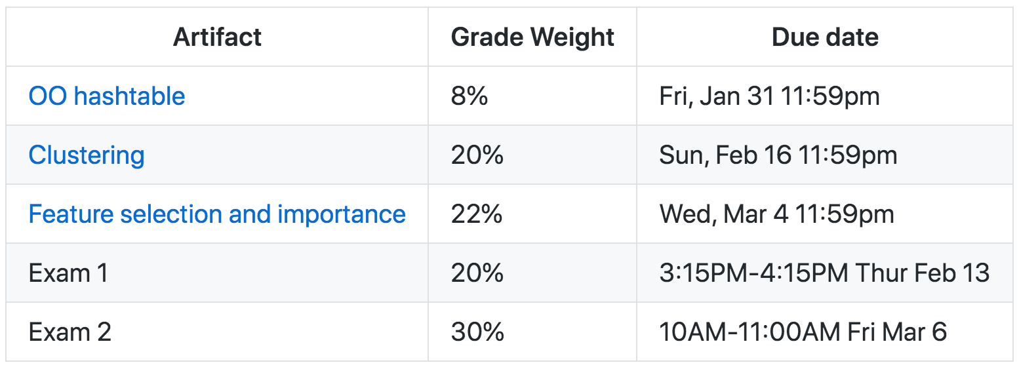
Student evaluation
Please note grader will take at least a week
to grade projects, but I’ll grade exams quickly
last day of class

Slide 5
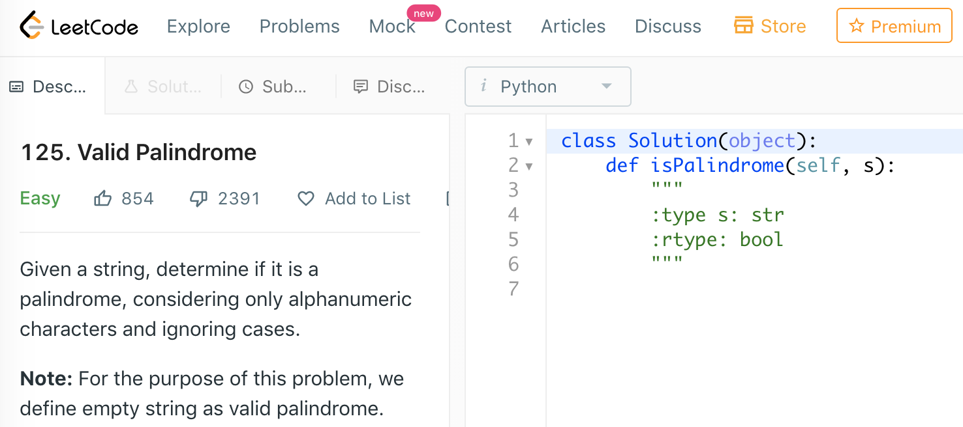
Extra things you can do
Lots of little practice quizzes; e.g., https://github.com/parrt/msds689/blob/master/labs/quiz-oo.ipynb
LeetCode algorithm and data structures challenges. e.g., https://leetcode.com/problems/valid-palindrome/

Slide 6
Resources
A great free book on algorithms by Jeff Erickson
Kleinberg and Tardos, Algorithm Design
Please see compressed pdf kleinberg-common-running-times.7z in Canvas course files area (do not post material publicly please)
A very useful set of programming-concepts-for-data-science and data science coding questions by former USF MSDS student Shikhar Gupta
10 steps to solving a programming problem
A review OO notebook and Operator overloading notebook

Slide 7
Administrivia
The usual academic honesty rules will be enforced; in projects, reports, exams or any other artifact; Honor Code
Do not represent another person’s work as your own
Don’t leave your laptop unattended/unlocked; others can take a picture of your code or simply use a USB key quickly
Students with Disabilities
If you are a student with a disability or disabling condition, or if you think you may have a disability, please contact USF Student Disability Services (SDS) for information about accommodations.
More details on the course syllabus: https://github.com/parrt/msds689

