Slide 1

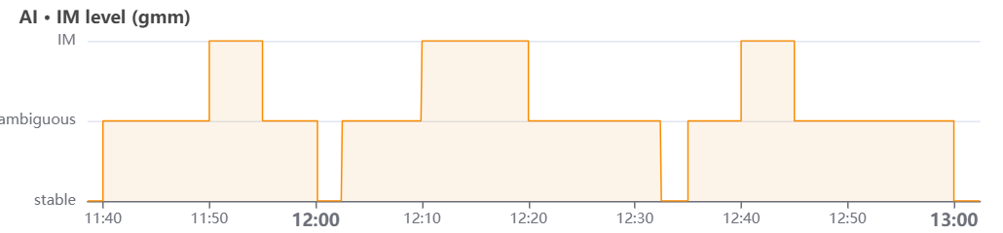
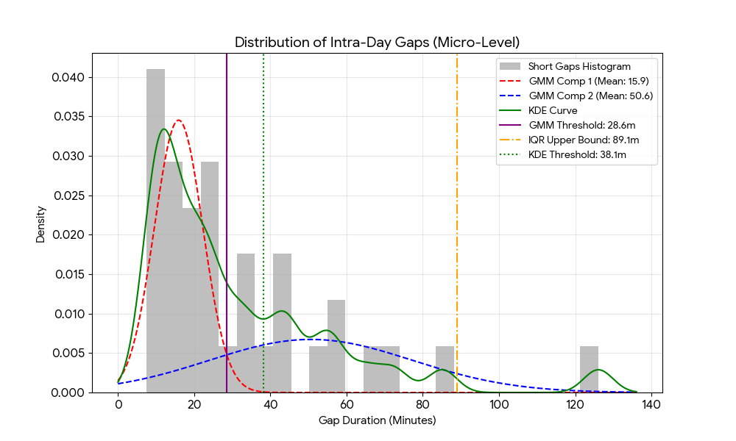
01
IM Level Definition (GMM)
◈ Defining an independent IM section — merge vs. split threshold
Data: Hong Daehwa, 7-day wrist HR (7/13–7/19), ~306K samples
Pipeline: M_phys (RF) → residual → 300s/150s window → 3-state GMM
Result: 85 IM bursts → 84 inter-burst gaps
Gap stats: mean 114.8 min / median 25.0 min / std 226.0 (right-skewed)
Threshold method comparison (log-gap, n=84):
GMM (2-comp): 26.4 min — BIC 305.89 (best fit) → Adopted
KDE: unimodal density, no valley → not usable
IQR: 234.4 min — ~9× GMM, over-conservative
Paper's 300s / 5-min rule (Sec. 3.6.3) = sensor non-wear session split, NOT an IM-merge criterion
Method | Threshold | Statistical basis | Verdict
GMM (log-gap, 2-comp.) | 26.4 min | BIC = 305.89 (lowest) | Adopted
KDE | n/a | Unimodal density - no valley | Not usable
IQR (Q3+1.5xIQR) | 234.4 min | Outlier rule (not mixture-aware) | Over-conservative (~9x GMM)

Slide 2
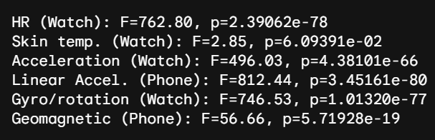
02
P-values
◈ Feature significance across Stable / Ambiguous / IM (one-way ANOVA)
Method: 300s window mean/variability → aligned to GMM IM level → ANOVA
All 6 features significant at p < .005
Data | Stable | Ambiguous | IM | p
HR (Watch) | Baseline | Gradual rise | Sharp deviation (3x) | < .005
EDA mean (Watch) | Baseline conductance | Similar level | Slight increase | < .005
Gyroscope variability (Watch) | Near-static | Increasing | Sharp increase (2x) | < .005
EDA variability (Watch) | Near-static | Rising (7x) | Sharp rise (22x) | < .005
Geomagnetic variability (Phone) | Stable | Rising (7x) | Large shift (26x) | < .005
Skin temperature (Watch) | Normal | Mild decrease | Marked decrease (vasoconstriction) | < .005
EDA variability ↑22× — strongest sympathetic-arousal marker
Skin temp ↓ — only decreasing feature (vasoconstriction)
Gyro / geomagnetic ↑ — possible movement confound
Next: add motion + EDA + skin-temp to M_phys as covariates
Accelerometer (3.3GB) unavailable → EDA used instead

Slide 3
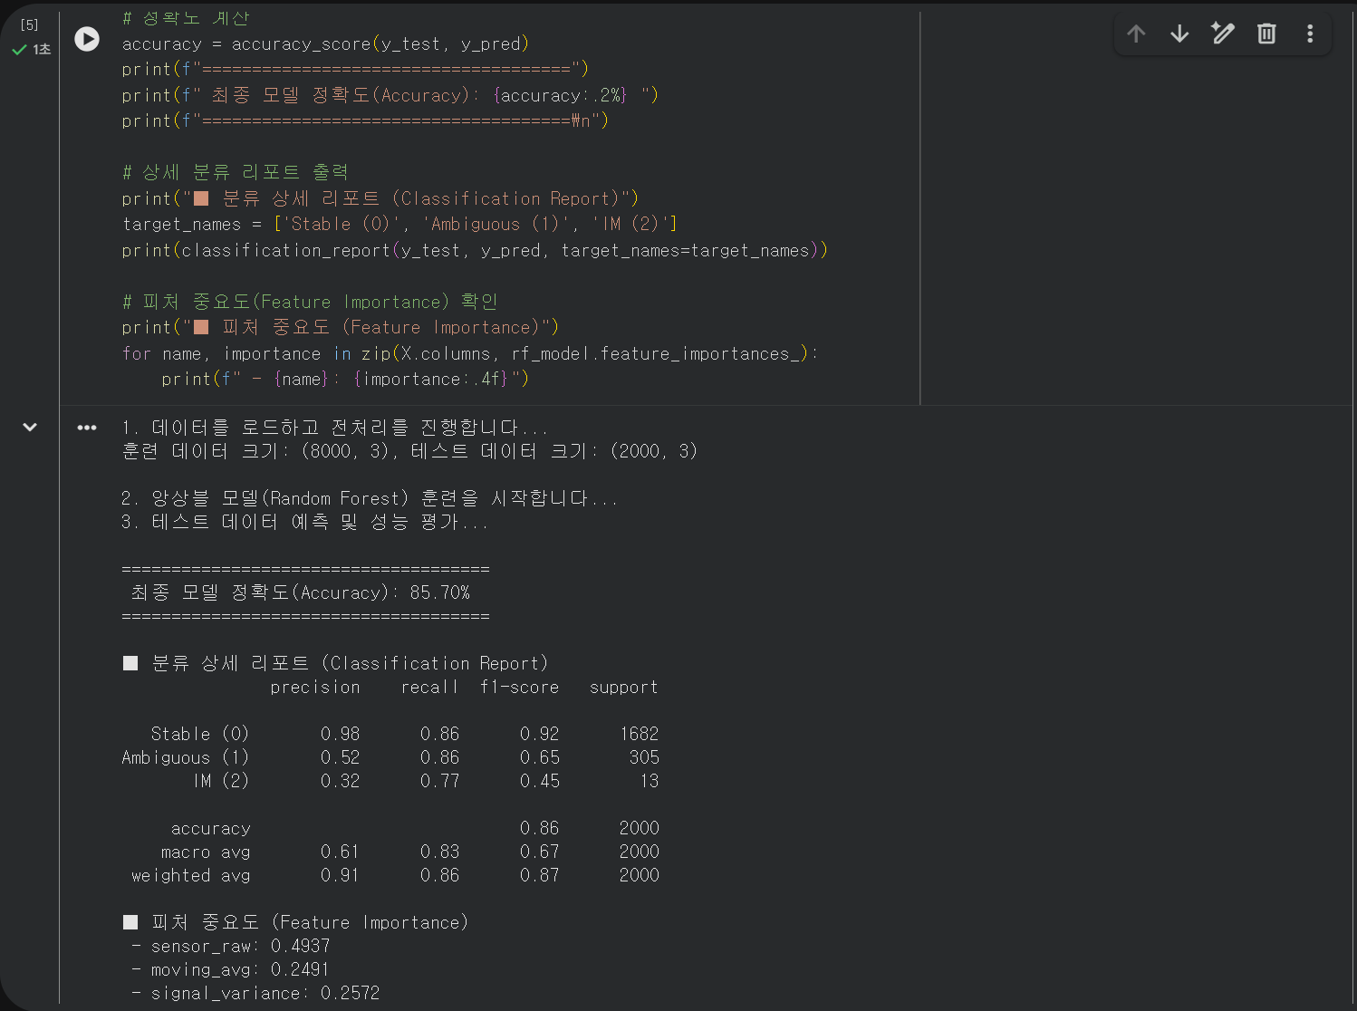
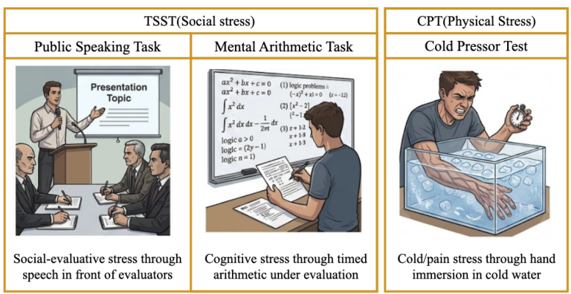
03
TSST & CPT
◈ Lab stress-induction protocol — 2 participants, Hanyang YK Intercollege, 7/23
Protocol: TSST (Public Speaking + Mental Arithmetic) + Cold Pressor Test (CPT) + Rest
Bomi Kim (18, iOS): Speech 13:37–13:41 · Math 13:57–14:01 · CPT 14:11–14:15 · Rest 14:15–14:45
Nahyun Kim (19, iOS): Speech 13:32–13:36 · Math 13:52–13:56 · CPT 14:06–14:10 · Rest 14:15–14:45
M_phys (baseline HR model) on lab data: Test R² = 0.83 (Nahyun) / 0.97 (Bomi)
AIES-style uncertainty sampling: 24% of data → 99% of full AUC-ROC (0.889 vs. 0.898)

