Slide 2

OPTIMIZATION PROJECT
Group 17
Nguyen Minh Cuong - 20210140
Nguyen Viet Minh-20214917
Nguyen Tuan Long-20214963
Problem 6:
Production scheduling

Slide 3
CONTENT
Presentation of subject a. Introduction b. Description c. Input format d. Output format
Problem modeling
Algorithms a. Exhaustive search b. Dynamic programming c. Constraint programming d. Mix-Integer programming e. Heuristic 1 f. Heuristic 2.0, 2.1, 2.2
Implementation
Comparison a. Accuracy b. Time complexity
Conclusion

Slide 4
Presentation of subject
Introduction Production scheduling includes setting up production schedules, coordinating and assigning labor to each person, group of people, and machine, and arranging the work order at each workplace to ensure production completion on schedule. Production scheduling aims to maximize the efficiency of the operation, utilize the maximum resources available and reduce costs. It is also an important tool for manufacturing and engineering, where it has a major impact on the process of production.

Slide 5
Presentation of subject
Description - An agricultural food-providing company needs to produce N products 1, 2, 3, … N - The proposed cost of producing 1 unit of product i is c(i) - The area of field needed to produce 1 unit of product i is a(i) - The profit obtained from producing 1 unit of product i is f(i) - Knowing that m(i) is the minimum number of units of product i needed to produce when deciding to make that product - The total area of the field is A
Goal: the profit is the maximum and the total cost of production is less than or equal to a value of C

Slide 6
Presentation of subject
Input format - Line 1: N, A, C - Line 2: c(1), c(2), c(3), … c(N) - Line 3: a(1), a(2), a(3), … a(N) - Line 4: f(1), f(2), f(3), … f(N) - Line 5: m(1), m(2), m(3), … m(N)
Output format - The number of products decided to make - The total profit
Example:
Input:
3, 10, 12
[2, 3, 5]
[1, 2, 3]
[3, 4, 8]
[1, 2, 1]
Output:
[1, 0, 2]
19

Slide 7


Problem Modeling
Variables: X_{i} ( i = 1, 2, 3, … N )
Constraint - $\sum_{i=1}^{N}{ai∗Xi≤A}$ - X_{i} > mi ( i = 1, 2, 3,… N ) or X_{i} = 0 - $\sum_{i=1}^{N}{ci∗xi≤C}$
Objective function Maximize $\sum_{i=1}^{N}{fi∗xi}$

Slide 8
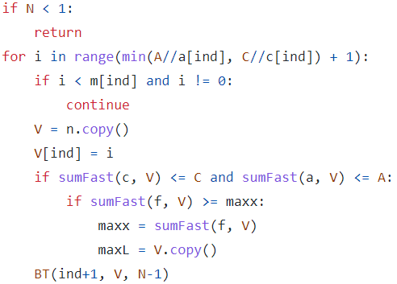
Algorithms
Exhaustive search (ES) - Aim: search for every possible solution and then compare it with the variable saved previously. If the solution in this loop bigger than the saved variable, we update it and continue.
- Similar: DFS, it search to the end of
1 loop then continue with others
→ Running time is very long O(2^{N})

Slide 9
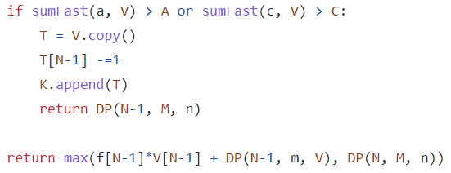
Algorithms
Dynamic programming (DP) - Improved a lot compared to ES. It still goes through all feasible solutions and compares all to give the optimal one. The difference from ES is that it will keep the result of decision variables throughout its loop so it will not repeat the same result.

Slide 10

Algorithms
Constraint programming (CP) This algorithm applies all the conditions of this project which have been modeled to the mathematics formula. It will use all the constraints to boost the time it find feasible answer and then try the next one always better than the previous To help with this method, we use OR-tools library for implementation. We use constraint optimization in this library for our code. OR-tools is a Google powerful tool, giving us the most optimal solution in less than a second.

Slide 11
Algorithms
Mix-Integer programming (MIP) This is the best method we have so far. In this algorithm, we not only use the all conditions which have been modeled in the above section but also use geometry to apply to the Mix-Integer problem. Our problem has Semi-Integer variables, so it is harder to construct in others than in this algorithm which is the best way. → We use Gurobi library to help us with this method. An extremely powerful tool that even gives the optimal answer in a shorter time than CP using OR-tools.

Slide 12
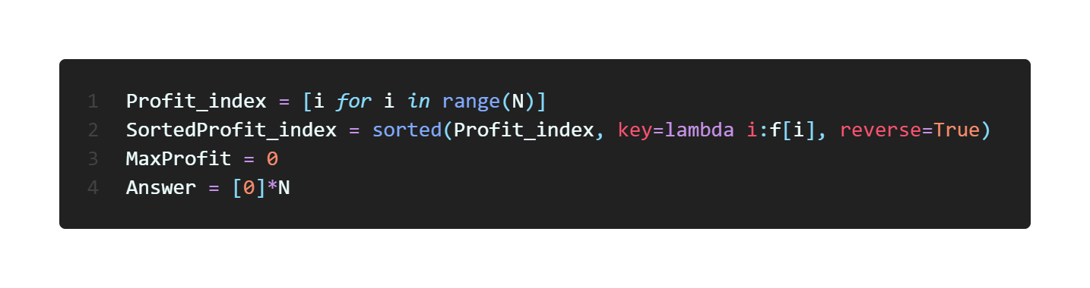
Algorithms
Heuristic 1 First, we arrange the list of index of profit of products in descending order:

Slide 13
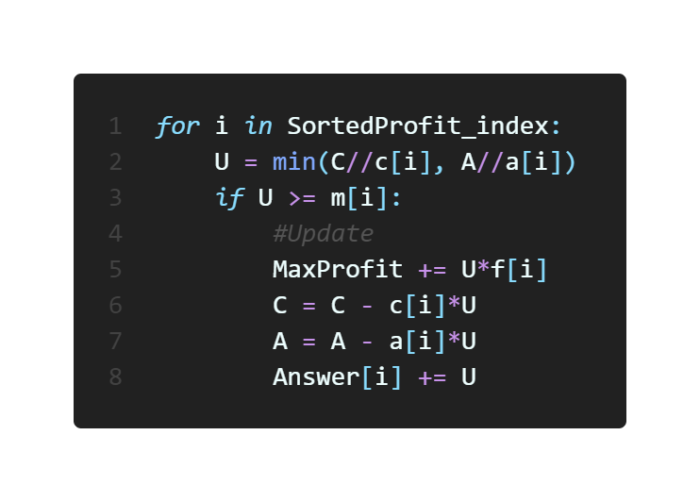
Algorithms
Then we loop through the SortedProfit_index list and if the index i of the product which satisfies U = min(C//c[i], A//a[i]) and U > m[i], we will produce U units of product i-th and update the MaxProfit, C, A and Answer, respectively.

Slide 14
Algorithms
Heuristic 2.0, 2.1, 2.2 We have implemented 3 kinds of heuristic based on an idea: Find the index i that satisfies all these conditions: - U = min(C//c[i], A//a[i]) - U >= m[i] - U*f[i] max

Slide 15
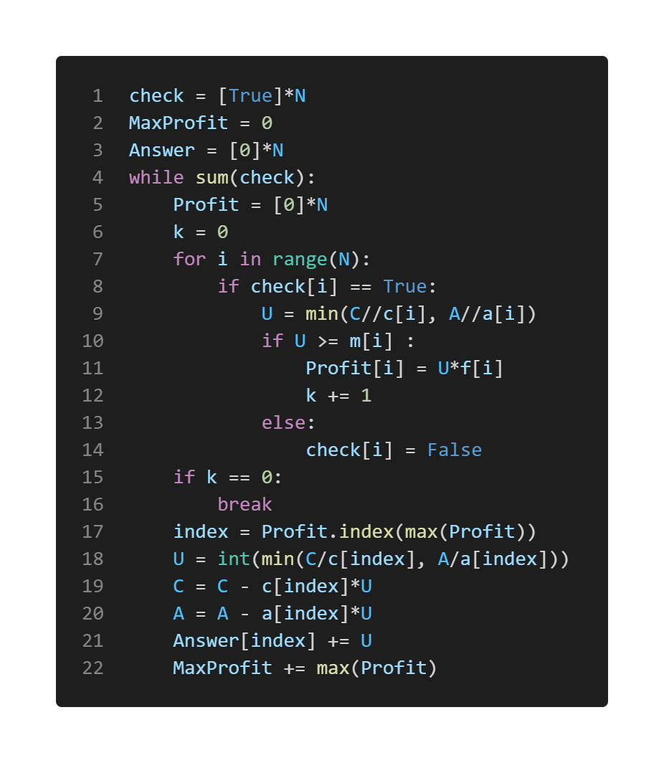
Algorithms
Heuristic 2.0 With found index i, we will produce U units of product i-th and update C, A, Answer and MaxProfit, respectively (similarly in Heuristic 1). If index i does not exist, we break the loop.

Slide 16
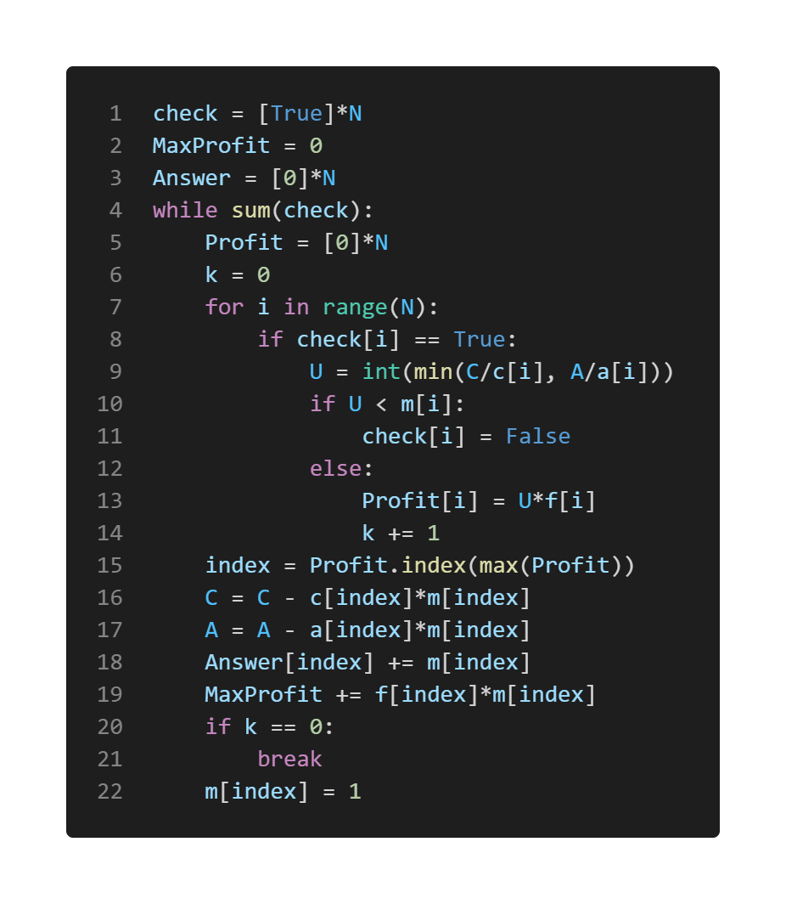
Algorithms
Heuristic 2.1 With found index i, we will produce m[i] units of product i-th and update C, A, Answer and MaxProfit, respectively (similarly in Heuristic 1) and denote m[i] = 1. If index i does not exist, we break the loop.

Slide 17
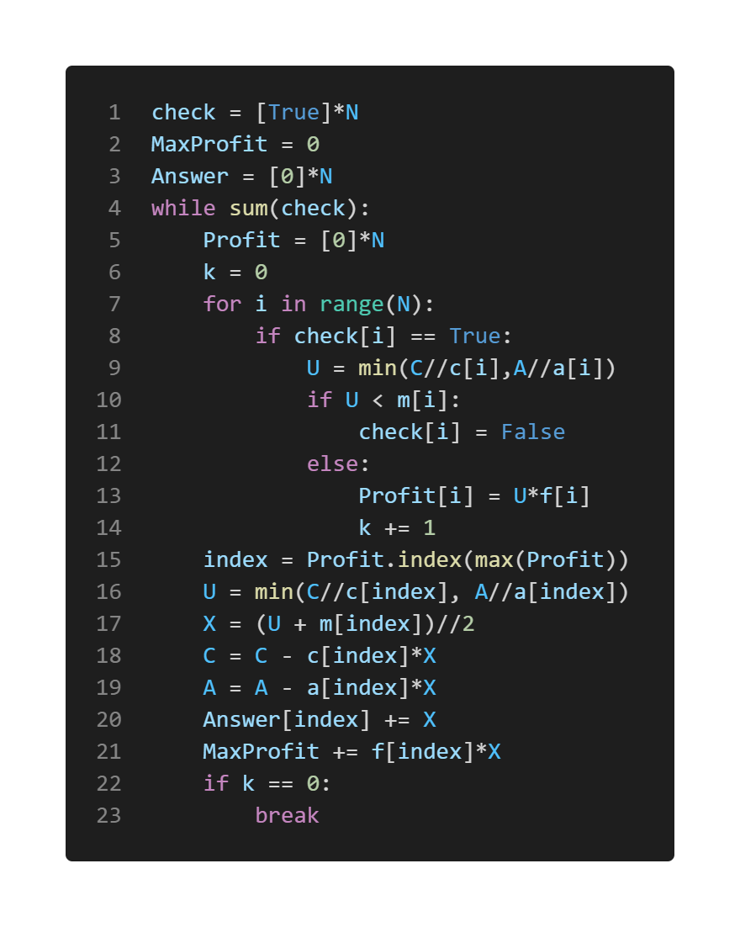
Algorithms
Heuristic 2.2 With found index I, we will produce (U + m[i])//2 units of product i-th and update C, A, Answer and MaxProfit, respectively (similarly in Heuristic 1). If index i does not exist, we break the loop.

Slide 18
Comparison
Accuracy In terms of accuracy, we experimented with 6 sizes of test (each size has 5 random tests). The results are shown for our 4 heuristic algorithms (He1.0, He2.0, He2.1, He2.2).

Slide 19
Comparison
Size | He1.0 | He2.0 | He2.1 | He2.2
N = 5 | 76.55% | 96.39% | 100.00% | 92.12%
N = 20 | 45.56% | 84.97% | 96.25% | 91.90%
N = 100 | 32.19% | 89.14% | 98.26% | 97.81%
N = 1000 | 10.05% | 88.21% | 98.92% | 99.00%
N = 5000 | 3.81% | 86.17% | TOO MUCH TIME TO HANDLE | 98.38%
N = 10000 | 2.47% | 82.39% |  | 94.56%
Table 1: Comparison of the accuracy among our heuristic methods (calculated by Profit of solution/Actual maximum profit*100%)

Slide 20
Comparison
He1.0 has the lowest accuracy, and its accuracy tends to go lower as the size of the test becomes larger (76.55% at N=5 → 2.47% at N=1000).
He2.0 has acceptable accuracy (always higher than 80%).
He2.0 is slightly better than He2.2 at small-size tests, while He2.2 has much better accuracy (about 10%) with greater test sizes.
He2.1 has almost perfect accuracy with small-size tests. However, when the test size becomes more significant, the running time exceeds the limit most of the time.
Sometimes, He1.0, He2.0 and He2.1 give the actual maximum solution, while He2.2 has seen no case.

Slide 21
Comparison
Time Complexity Regarding time complexity, we experimented with 6 sizes of test (each size has 5 random tests). The results are shown for all our algorithms: Exhaustive Search (ES), Dynamic Programming (DP), Constraint Programming (CP), Mix-Integer Programming (MIP) and 4 kinds of Heuristic (He1.0, He2.0, He2.1, He2.2).

Slide 22
Comparison
Size | ES | DP | CP | MIP | He1.0 | He2.0 | He2.1 | He2.2
N = 5 | 24.58 | 0.184 | 0.013 | 0.002 | <0.001 | <0.001 | <0.001 | <0.001
N = 10 (100 < A, C < 1000) | 0.023 | 0.001 | 0.009 | 0.001 | <0.001 | <0.001 | <0.001 | <0.001
N = 10 (1000 < A, C < 10000) | >1 hour | 405.01 | 0.022 | 0.012 | <0.001 | <0.001 | <0.001 | <0.001
N = 100 | >1 hour | >1 hour | 0.021 | 0.007 | <0.001 | <0.001 | 0.242 | 0.001
N = 1000 (10⁶ < A, C < 10⁷) | >1 hour | >1 hour | 0.136 | 0.015 | 0.001 | 0.001 | 15.21 | 0.004
N = 1000 (10¹¹ < A, C < 10¹²) | >1 hour | >1 hour | 0.122 | 0.013 | 0.001 | 0.001 | >1 hour | 0.016
Table 2: The comparison of the experimental results time among our methods (unit: second)

Slide 23
Comparison
At N = 5,10 and A, C small, all algorithms give answers instantly.
As the tests get bigger, ES runs slowest, while DP struggle as N ≥ 100.
CP and MIP are stable methods throughout, but MIP is shown to be slightly better.
For all Heuristic algorithms, He1.0 and He2.0 run the quickest, even faster than CP and MIP. He2.2 becomes a bit slower at significant size tests, while He2.1 cannot be solved under 1 hour at the largest size.
All algorithms surely can give solutions, even the slowest, if given enough time.

Slide 24
Conclusion
MIP and CP are the most efficient.
For small-size tests (N = 5,10), all algorithms can solve in an acceptable time. In 4 exact methods, the fastest is MIP, followed by CP, DP and ES.
Regarding the 4 Heuristic algorithms, we not only compare in time but also the accuracy. - In time complexity: He1.0 ~ He2.0 > He2.2 > He2.1 - For the accuracy: He2.1 > He2.2 > He2.0 > He1.0. → Combining these factors, we conclude about the optimality : He2.2 > He2.0 > He2.1 > He1.0. Although He2.1 has better accuracy than the others 3, the drawback is the time running of large-size tests is unacceptable (>1hour)

Slide 25
Thank you for listening!

