Slide 1
Spam Review Detection
Project 2
Student: Nguyen Viet Minh – 20214917 Teacher: Ngo Thanh Trung

Slide 2
Content
Introduction
Dataset Description
Data Preprocessing
Model
Experiment Result
Conclusion

Slide 3
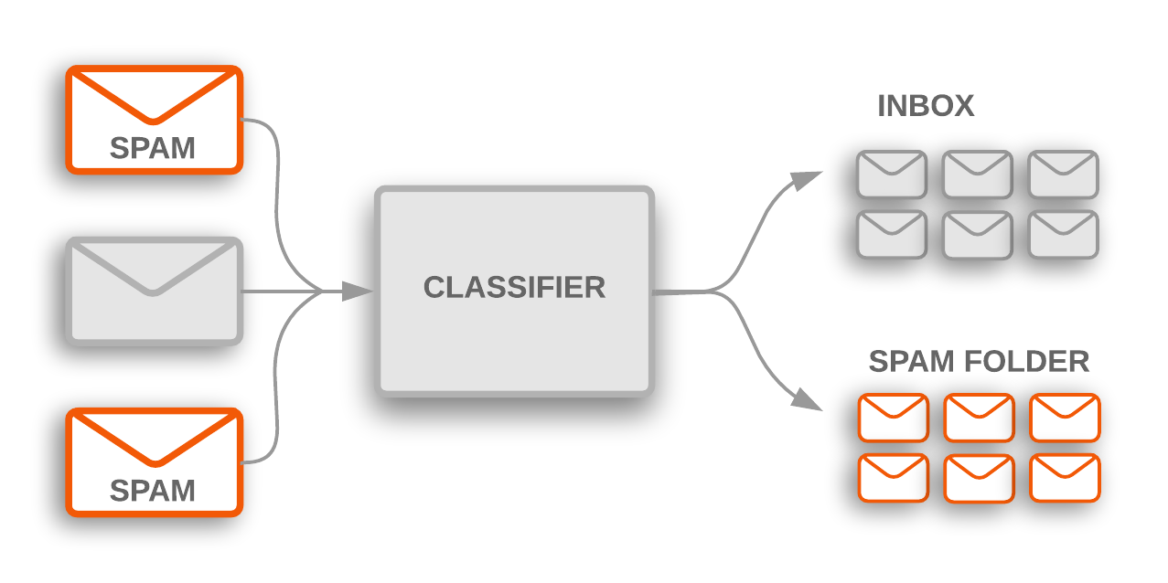
Introduction
Text classification is a fundamental task in natural language processing (NLP) that involves categorizing text into predefined classes.
Spam review detection targets the identification and filtering of irrelevant or deceptive reviews, which are often posted on websites to mislead consumers or manipulate product rating.
Binary Classification problem

Slide 4
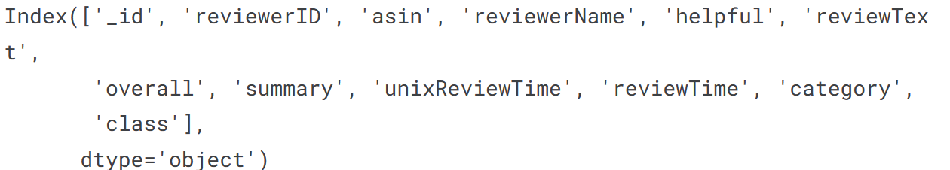
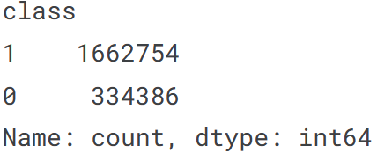
Dataset Description
Dataset choosen: Amazon product reviews with spam and not spam labeling. This is a large corpus that contains 26.7 million reviews and 15.4 million reviewers. The class label is spam and not spam, where "0" indicates not spam and "1" indicates spam reviews. All in .json file
Imbalanced dataset:

Slide 5
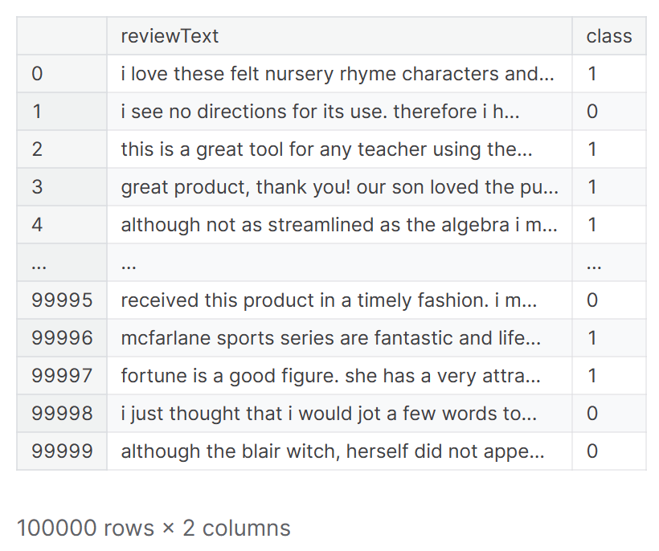
Data Cleaning
Data Preprocessing
Only Toys and Games category
We take only reviewText and class and 100000 datapoints
Apply contractions, remove special
characters like '$' and '!'
Remove numeric digits like '19.99'

Slide 6
Model
We run 7 ML models, 4 DL models with different configs and feature extraction methods to see the differences

Slide 7
Model – Feature Extraction
We propose 2 feature extraction methods
CountVectorizer, remove stop words, ignore terms that appear in more than 80% documents, top 2000 most frequently occurring words in the corpus, ngram don’t work here
TF-IDFVectorizer, same with CountVectorizer
Combine of both, CountVectorizer then TfidfTransformer
Word embedding for DL, embedding dimension is 100

Slide 8
Model – fine tuning
We choose combine 2 feature extraction CountVectorizer then TfidfTransformer for fine-tuning parameter, the hyper-parameter we do here is alphas of model multinomial NB which is a statistic model that I think suitable for best present this problem.
It return best alpha is 0.1 and result accuracy is 0.887 and pr_auc_score is 0.944 which is a little bit better than model not fine-tuning but the problem that we use 2 feature extraction here. So we can conclude that maybe 1 feature extraction is enough. No need of 2, not better and time-consuming.

Slide 9
Experiment Result - ML
 | Accuracy(Basic) | PR-AUC-Score(Imbalanced Dataset)
Multinomial Naive Bayes | Count: 0.876 Tfidf: 0.886 Count+Tfidf+bestAlpha: 0.887 | Count: 0.965 Tfidf: 0.942 Count+Tfidf+bestAlpha: 0.944
DecisionTreeClassifier | Count: 0.844 Tfidf: 0.841 | Count: 0.948 Tfidf: 0.947
LogisticRegression | Count: 0.906 Tfidf: 0.909 | Count: 0.959 Tfidf: 0.958
RandomForestClassifier | Count: 0.894 Tfidf: 0.892 | Count: 0.948 Tfidf: 0.947
LinearSVC | Count: 0.905 Tfidf: 0.911 | Count: 0.958 Tfidf: 0.961
Perceptron | Count: 0.884 Tfidf: 0.869 | Count: 0.958 Tfidf: 0.957
XGBoost | Count: 0.909 Tfidf: 0.906 | Count: 0.959 Tfidf: 0.958

Slide 10
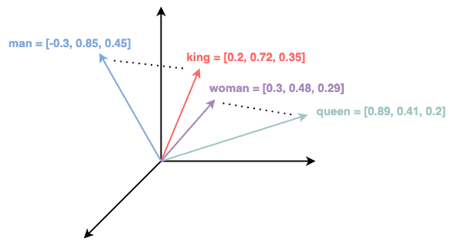
Model – DL – feature extraction
We still using CountVectorizer and TfIDFVectorizer as a basic method for feature extraction
Additional, we have word embedding using Spacy library, BERT or pretrained model have word embedding by its self

Slide 11
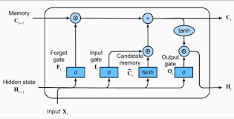
Model – DL - LSTM
One of the most DL model for NLP in general and text classification task is RNN. And LSTM is the most well-known type of RNN, it enhances by incorporating memory cells and three types of gates(input, output, forget). This help it overcome the limitation of traditional RNNs which is learning long-term dependencies.

Slide 12
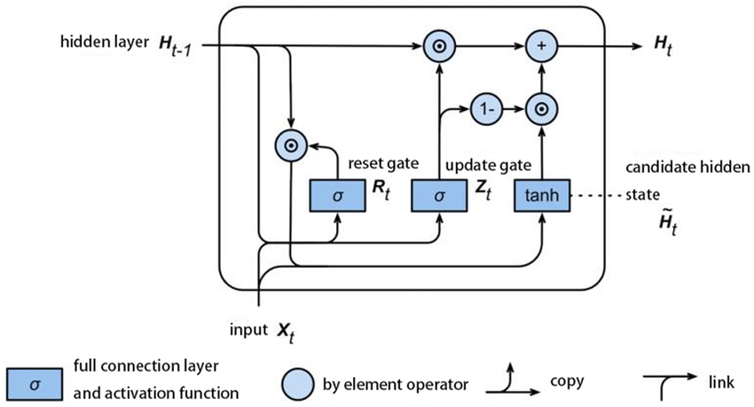
Model – DL - GRU
Also a type of RNN architecture and kind of the same with LSTM, Although not famous as LSTM but introduced after LSTM quite a long time, it was hopefully can have better result and faster than LSTM by combining input and forget gates into update gate and merges the cell and hidden state.

Slide 13
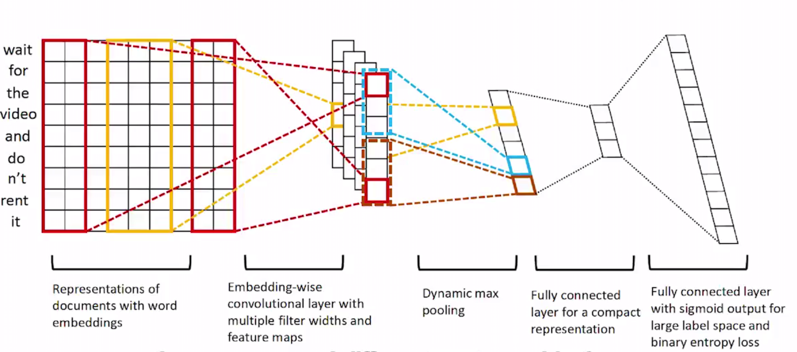
Model – DL - CNN
Although the famous of CNN model in computer vision problem, it can also be used in NLP and success in capturing local patterns in data, work like n-gram features in our problem. This architecture highly depend on embedding layer and kernel size of CNN is n-grams size.

Slide 14
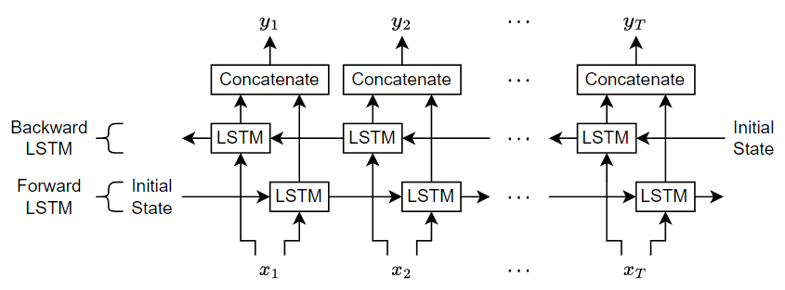
Model – DL - BiLSTM
Bidirectional LSTM enhance standard LSTM by processing data in both forward and backward directions, allows network to have a comprehensive understanding of the entire context, both past and future, improve performance in tasks where context from both directions are vital.

Slide 15
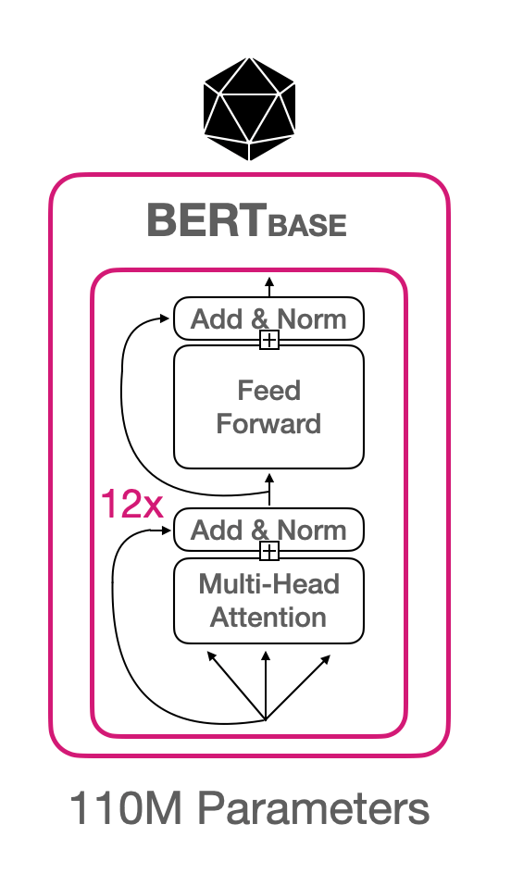
Model – LLM - BERT
Bidirectional Encoder Representations from Transformers. It is also a LLM by its self, it consists of multiple layers of transformers, each layer with applying self-attention mechanisms.
Encoder before all of this, inside have bidirectional and Decoder after.
As a LLM model, BERT has been pre-trained on
vast amounts of data with 2 main tasks which is
mask language model: predict masked word and next sentence prediction: understand relationship between pairs of sentences.

Slide 16
Model – LLM - GPT2 and Mamba
Generative Pre-trained Transformer, here we use version 2.0 for experiment
Mamba is built with purpose directly compare with transformer
LLM model like GPT. Architecture integrates the SSM
(State Space sequence Model) to manage lengthy data sequence. Combine of the best features of recurrent, convolutional,
continuous-time models, it can effectively simulate long-term
dependencies .
Its architecture revolves around a special selection mechanism and hoping to have shorter time running than Transformer

Slide 17
Experiment Result - DL
 | Accuracy | PR_AUC | Time(s)
LSTM | CountVectorizer: 0.902 TfIDFVectorizer: 0.907 BERT WEmb: 0.922 Spacy WEmb: 0.918 Pretrained: 0.909 | CountVectorizer: 0.961 TfIDFVectorizer: 0.964 BERT WEmb: 0.972 Spacy WEmb: 0.970 Pretrained: 0.963 | CountVectorizer: 94 TfIDFVectorizer: 94 BERT WEmb: 10000 Spacy WEmb: 19000 Pretrained: 2212
GRU | CountVectorizer: 0.902 TfIDFVectorizer: 0.911 BERT WEmb: 0.926 Spacy WEmb: 0.915 | CountVectorizer: 0.962 TfIDFVectorizer: 0.963 BERT WEmb: 0.975 Spacy WEmb: 0.970 | CountVectorizer: 83 TfIDFVectorizer: 83 BERT WEmb: 9817 Spacy WEmb: 20000
CNN | Max: 0.933 Mean: 0.931 | Max: 0.972 Mean: 0.973 | Max: 15100 Mean: 15131
BiLSTM | 0.926 | 0.971 | 12000
BERT(3 epochs) | 0.943 | 0.980 | 10000
GPT2(3 epochs) | 0.936 | 0.978 | 5200
Mamba(1 epoch) | 0.911 | 0.962 | 38000

Slide 18
Conclusion and improvement
Although our ML model do quite well, we can use
stronger DL model like normal LTSM or GRU model.
For this spam review detection, I suggest using Logistic Regression is enough for the trades off between speed and accuracy.
If we want to improve performance and have a lot time to train, with fast infer, we suggest BERT or pre-trained GPT. But we think BERT will be suitable for more and more other problem.
We can improve more by BERT large or newer version.

Slide 19
DEMO
Click here

Slide 20


