Slide 1
CIFAR 10 Classification by CNN - From 79% to 90% Accuracy
醫工系107 吳旻昇

Slide 2
優化 CNN 的方法
改善 Gradient Vanishing 問題：
Xavier Initialization → He Initialization
Batch Normalization
Selu (Self-Normalizing ReLU, SNN)
讓 Dropout 比例不一：Differential Dropout
隨機打亂資料：Random Shuffling
考慮模型複雜度的懲罰值：L2 Regularization
Learning rate decay
NIN
Data Augmentation

Slide 3
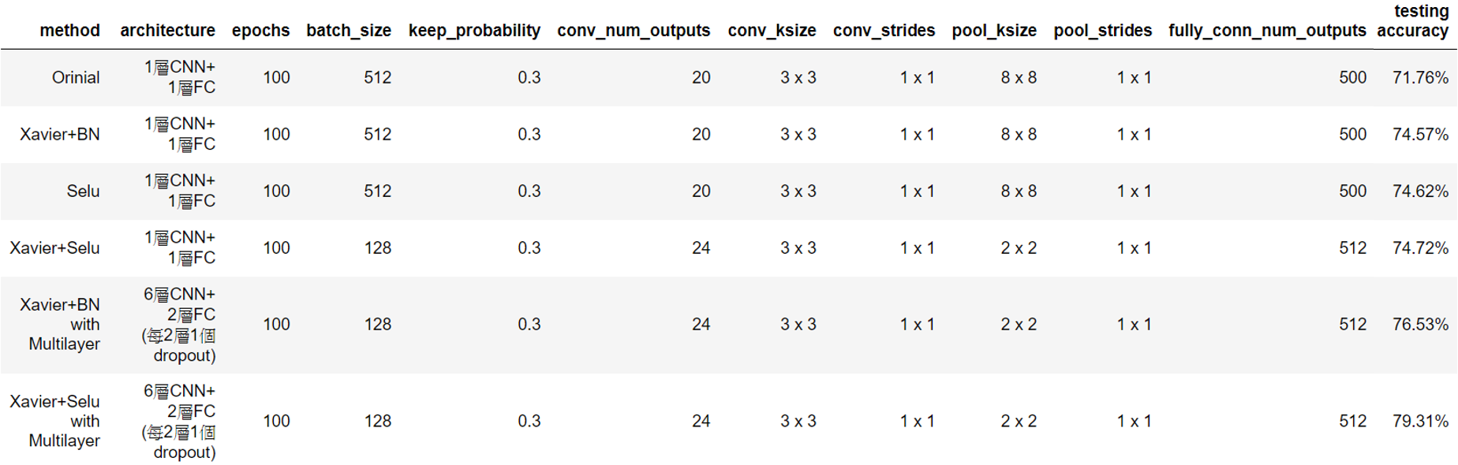
先講結論
使用 Xavier Initialization + Selu 讓 Accuracy 提升至 79%
Constricted by OOM Problem

Slide 4
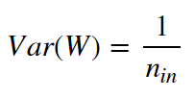



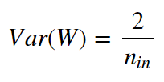
Xavier Initialization
讓權重的初始值之高斯分布的變異數與 neuron 個數有關。
假設有一 linear neuron layer，希望讓 input 與 output 的變異數一樣。
對於 non-linear ， He 等人提出 He Initialization。

Slide 5
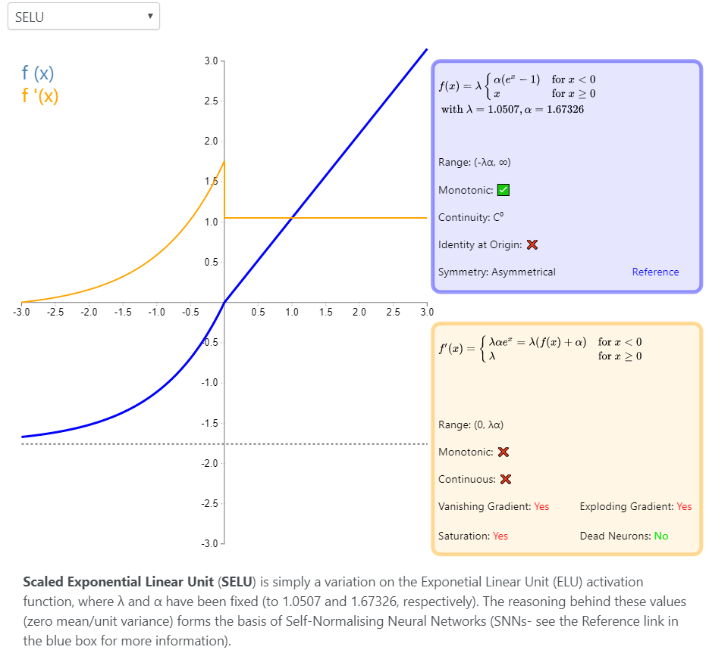
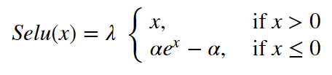

Selu (Self-Normalizing ReLU , SNN)
Günter Klambaue et al., Andreas May. Self-Normalizing Neural Networks (2017)
自動讓輸出值正規化。
Different Activation Functions Displaying

Slide 6
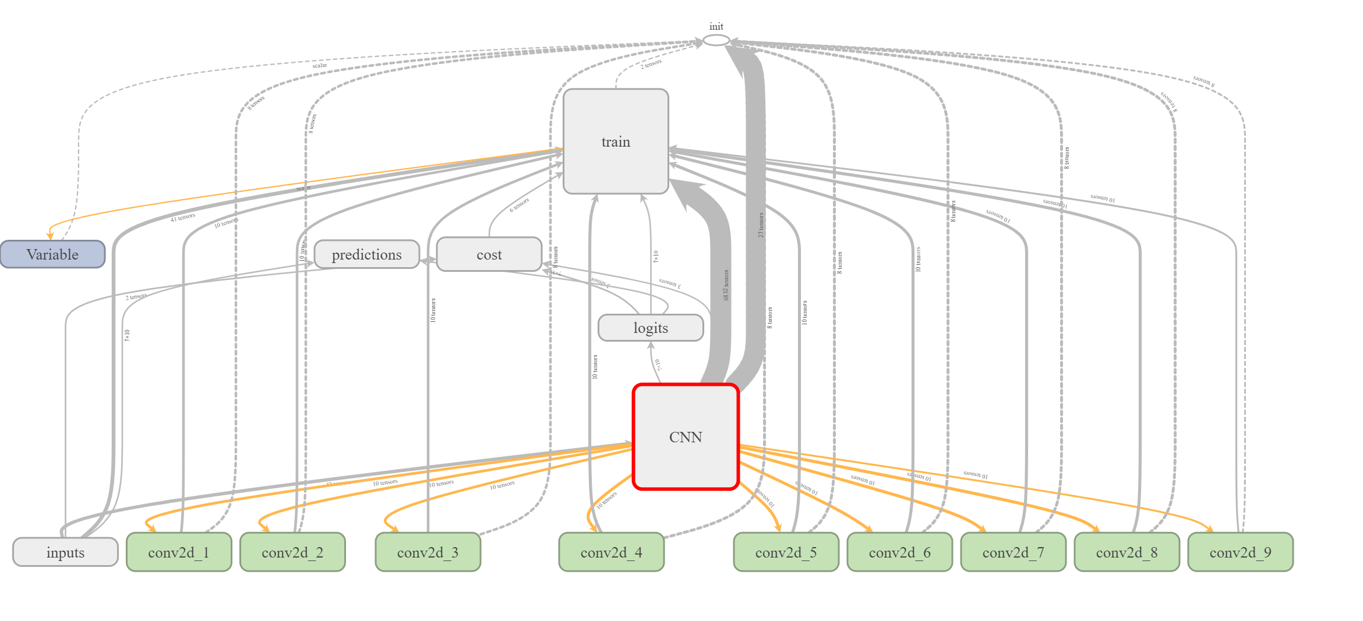
Final CNN Architecture

Slide 7
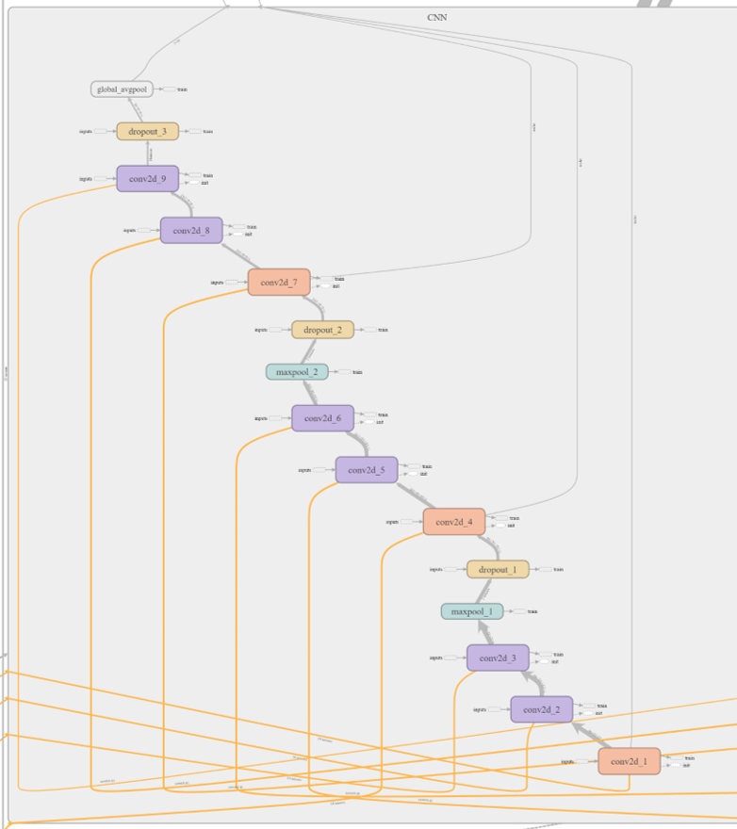
CNN Layers - NIN (Network in Network)
9 weight layers
conv2d_1 | 3x3 conv 92 ReLU with l2 regularizer 3x3 conv 92 ReLU 3x3 conv 92 ReLU
conv2d_2
conv2d_3
maxpool_1 | maxpool with stride = 2
dropout_1 | dropout with keep-prob = 0.5
conv2d_4 | 3x3 conv 192 ReLU with l2 regularizer 3x3 conv 192 ReLU 3x3 conv 192 ReLU
conv2d_5
conv2d_6
maxpool_2 | maxpool with stride = 2
dropout_2 | dropout with keep-prob = 0.5
conv2d_7 | 3x3 conv 192 ReLU with l2 regularizer 1x1 conv 192 ReLU 1x1 conv 10 ReLU
conv2d_8
conv2d_9
global_avgpool | global average pooling

Slide 8
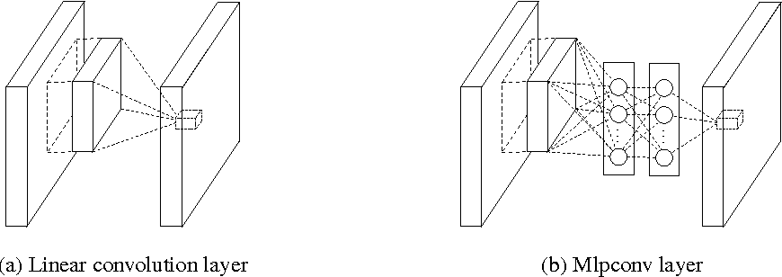
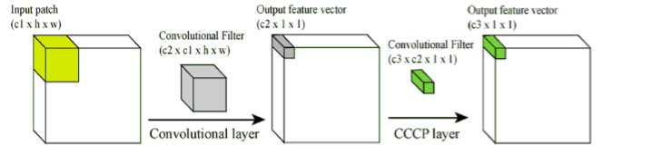
Mlpconv (multilayer perceptron convolution)
在 conv layers 中間加上多層的 fully connected layers。
實作上使用 1x1 conv (又稱 cascaded cross-channel pooling, CCCP)。
提高 conv layer 的非線性感知能力。

Slide 9
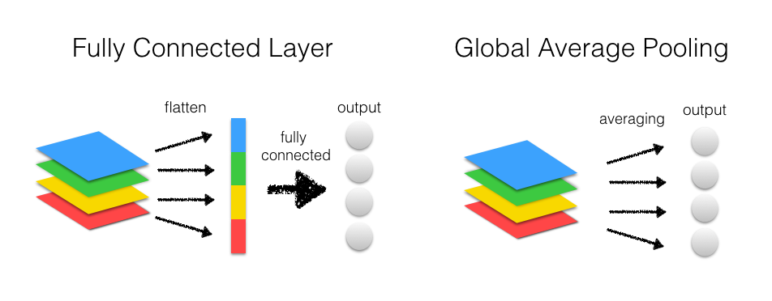
Global Average Pooling
對整個 feature map 取平均值，直接作為output layer的結果。
取代 fully connected layers ，大幅減少 parameters 。

Slide 10
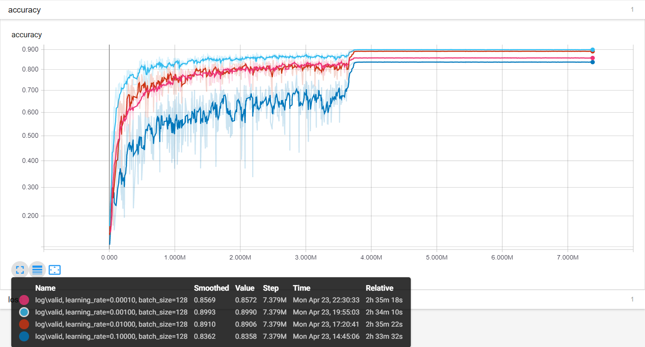
learning rate decay over 81 epochs
Choosing Learning Rate

Slide 11
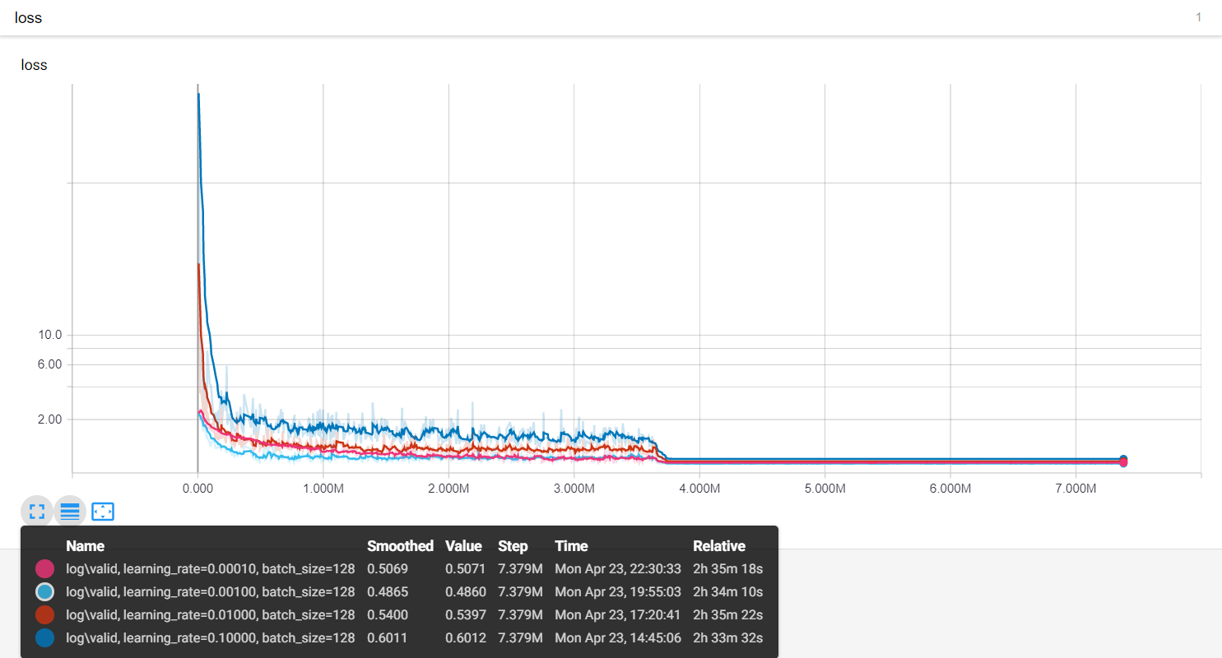
Choosing Learning Rate

Slide 12
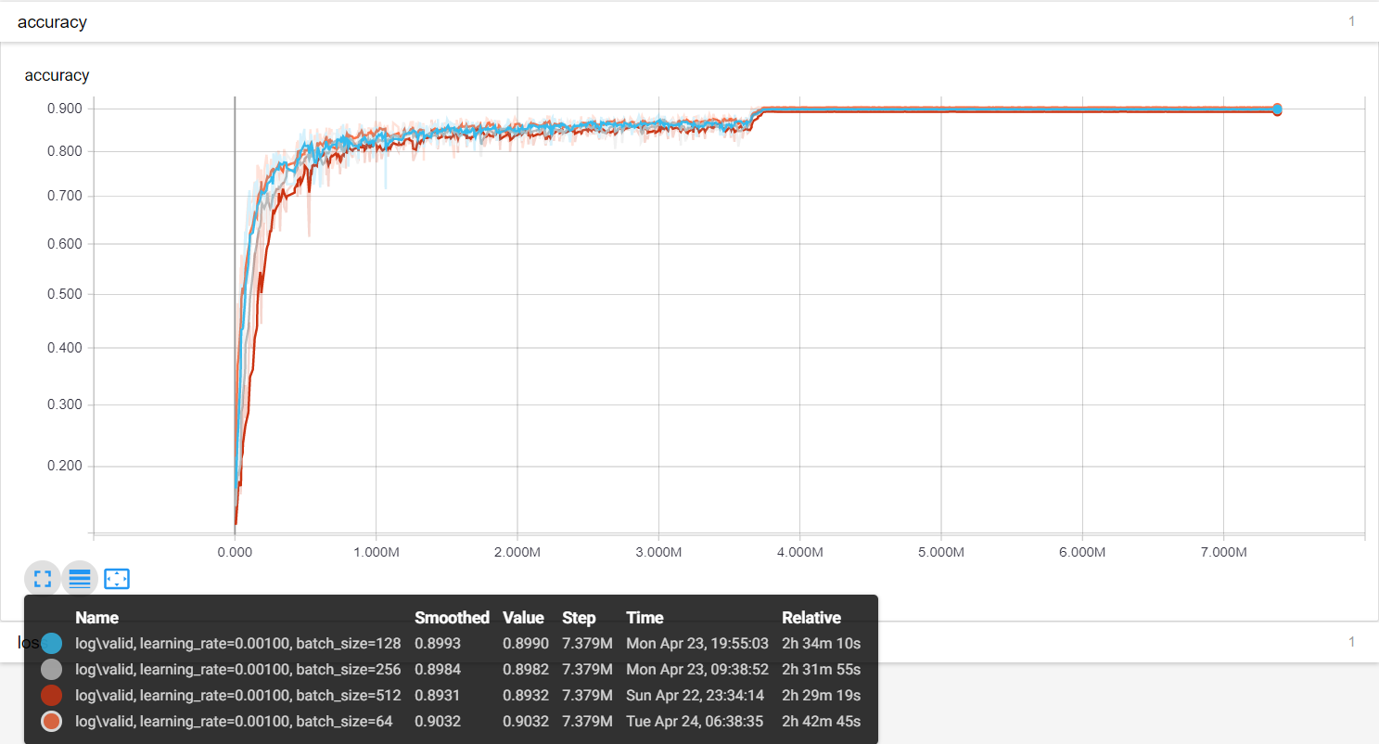
Choosing Batch Size

Slide 13
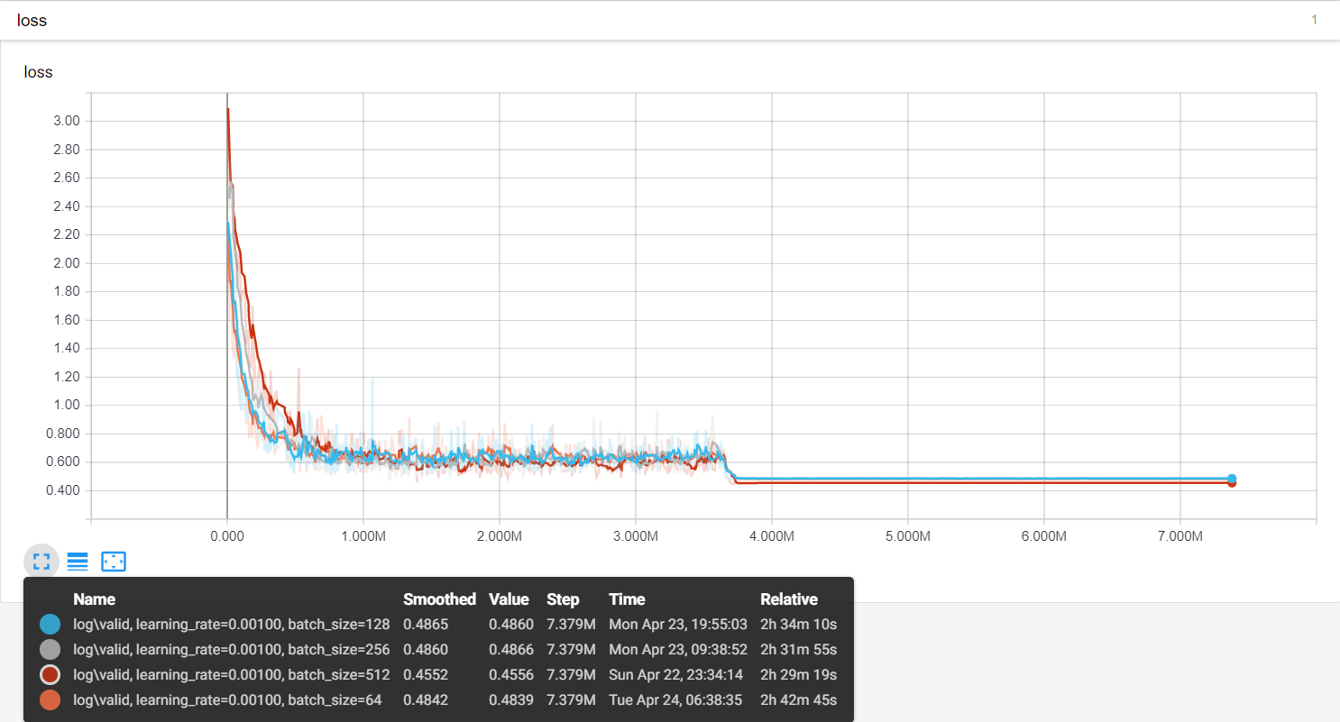
Choosing Batch Size

Slide 14
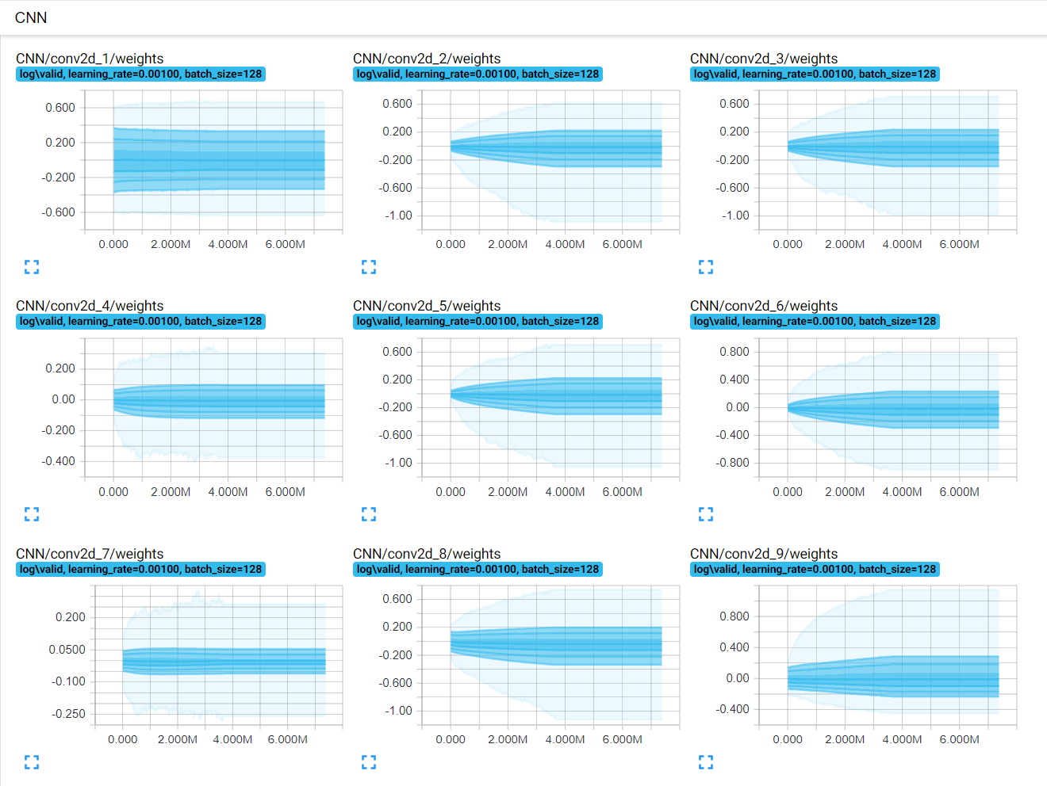
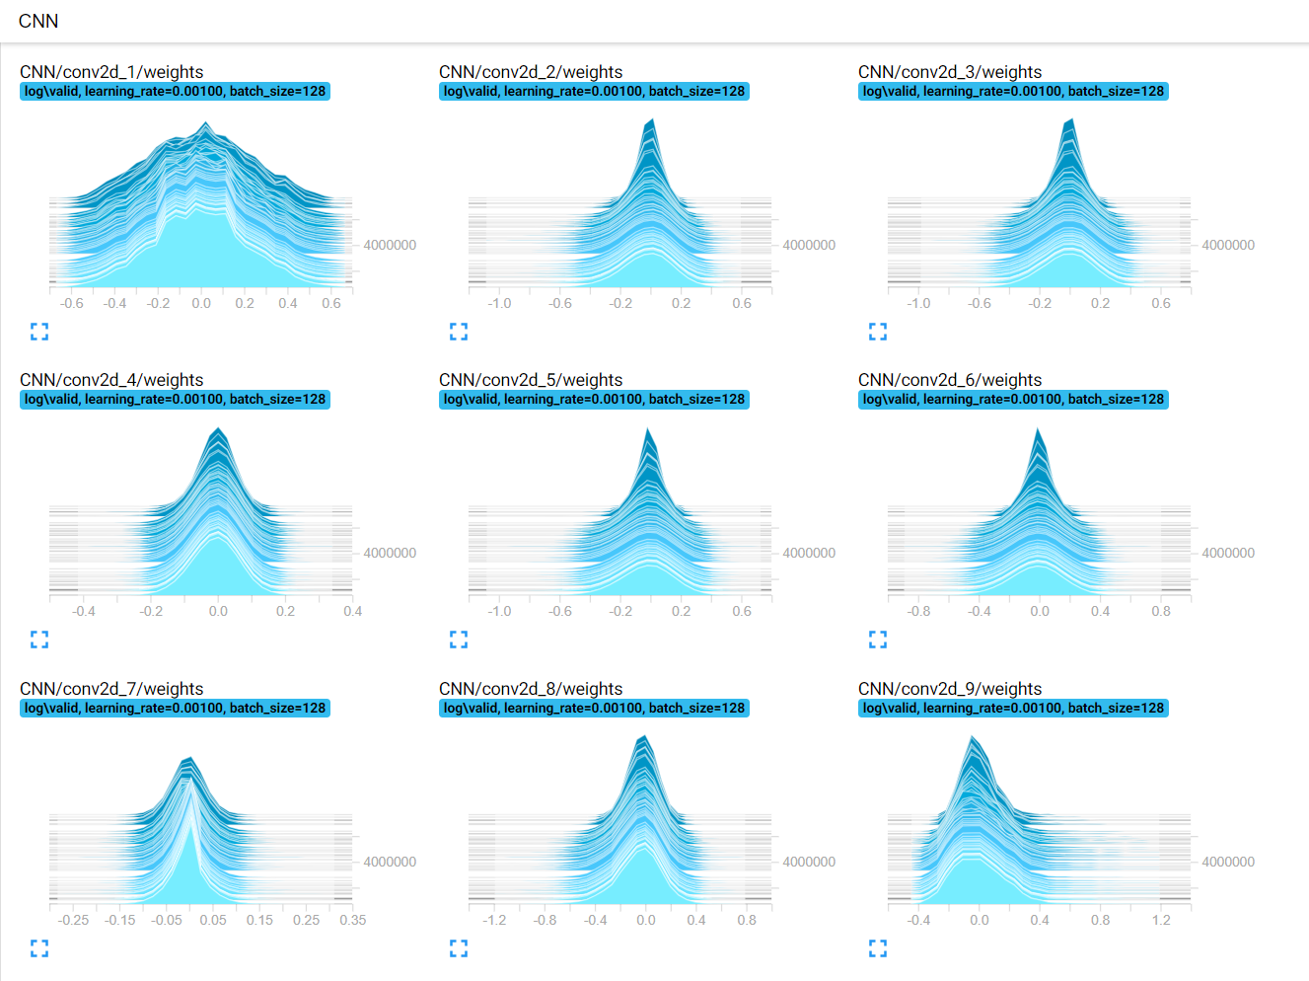

Slide 15
How to achieve 90% accuracy?

Slide 16
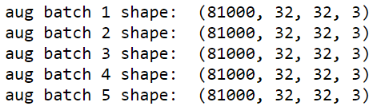
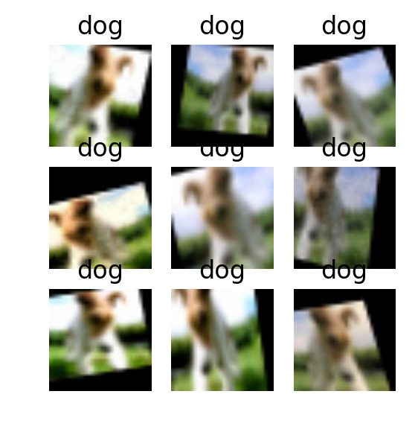
Data Augmentation
Kind |  | Method | Percentage of images
Horizontal flip |  | Random | 50%
Crop from each side |  | Random | 0 ~ 10%
Gaussian blur |  | Random sigma 0 ~ 0.5 | 50%
Contrast |  | 0.75 ~ 1.5 | 100%
Add gaussian noise |  | per pixel | 50%
 |  | per pixel and per channel | 50%
Multiply |  | 0.8 ~ 1.2 | 20%
Affine transformations | scale | 0.8 ~ 1.2x | 100%
 | translate | x = -0.2 ~ 0.2 y = -0.2 ~ 0.2
 | rotate | -25 ~ 25 deg
 | shear | -8 ~ 8 deg
https://github.com/aleju/imgaug

Slide 17
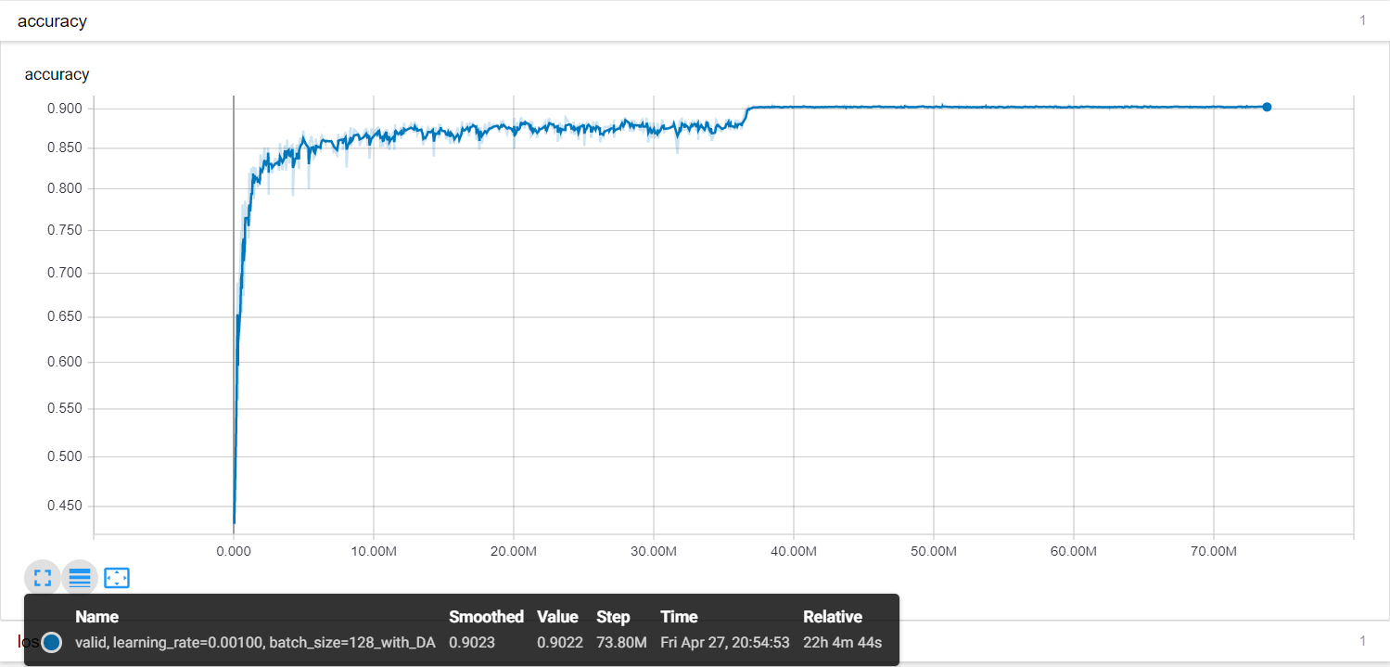

Slide 18
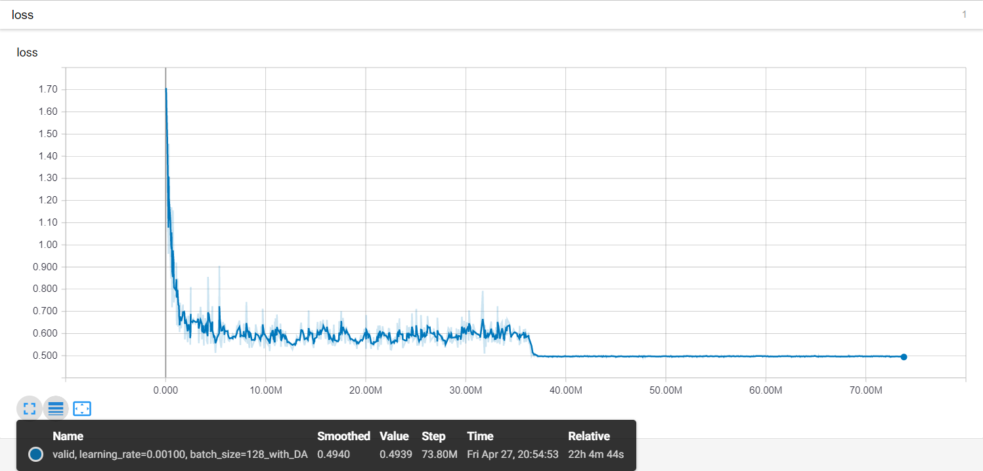

Slide 19
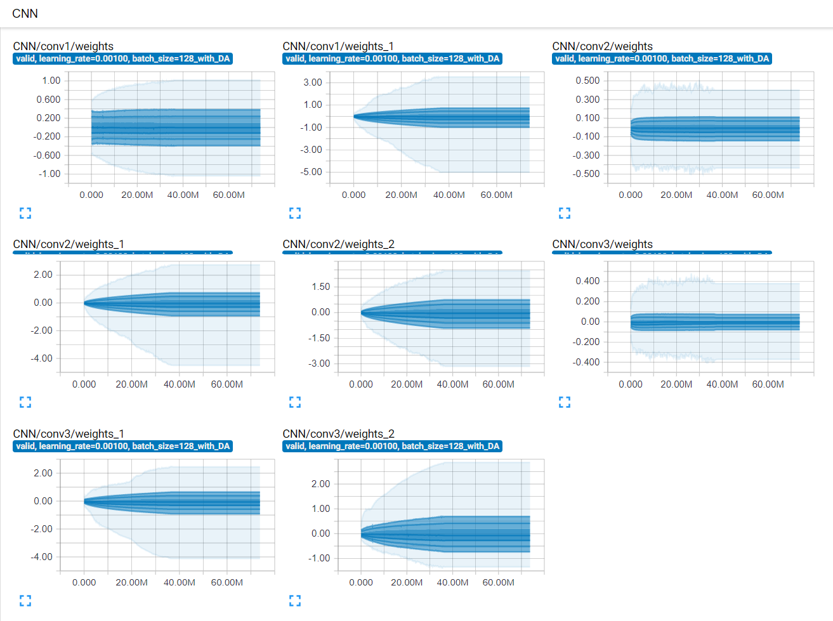
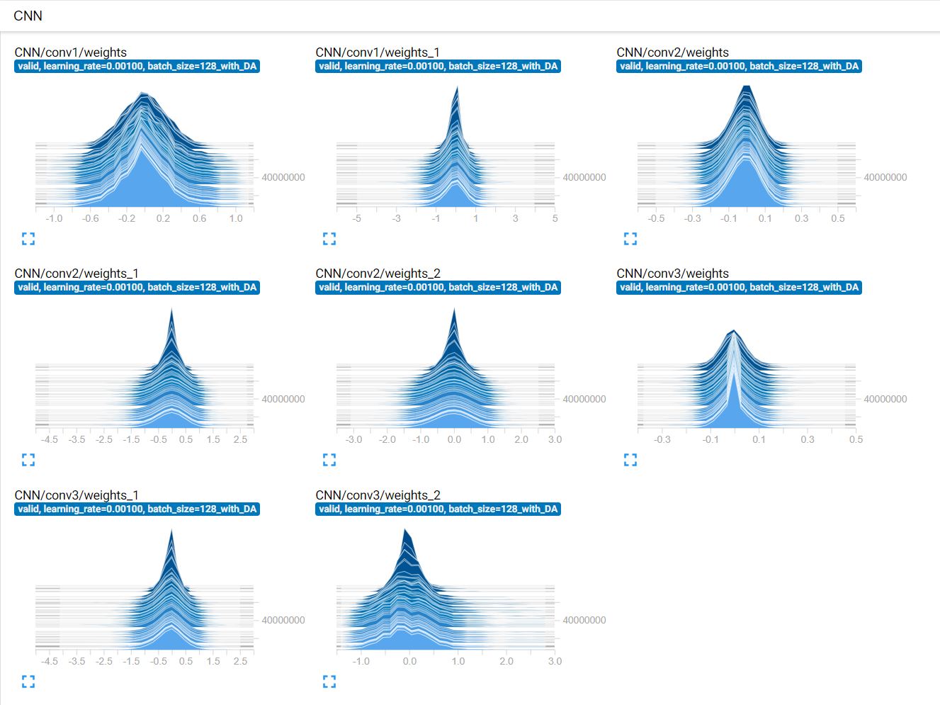

Slide 20
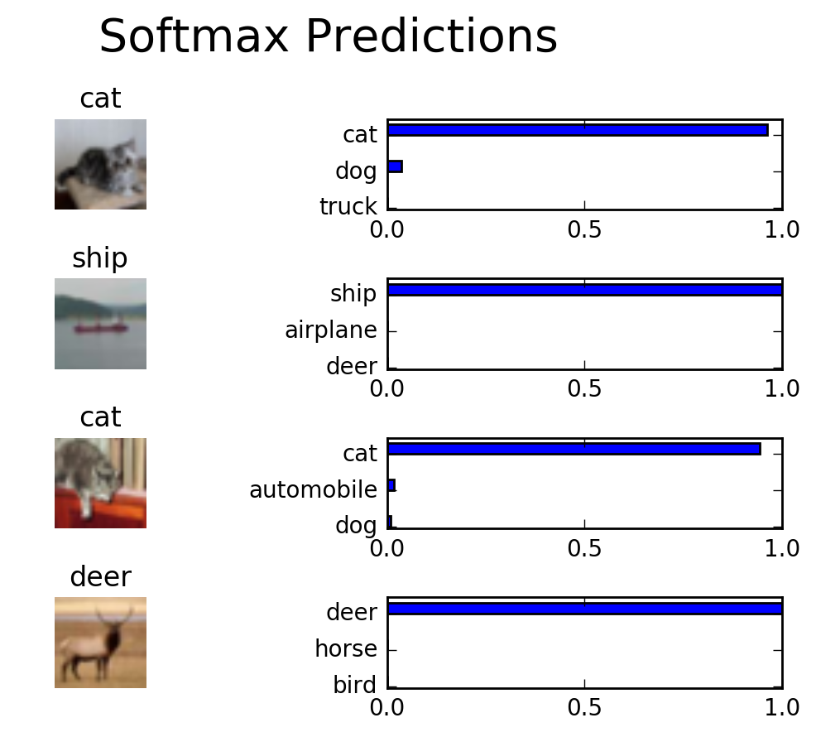
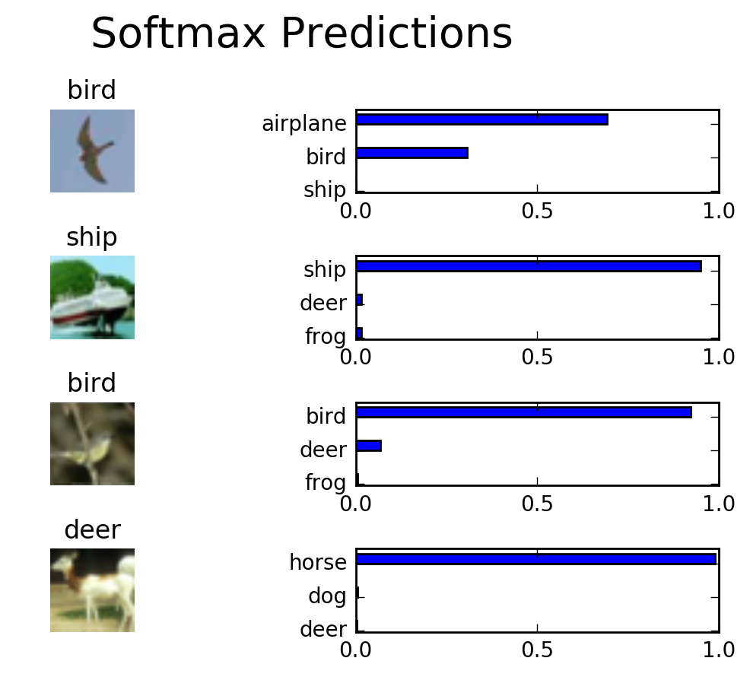
Final Testing Accuracy
Batch size : 128
Initial learning rate : 0.001
Epochs : 164

Slide 21
Reference
《Network In Network》
https://arxiv.org/pdf/1312.4400.pdf
《Striving For Simplicity：The All Convolutional Net》
https://arxiv.org/pdf/1412.6806.pdf
NIN
https://github.com/BIGBALLON/Deep-learning-and-practices/tree/master/Lab3-NIN
Xavier Initialization
http://andyljones.tumblr.com/post/110998971763/an-explanation-of-xavier-initialization
《Self-Normalizing Neural Networks》
https://arxiv.org/pdf/1706.02515.pdf

