Slide 1
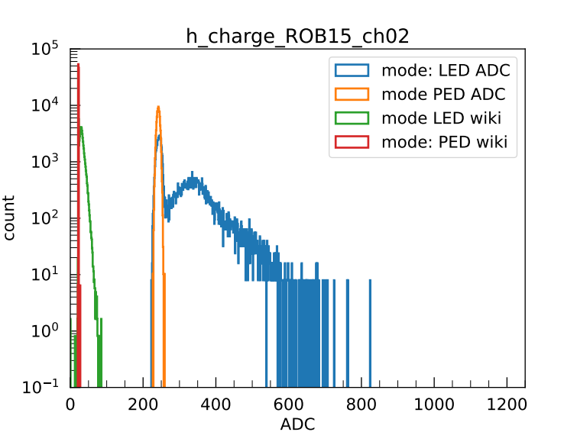
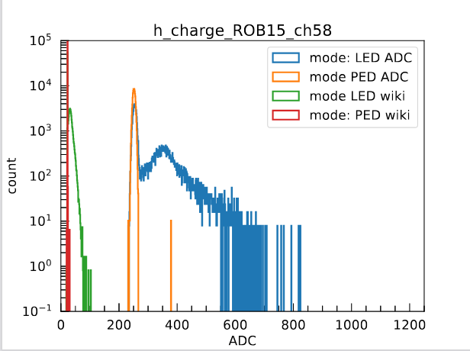
TRT | Threshold ADC: 430
Wilkinson ADC | led_cCB-22_2023-12-18_18_12_hist.root | ped_cCB-22_2023-12-18_18_19_hist.root
FADC | led_cCB-22_2023-12-18_18_18_hist.root | ped_cCB-22_2023-12-18_18_20_hist.root
Channel 1,5,6,12,13,15,33,40,
41, 48,58

Slide 2
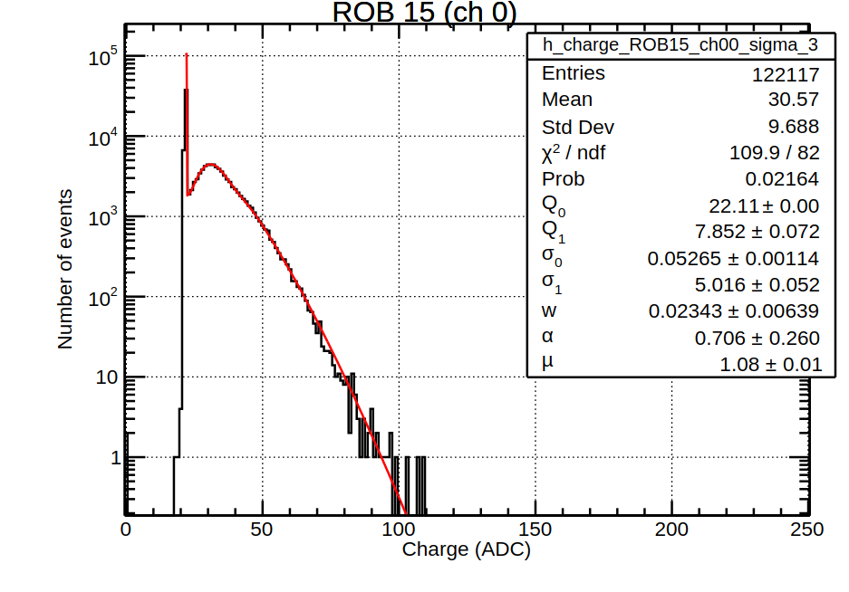
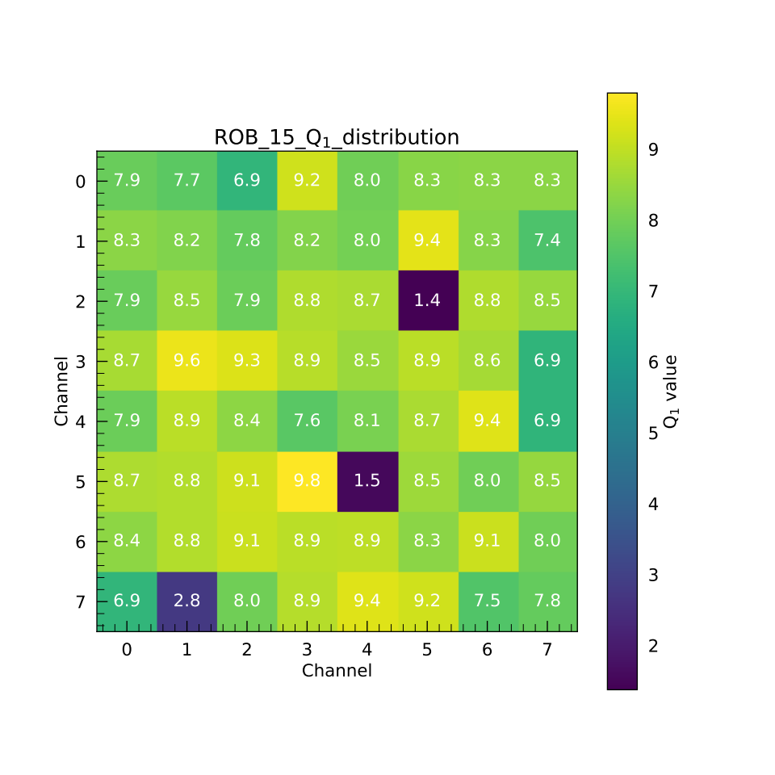
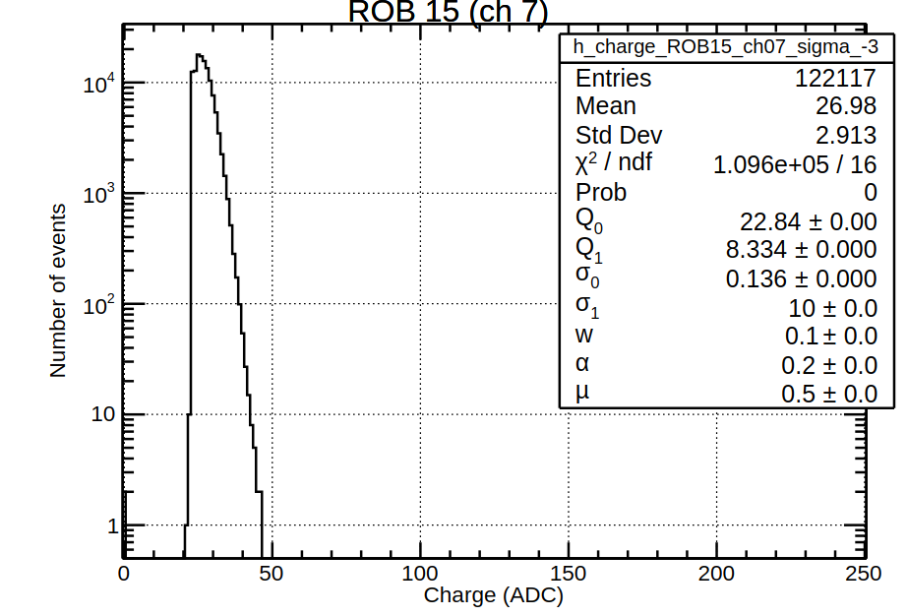
Wilkinson ADC
Channel 7,21, 44,57

Slide 3
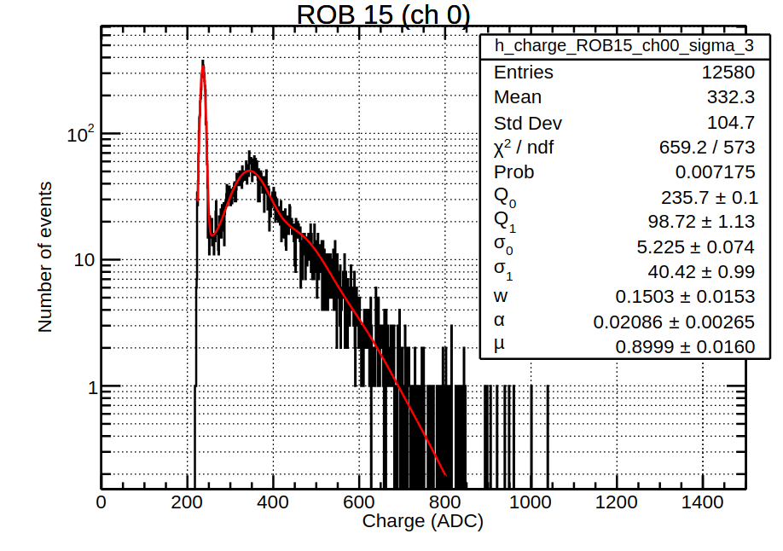
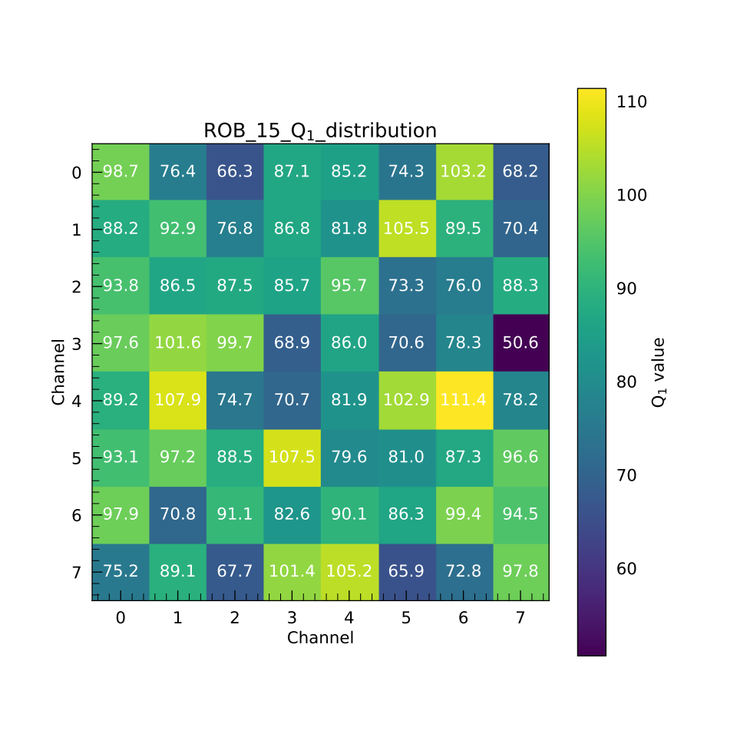
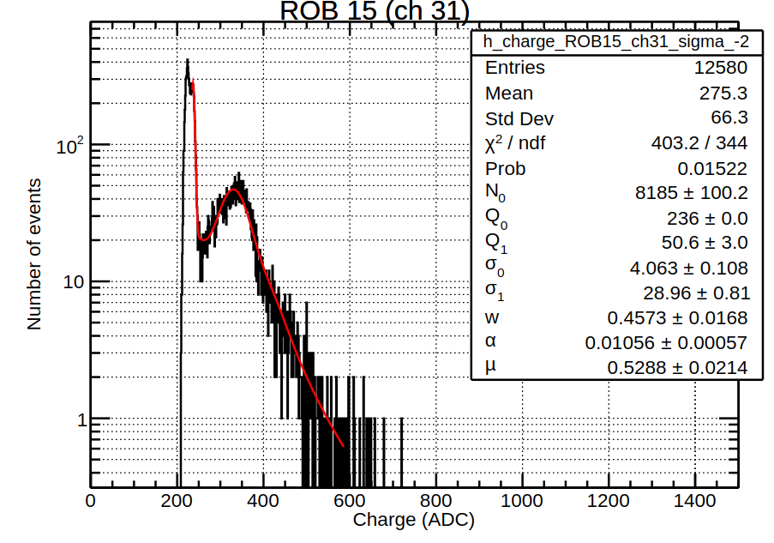
FADC

Slide 4
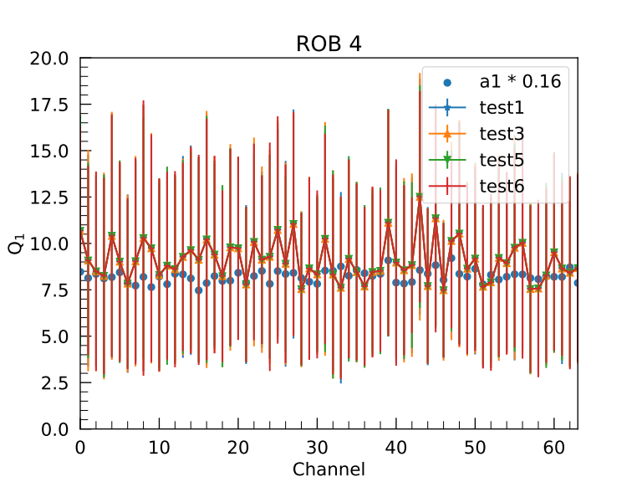
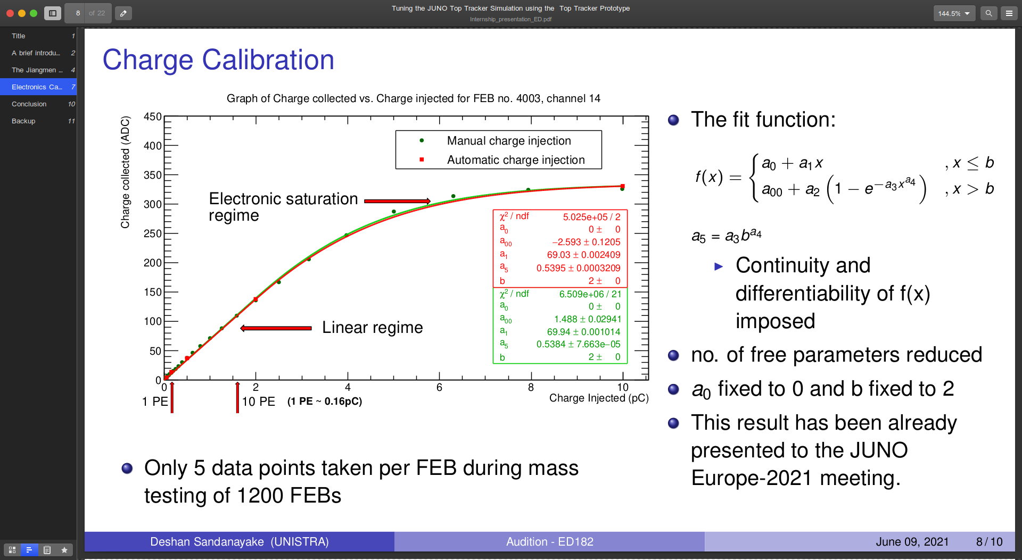
Q1 = ADC/PE
a1 = ADC/pC
1PE = 0.16pC
Q1 ~ a1 *0.16
Error : sigma1

