Slide 1

US housing starts forecasting
We seek to forecast house builds in the US using only historic data.
We get the data from Federal Reserve Economic Data (FRED), provided by the Federal Reserve Bank of St. Louis.

Slide 2
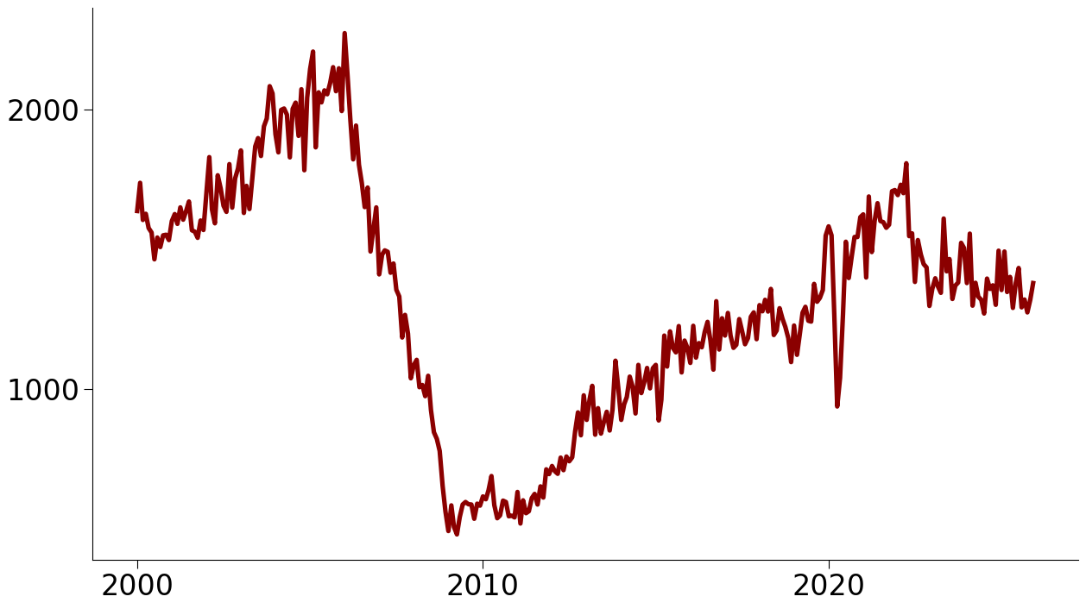
Monthly US housing starts
COVID 19
2008 Crash
The housing build rate fell in 2008. The pandemic caused another sharp fall in 2020. Housing starts remain below their mid-2000s peak.

Slide 3
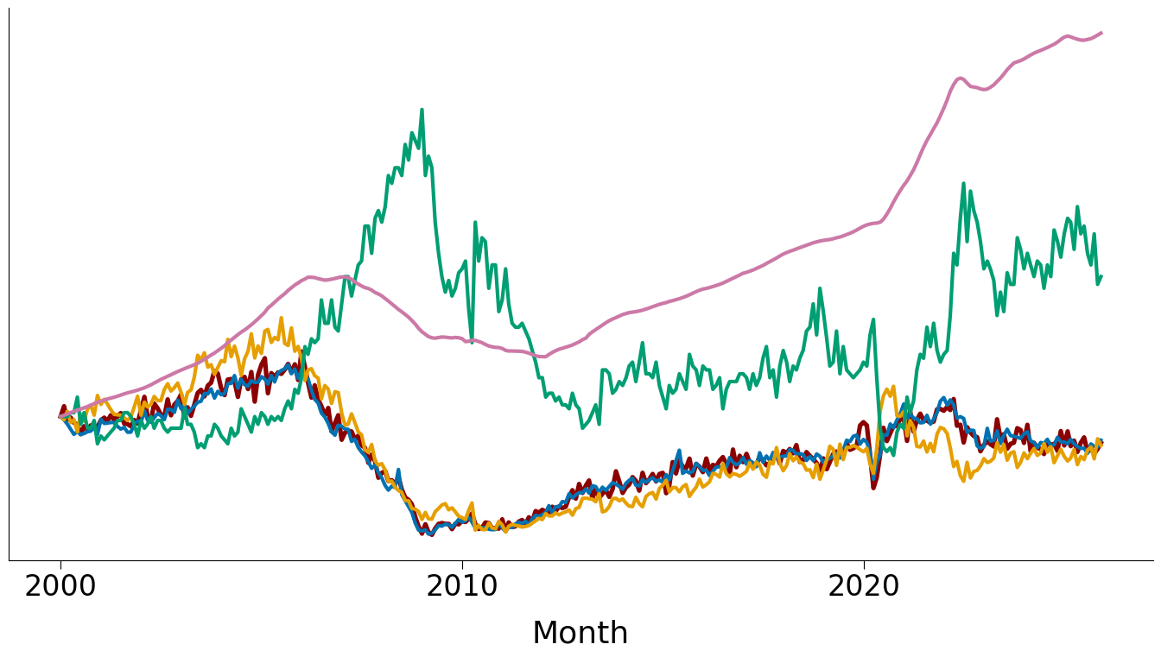
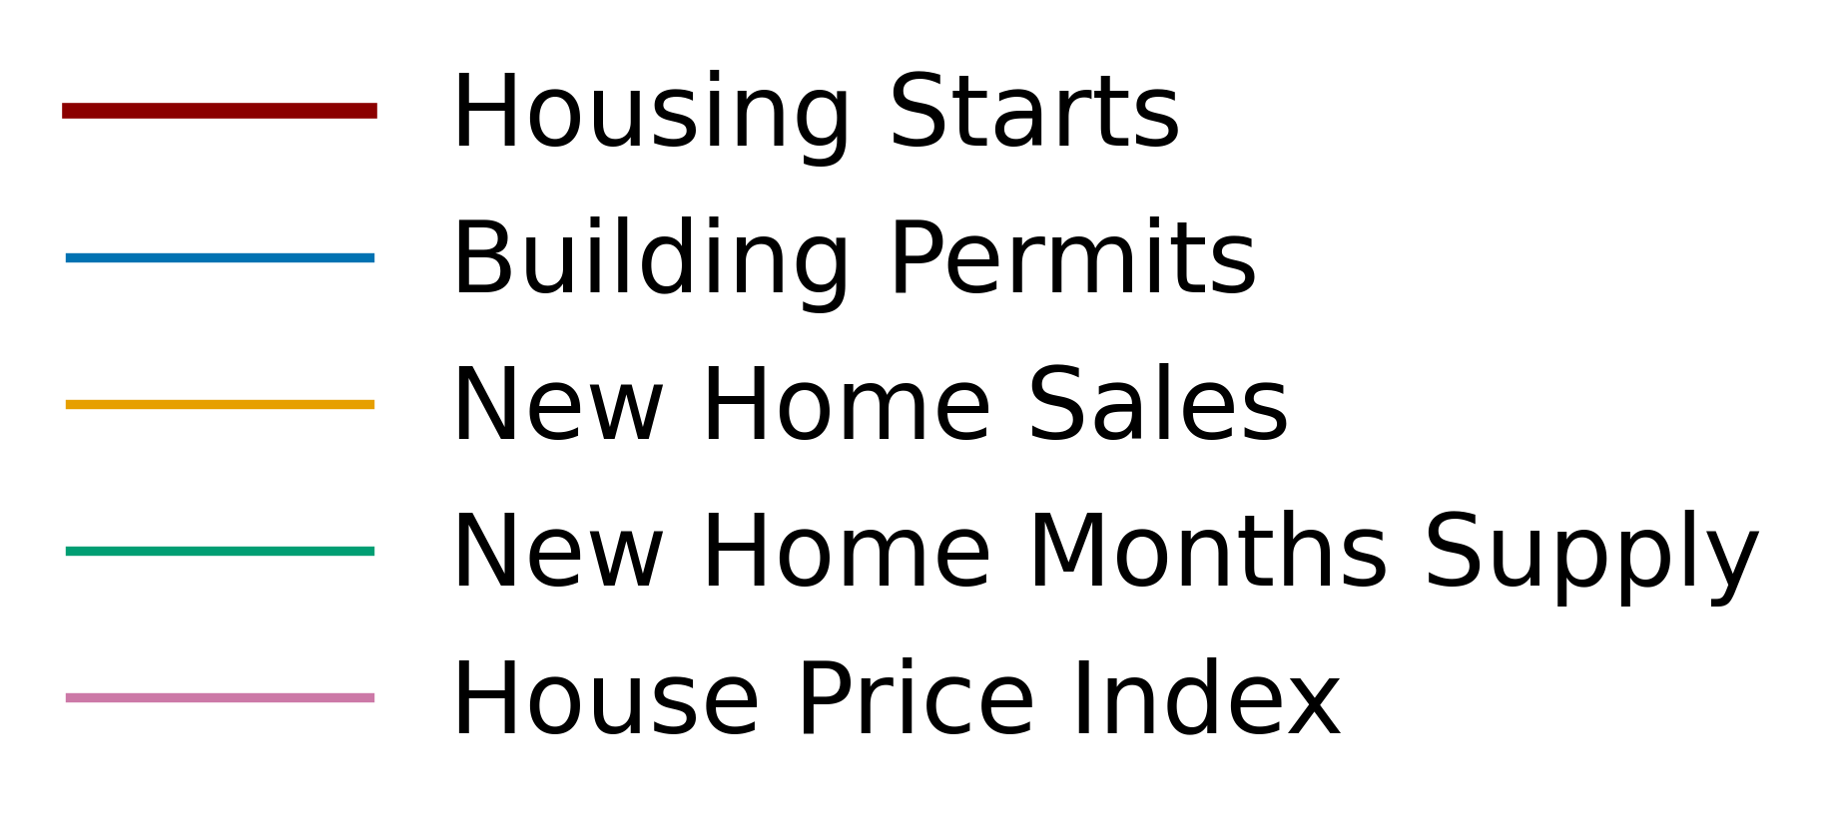
Housing starts and economic factors
Series rebased to 1 at January 2000
Starts, permits and sales are closely linked.
House prices rose while starts recovered.
Months of supply tends to move inversely with housing starts.

Slide 4
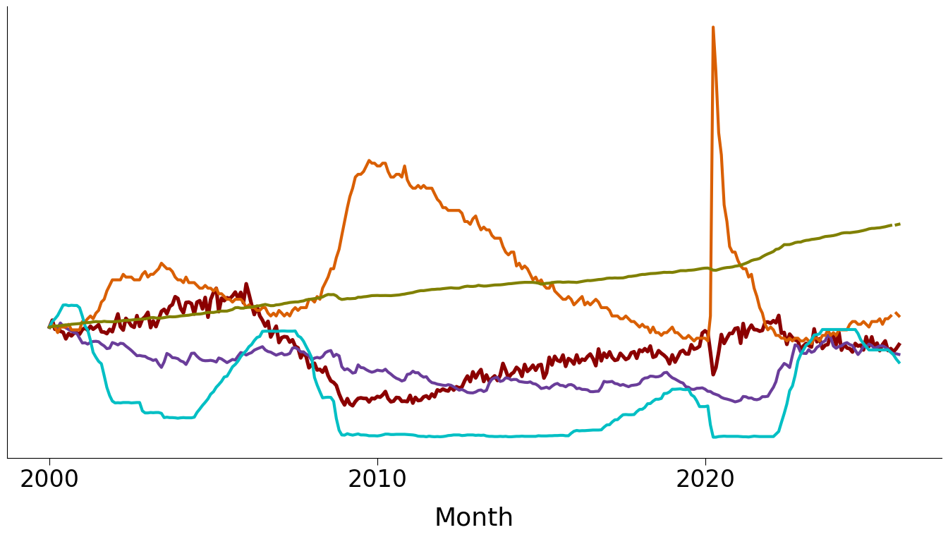
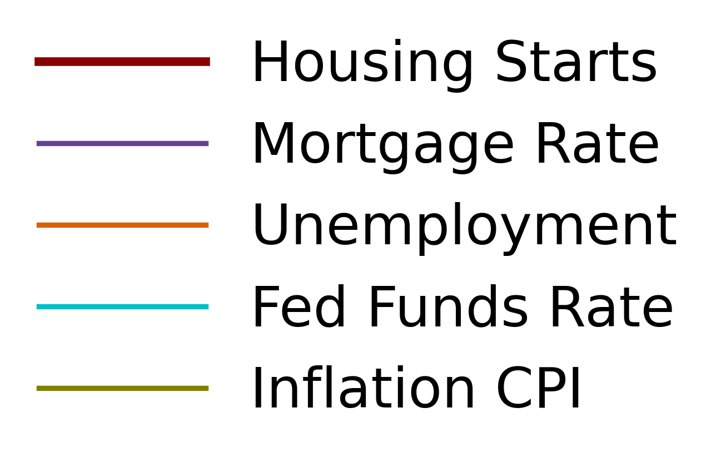
Housing starts and economic factors
Series rebased to 1 at January 2000
Unemployment often moves opposite to housing starts.
Interest-rate relationships vary over time.
The CPI level shows a different long-term pattern from housing starts.

Slide 5
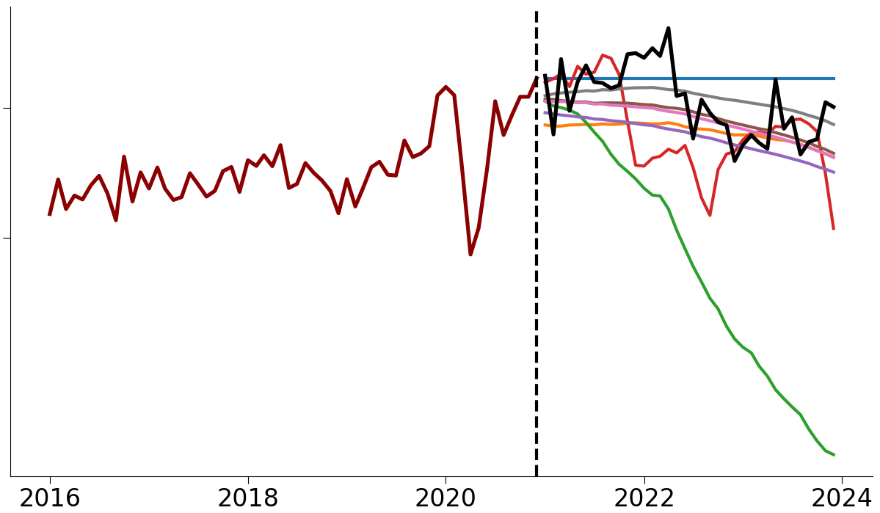
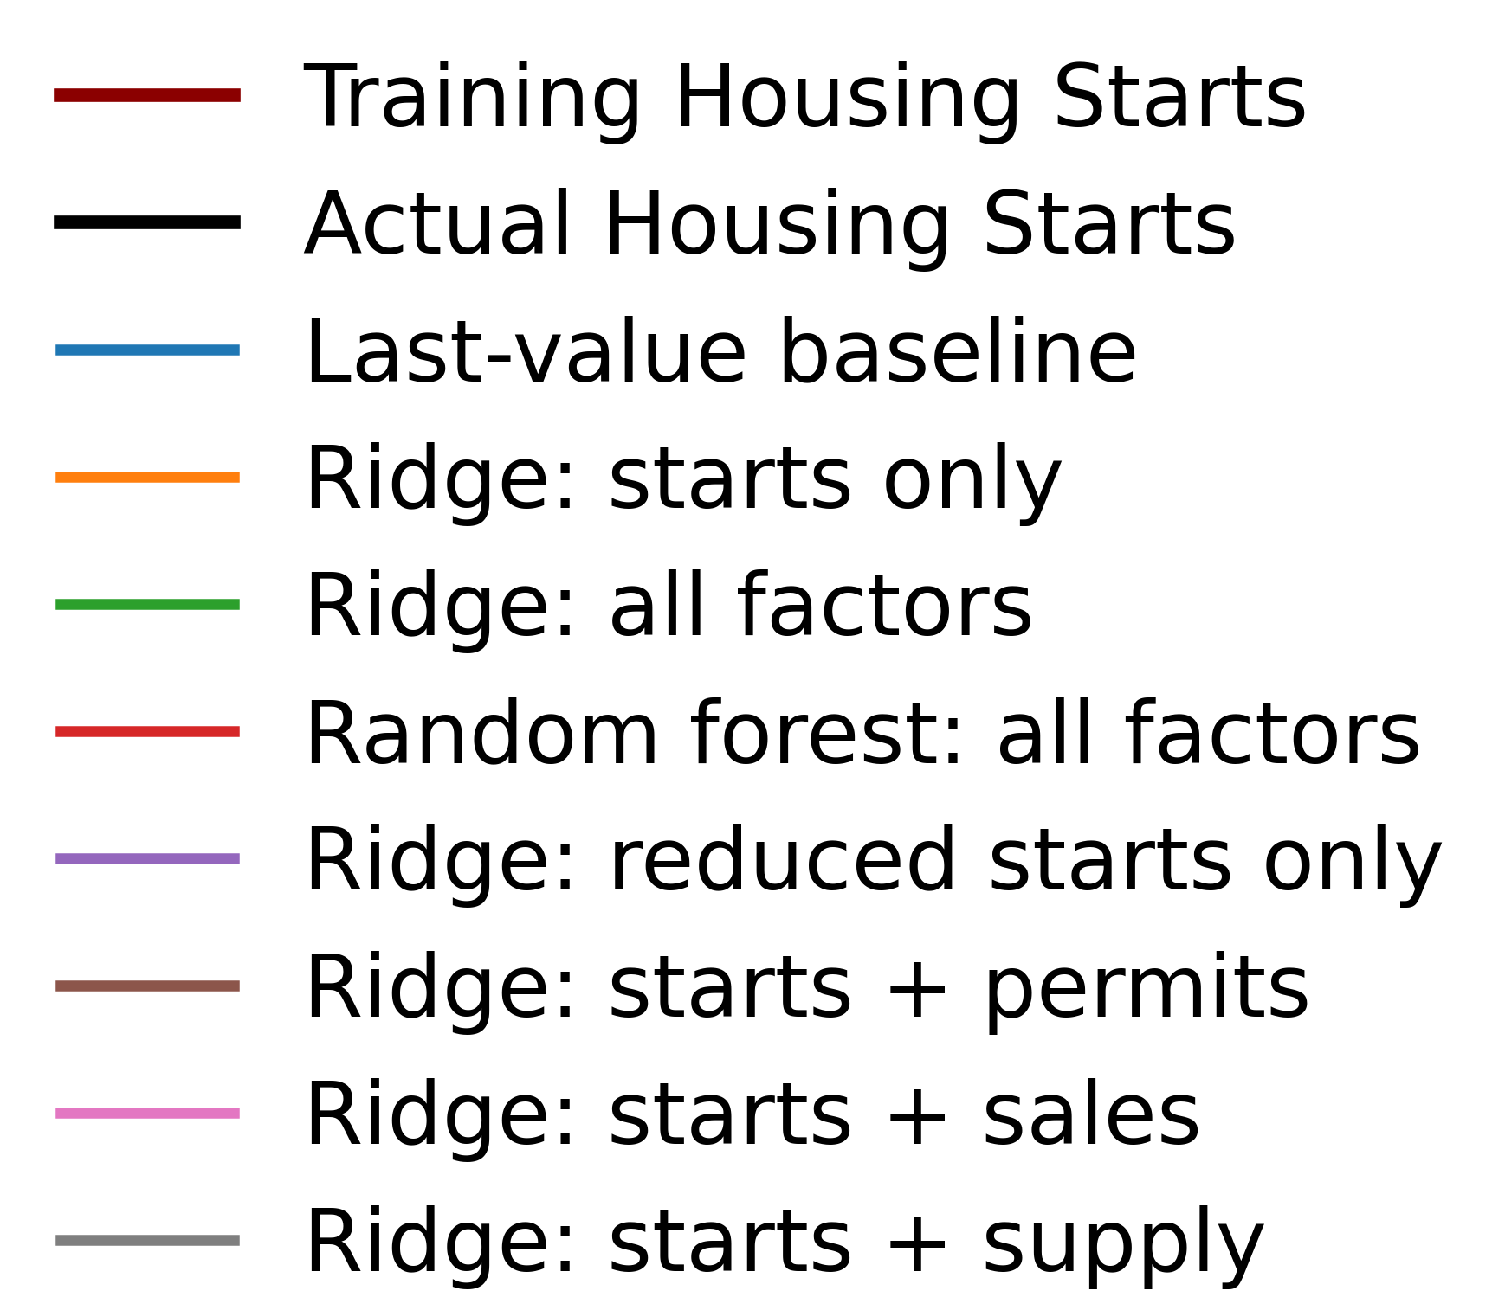
Model predictions versus observed housing starts
We compared models using different factors and lag selections, trained through Dec 2020 to predict Jan 2021 to Dec 2023.
Simple Ridge models on using selected factors and fewer lags got the best results.

Slide 6
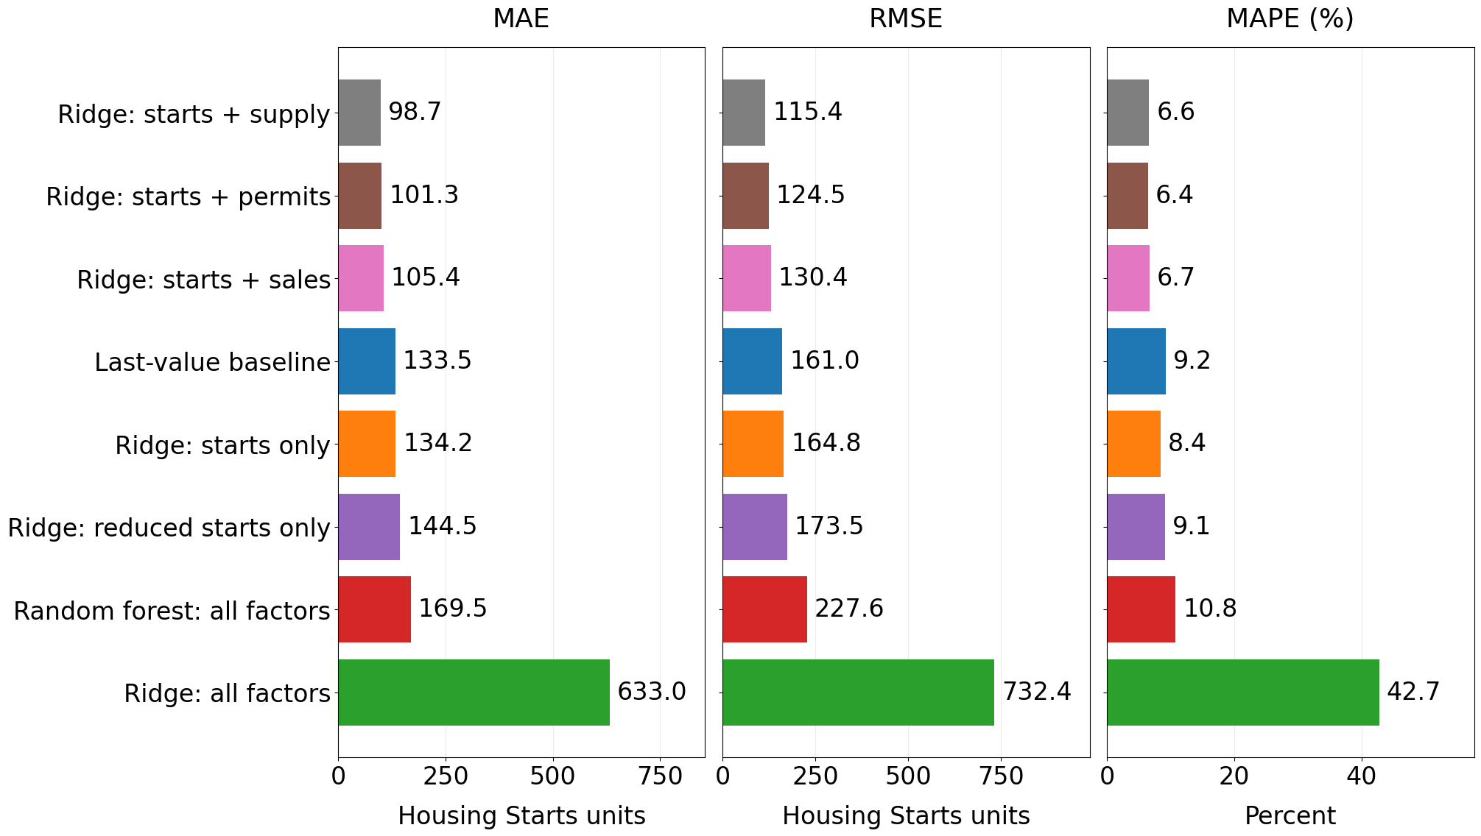
Measurements of Model Accuracy
Lower is better
Selected Ridge models beat the baseline on the 2021–2023 holdout, but improvements were inconsistent across earlier periods.
Ridge models with selected inputs performed best on the 2021–2023 holdout.

Slide 7
Caveats:
The main comparison uses one holdout period; backtests assess several earlier cutoffs. No model consistently beat the baseline across earlier periods.
Results vary by economic period. Overlapping forecasts and revised data limit confidence.
Future work:
Test shorter training windows, tune using earlier periods, and evaluate on untouched data.

