Slide 1
来看电影网
演讲者：刘畅
制作团队：Asterism
© Social Centered Selling LLC | connect. collaborate. close!
*

Slide 2
您将了解到
我们如何满足市场需求
我们的技术特点
我们用户体验方面的特色
© Social Centered Selling LLC | connect. collaborate. close!
*

Slide 3
着眼于需求
© Social Centered Selling LLC | connect. collaborate. close!
*
Notes:
59% engaged with a peer who had addressed the challenge
48% followed industry conversations on the topic
37% posted questions on social networking sites looking for suggestions/feedback
20% connected directly with potential solution providers via social networking channels
Source: DemandGen

Slide 4
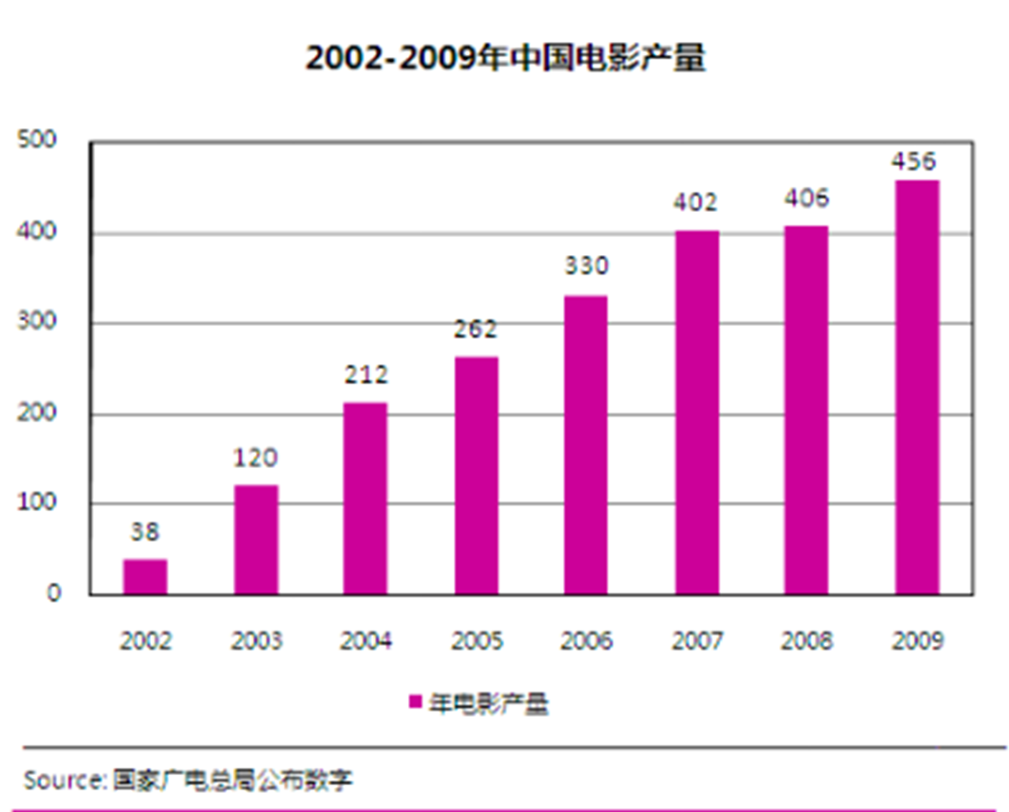
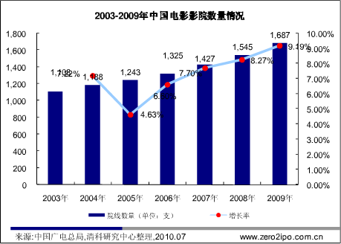
行业蓬勃发展
© Social Centered Selling LLC | connect. collaborate. close!
*

Slide 5
火柴人的电影故事
© Social Centered Selling LLC | connect. collaborate. close!
*

Slide 6
来看电影网
© Social Centered Selling LLC | connect. collaborate. close!
*

Slide 7
when
where
suitable
© Social Centered Selling LLC | connect. collaborate. close!
*

Slide 8
这还不够？！
偏好系统——量身定制信息
© Social Centered Selling LLC | connect. collaborate. close!
*

Slide 9
方便！
更贴心！！
© Social Centered Selling LLC | connect. collaborate. close!
*

Slide 10
我们的技术特色
© Social Centered Selling LLC | connect. collaborate. close!
*

Slide 11
优秀的数据库
© Social Centered Selling LLC | connect. collaborate. close!
*

Slide 12
基于第三范式、可并行输入
有效地避免更新和删除异常
有效减少数据冗余
© Social Centered Selling LLC | connect. collaborate. close!
*

Slide 13
高效的爬虫程序
© Social Centered Selling LLC | connect. collaborate. close!
*

Slide 14
可以 内，获取 的更新数据
30秒
一天
© Social Centered Selling LLC | connect. collaborate. close!
*

Slide 15
清爽的用户体验
© Social Centered Selling LLC | connect. collaborate. close!
*

Slide 16
简单、直接
© Social Centered Selling LLC | connect. collaborate. close!
*

Slide 17
演示环节
© Social Centered Selling LLC | connect. collaborate. close!
*

Slide 18
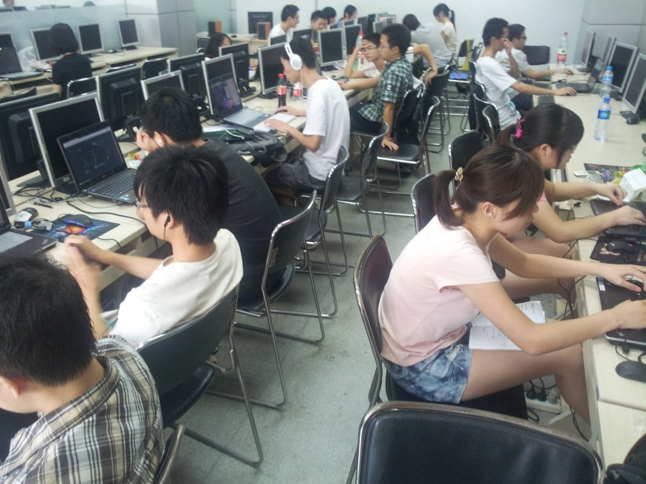
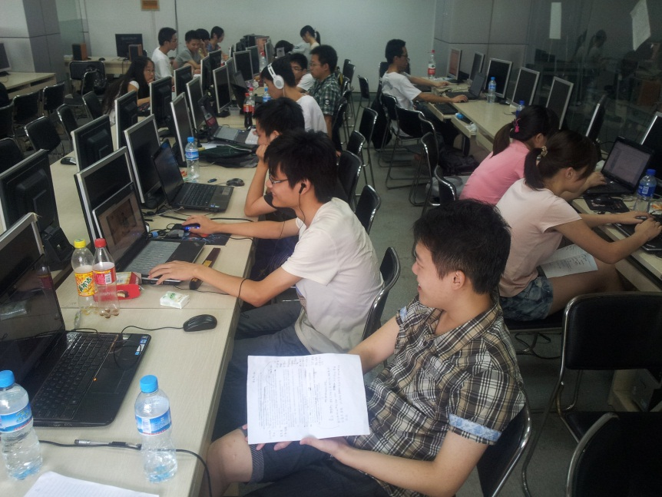
我们的团队
我们在机房的工作场景：

Slide 19
Thank You

