Slide 1
從經濟學看世界 4.1 供給與需求的推導
國立暨南國際大學
陳建良
國立暨南國際大學經濟學系
Oct. 6, 2020

Slide 2
課程大綱
供給的要義
需求的要義
市場結構與社會福利
市場機制下的效率原則
市場上的供給有無短缺或不足
市場上的買者與賣者
7.價格是如何決定的
8.需求曲線的推導
9.供給曲線的推導
10.市場均衡與失衡
11.失衡的調整
12.立法管制與市場機制
13.經濟學家與貧窮問題
14. Uber 的定價系統

Slide 3
課程主旨
如何表示一個個人的需求
如何表示整個團體的需求
如何表示一個個人的供給
如何表示整個團體的供給
供需均衡和失衡的要義何在
管制是否效率
如何追求社會最適化

Slide 4
1. 供給的要義
生產什麼，如何生產，何時生產，為誰生產 What, How, When and For Whom?
生產什麼，生產多少
用什麼技術，用什麼資源
何時生產，時間點如何掌握
為誰生產，如何分配產品與所得
Notes:
WHAT: Major market divisions: consumption goods vs. investment goods; housing, food, clothing, entertainment. Granular detail: professional sports vs. college sports vs. high school sports vs. city and private leagues vs. sports for kids.
HOW: Students sometimes have difficulty imagining technologies other than the ones in use. Some other examples:
Iced tea: 1 commercial tea bag, 3 family size tea bags, 8 individual bags, or loose tea? Sweeten the tea by adding sugar or by making a sugar syrup or corn sweeteners or by adding Equal, Splenda, or Sweet and Low? Caffeinated or decaf? Make it with hot water or cold?
Preparing the lot for a home to be built on a slab: 10 workers with 10 shovels? One worker and a Bobcat? One worker and a CAT bulldozer?
FOR WHOM: Market forces have powerful answers. They respond to people who are willing and able to buy what is offered. When Bill Gates wants something, he is likely to get it? Other forces matter, too.
Government and private charity programs can supplement incomes with food stamps, subsidized housing, subsidized transportation (Amtrak), or by protecting certain businesses from foreign competition (sugar beet farmers). Law makers and other politicians sometimes respond to requests from friends or to members of their own political party to provide them with scarce government services or contracts.
Within families, resources are shared based on perceived need.
4

Slide 5
2. 需求的要義
購買什麼，如何購買，何時購買，為誰購買 What, How, When and For Whom?
需求什麼，需求多少
用什麼資源
何時需求，時間點如何掌握
為誰需求，如何分配所購產品
Notes:
WHAT: Major market divisions: consumption goods vs. investment goods; housing, food, clothing, entertainment. Granular detail: professional sports vs. college sports vs. high school sports vs. city and private leagues vs. sports for kids.
HOW: Students sometimes have difficulty imagining technologies other than the ones in use. Some other examples:
Iced tea: 1 commercial tea bag, 3 family size tea bags, 8 individual bags, or loose tea? Sweeten the tea by adding sugar or by making a sugar syrup or corn sweeteners or by adding Equal, Splenda, or Sweet and Low? Caffeinated or decaf? Make it with hot water or cold?
Preparing the lot for a home to be built on a slab: 10 workers with 10 shovels? One worker and a Bobcat? One worker and a CAT bulldozer?
FOR WHOM: Market forces have powerful answers. They respond to people who are willing and able to buy what is offered. When Bill Gates wants something, he is likely to get it? Other forces matter, too.
Government and private charity programs can supplement incomes with food stamps, subsidized housing, subsidized transportation (Amtrak), or by protecting certain businesses from foreign competition (sugar beet farmers). Law makers and other politicians sometimes respond to requests from friends or to members of their own political party to provide them with scarce government services or contracts.
Within families, resources are shared based on perceived need.
5

Slide 6
3. 市場結構與社會福利
中央集權 Central Planning
史前農業社會，前蘇聯，北韓，中國大陸改革開放之前
國家機器或集體意志決定經濟的生產
個人在生產及消費上沒有完全自由的意志
有些特殊例子，甚至連生育子女的數目都要受到管制
自由市場 Free Market
大多數國家都是市場經濟
資本主義經濟 Capitalist economies
個人意志決定經濟行為，包含就業、生產、定價、消費、旅遊、遷移

Slide 7

林毅夫，蔡昉，李周， 中國的奇蹟：發展戰略與經濟改革， 上海三連書店，上海人民出版社，1994
過去十五年，中國的經濟改革獲得極大的成功。中國是世界上最大的國家，在歷史上經歷了由人類文明的頂峰跌入谷底的過程，並長期處於貧困落後的狀態，因而他的重新崛起引起了世界範圍的關注。
中國傳統經濟體制形成的邏輯起點是重工業優先發展戰略的選擇。在一個經濟發展初期的國家，所有的條件都未能配合，因此必須扭曲要素和產品價格，也就是完全不同於市場機制的資源配置制度。為了保證微觀經營單位的方向也合乎戰略目標的要求，所以也由工業國有化以及人民公社建立起與重工業發展相應的微觀經營機制。

Slide 8
林毅夫，蔡昉，李周， 中國的奇蹟：發展戰略與經濟改革， 上海三連書店，上海人民出版社，1994
在扭曲價格的宏觀環境下，微觀經營單位缺乏客觀評價經營績效的標準，因此不能給微觀經營單位以經營自主權。因此，在外生的重工業優先發展戰略選擇下，產生：
扭曲的宏觀政策環境
資源計畫配置制度
沒有自主權的微觀經營機制
三位一體的制度是內生的。因為缺乏激勵機制，效率低下，以及扭曲的經濟結構，造成經濟增長緩慢，傳統經濟體制並未實踐趕超的使命。

Slide 9
林毅夫，蔡昉，李周， 中國的奇蹟：發展戰略與經濟改革， 上海三連書店，上海人民出版社，1994
始於七0年代末的中國經濟改革，是微觀經營環境上的放權讓利的開始。
在國有企業與農村的開放中，受壓抑部門的部門發展了勞動力密集的產業，矯正了扭曲的產業結構和發展資源比較優勢的效應，帶來了中國經濟的巨大增長
自80年代以來一直保持10%左右的平均成長速度的世界奇蹟

Slide 10
4. 市場機制下的效率原則 Market mechanism leads to efficiency principle
市場機制 (market mechanism) 等同於價格機制 (price mechanism)
價格是引導資源配置的信號 (signal)
如果價量彼此相關，為何價格是信號但數量不是？
因為價格隨處可見 (observable)，但是數量未必可見 (unobservable)
供給和需求來自不同的力量主導，前者來自供給者，後者來自需求者
當供給和需求雙方達於均衡時，社會就達到最效率境界
透過市場機制可以追求社會福利最大：效率原則
回顧第一章的決策準則：MB = MC，保證經濟剩餘加總的最大化

Slide 11
史記貨殖列傳第六十九
太史公寫史記，漢武帝太初年間 (104-101 BC)
人各任其能，竭其力，以得所欲。
故物賤之徵貴，貴之徵賤，各勸其業，樂其事，若水之趨下，日夜無休時
不召而自來，不求而民出之
豈非道之所符，而自然之驗邪？
充分反映當今市場經濟現象，和二千多年前並無二致

Slide 12
5. 市場上的供給有無短缺或不足？
臺灣有 2,300 萬人口
供應這些人每日所需的食、衣、住、行、育、樂，有無不足？
遊覽車的供應在旺季時可能不足
自由市場背後有一股很大的力量主導
主導者是政府嗎？還是市場自己
市場是誰？
是無數個個人和企業所構成
看不見的手原則 (invisible hand principle)
政府管制遊覽車的牌照
政府管制數量之後，就可能造成供需失衡

Slide 13
6. 市場的構成：買者與賣者 Buyers and Sellers in the Market
買者和賣者雙方的動機不同
買者要從所購買的財貨取得效益
賣者要從所出售的財貨獲取利潤
買賣雙方在市場碰面
買賣雙方共同決定財貨的交易
價格平衡供需雙方力量
價格對於供需雙方有不同的意義
對買者而言，價格是效益
對賣者而言，價格是成本
回顧第一章的保留價格概念，效益面是買者願意出的最高價，成本面是賣者願意接受的最低價
Notes:
Students sometimes confuse the motivations of buyers with the motivations of sellers. Try dividing the class in two and assign the role of buyer or seller to each half, then get them to answer questions from that perspective.
Buyers want only to buy goods and services that satisfy their wants. While they are responsive to prices, they do not care about what it costs to produce a good or service. They do not care about whether the seller makes a profit. They care only for their own benefit.
Buyers respond to prices, to information about their choices (smoking is bad for you), to their preferences (iPod vs. other MP3 players), to income, to prices of alternatives, prices of complements, and to their expectations about the future (future income, future prices, etc.)
Buyers do not respond to changes in the wages paid to workers who produce the product or to the cost of other inputs.
Sellers focus on profit. In the basic model for this course, there is no consideration of multi-period optimization or other objectives beyond single period profit maximization. Sellers are motivated by the profit motive to find the least-cost way to produce their products, choosing among alternative technologies and inputs available.
This is a good time to discuss the need to clearly define the market under discussion. If we are considering the market for Coca Cola, then Pepsi is a substitute, but if we are considering soft drinks, then we are talking about Coke and Pepsi and juice and water all at the same time.
13

Slide 14
6. 市場的構成：買者與賣者 Buyers and Sellers in the Market
任一財貨或勞務的市場，皆由買者與賣者構成
其中包含可能或確實的買者
也包含可能或確實的賣者
來市場的人，不管是買者或賣者，不是每個人都會在每個項目上進行買 (賣) 的行為
他們心中都有保留價格，端視保留價格和他們所看到的賣者或買者的出 (售) 價比較，才會決定是否交易

Slide 15
6. 市場的構成：買者與賣者 Buyers and Sellers in the Market
買者和賣者如何溝通？
透過市場，市場機制決定供給和需求雙方對於數量和品質的要求與配置
為何有些市場均衡結清，有些市場不均衡
政府管制造成財貨勞務配置不均衡

Slide 16
7. 價格是如何決定的
財貨和勞務的價格，是如何決定的？
為何有些東西貴，有些東西便宜
每個人的認知都不同，貴賤與否，和每個人心中的保留價格有關
所以，同樣的東西，有些人覺得貴，有些人覺得便宜
價格取決於兩個因素：
生產成本：
高級貨或廉價品，一分錢一分貨
主觀價值：
黃金或鑽石，古董或名畫

Slide 17


一杯水和一顆鑽戒，哪一個比較值錢？
從生產成本和主觀價值來比較，兩者有何差異
在都市中，兩者的主觀價值如何？市場價值如何？
在沙漠中，兩者的主觀價值如何？市場價值如何？

Slide 18
8. 需求曲線的推導 Demand Curve
需求是價量之間的負向關係
直接的理由是邊際報酬遞減
需求者的保留價格，是願意支付購買某一數量的最高價格
Buyers value goods differently. The buyer’s reservation price is the highest price an individual is willing to pay for a good
數量愈大，願意支付的邊際保留價格愈低
所以，下一個單位的價格要下降，才會持續買；價格上升買不起，就會減少購買
價格上漲帶來兩個效果
替代效果 (substitution effect)：價格變貴就買其他便宜的產品來替代
所得效果 (income effect)：價格變貴後整體購買力 (purchasing power) 下降，因此買得少

Slide 19
購買力的概念：實質與名目 Real vs. Nominal
購買力 (Purchasing power) 的概念
名目所得
以貨幣表示的所得絕對值
實質所得
相對於某一價格水準的所得
實質購買力
不同時期的所得水準高低，不必然表示購買力高低，必需考慮各時期的物價水準才公平
就如同不同國家的所得水準，受到各國幣值兌換美元匯率的影響

Slide 20
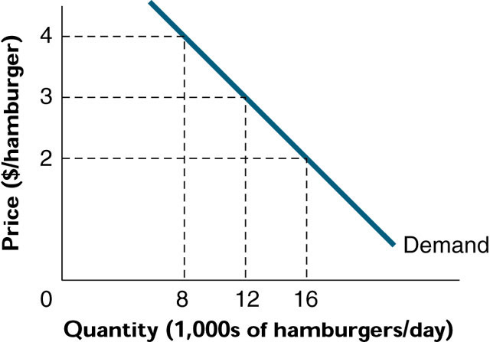
圖 4.1 麵包的需求曲線

Slide 21
8. 需求曲線的推導 Demand Curve
一個人的需求線和整個市場的需求線形狀很類似
假設每個人都一樣，整個市場的曲線就乘以人數
從垂直的觀點來看，是這個數量下的 (保留) 價格是多少
從水平的觀點來看，是這個價格下的需求數量有多少

Slide 22
9. 供給曲線的推導 Supply Curve
供給線是每個價格下，生產者願意提供的數量，價量關係是正向的
生產數量的多寡和機會成本 (其實就是生產成本，因為放棄的最佳選擇) 有關
某一財貨的價格愈高，超過生產此財貨的機會成本也愈高，供給量愈大；低果先摘原則
機會成本不同
技術 成本
技能 預期
價格愈高，廠商願意摘下來賣的果子也愈高愈難摘
Notes:
This slide introduces the sellers' side of the market.
If the supplier can cover the opportunity cost of his product, he will continue to increase the level of output. Production for a supplier stops when the market price is equal to the opportunity cost of production. Producing more educes profit.
Different producers have different costs
Plant size and automation may lower costs for some producers
Experienced workers and skilled management can be a source of lower costs
An innovation in production such as lights-out manufacturing can lower costs
Lights-out manufacturing is the operation of a factory without human management on location. Systems are alarmed and can page a technician if a problem occurs. Since systems are on-line, the technician first attempts to correct the fault from his home PC.
The metal cutters on a dental floss container are one of the products made with lights-out.
Regional differences in wages or rent can give producers in those regions a cost advantage
The supply curve has a positive slope because the lowest cost producers enter the market first. To get more of the good, we add less productive firms and we may expand the efficient firms into an area where their costs increase.
22

Slide 23
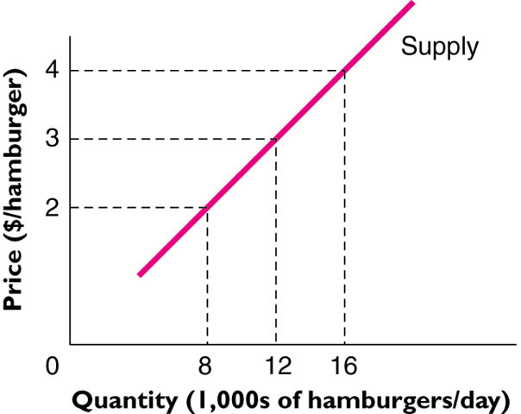
圖4.2 麵包的每日供應量—低果先摘法則

Slide 24
9. 供給曲線的推導 Supply Curve
低果先摘原則
The Low-Hanging Fruit Principle explains the upward sloping supply curve
The seller’s reservation price is the lowest price the seller would be willing to sell for. Equal to marginal cost
一個人的供給線和整個市場的供給線形狀很類似
假設每個人都一樣，整個市場的曲線就乘以人數
從垂直的觀點來看，是這個數量下的出售 (保留) 價格是多少
從水平的觀點來看，是這個價格下的供給數量有多少
從生產可能線和價格線可以推導出供給線

Slide 25
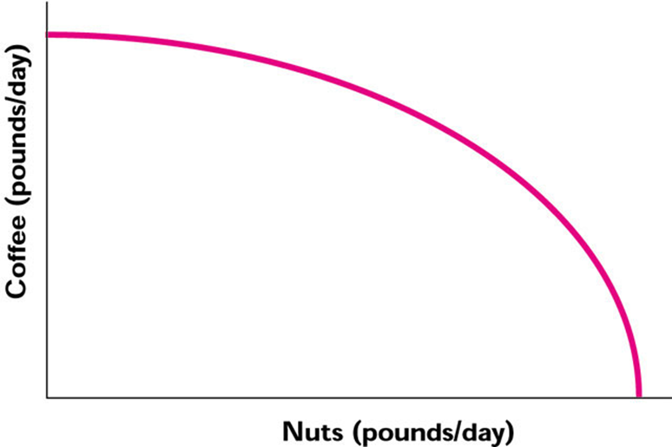
從生產可能線和價格線推導供給線

Slide 26
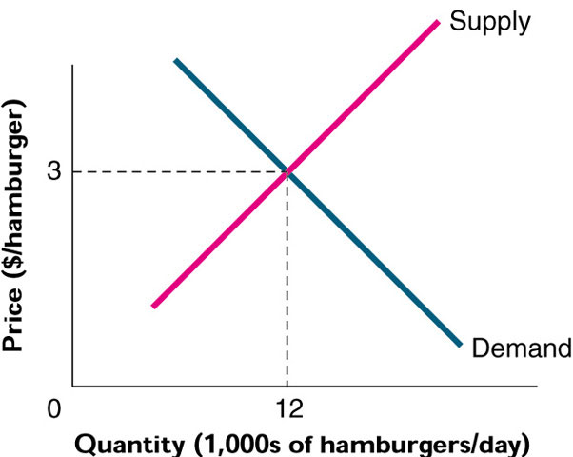
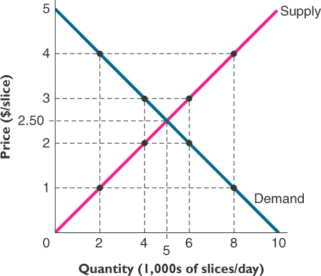
10. 市場均衡與失衡 Market Equilibrium and Disequilibrium
當買方與賣方都滿意於市場的價格與數量時
穩定均衡，表示若無其他外力，均衡點會一直存在
供給線與需求線的相交點
均衡價格：均衡點之下供需雙方合意的價格
均衡數量：均衡點之下供需雙方合意的數量

Slide 27
10. 市場均衡與失衡 Market Equilibrium and Disequilibrium
當價格沒有停在供需線的交叉點時，就是供需的失衡
超額供給
價格高於均衡價格，造成賣方剩餘
賣方不滿足
供過於求
超額需求
價格低於均衡價格，造成買方短缺
買方不滿足
供不應求

Slide 28
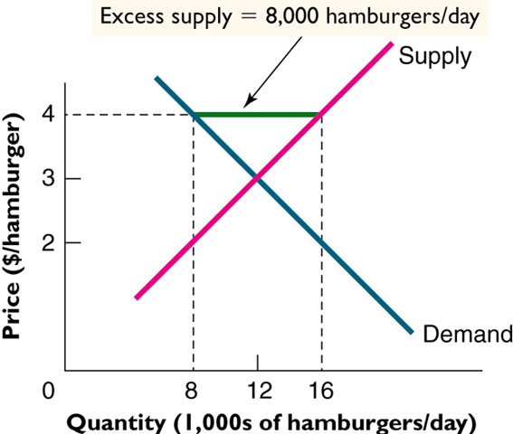
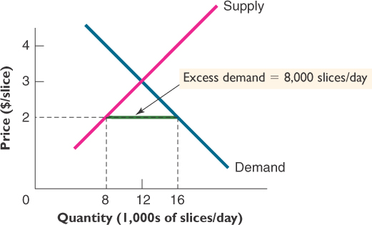
超額供給 v.s. 超額需求

Slide 29
11. 失衡的調整
超額供給的調整
供過於求，穀賤傷農，價格下降，需求增加，供給減少
超額需求的調整
供不應求，穀貴傷民，價格上升，需求減少，供給增加
藉由價格的調整，趨向供需均衡
有哪些財貨的超額需求與供給是短時間內均衡的？
外匯、股票、蔬菜、書本、雜貨

Slide 30
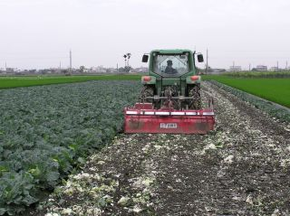
耕鋤保價機制奏效 產地菜價止跌稍回穩 (中廣新聞 2008.04.01)

Slide 31
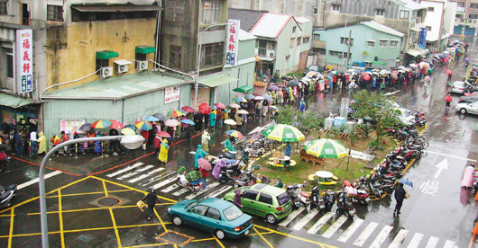
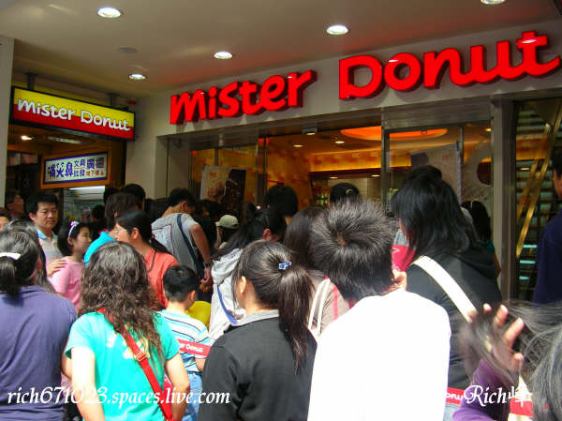
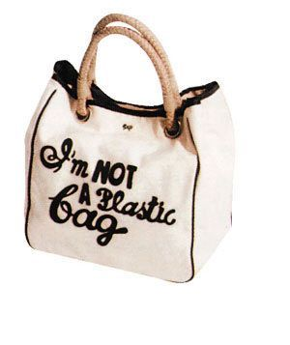
這些財貨都供不應求，也就是有超額需求
超額需求如何反映在價格上?

Slide 32
12. 立法管制與市場機制 Legislation and Market Mechanism
市場均衡並不代表每個人的慾望得以滿足
市場上有可能的買者和賣者
沒有達成交易的人，可能是保留價格不合乎市場均衡價格
出價太低 (預算受限)，無法購買；售價太高 (成本受限)，無法賣出

Slide 33
12. 立法管制與市場機制 Legislation and Market Mechanism
政府因此可能透過立法管制價格
價格上限 (price ceiling) 政策保護消費者
最高價格由法律制訂
價格太低，消費者需求過多
例如油電水價格凍漲，國外有房租管制
結果是過度消費或是短缺，造成不效率
價格下限 (price floor) 政策保護生產者
最低價格由法律制訂
價格太高，生產者生產過多
例如最低工資、農產品保證收購價格
結果是過度生產，造成不效率

Slide 34
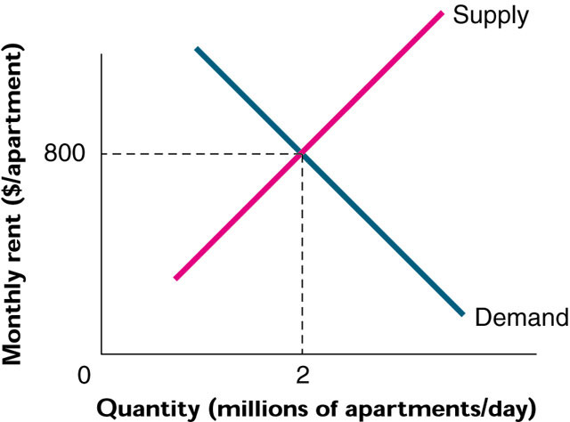
12. 立法管制與市場機制 Legislation and Market Mechanism

Slide 35
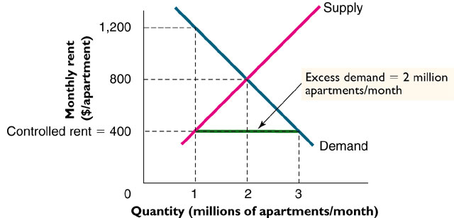
12. 立法管制與市場機制 Legislation and Market Mechanism

Slide 36
13. 經濟學家與貧窮問題 Economists and the Poverty Problem
經濟學家不傾向於用干預市場經濟的方式來解決貧窮問題
直言之，價格管制通常是不效率的
政府管制汽油、水、電價格是不效率的
管制帶來的不效率如何衡量？
社會最適數量就是追求最大的經濟剩餘
MB = MC 效率的準則，第一章圖形，經濟剩餘三角形加總最大
只有一個生產點（消費點）是明智的，其他都是不智的 “Smart for one Dumb for all”
只有在這一點上消費者和生產者經濟剩餘加總最大
從社會觀點來看，經濟效率是社會最適

Slide 37
油價若升破120-130美元 政府將補貼 【聯合報╱記者李明賢、朱婉寧／台北報導】2011.03.06
吳揆明確表示，從過去經驗來看，凍漲油價比較不健康，政府會有自己的作法。
吳揆表示，民進黨在二○○八年大選前凍漲，當時凍漲讓國庫虧損新台幣一千多億元，結果造成大家拿桶子買油，痛苦仍記憶猶新
所以，「我們對凍漲不輕易考量」

Slide 38
13. 經濟學家與貧窮問題 Economists and the Poverty Problem
效率原則 (Efficiency Principle)
追求效率是重要的社會目標 (social goal)
首要目標是創造更大的派，讓每個人可能分到的份額增加
均衡原則 (Equilibrium Principle)
達到均衡的市場，沒有尚未開發的機會或利益
還是依循 MB = MC 的原則，隱含個人最適化就是社會最適化
桌上沒有現金 (No “cash on the table” remains)
任何有利可圖的機會都被開發了
此前都沒有提到分配的問題
效率是第一考量，分配是次要問題

Slide 39
Why Uber's surge pricing is good for you, according to Uber
Study from ride-sharing app's economists claims to show how getting rid of surge pricing would be a disaster
By James Titcomb,18 Sep 2015
Uber's surge pricing is set using basic supply and demand (although reports have claimed it isn't this simple):
At busy periods (high demand), or when for whatever reason there aren't many drivers around (low supply), Uber's prices go up.

Slide 40
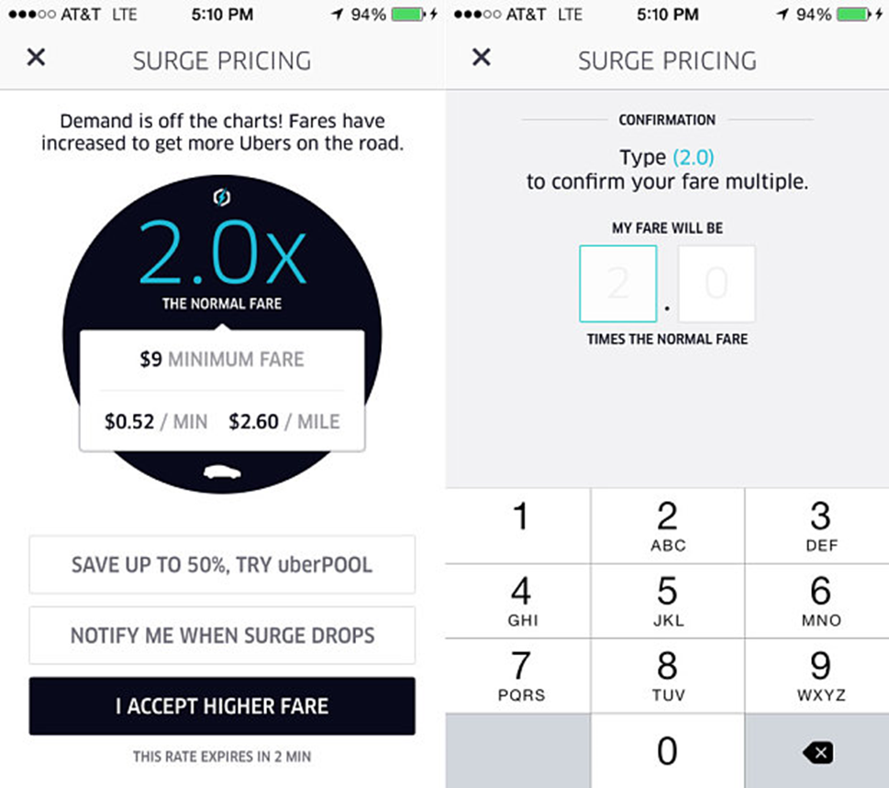
Surge pricing

Slide 41
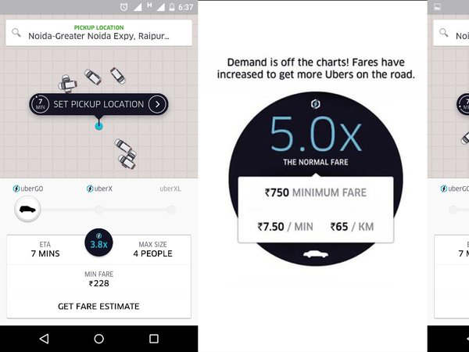
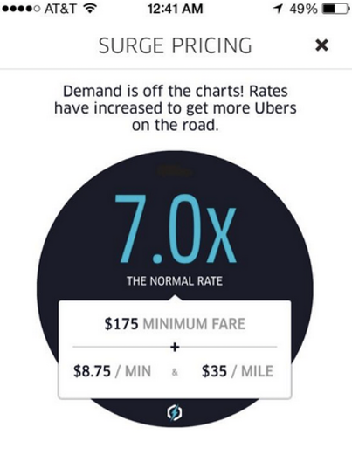
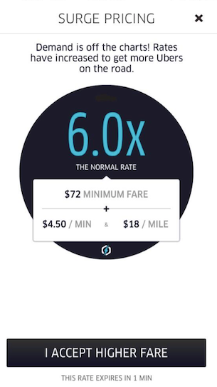

Slide 42
What happens when prices surge
The study cites an concert in New York's Madison Square Garden from the popstar Ariana Grande on March 21, 2015 for one example of how surge pricing works.
When the concert ended, there was a flood of people opening their Uber app - those considering using it to get home.
When this happened, surge pricing kicked in, going up to around 1.8 times Uber's base fare.
This meant it became more lucrative to be an Uber driver, and more drivers subsequently came on the road.

Slide 43
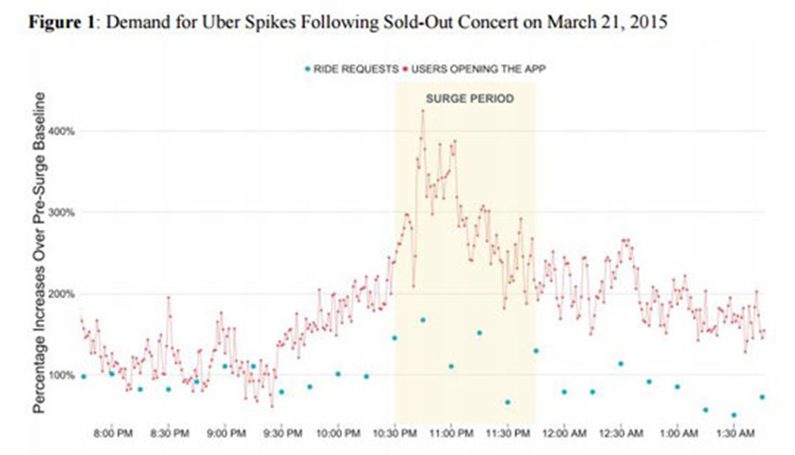

Slide 44
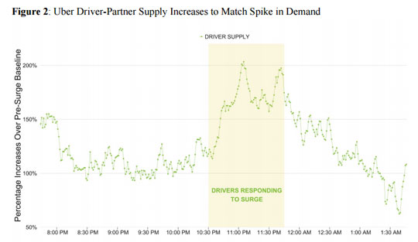

Slide 46
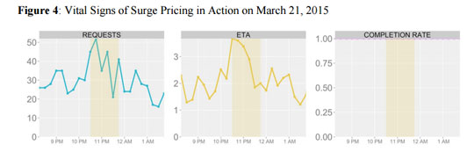
"All of the riders who decided that they were willing to pay the surge price and thus effectively signaled that
they had a value for Uber services in that particular moment were able to get a ride.
Others had the option of waiting until the surge multiplier fell,"

Slide 48
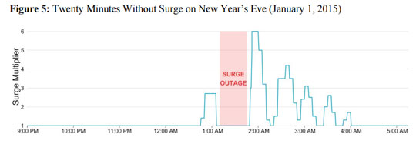
What happens without surge pricing
The researchers compared this to an incident when a glitch in Uber's software meant surge pricing broke down for 26 minutes on possibly the busiest time of the year - New Year's Eve 2014.

Slide 49
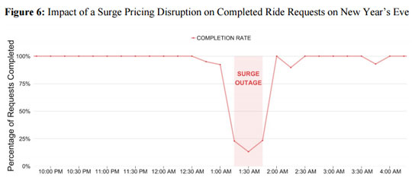

Slide 50
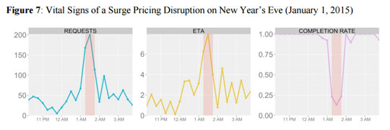
"Without surge pricing, Uber is not really Uber -- you can’t push a button and get a ride in minutes," Uber said.
Most economists agree that surge pricing is a good thing, with 80 per cent saying it raises consumer welfare according to one report.

Slide 51
How to feature Uber’s pricing strategy in a supply-demand framework?
Movement vs. shift of Supply and demand curves

Slide 52
Chapter 3 Appendix
The Algebra of Supply and Demand

Slide 53
From Graphs to Equations …
Sample equations
P = 16 – 2 Q^{d}
is a straight-line demand curve with intercept 16 on the vertical (P) axis and a slope of – 2
P = 4 + 4 Q^{s}
is a straight-line supply curve with intercept 4 and a slope of 4

Slide 54
… To Equilibrium P and Q
Equilibrium is where P and Q are the same for demand and supply
Set the two equations equal to each other (P = P) and solve for Q (Q^{s} = Q^{d} = Q*)
16 – 2 Q* = 4 + 4 Q*
6 Q* = 12
Q* = 2
Use either the supply or demand curve and Q* = 2 to find price
P = 16 – 2 Q*
P = 16 – 2 (2)
P = $12

Slide 55
討論主題
需求曲線反映邊際效益遞減法則，有無違背的例子
供給曲線反映邊際成本遞增法則，有無違背的例子
供需均衡一定存在嗎？自然或人為的？
供需失衡時，調整的速度與方向何在？
供需均衡一定帶來個人和社會最適化的同時達成嗎？

Slide 56
今日課堂複習 供給與需求的互動
供給的要義
需求的要義
市場結構與社會福利
市場機制下的效率原則
市場上的供給有無短缺或不足
市場上的買者與賣者
7.價格是如何決定的
8.需求曲線的推導
9.供給曲線的推導
10.市場均衡與失衡
11.失衡的調整
12.立法管制與市場機制
13.經濟學家與貧窮問題
14. Uber 的定價系統

