Slide 1
【HW2】Custom Layers
108321033 吳明騰
108321037 林峻葆

Slide 2
Code
from mxnet import np, npx
from mxnet.gluon import nn
npx.set_np()
class MyDense(nn.Block):
def __init__(self, units, in_units, **kwargs):
super().__init__(**kwargs)
self.weight = self.params.get('weight', shape=(in_units, units))
self.bias = self.params.get('bias', shape=(units,))
def forward(self, x):
linear = np.dot(
x, self.weight.data(ctx=x.ctx)) + self.bias.data(ctx=x.ctx)
return npx.relu(linear)
r = 2
c = 5
X1 = np.random.uniform(size=(r,c))
X2 = np.random.uniform(size=(r,c))
X3 = np.random.uniform(size=(r,c))
# Xi * Xj
for i in range(len(X1)):
for j in range(len(X1[0])):
X3[i][j] = X1[i][j] * X2[i][j]
print("Input:")
for i in X3:
print(i)
print("\n")
net = nn.Sequential()
net.add(MyDense(units= 3, in_units=c))
net.add(MyDense(units= 5, in_units=3))
print("Output:")
net.initialize()
net(X3)

Slide 3
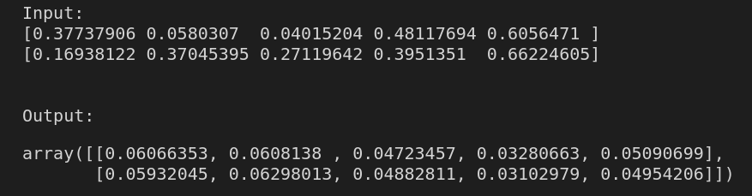
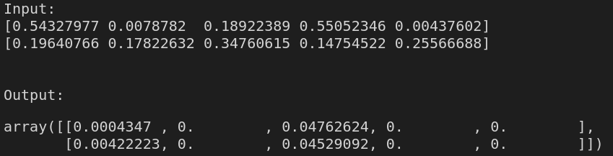
Input & Output 1

Slide 4
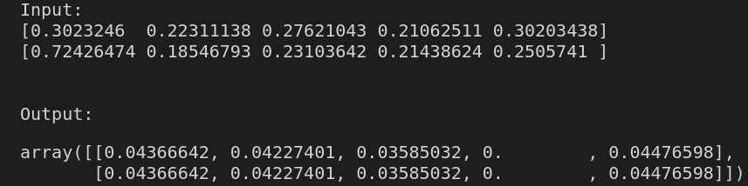
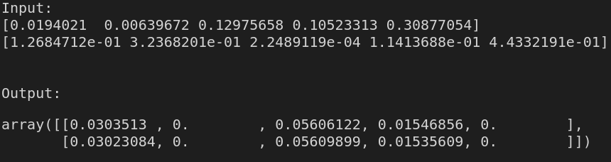
Input & Output 2

Slide 5
心得
我們利用X1和X2 每個數字相乘得到X3，在拿去做訓練，得到output，相乘的方式是用兩個for迴圈，效率不好，之後會考慮使用矩陣相乘的方式做改進。

