Slide 1
SSD vs YOLO
using convolution rather then fully connected
many kinds of anchor box
tested by CNN

Slide 2
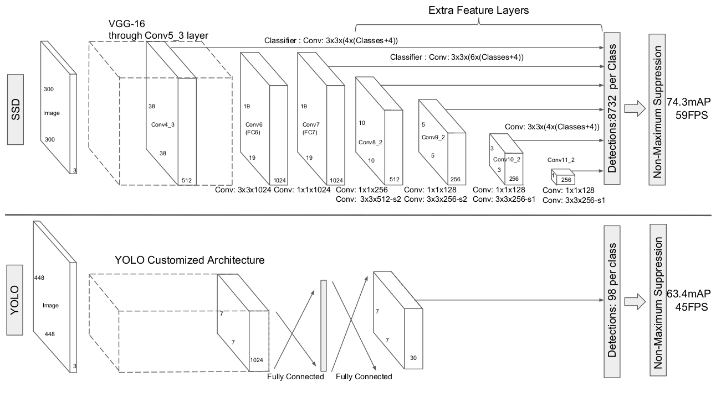

Slide 3
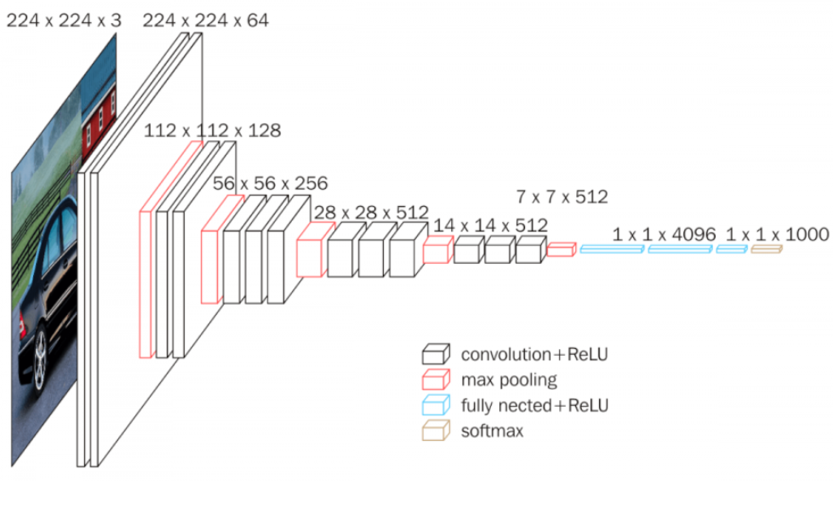
VGG 16 Architecture

Slide 4
VGG 16
Input 300*300*3
Conv1-2:kernel=3*3*3*64,padding=2,stride=1 &
Max Polling: kernel=2*2 stride=2 ->Output: 150*150*64
Cov2-3: using the same->Output: 75*75*128
Cov3-4: using the same->Output: 38*38*256
Cov4-5: using the same->Output: 19*19*512

Slide 5
Why using convolution rather than fully connected

Slide 6
How to find fixed-size bounding boxes
using Multi-scale feature maps for detection to produce either a score for a category, or a shape offset relative to the default box coordinates.

Slide 7
Anchor box
y=[p,bx,by,bw,bh,c1,c2,……..,cn]
n: class of object including background
bx, by: central point of anchor
bw, bh: the height and width of anchor
c1, c2, ……,cn: the confidence of object

Slide 8
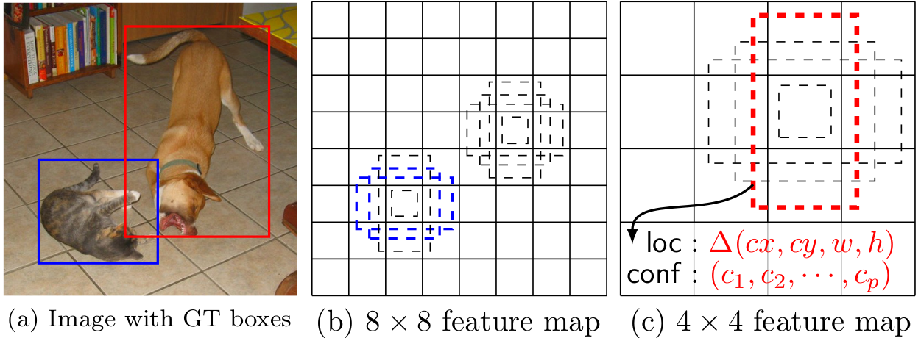
Feature map
Y = [1,bx,by,bw,bh,1,0,0,0,0,0] is for dog
Big feature map for small object.
Small feature map for big object

Slide 9

Feature map
The scale of the default boxes for each feature map is computed as:
m: the number of feature map
s=0.2 & s=0.9, meaning the lowest layer has a scale of 0.2 and the highest layer has a scale of 0.9

Slide 10
The length & width
We impose different aspect ratios for the default boxes, and denote them as ar ∈{1,2,3,12,13 }.

Slide 11
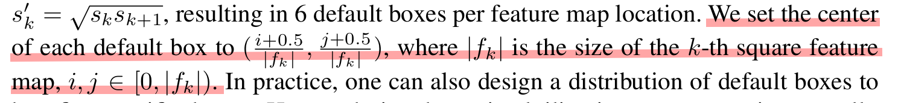
The center of anchor
If feature map on (I, j), the center of anchor is (i+0.5, j+0.5)

