Slide 1
[HW5] 9.2.5 第3題
108321033 吳明騰
108321037 林峻葆

Slide 2
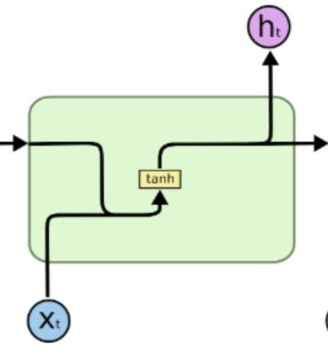
Recurrent Neural Network (RNN)

Slide 3
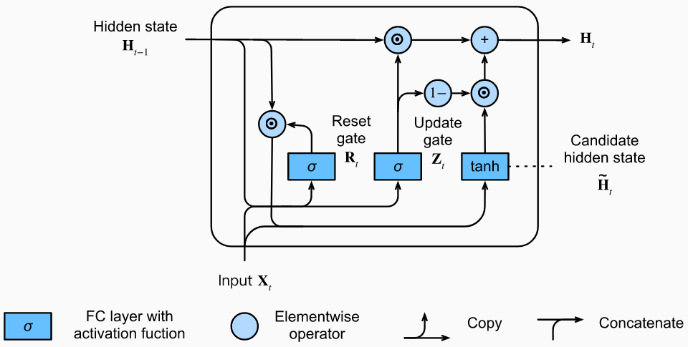
Gated Recurrent Units (GRU)

Slide 4
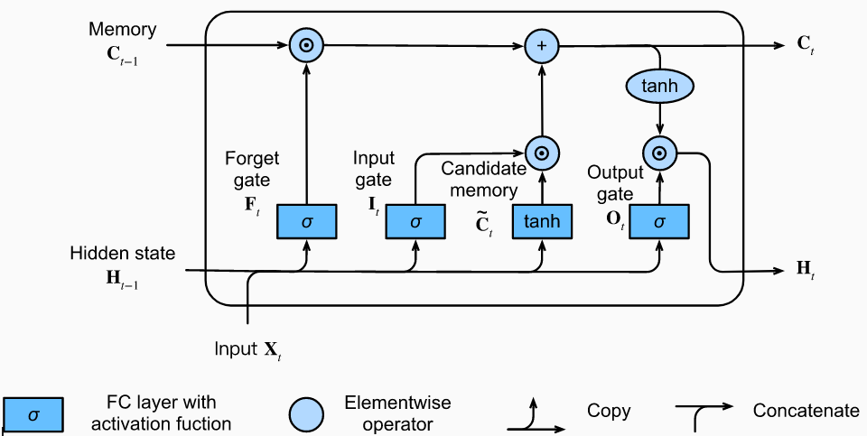
Long Short-Term Memory (LSTM)

Slide 5
Compare the computational cost for GRUs, LSTMs, RNNs
2 layers of 10 hidden states
RNN: 10 ^ 10 = 100
GRU: 10 * 3 + 10 ^ 10 * 5 = 530
LSTM: 10 * 5 + 10 ^ 10 * 4 = 450

