Slide 1
【HW1】Multilayer Perceptrons
108321033 吳明騰
108321037 林峻葆

Slide 2
No dropout
3 hidden layers

Slide 3
Code
from mxnet import gluon, init, npx
from mxnet.gluon import nn
from d2l import mxnet as d2l
npx.set_np()
dropout = 0.5
batch_size = 256
train_iter, test_iter = d2l.load_data_fashion_mnist(batch_size)
net = nn.Sequential()
for add_layer in range(3):
net.add(nn.Dense(256, activation='relu'))
net.add(nn.Dense(10))
net.initialize(init.Normal(sigma=0.01))
loss = gluon.loss.SoftmaxCrossEntropyLoss()
trainer = gluon.Trainer(net.collect_params(), 'sgd', {'learning_rate': 0.1})
num_epochs = 50
d2l.train_ch3(net, train_iter, test_iter, loss, num_epochs, trainer)

Slide 4
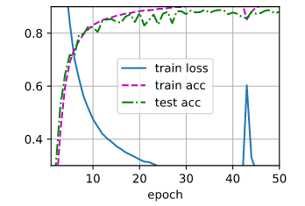
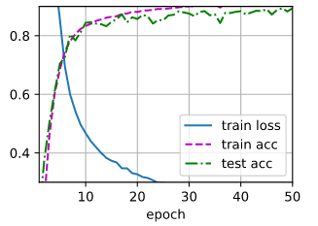
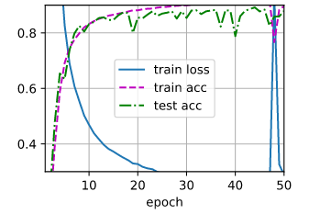
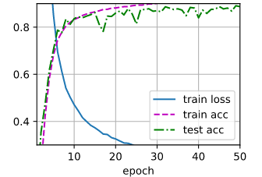
Result

Slide 5
Has dropout
3 hidden layers

Slide 6
Code
from mxnet import gluon, init, npx
from mxnet.gluon import nn
from d2l import mxnet as d2l
npx.set_np()
dropout = 0.5
batch_size = 256
train_iter, test_iter = d2l.load_data_fashion_mnist(batch_size)
net = nn.Sequential()
for add_layer in range(3):
net.add(nn.Dense(256, activation='relu')), nn.Dropout(dropout)
net.add(nn.Dense(10))
net.initialize(init.Normal(sigma=0.01))
loss = gluon.loss.SoftmaxCrossEntropyLoss()
trainer = gluon.Trainer(net.collect_params(), 'sgd', {'learning_rate': 0.1})
num_epochs = 50
d2l.train_ch3(net, train_iter, test_iter, loss, num_epochs, trainer)

Slide 7
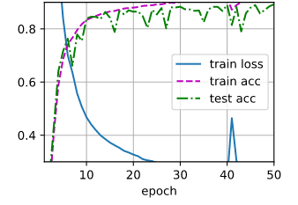
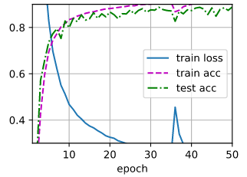
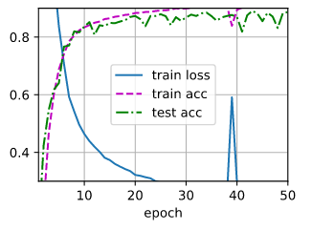
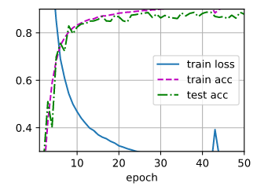
Result

