Slide 1
【HW3】Network in Network
108321033 吳明騰
108321037 林峻葆

Slide 2
Calculate the resource usage for NiN.
What is the number of parameters?
What is the amount of computation?
What is the amount of memory needed during training?
What is the amount of memory needed during prediction?

Slide 3
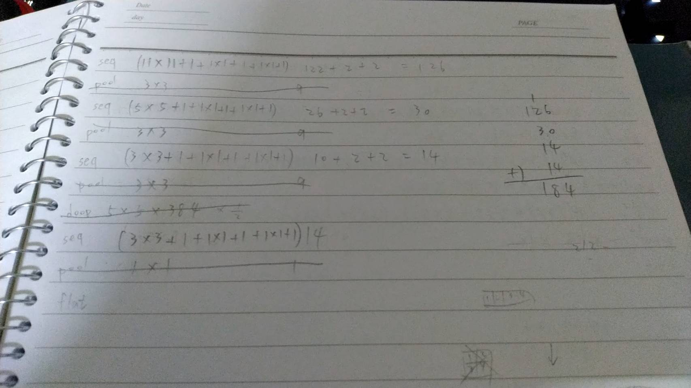
What is the number of parameters?

Slide 4
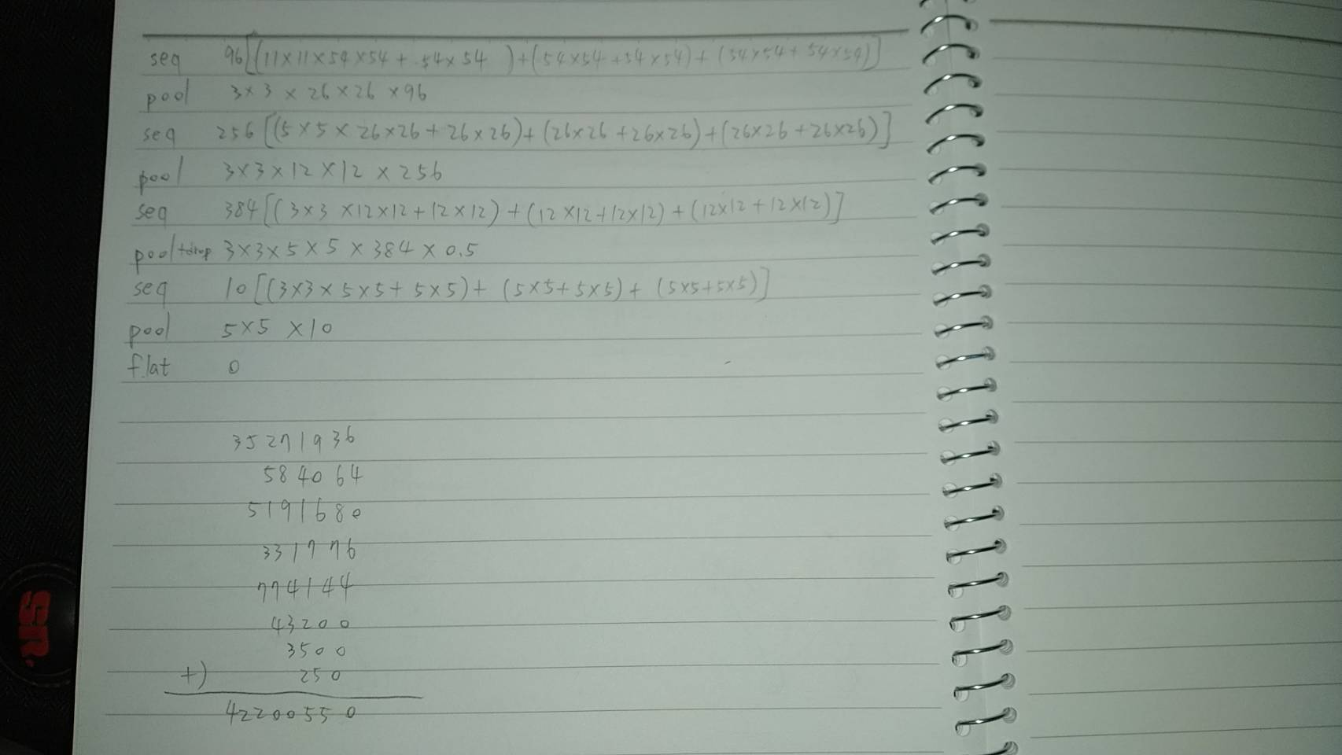
What is the amount of computation?

Slide 5
What is the amount of memory needed during training?

Slide 6
What is the amount of memory needed during training?

Slide 7
抱歉，我們已經看很久，還是不知道要怎寫，明天要考組數第二次段考，所以之後再問老師，感謝您的體諒。

