Slide 1
【HW4】LeNet with Batch Normalization
108321033 吳明騰
108321037 林峻葆

Slide 2
No Batch Normalization Code
from mxnet import autograd, gluon, init, np, npx
from mxnet.gluon import nn
from d2l import mxnet as d2l
npx.set_np()
net = nn.Sequential()
net.add(
nn.Conv2D(channels=6, kernel_size=5, padding=2, activation='sigmoid'),
nn.AvgPool2D(pool_size=2, strides=2),
nn.Conv2D(channels=16, kernel_size=5, activation='sigmoid'),
nn.AvgPool2D(pool_size=2, strides=2),
nn.Dense(120, activation='sigmoid'), nn.Dense(84, activation='sigmoid'),
nn.Dense(10))
X = np.random.uniform(size=(1, 1, 28, 28))
net.initialize()
for layer in net:
X = layer(X)
print(layer.name, 'output shape:\t', X.shape)
batch_size = 256
train_iter, test_iter = d2l.load_data_fashion_mnist(batch_size=batch_size)
def evaluate_accuracy_gpu(net, data_iter, device=None): #@save
if not device: # Query the first device where the first parameter is on
device = list(net.collect_params().values())[0].list_ctx()[0]
metric = d2l.Accumulator(2)
for X, y in data_iter:
X, y = X.as_in_ctx(device), y.as_in_ctx(device)
metric.add(d2l.accuracy(net(X), y), y.size)
return metric[0] / metric[1]
lr, num_epochs = 0.9, 10
d2l.train_ch6(net, train_iter, test_iter, num_epochs, lr, d2l.try_gpu())

Slide 3
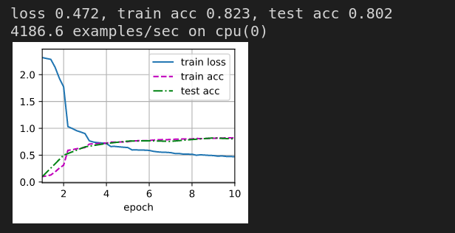
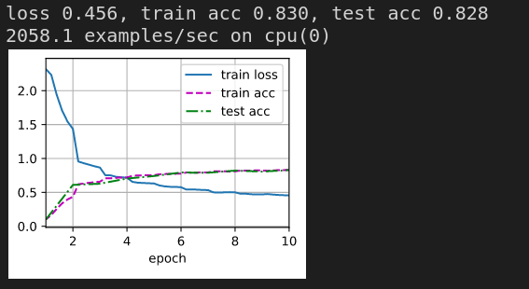
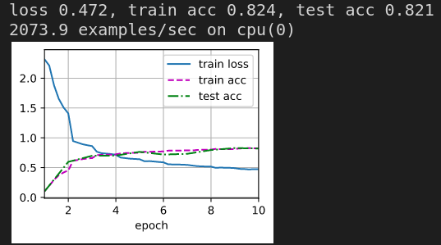
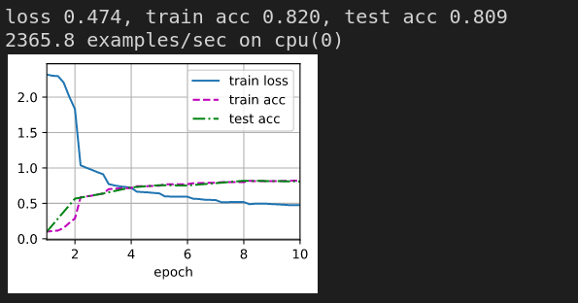
No Batch Normalization Result

Slide 4
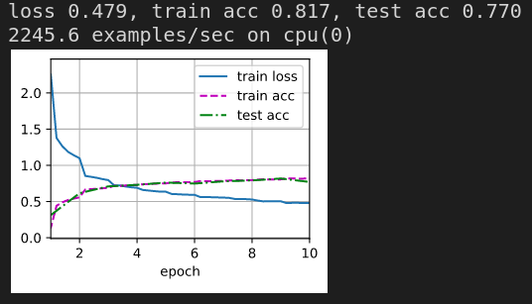
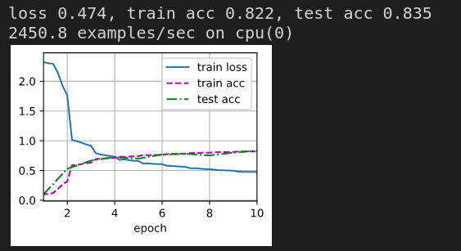
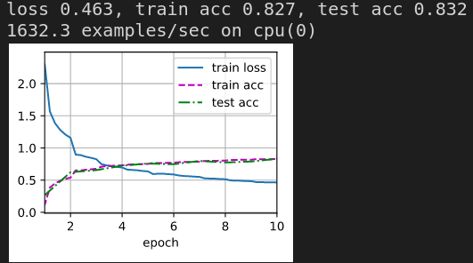
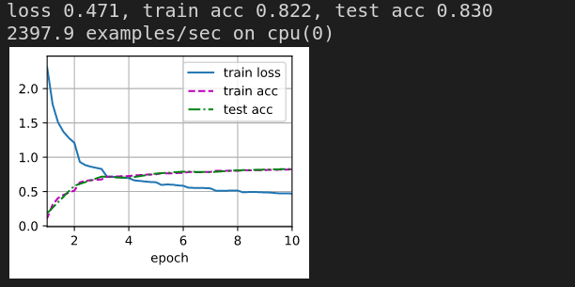
No Batch Normalization Result

Slide 5
Batch Normalization Code
from mxnet import autograd, init, np, npx
from mxnet.gluon import nn
from d2l import mxnet as d2l
npx.set_np()
def batch_norm(X, gamma, beta, moving_mean, moving_var, eps, momentum):
if not autograd.is_training():
X_hat = (X - moving_mean) / np.sqrt(moving_var + eps)
else:
assert len(X.shape) in (2, 4)
if len(X.shape) == 2:
mean = X.mean(axis=0)
var = ((X - mean)**2).mean(axis=0)
else:
mean = X.mean(axis=(0, 2, 3), keepdims=True)
var = ((X - mean)**2).mean(axis=(0, 2, 3), keepdims=True)
X_hat = (X - mean) / np.sqrt(var + eps)
moving_mean = momentum * moving_mean + (1.0 - momentum) * mean
moving_var = momentum * moving_var + (1.0 - momentum) * var
Y = gamma * X_hat + beta # Scale and shift
return Y, moving_mean, moving_var
class BatchNorm(nn.Block):
def __init__(self, num_features, num_dims, **kwargs):
super().__init__(**kwargs)
if num_dims == 2:
shape = (1, num_features)
else:
shape = (1, num_features, 1, 1)
self.gamma = self.params.get('gamma', shape=shape, init=init.One())
self.beta = self.params.get('beta', shape=shape, init=init.Zero())
self.moving_mean = np.zeros(shape)
self.moving_var = np.ones(shape)
def forward(self, X):
if self.moving_mean.ctx != X.ctx:
self.moving_mean = self.moving_mean.copyto(X.ctx)
self.moving_var = self.moving_var.copyto(X.ctx)
Y, self.moving_mean, self.moving_var = batch_norm(
X, self.gamma.data(), self.beta.data(), self.moving_mean,
self.moving_var, eps=1e-12, momentum=0.9)
return Y
net = nn.Sequential()
net.add(nn.Conv2D(6, kernel_size=5), BatchNorm(6, num_dims=4),
nn.Activation('sigmoid'), nn.MaxPool2D(pool_size=2, strides=2),
nn.Conv2D(16, kernel_size=5), BatchNorm(16, num_dims=4),
nn.Activation('sigmoid'), nn.MaxPool2D(pool_size=2, strides=2),
nn.Dense(120), BatchNorm(120, num_dims=2), nn.Activation('sigmoid'),
nn.Dense(84), BatchNorm(84, num_dims=2), nn.Activation('sigmoid'),
nn.Dense(10))
lr, num_epochs, batch_size = 1.0, 10, 256
train_iter, test_iter = d2l.load_data_fashion_mnist(batch_size)
d2l.train_ch6(net, train_iter, test_iter, num_epochs, lr, d2l.try_gpu())
net[1].gamma.data().reshape(-1,), net[1].beta.data().reshape(-1,)

Slide 6
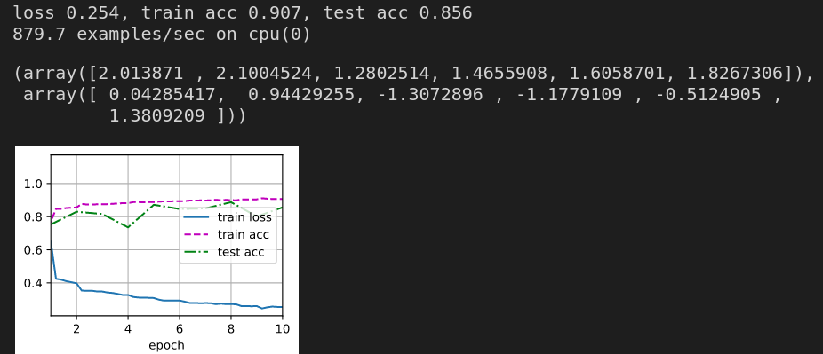
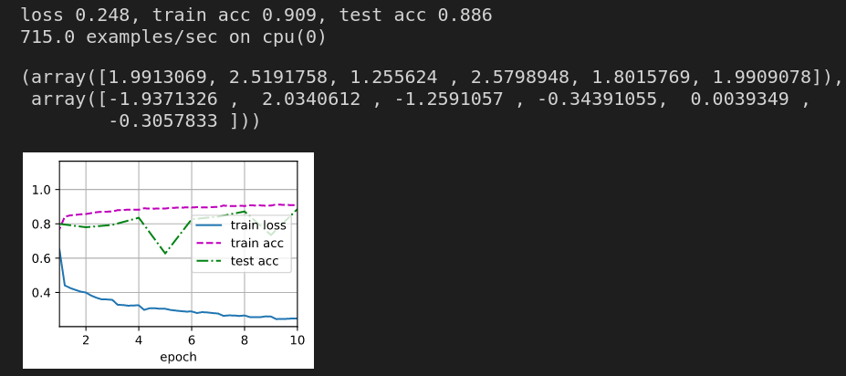
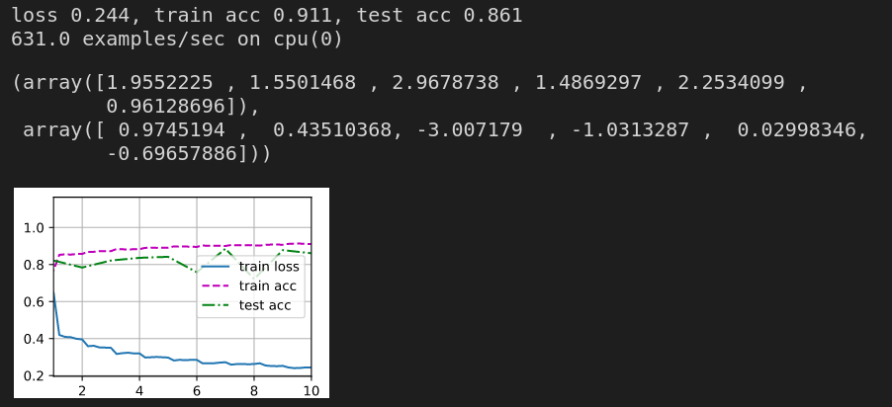
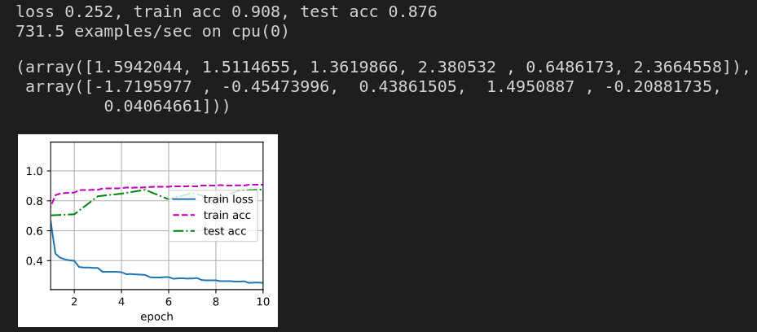
Batch Normalization Result

Slide 7
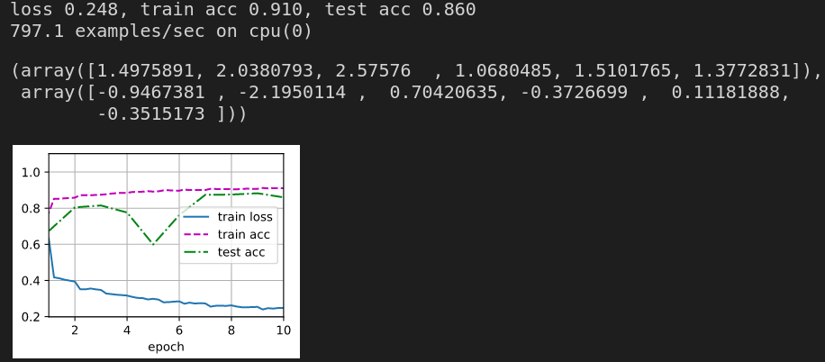
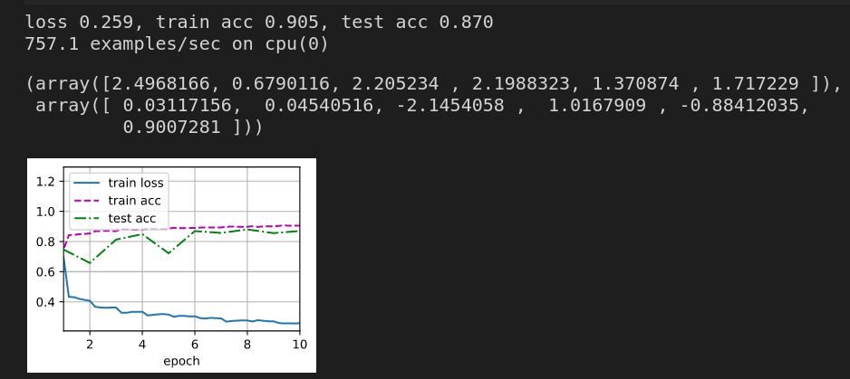
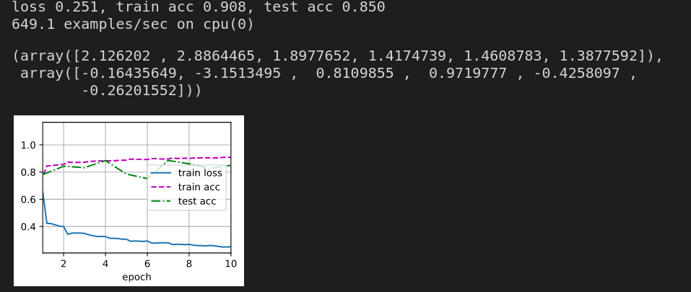
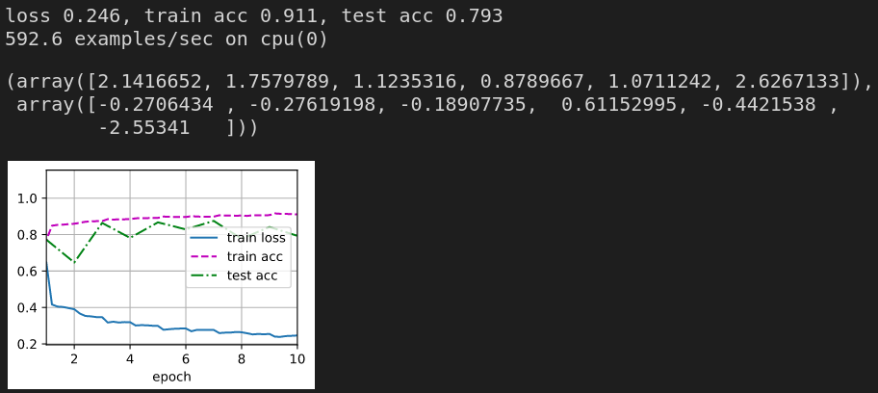
Batch Normalization Result

