Slide 1



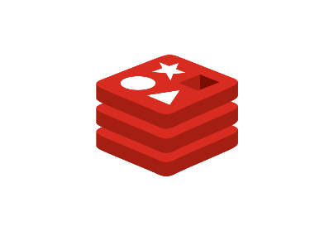











IDE
WebSocket
Database
CI/CD
PUSH
Web Hook
Backend
Deploy
Client
Deploy
Internet Of Things
Frontend
Database
Reverse Proxy

