Slide 1
Redux VS MobX
——Min Zhou

Slide 2
Similarity of Redux and MobX
Both Redux and MobX are state management libraries
State is one of the most important things
They can work well with many different frameworks
They are perfect for React

Slide 3
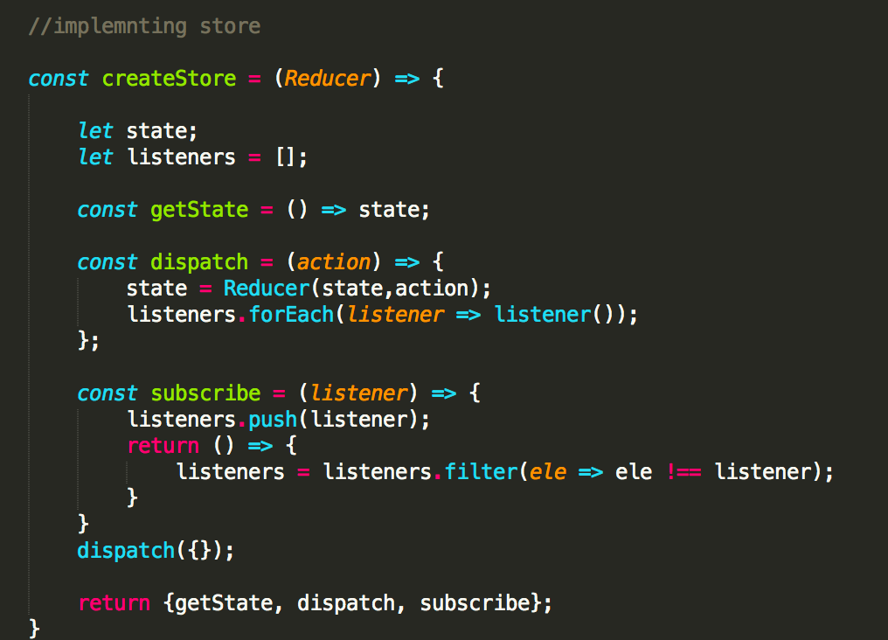
Redux——An easiest application
Create a store object using the reducer as input, the object has three methods—getState(), dispatch() and subscribe();

Slide 4
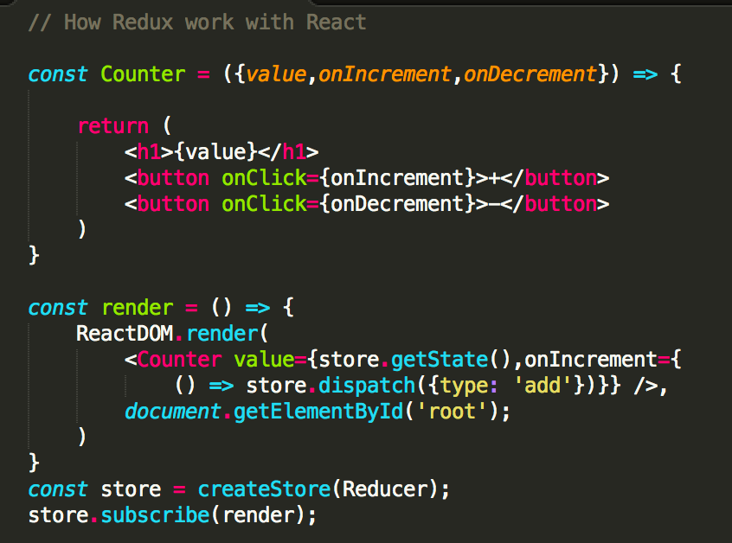
Redux——An easiest application
Subscribe an action to the store, usually the action is render() function when you use react with redux.

Slide 5
MobX——An easiest application
Make an observable state, using the @observable decorator or observable functions to make the state trackable for MobX.
Using @computed decorator to create functions which can derive data from state automatically
Using autorun function, whenever the observable state changes, this function would run automatically.

Slide 6
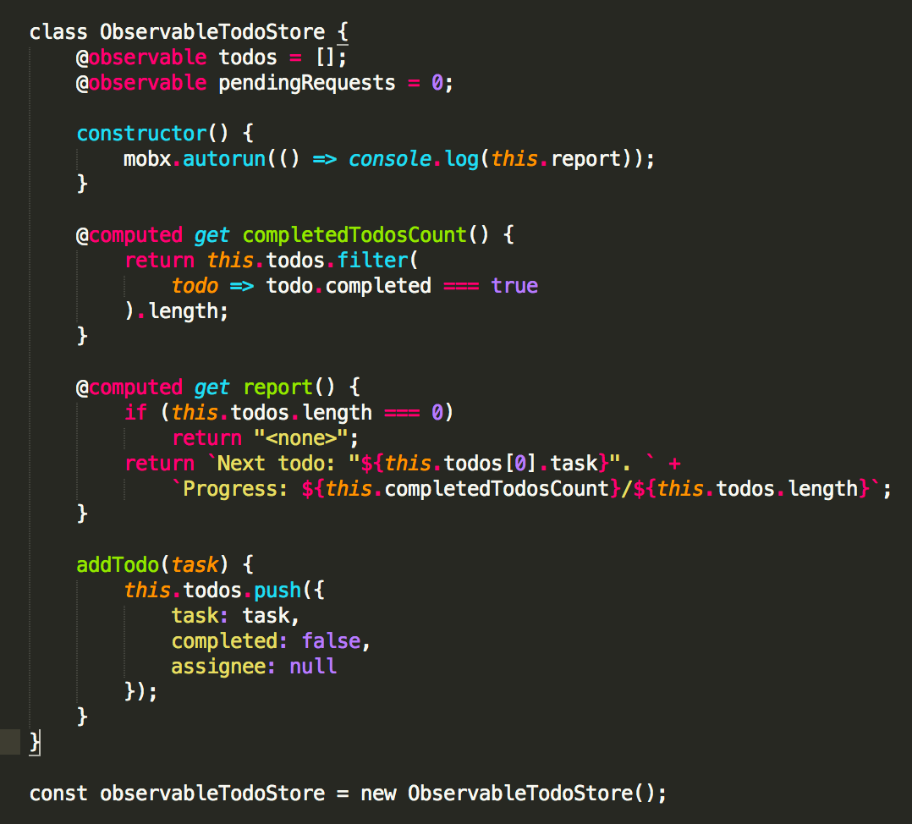
MobX——An easiest application

Slide 7
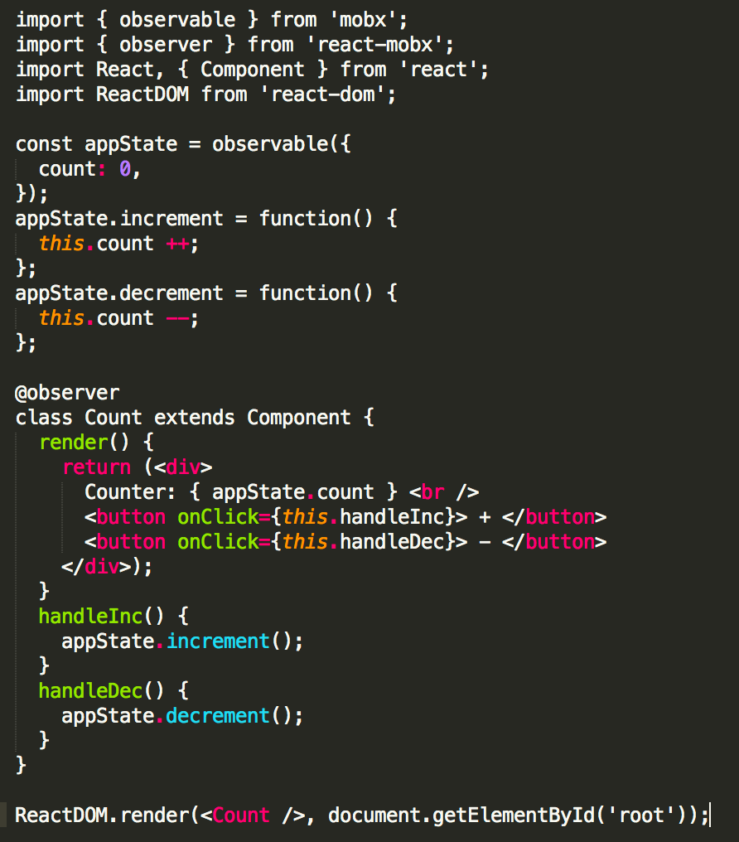
MobX——An easiest application
When you use MobX with React, Use @observer decorator from the mobx-react package to wrap the render function into autorun, So when the state is changed, the component would re-render

Slide 8
Difference of Redux and MobX
Redux
single store
functional programming paradigm
immutable
pure
plain JavaScript
more boilerplate
normalized state
MobX
multiple stores
object-oriented programming and reactive programming paradigms
mutable
impure
“magic” JavaScript
less boilerplate
denormalized state

Slide 9
Difference of Redux and MobX
use Redux over MobX:
clear constraints
Easy test
mature best practices
used in complex applications
immutable data
in a bigger size & several developers / teams project
use MobX over Redux:
short learning curve
simple to use (magic)
quick start
minimal boilerplate
used in lightweight applications
but can be used in bigger size projects too, when used with explicit constraints

