Slide 1


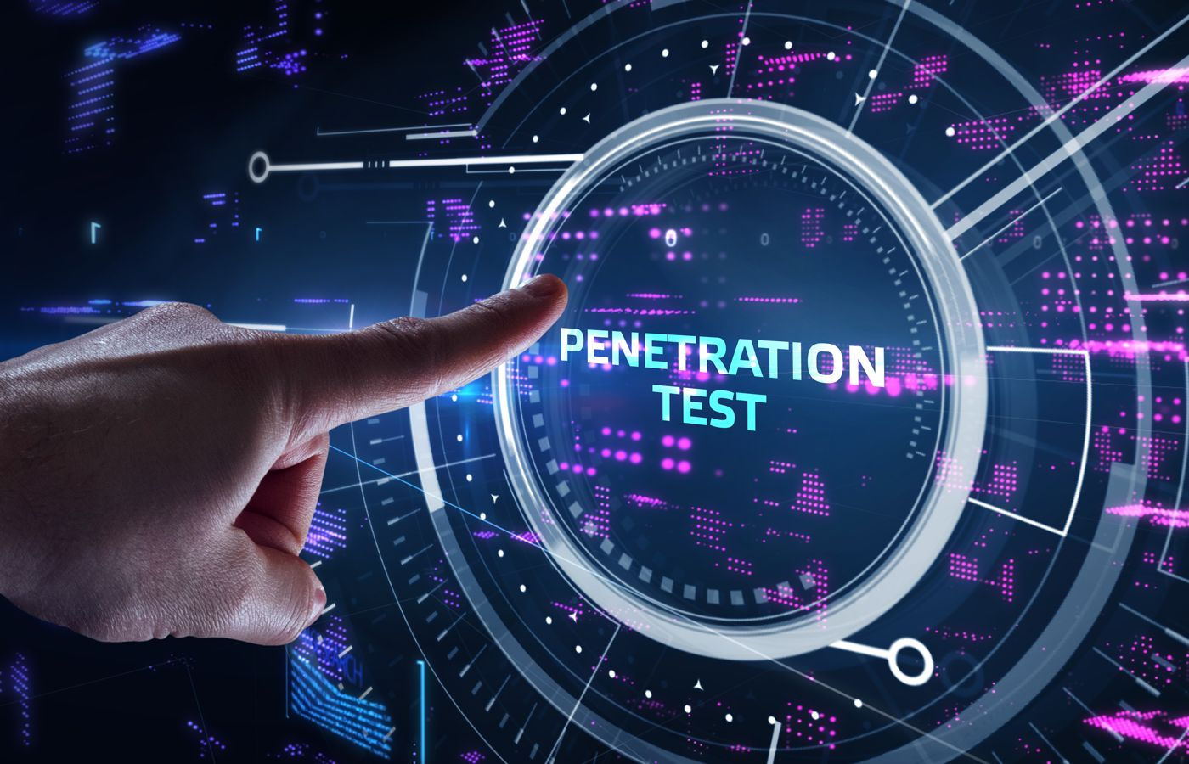



Title: penetration testing Framework for smart contract blockchain
subtitle: Enhancing smart contract security with manual testing Presented by: Mina Adel/ Mina Atef
Authors: Akashdeep Bhardwaj, Syed Bilal Hussian Shah, Achyut Shankar, Mamoun Alazab, Manoj Kumar, Thippa Reddy Gadekallu

Slide 2

What is blockchain and smart contracts?
Blockchain is a decentralized database shared across many computers. It's secure, transparent, and hard to change.
Smart Contracts are programs on the blockchain that run automatically when conditions are met. ➤ No middlemen (like banks or lawyers).
Why it matters: Once deployed, smart contracts can’t be changed
If hacked or buggy, losses are permanent.

Slide 3

Why Are Smart Contracts Vulnerable?
⚙️ Complexity of Technology Requires specialized skills; mistakes are easy to make.
📌 Immutable Deployment Once deployed, code cannot be changed—even if it has bugs.
🧩 Third-Party Integrations External tools can introduce new vulnerabilities.
🧪 Insufficient Testing Lack of thorough manual and automated penetration testing.
🌐 Network-Level Attacks Risks like 51% attacks, routing attacks, and Sybil attacks.
🔁 Transaction Malleability Attackers can change transaction IDs to trick the system.

Slide 4

Problems With Automated Tools
⚠️ Miss Vulnerabilities Automated scanners failed to detect some critical bugs found by manual testing (e.g., reentrancy, buffer overflow).
🐢 Slow Performance Tools like SAST and DAST are time-consuming — some scans can take hours or even days. behavior.
❌ False Positives and Negatives High false positive and false negative rates reduce reliability:
Example: Automated tools had 31–39% false negatives in detecting timestamp and reentrancy bugs.
🧪 No Runtime Insight Tools can't monitor control/data flow deeply like manual analysis can.

Slide 5
Key Challenges of Manual Testing
🧠 Requires Skilled Professionals Deep understanding of blockchain, smart contract logic, and security is essential not every developer can perform it.
🕒 Time-Consuming Manual testing takes significantly more time compared to automated scans.
🔍 Hard to Scale Testing many smart contracts (e.g., thousands) manually is not practical.

Slide 6

Goal of this research
To create a better way to find security problems in blockchain smart contracts by using manual testing (human experts) instead of just relying on automated tools.
Combining both ways of testing is way more safer.

Slide 7
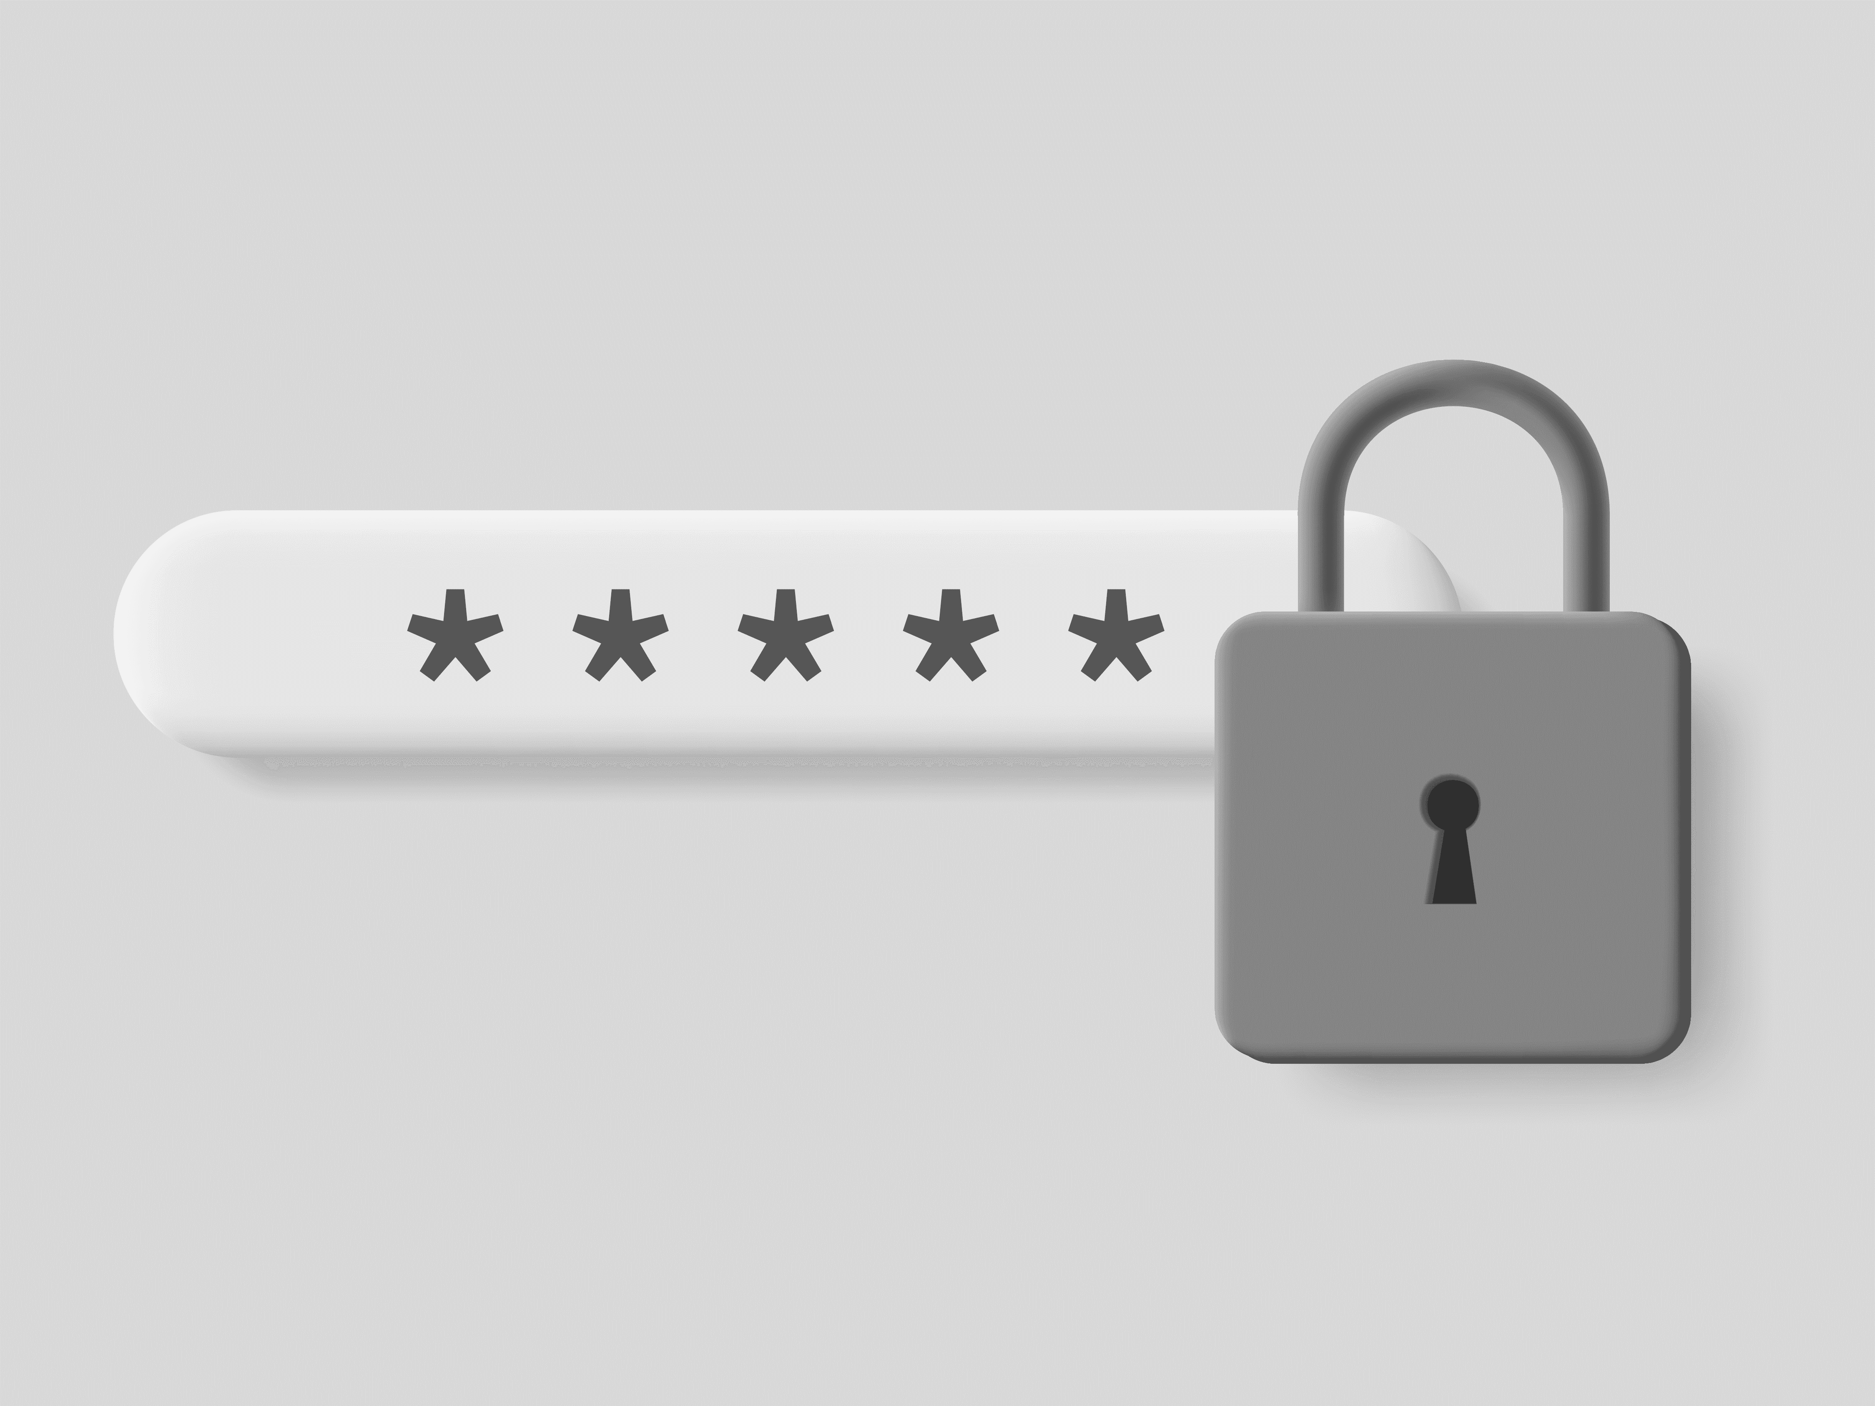

What is JOHN RIPPER Tool ?
How Does It Work?
John the Ripper is a tool that helps find passwords.
It tries to guess passwords by testing lots of options.
Used to check if passwords are strong or weak.
You give John a list of hashed passwords (secret codes).
John uses a wordlist (like rockyou.txt) with many common passwords.
It guesses passwords, hashes them, and compares to find a match.
If it matches, John reveals the real password.

Slide 8
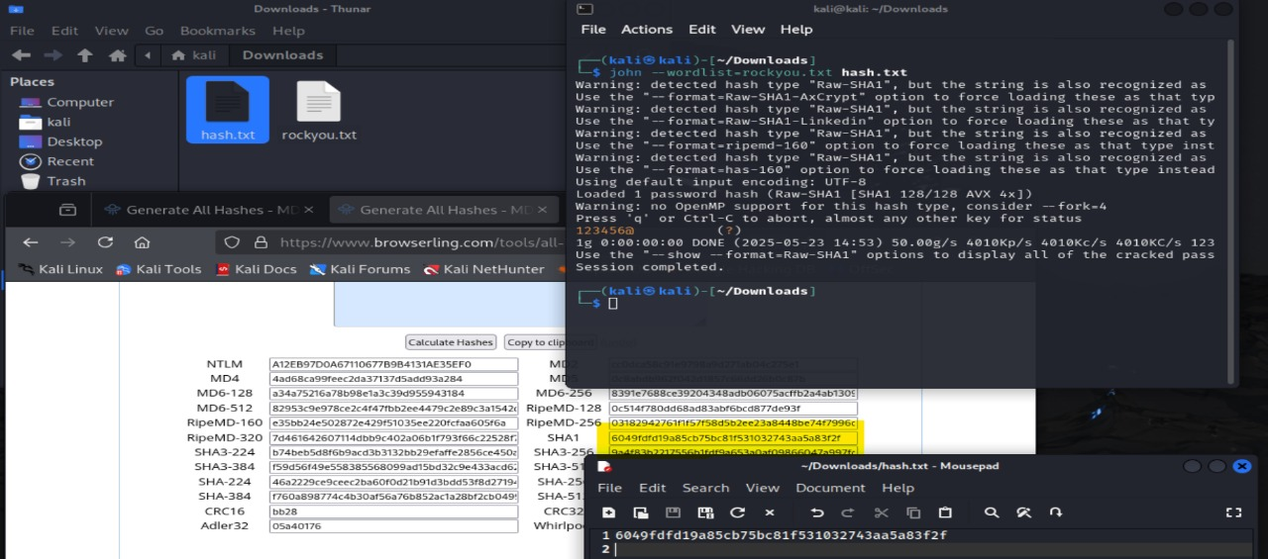

Slide 9
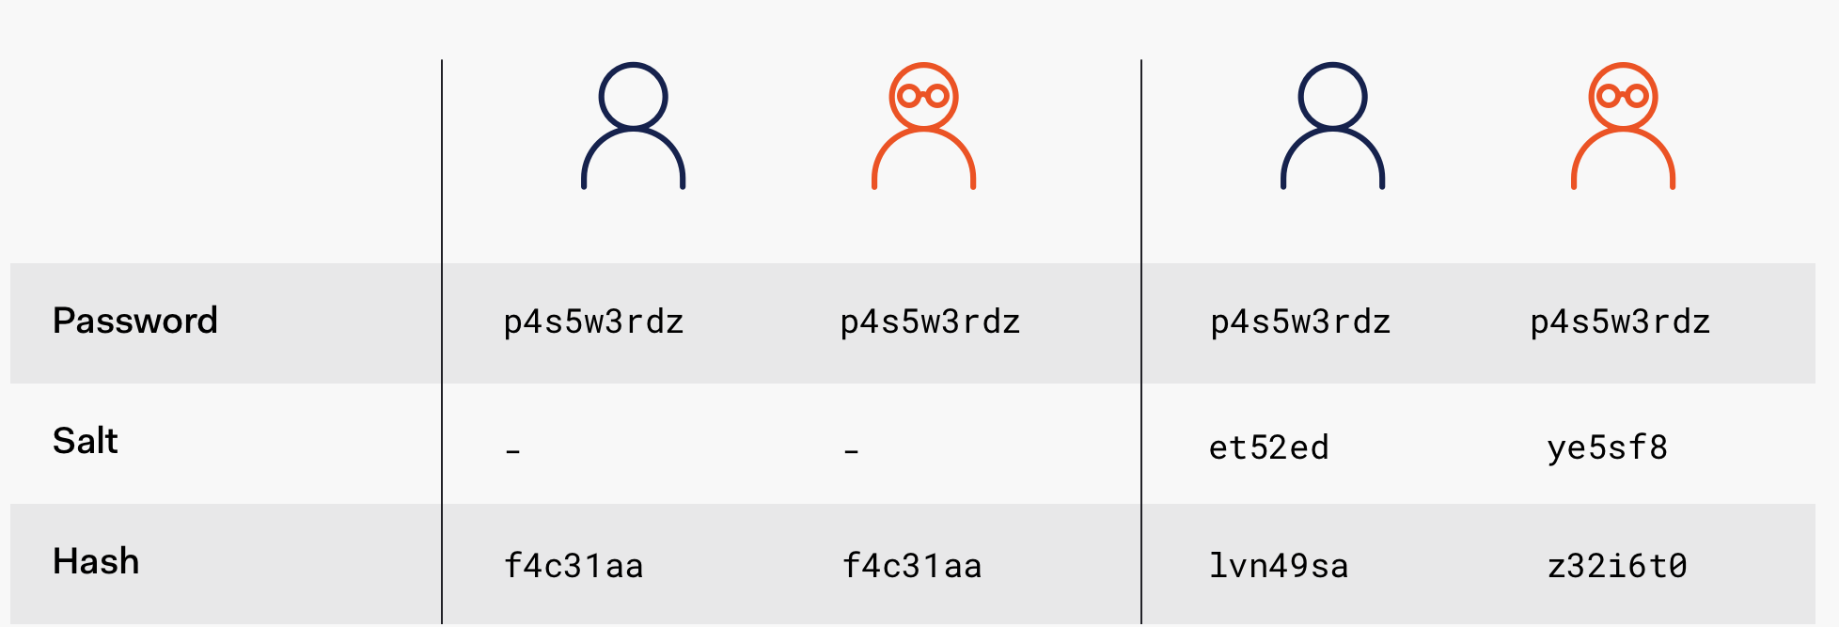
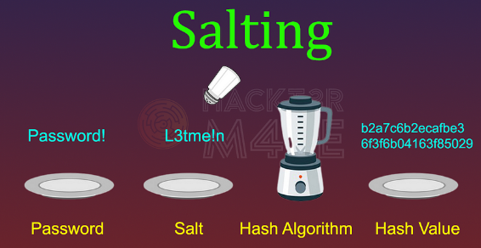
How to Prevent Password Cracking?
How Does salt works?
Use strong and complex passwords (mix letters, numbers, symbols).
Make passwords longer — longer passwords are harder to crack.
Always use salting to add randomness before hashing.
Use secure hashing algorithms like bcrypt or Argon2.

