Slide 1
Water Quality
Made by :
Mina Adel
Mina Atef
Aly Hassan

Slide 2
CONTENTS
1.introduction
2.Data analysis
3.Data modeling
4. Prediction

Slide 3
Drinking water quality varies from location to location depending on the state of the water source it is drawn from and the level of treatment it receives, but there are some factors that affect water quality, such as:
pH level:
Hardness:
Solids (Total dissolved solids - TDS):
Chloramines:
Sulfate:
Conductivity:
Organic carbon:
Trihalomethanes:
Turbidity:
Next, we can determine whether it is potable or not.
1. introduction

Slide 4
2.Data analysis
Tree
viewer
Tree
Data table
Distribution
free viz
correlation
impute
scatter plot
Feature statcics
File
rank

Slide 5
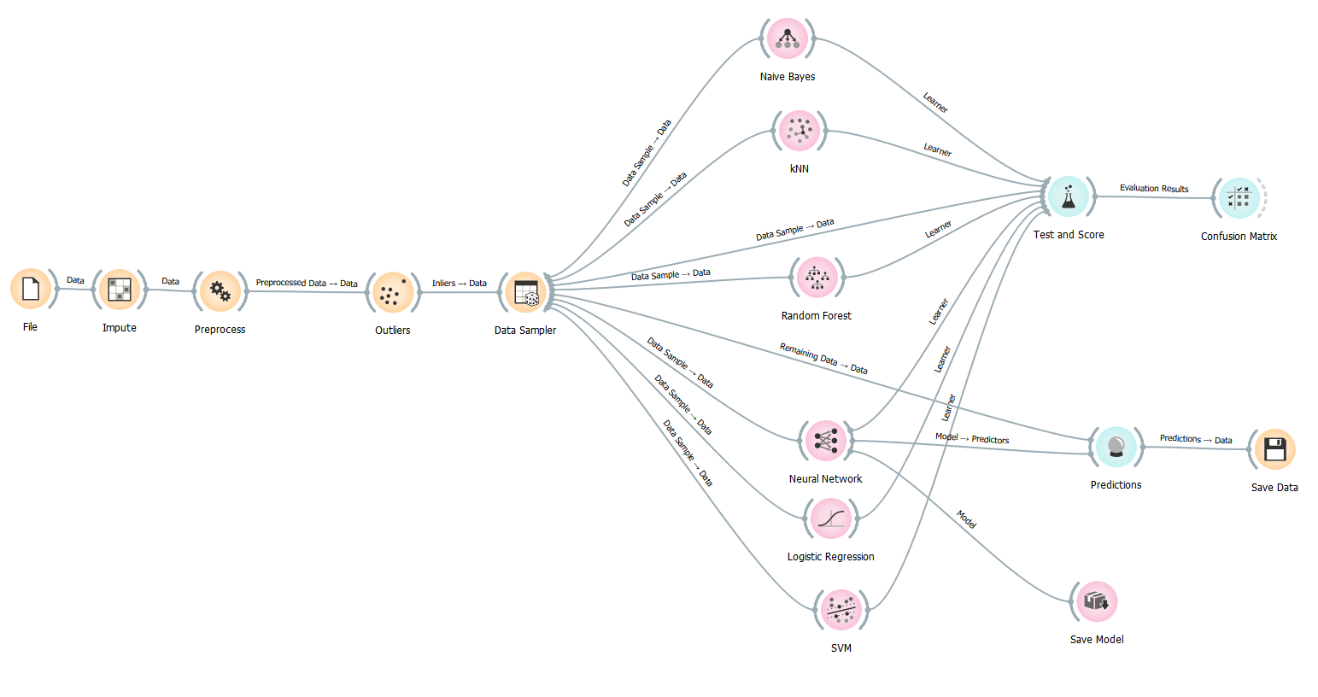
3.Data Modeling

Slide 6
3.Prediction
File
Save Data
Prediction
Load
Model

Slide 7
summary
One of everyone's basic needs is access to clean water for drinking. Legally speaking, having access to clean water for consumption is a fundamental human right. Water quality is influenced by a variety of factors and is one of the main topics of machine learning research.
So, using this method, you can classify drinking water into safe and unsafe categories and train a machine learning model to do so. One of everyone's basic needs is access to clean water for drinking. Legally speaking, having access to clean water for consumption is a fundamental human right. Water quality is influenced by a variety of factors and is one of the main topics of machine learning research.

Slide 8
THANK YOU

