Slide 1
Ransomware encryption and decreption
Mina Adel ,Mina Atef
Course :Introduction to Cybercrime
Reviewed by: Dr Mohamed Elemam, Dr Rahma

Slide 2
Table of contents
01
02
03
04
05
06
ransomware
Types of encryption
AES,DES,RSA
Definition
Symetric and Asymetric
Comparsion
7 phases
Defense
Impact
How to prevent or defense the ransomware

Slide 3
What is ransomware
A type of malware that blocks access to data or systems
Victim must pay a ransom to regain access
Spreads through phishing emails, malicious websites, etc.
Often encrypts files to lock users out

Slide 4
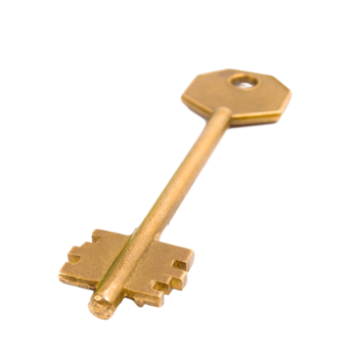
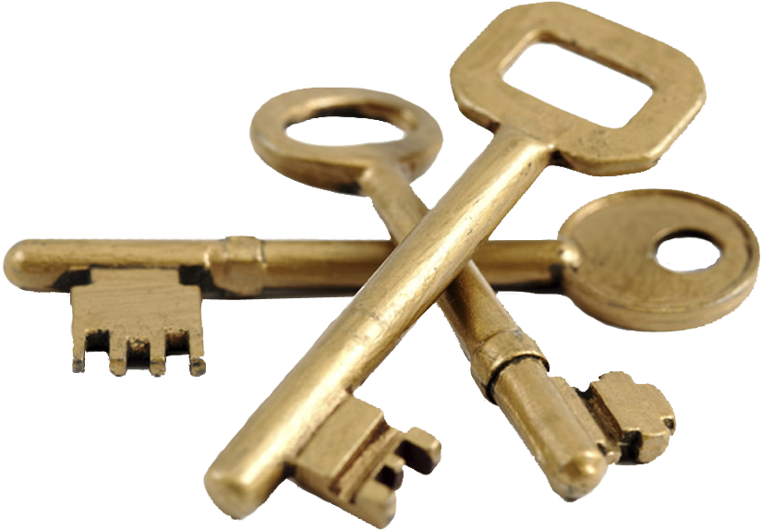
Symmetric Vs Asymmetric
Feature | Symmetric Encryption | Asymmetric Encryption
Key Use | Same key for locking and unlocking | Two different keys: public & private
Speed | Faster | Slower
Example Algorithms | AES, DES | RSA
Security | Key must be kept secret; if key is leaked, data is at risk | More secure for sharing keys because public key can be shared openly
Use Case | Encrypting large amounts of data quickly | Securely sharing keys, digital signatures, encrypting small data
Key Length | Usually shorter keys (e.g., 128 or 256 bits) | Usually longer keys (e.g., 1024 or 2048 bits)

Slide 5
01 What are AES, DES, and RSA?

Slide 6
AES (Advanced Encryption Standard):
is a modern symmetric encryption algorithm widely used to secure data. It encrypts and
decrypts data using the same secret key, making it fast and efficient for protecting large
amounts of data. AES supports key sizes of 128, 192, or 256 bits and is considered very secure.
DES (Data Encryption Standard):
DES is an older symmetric encryption algorithm that was widely used in the past. It also uses the same key for encryption and decryption but operates with a 56-bit key, which is now considered too short and vulnerable to brute-force attacks. DES has mostly been replaced by AES.
RSA(Rivest-Shamir-Adleman):
RSA is an asymmetric encryption algorithm that uses a pair of keys: a public key to encrypt data and a private key to decrypt it. It is commonly used for secure data transmission, digital signatures, and key exchange, but it is slower than symmetric algorithms like AES.
Hybrid RSA + AES Encryption
Hybrid RSA + AES encryption is a secure method that combines two algorithms. AES quickly encrypts the actual data, while RSA encrypts the AES key for safe sharing. This approach ensures both speed and strong security, making it ideal for protecting sensitive files. Only someone with the RSA private key can unlock the AES key and decrypt the data.

Slide 7
The 7 Stages of a Ransomware Kill Chain
01
02
03
04
06
07
Delivery
Payload Install
Reconnaissance
Malware enters through email or websites.
Connects to attacker, downloads harmful software.
Attacker explores system, finds valuable data.
05
Exfiltration
Encryption
The Ransom
Remediation
Data is stolen and sent away.
Files are locked, become unreadable quickly.
Attackers demand money to unlock files.
Clean system, remove malware, restore operations.

Slide 8
🛡️ How to Defend Against Ransomware
Don’t click suspicious links or emails.
Keep software and systems updated
Use strong antivirus and firewalls
Back up your data regularly
Limit user access (least privilege)
6.Train employees on cyber safety
7.Use multi-factor authentication (MFA)
8.Monitor systems for strange behavior
9.Segment your network
10.Create and test a response plan

Slide 9
🔒 Impact of Ransomware
Important files are locked, stolen, or deleted.
Data Loss
Huge costs from ransom, recovery, and downtime.
Financial Damage
Operations stop, causing delays and lost trust.
Business Disruption
Customer data leaks can lead to fines and brand damage.
Legal & Reputation Risks

