Slide 1
Vulnerability Assessment and Remediation Plan
Supervised by:
Eng. Nour eldin Essam
Oct-2024

Slide 2
Team members
1- Mostafa Fayez Saad Malek
2- Ahmed AboBaker Mohamed
3- Ebrahim Ahmed Azoz
4- Mina Maximous Masha

Slide 3
Project Objective:
This document outlines the results of a vulnerability assessment performed on a network environment comprising a vulnerable machine and a Kali Linux machine configured for penetration testing.
1
Findings
2
Recommendations
The assessment identified several critical vulnerabilities that could be exploited, posing significant risks to the overall security posture.
Proposed remediation strategies are outlined to mitigate the identified risks effectively.
3

Slide 4
Network Environment Setup:
Vulnerable Machine
Router R1
- IP Address: 10.0.0.10/24
- Interfaces: e0/0 connected to the vulnerable machine (10.0.0.200).
- They are connected to router R1 via interface e0/0.
- e0/2 connected to the internet (192.168.1.10).
Switch
- e0/1 connected to another router R2 (20.0.0.200).
- Ports: e0/1 connected to R1 (20.0.0.0/24).
- e0/0 connected to the Kali Machine for scanning.

Slide 5
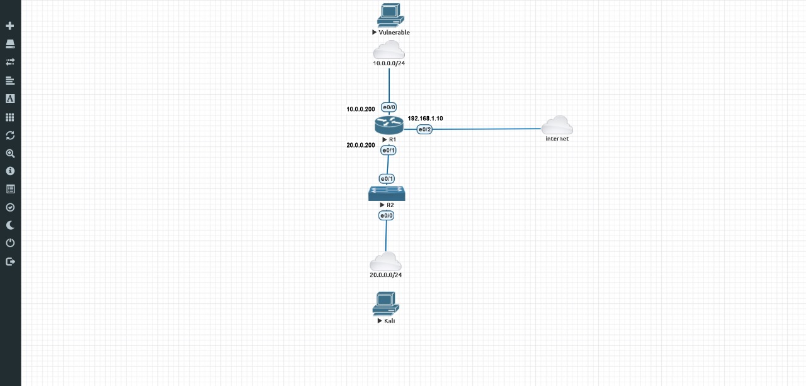

Slide 6
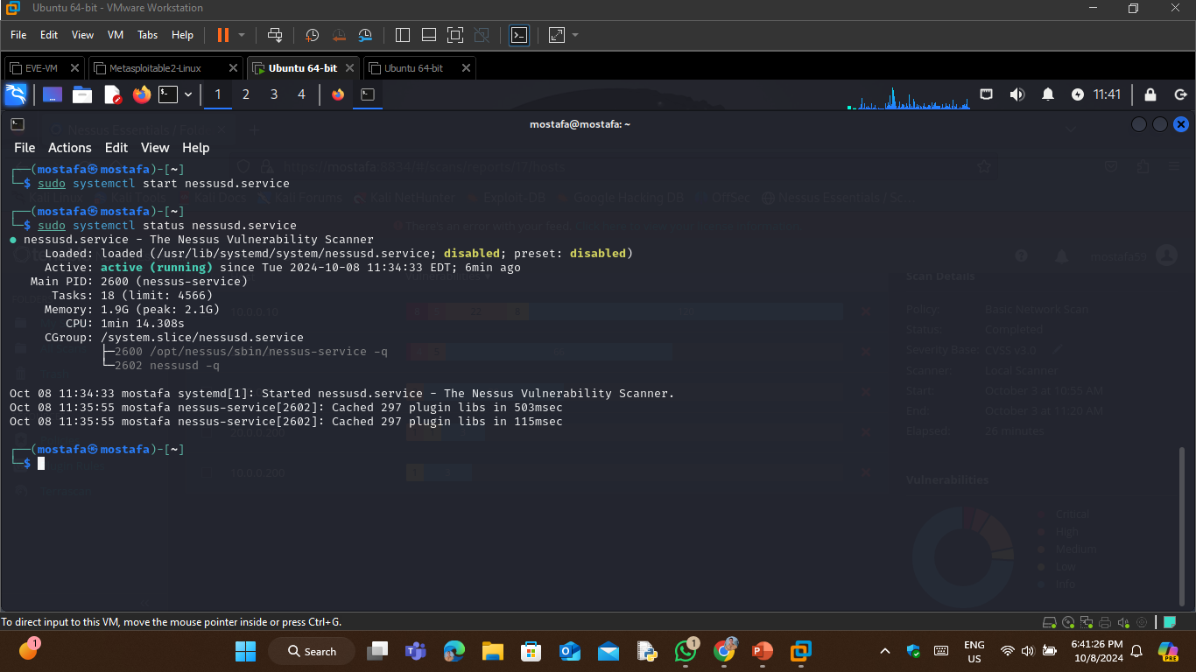
On Kali Linux Machine:

Slide 7
Commands used:
“sudo systemctl start nessusd.service”
sudo: Executes the command with superuser privileges.
start: Instructs systemctl to start the specified service.
nessusd.service: The name of the Nessus daemon service that enables vulnerability scanning.
“sudo systemctl start nessusd.service”.
status: This argument requests the current state of the specified service.

Slide 8
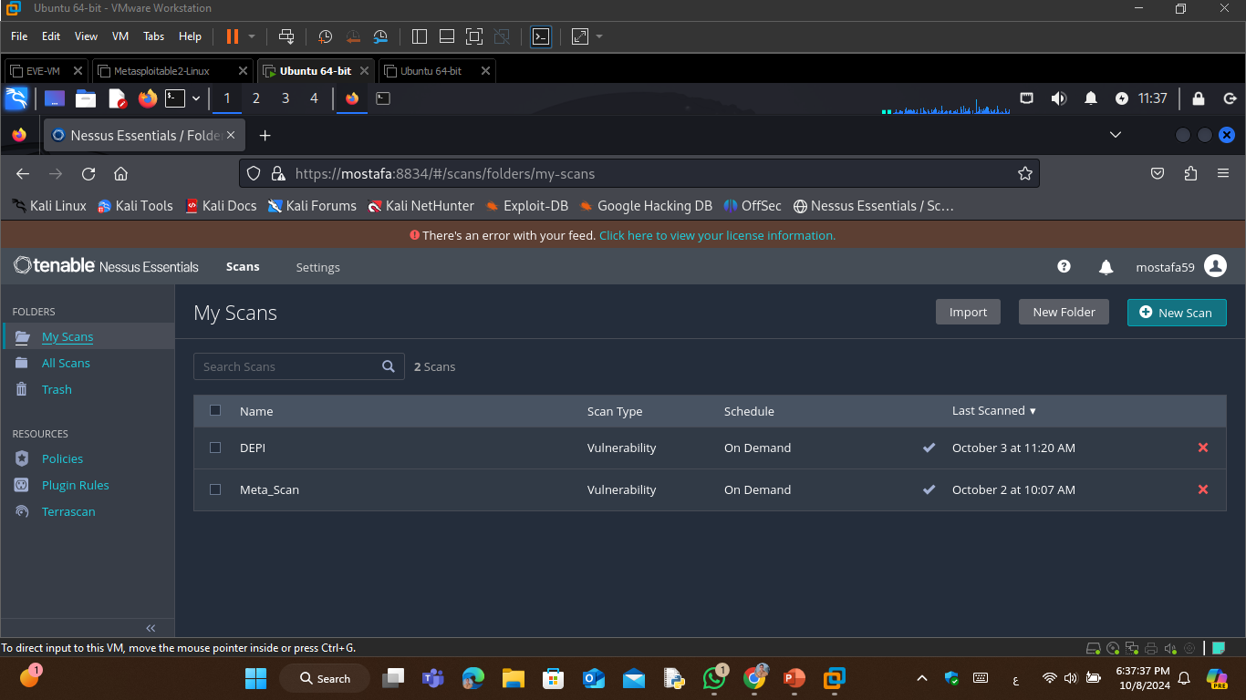
Open Nessus:

Slide 9
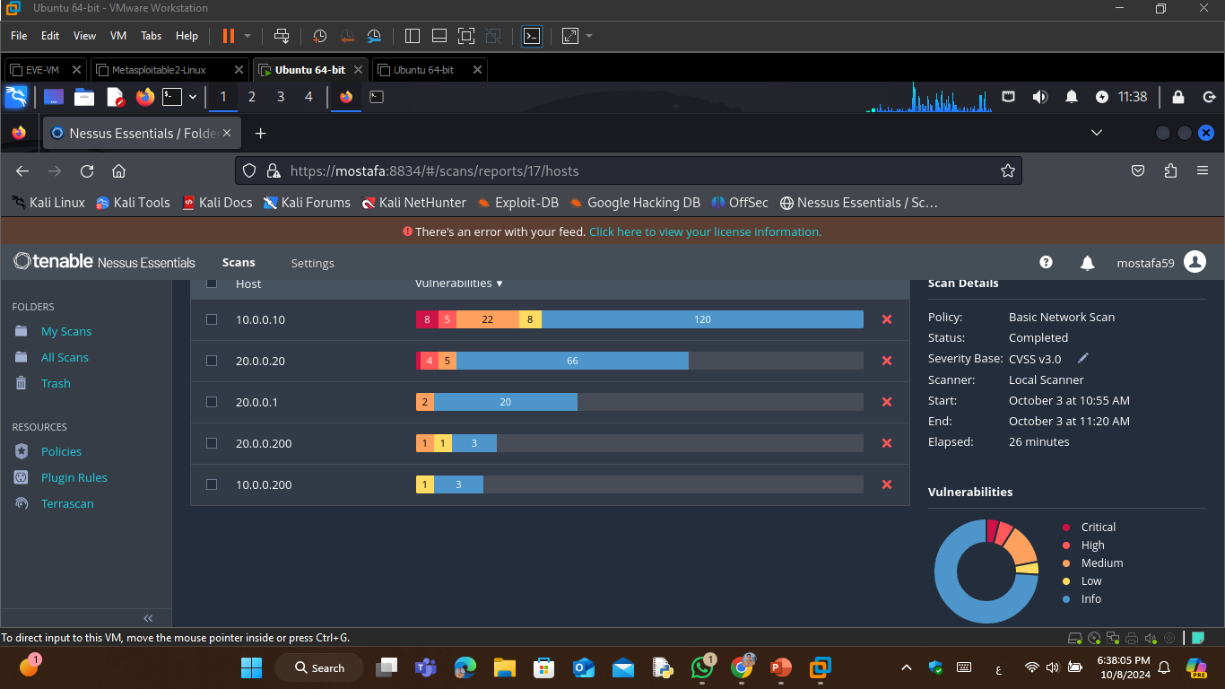
Do Our Network Scan:

Slide 10
Vulnerabilities by Host: 10.0.0.10
Vulnerability ID
Description
Risk Factor
70728
Apache PHP-CGI Remote Code Execution
High
134862
Apache Tomcat Ajp Connector Request Injection (Ghostcat)
High
51988
Bind Shell Backdoor Detection
Critical

Slide 11
Vulnerabilities by Host: 10.0.0.10 (Continued)
Vulnerability ID
Description
Risk Factor
32314
Debian OpenSSH/OpenSSL Package Random Number Generator Weakness
Critical
32321
Debian OpenSSH/OpenSSL Package Random Number Generator Weakness (SSL check)
Critical
20007
Ssl Version 2 And 3 Protocol Detection
Critical

Slide 12
Vulnerability ID
Description
Risk Factor
42256
Nfs Shares World Readable
Medium
PHP PHP-CGI Query String Parameter Injection Arbitrary Code Execution
59088
High
42873
Ssl Medium Strength Cipher Suites Supported (Sweet32)
Medium

Slide 13
Vulnerability ID
Description
Risk Factor
90509
Samba Badlock Vulnerability
Medium
19704
Twiki 'Rev' Parameter Arbitrary Command Execution
High
36171
phpMyAdmin Setup Script Configuration Parameters Arbitrary PHP Code Injection (PMASA-2009-4)
High

Slide 14
Vulnerabilities by Host: 20.0.0.200
1
50686 - IP Forwarding Enabled
The remote host has IP forwarding enabled. An attacker can exploit this to route packets through the host and potentially bypass some firewalls / routers / NAC filtering. Unless the remote host is a router, it is recommended that you disable IP forwarding.

Slide 15
Thank you

