Slide 1
Vulnerability Assessment and Remediation Plan
Supervised by:
Eng. Nour eldin Essam
Oct-2024

Slide 2
Team members
1- Mostafa Fayez Saad Malek
2- Ahmed AboBaker Mohamed
3- Ebrahim Ahmed Azoz
4- Mina Maximous Masha

Slide 3
Project Objective:
This document outlines the results of a vulnerability assessment performed on a network environment comprising a vulnerable machine and a Kali Linux machine configured for penetration testing.
1
Validate identified vulnerabilities through penetration testing.
1
Simulate real-world attacks on systems and applications.
2
Exploit weaknesses like misconfigurations, unpatched software,
and weak authentication.
3
4
Confirm the severity of vulnerabilities by successful exploitation.
Provide insights and recommendations for remediation based on the
testing results.
5

Slide 4
Exploitation on Host 10.0.0.10
Apache PHP-CGI Remote Code Execution
PHP CGI Argument Injection is a vulnerability that occurs when PHP is
running in CGI mode and improperly handling query string parameters,
allowing attackers to pass malicious arguments. This can lead to remote
code execution or other security breaches by injecting commands via
the query string.
msf > use exploit/multi/http/php_cgi_arg_injection
msf exploit(php_cgi_arg_injection) > show targets ...targets...
msf exploit(php_cgi_arg_injection) > set TARGET < target-id >
msf exploit(php_cgi_arg_injection) > show options ...show and set options...
msf exploit(php_cgi_arg_injection) > exploit

Slide 5
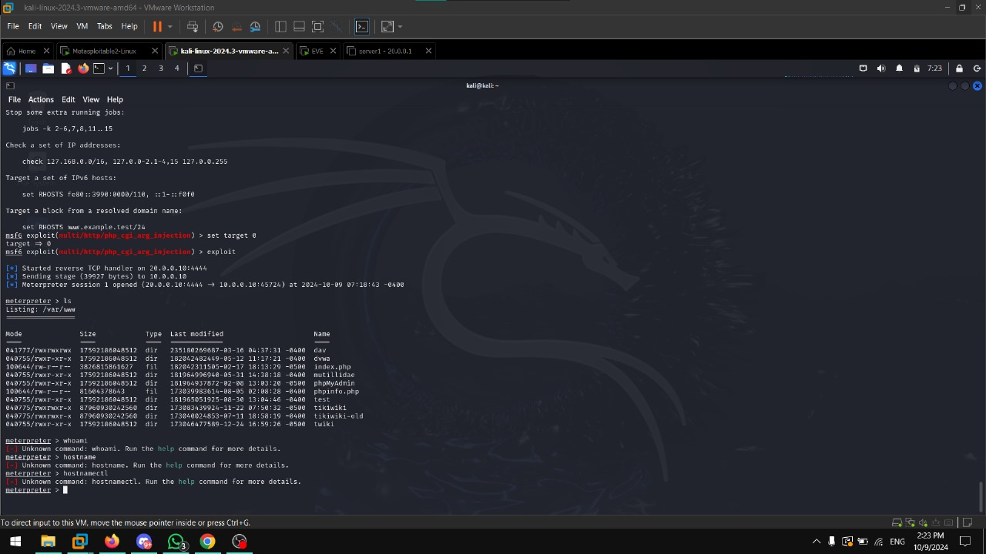

Slide 6
Exploitation on Host 10.0.0.10
Apache Tomcat AJP Connector Request Injection (Ghostcat)
The Apache Tomcat AJP Connector Request Injection vulnerability, also
known as **Ghostcat (CVE-2020-1938)**, allows attackers to read or
include files from the server via the AJP protocol. This can lead
to information disclosure or remote code execution if sensitive files or
configuration data are exposed.
msf > use auxiliary/admin/http/tomcat_ghostcat
msf auxiliary(tomcat_ghostcat) > show actions
msf auxiliary(tomcat_ghostcat) > set ACTION < action-name >
msf auxiliary(tomcat_ghostcat) > show options
...show and set options...
msf auxiliary(tomcat_ghostcat) > run

Slide 7
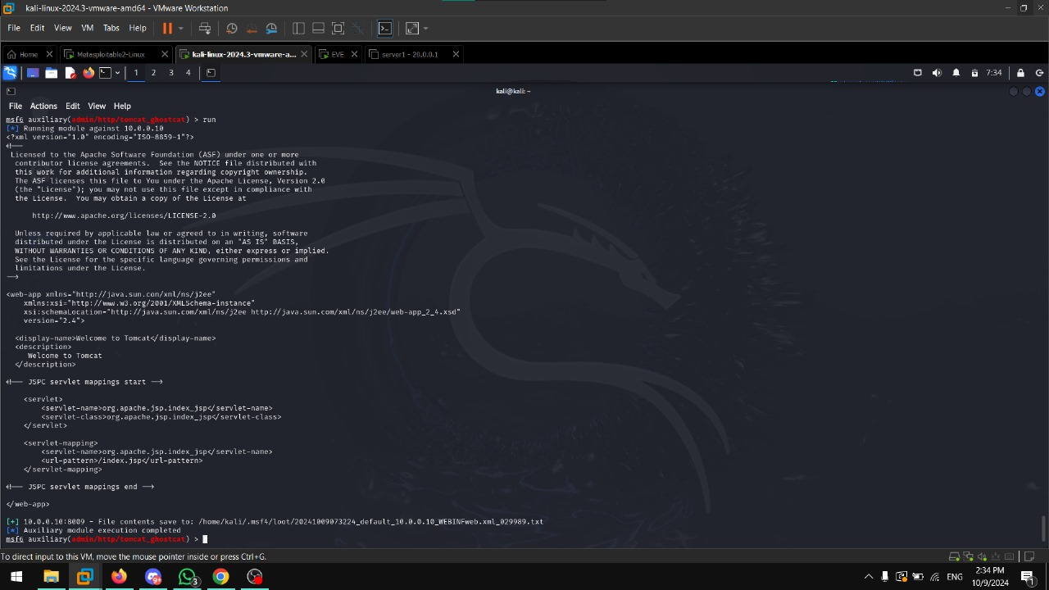

Slide 8
Exploitation on Host 10.0.0.10
Apache Tomcat AJP Connector Request Injection (Ghostcat)
A Simple Backdoor Shell allows attackers to execute arbitrary remotely
code on a compromised server. This type of vulnerability typically arises
from malicious files or scripts uploaded to a vulnerable system, enabling
attackers to control the server remotely.
msf > use exploit/multi/http/simple_backdoors_exec
msf exploit(simple_backdoors_exec) > show targets ...targets...
msf exploit(simple_backdoors_exec) > set TARGET < target-id >
msf exploit(simple_backdoors_exec) > show options ...show and set options...
msf exploit(simple_backdoors_exec) > exploit

Slide 9
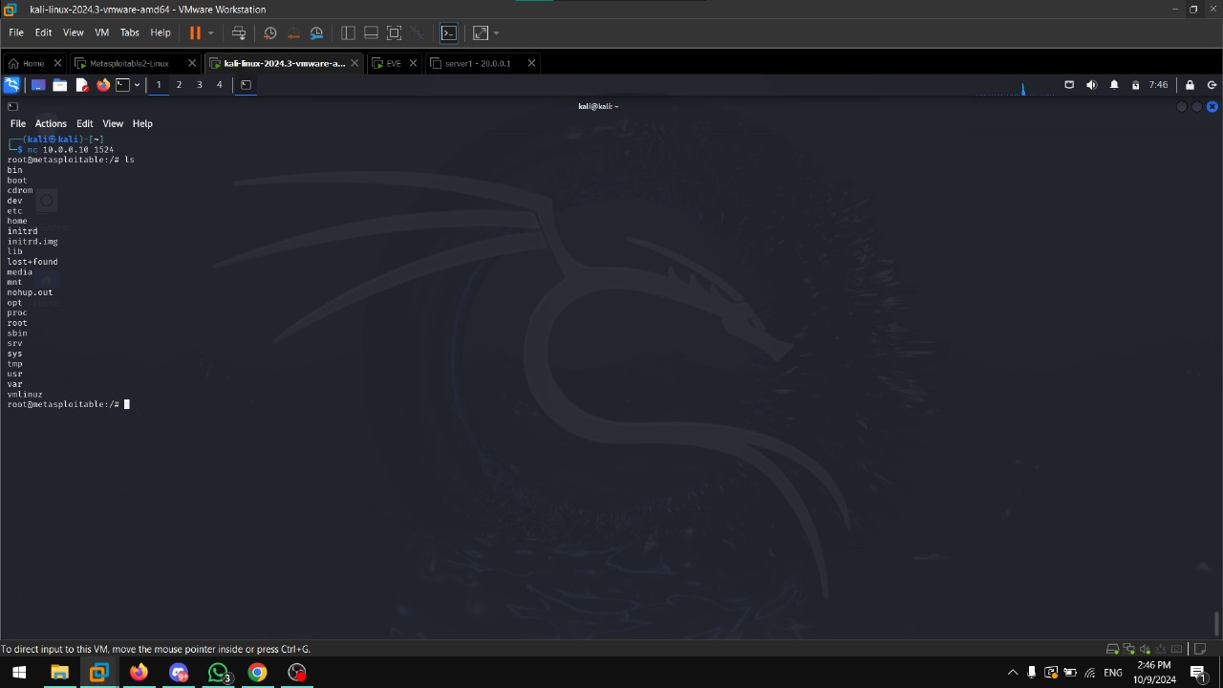

Slide 10
Exploitation on Host 10.0.0.10
Debian OpenSSH/OpenSSL Package Random Number Generator Weakness
The Debian OpenSSH/OpenSSL package vulnerability (CVE-2008-0166)
results from a weak random number generator, leading to predictable
cryptographic keys. This weakness allows attackers to easily guess SSH
keys, compromising the security of encrypted communications.
https://1500bytes.blogspot.com/2018/02/exploiting-openssh-47-openssl-098.html
https://github.com/mpgn/poodle-PoC?tab=readme-ov-file

Slide 11
Exploitation on Host 10.0.0.10
Debian OpenSSH/OpenSSL Package Random Number Generator Weakness
Debian OpenSSH/OpenSSL Package Random Number Generator Weakness
SSL Version 2 and 3 Protocol Detection
SSL Version 2 and 3 Protocol Detection
Debian OpenSSH/OpenSSL Package Random Number Generator Weakness
This vulnerability (CVE-2008-0166) weakens the random number generation
in Debian systems, leading to easily predictable SSH keys. It allows
attackers to compromise encrypted communications by exploiting weak
cryptographic keys.
SSL Version 2 and 3 Protocol Detection:
DSSL versions 2 and 3 are outdated and vulnerable to various attacks
such as POODLE. etecting these protocols signals the need to disable
them and upgrade to more secure protocols like TLS to prevent
man-in-the-middle attacks.

Slide 12
Exploitation on Host 10.0.0.10
VNC Server 'password' Password
The VNC Server 'password' Password** vulnerability allows attackers
to gain unauthorized access to a VNC server if the password is weak,
hardcoded, or easily guessable. This can lead to full control over the
remote system, compromising its security and data.

Slide 13
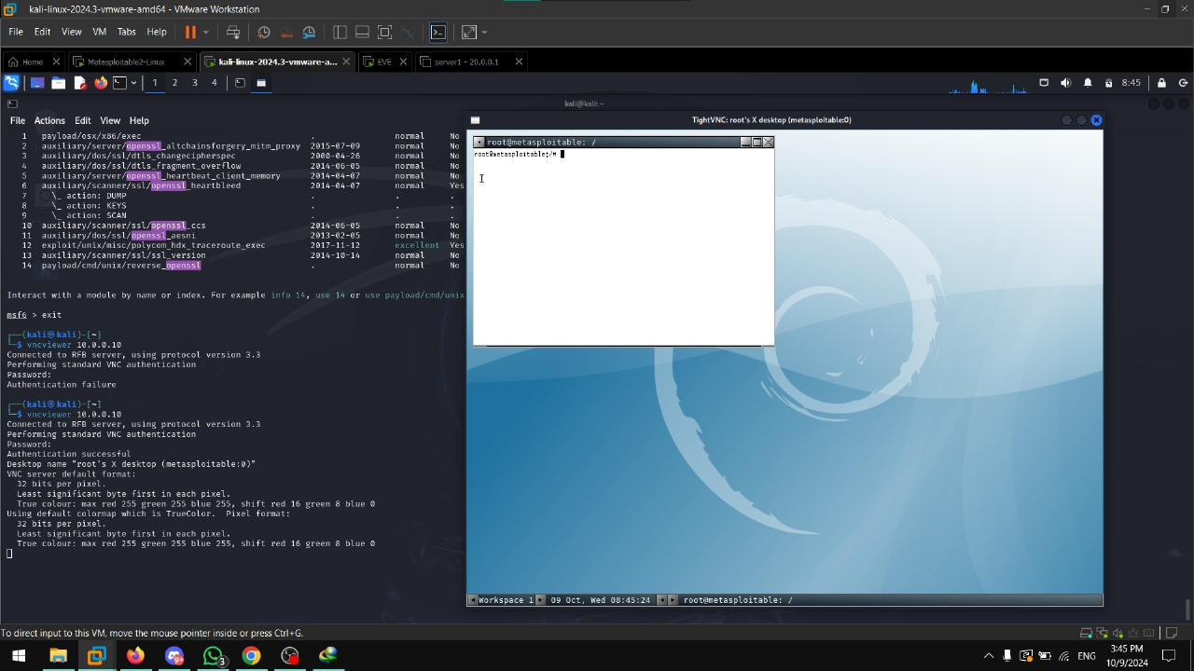

Slide 14
Exploitation on Host 10.0.0.10
phpMyAdmin prior to 4.8.6 SQLi vulnerability (PMASA-2019-3)
The phpMyAdmin SQL Injection vulnerability (PMASA-2019-3) in versions
before 4.8.6 allows attackers to execute arbitrary SQL commands through
maliciously crafted database queries. This flaw can lead to unauthorized
data access, modification, or deletion in the affected system.

Slide 15
Exploitation on Host 10.0.0.10
CGI Generic Remote File Inclusion lines
The CGI Generic Remote File Inclusion (RFI) vulnerability allows attackers
to include remote files, such as scripts, into a vulnerable web application
via improperly validated user input. This can lead to remote code execution,
enabling attackers to gain control over the affected server.

Slide 16
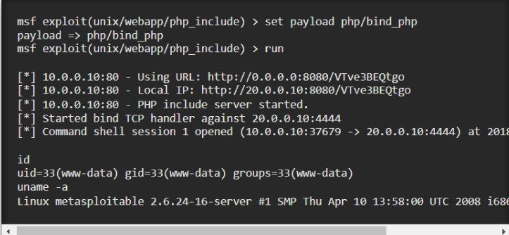

Slide 17
Exploitation on Host 10.0.0.10
ISC BIND Service Downgrade / Reflected DoS
The ISC BIND Service Downgrade / Reflected Denial of Service (DoS)
vulnerability allows attackers to exploit BIND servers by forcing them to
downgrade to less secure versions. This can lead to increased
susceptibility to further attacks and can overwhelm the server
with maliciously crafted DNS queries, causing service disruptions.

Slide 18
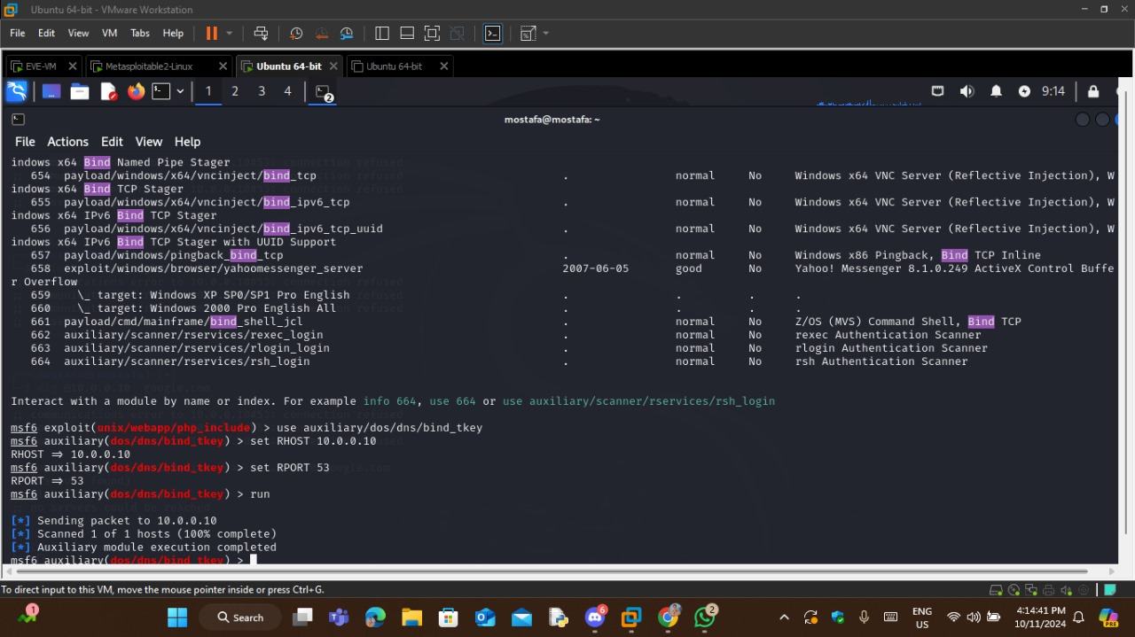

Slide 19
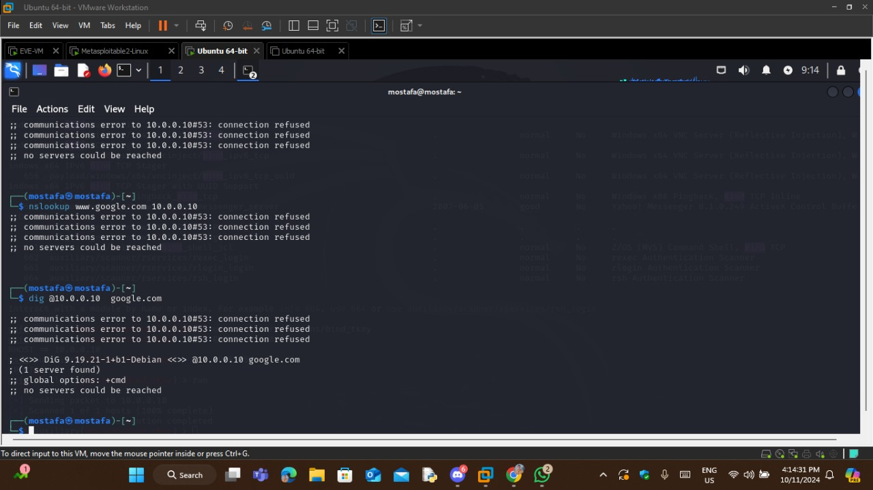

Slide 20
Exploitation on Host 10.0.0.10
NFS Shares World Readable
The NFS Shares World Readable vulnerability occurs when the Network
File System (NFS) shares are configured with overly permissive access
controls, allowing users to read the shared files. This can lead to
unauthorized data exposure and potentially compromise sensitive
information stored on the server.

Slide 21
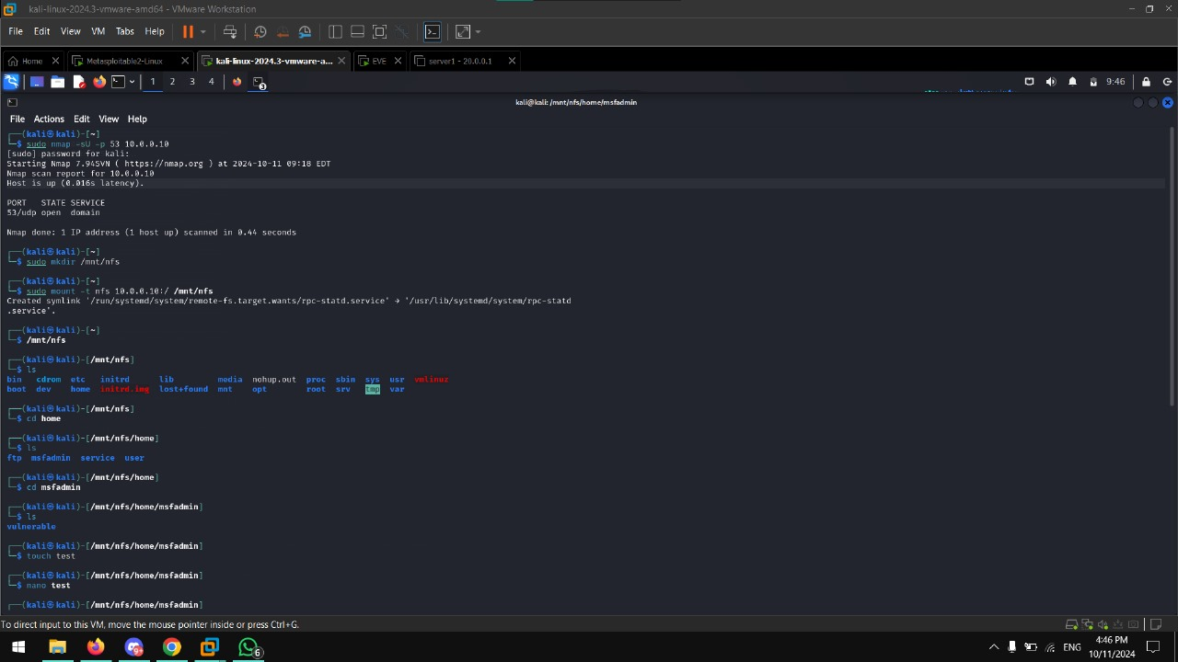

Slide 22
Exploitation on Host 10.0.0.10
PHP PHP-CGI Query String Parameter Injection Arbitrary Code Execution
The PHP PHP-CGI Query String Parameter Injection vulnerability allows
attackers to inject arbitrary code through crafted query string parameters
in PHP-CGI applications. Exploiting this flaw can lead to remote code
execution, giving attackers full control over the affected server.

Slide 23
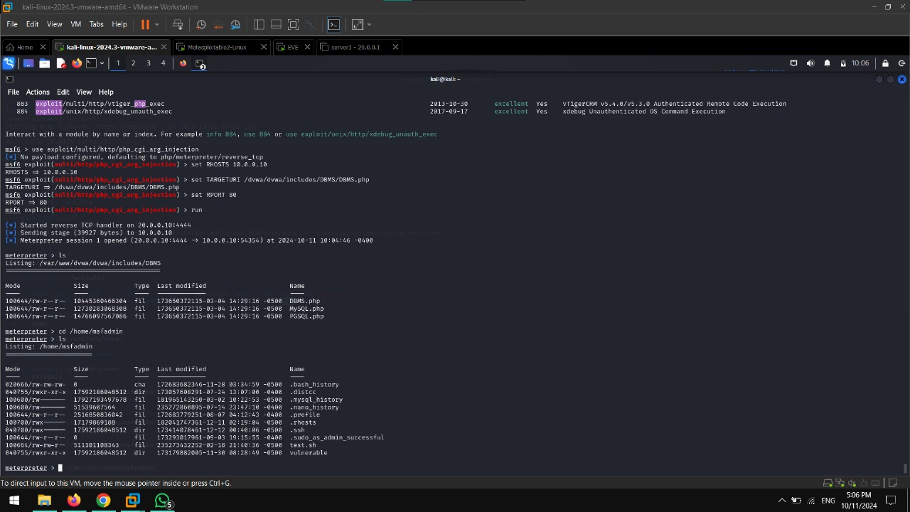

Slide 24
Exploitation on Host 10.0.0.10
Samba Badlock Vulnerability
The Samba Badlock Vulnerability (CVE-2016-2118) is a critical flaw in
Samba that allows attackers to exploit a race condition, potentially leading
to remote code execution or denial of service. This vulnerability affects
various Samba versions and can compromise systems interacting with
SMB/CIFS shares.

Slide 25
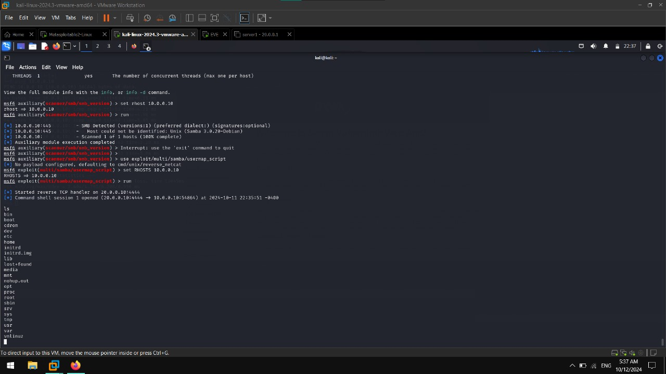

Slide 26
Thank you

