Slide 1
Vulnerability Assessment and Remediation Plan
Supervised by:
Eng. Nour eldin Essam
Oct-2024

Slide 2
Team members
1- Mostafa Fayez Saad Malek
2- Ahmed AboBaker Mohamed
3- Ebrahim Ahmed Azoz
4- Mina Maximous Masha

Slide 3
Project Objective:
This task aims to develop and implement secure configuration and patch management processes that minimize vulnerabilities within an organization's IT infrastructure. By establishing secure baseline configurations and maintaining an effective patch management system, the organization aims to reduce the risk of security incidents caused by misconfigurations or unpatched vulnerabilities.
Secure Configuration Management Plan:
Documentation outlining the secure baseline configurations for all systems.
Procedures for managing, auditing, and controlling configuration changes.
Patch Management Report:
A detailed report on the patch management process, including dates, systems patched, vulnerabilities addressed, and any issues encountered during patch deployment.

Slide 4
NFS “Network File Sharing”
NFS Functionality:
- Users can mount remote directories and access them like local directories.
- It’s commonly used in UNIX/Linux environments to share files across
different systems.
Port 111 (rpcbind):
- Facilitates the dynamic assignment of ports to RPC-based services, including NFS.
Port 2049 (NFS):
- Handles the actual file sharing and data transmission between the client and server.

Slide 5
In Metasploitable 2,
NFS is misconfigured so that it provides full access to its entire root
filesystem to all devices on the network. As you can see from
”/etc/exports”
down below, means that all hosts are allowed to mount the root
filesystem which is ill-advised. It is considered best practice to limit
access to only necessary hosts and restrict to only necessary
directories.
/var/www host1.example.com(rw, sync, no_sub-tree_check) host2.example.com(r, sync, no_sub-tree_check)

Slide 6
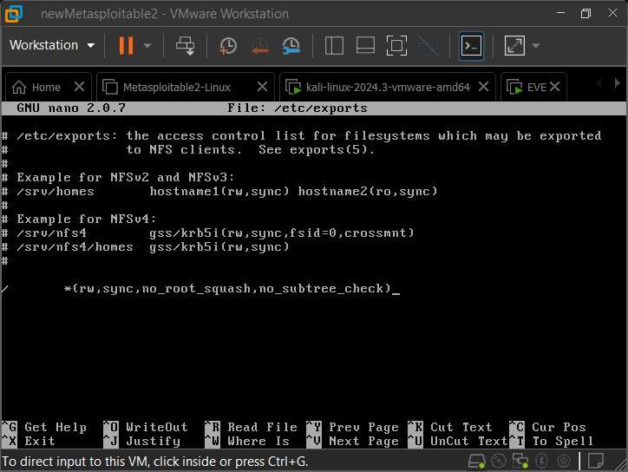

Slide 7
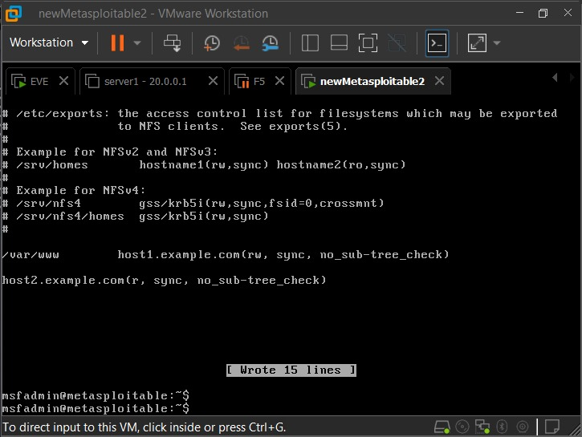

Slide 8
VNC(5900)
The VNC password for Metasploitable 2 is “password” funnily enough which makes
it very easy to brute-force. The VNC password should be changed by using The
command vncpasswd.

Slide 9
SMB (139, 445)
Samba or SMB for short is a file sharing service that lets users access files and printer
services in a network. Using MSF6, the exploit exploit/multi/samba/usermap_script gains
root access to Metasploitable 2.The exploit can be rendered useless if the line username
map script =
“/etc/samba/scripts/mapusers.sh”
is commented.

Slide 10
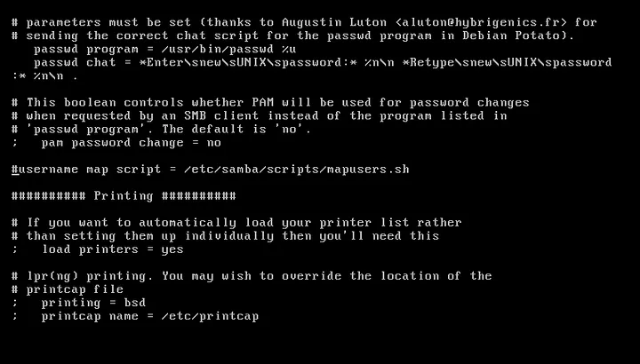

Slide 11
Apache Tomcat AJP Connector (8009) The AJP Connector facilitates communication between Tomcat and the installed web server which in this
case is Apache. Its similar to that of a load balancer as it offload static rendering of web pages to the web
server while directing dynamic java processing to Tomcat. This particular version of Tomcat installed on
Metasploitable 2 is running a vulnerable AJP Connector. The Ghostcat vulnerability (CVE-2020–1938)
allows an attacker to retrieve all files in the web application that can be reached with
“ServletContext.getResourceAsStream()”.
It also allows the attacker to process any file as JSP which coupled with remote file upload could lead to
remote code execution. This vulnerability can be remediated by adding the following line to
“/etc/tomcat5.5/server.xml ”
which provides a layer of authentication.

Slide 12
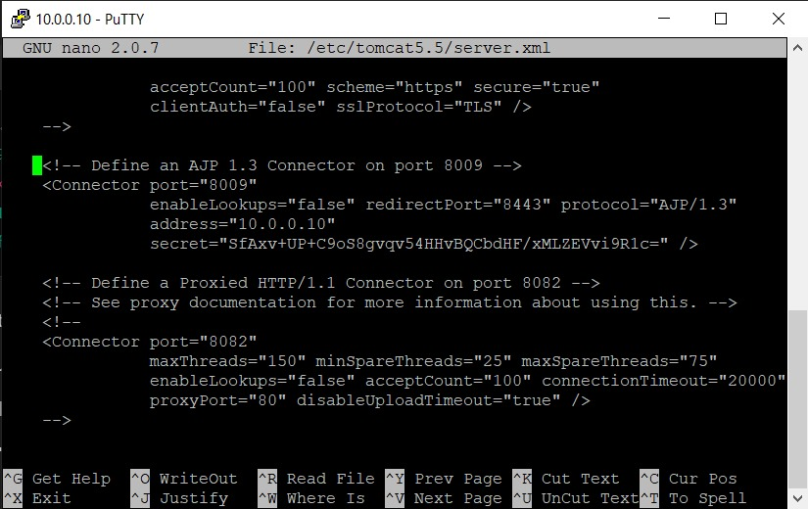

Slide 13
FTP (21) FTP is the file transfer protocol that is used transfer files between remote hosts. Metasploitable 2 is
running version vsftpd 2.3.4 which is vulnerable to backdoor code execution. In order to remediate this
vulnerability, anonymous upload should be anon_upload_enable=NO should be set in /etc/vsftpd.conf.
Furthermore, due to the fact that the backdoor resides on port 6200, incoming traffic to port 6200
should be blocked

Slide 14
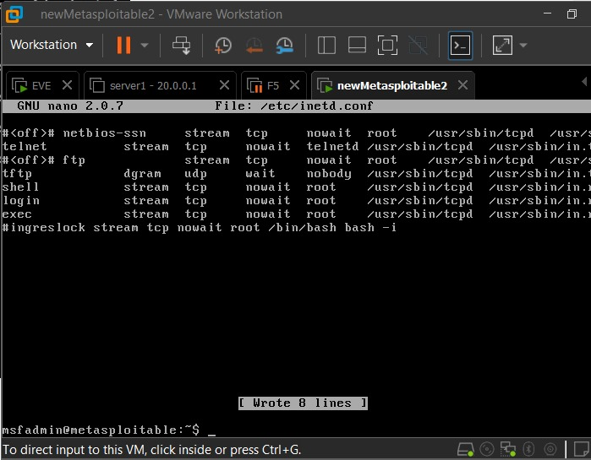

Slide 15
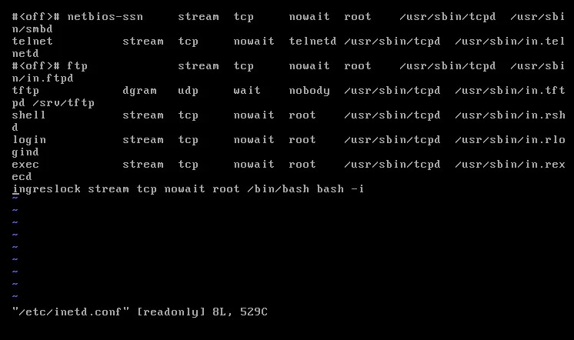

Slide 16
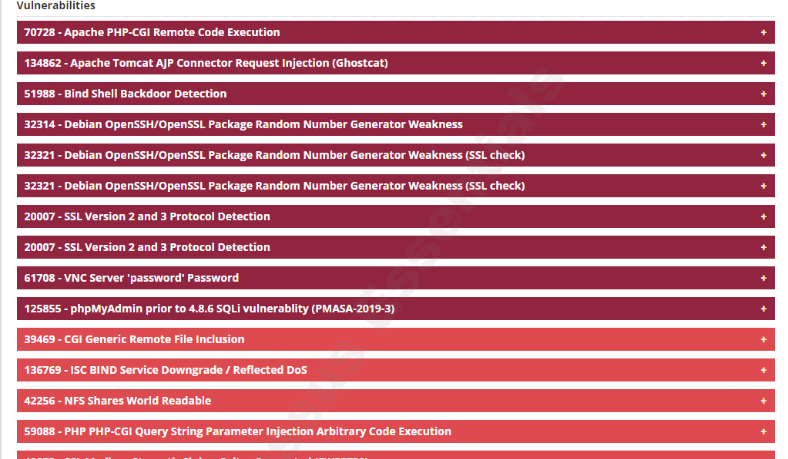
Before making Remediation

Slide 17
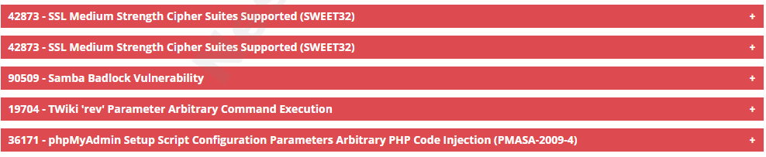
Before making Remediation

Slide 18
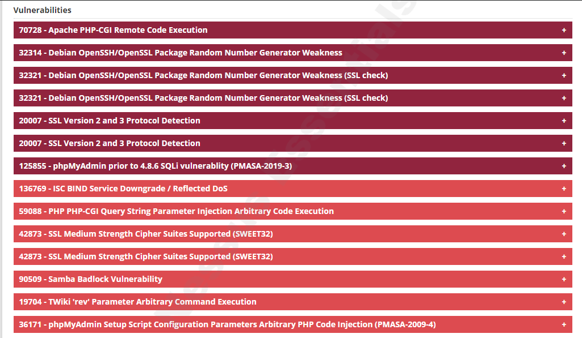
After making Remediation

Slide 19
Thank you

