Slide 1
Pashto Izdakrra
Software Engineering Course Project
Session 2012-2013

Slide 2
OUR TEAM & ROLES
Aakif Sultan 14100136
Danish Jalil 14100109
Quratulain Zahid Sheikh 14100146
Zarmina Khan 14100205
Project Planner - Requirements Analyst – Designer - Programmer - Documentation Manager – Report Writer - Tester -

Slide 3
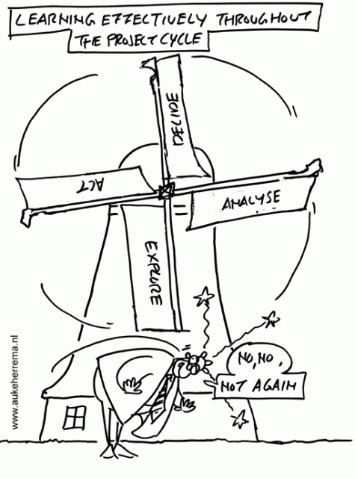
We decided to follow the righteous path...

Slide 4
We decided to follow the RIGHT path...

Slide 5
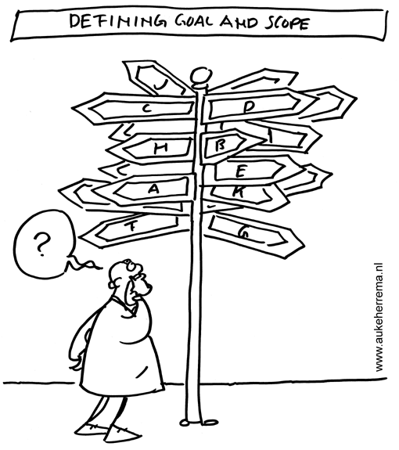

Slide 6
Brief
Introduction
to
Pashto
Izhdakkra

Slide 7
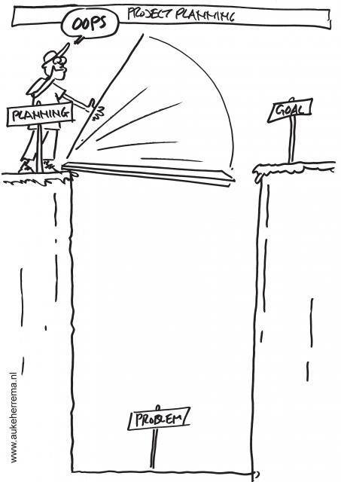

Slide 8
DEVELOPMENT PROCESS MODEL
>WATERFALL MODEL
> WHY?
Simple and easy to understand and use.
Time spent early on making sure requirements and design are correct saves much time and effort later
Easy to manage due to the rigidity of the model – each phase has specific deliverables and a review process.
Phases are processed and completed one at a time.

Slide 9
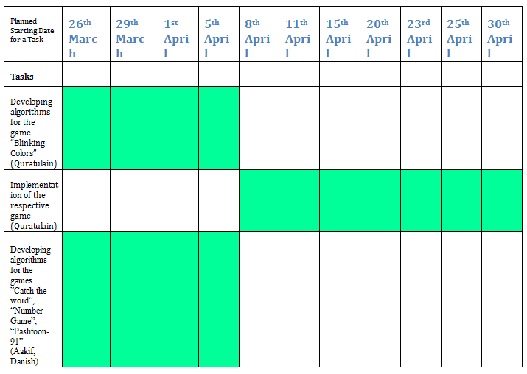
PROJECT ACTIVITIES TIMELINE

Slide 10
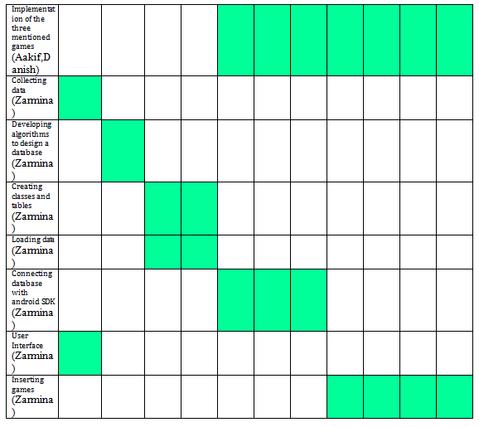
PROJECT ACTIVITIES TIMELINE

Slide 11

TOOLS &TECHNOLOGIES
SQLite Manager
Sound Recorder
WMA to MP3 convertor
Microsoft Office Visio
Android SDK API 17
Eclipse
GITHUB URL:https://github.com/Mina92/Pashto_software.git
LibreOffice Impress
Microsoft Office Word

Slide 12
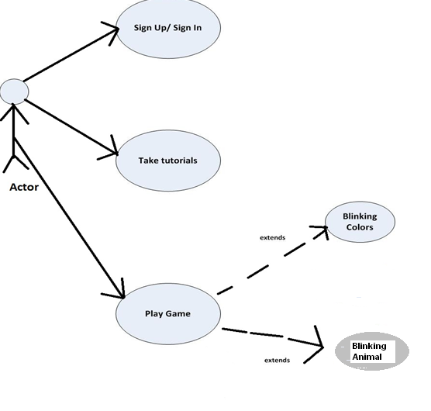
USE CASE DIAGRAM

Slide 13
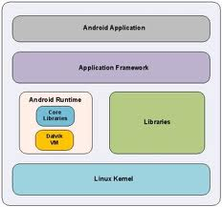
SYSTEM ARCHITECTURE
eg.SQLite Manager

Slide 14
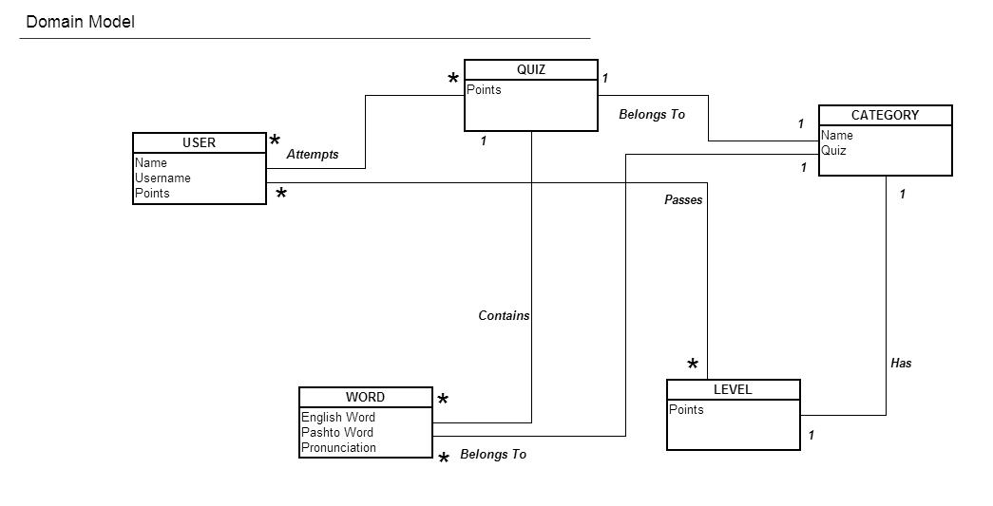
DOMAIN MODEL

Slide 15
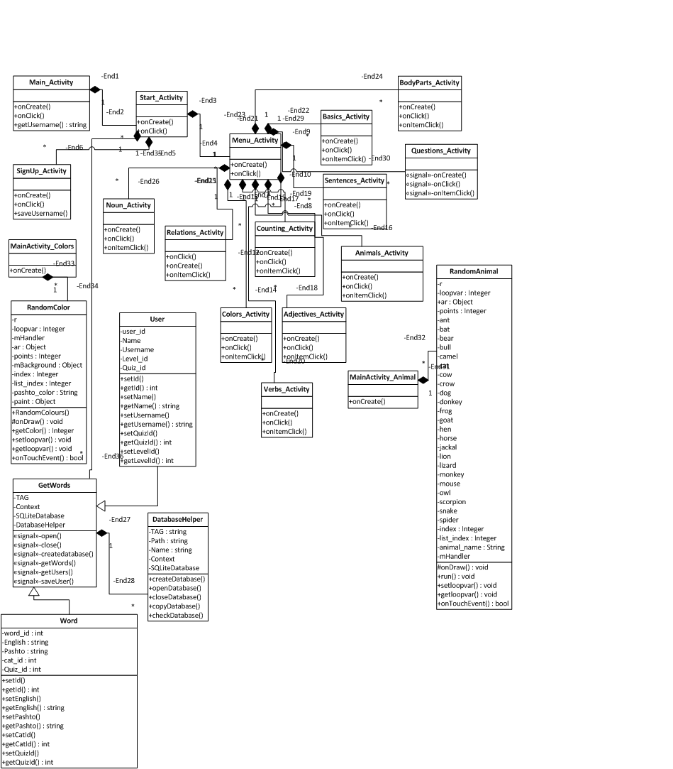
CLASS DIAGRAM

Slide 16
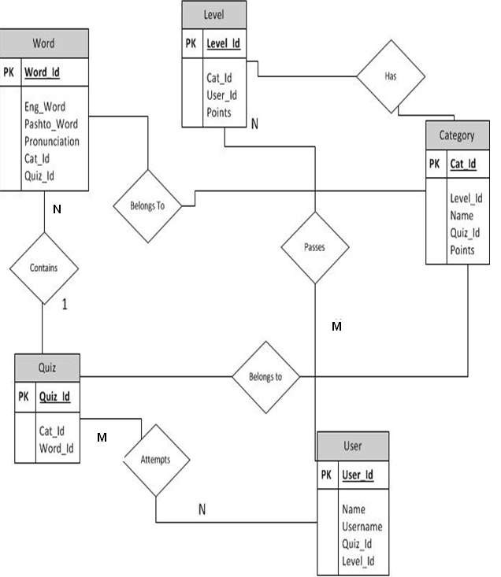
DATABASE SCHEMA

Slide 17
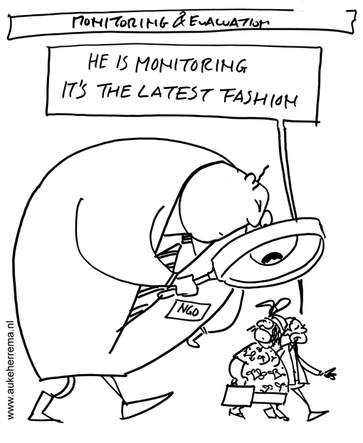
We were monitored every week....

Slide 18
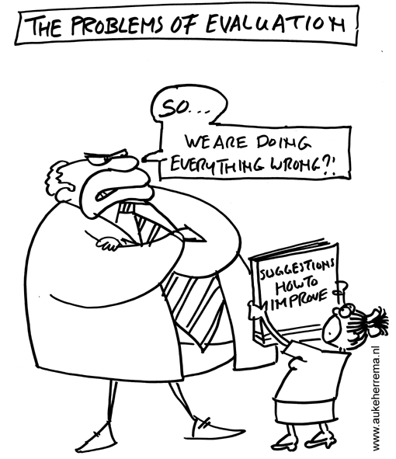
At times,
things went bad ….

Slide 19
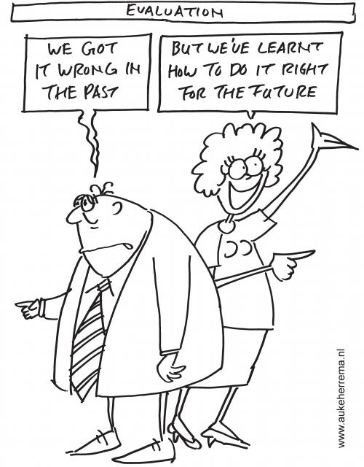
BUT...
We managed to figure things out!!
KEY: B +ve

Slide 20
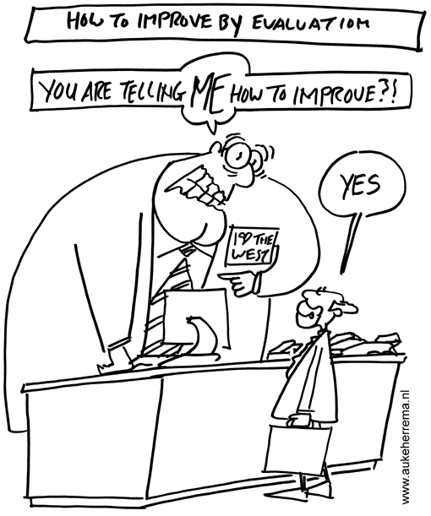
No group is PERFECT.
So, this was meant to happen....

Slide 21
Let's learn Pashto!DEMONSTRATION

Slide 22
A special thank you
To
Wasif Ali,
for lending us
his voice!

Slide 23
References
http://www.cs.virginia.edu/~jck/publications/fie05-cs340-v5.pdf
Cartoons/Images:
  http://www.smarttoolkit.net/?q=image/tid/8
  http://www.google.com

