Slide 1
Data Analysis
Mina Badri

Slide 2
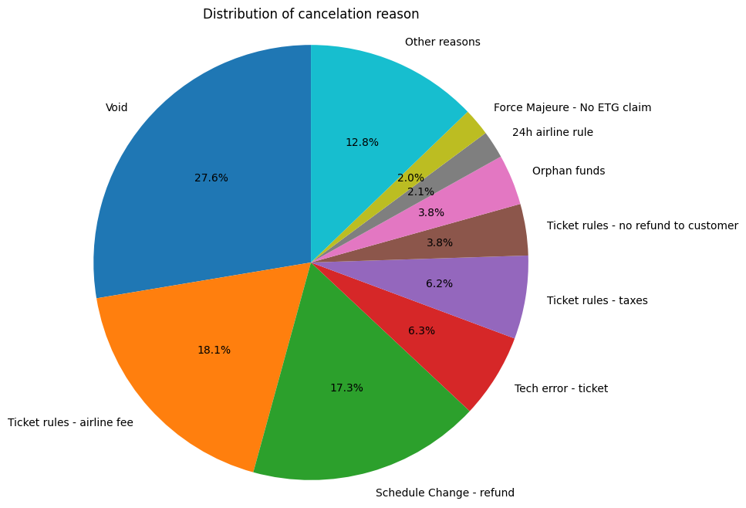
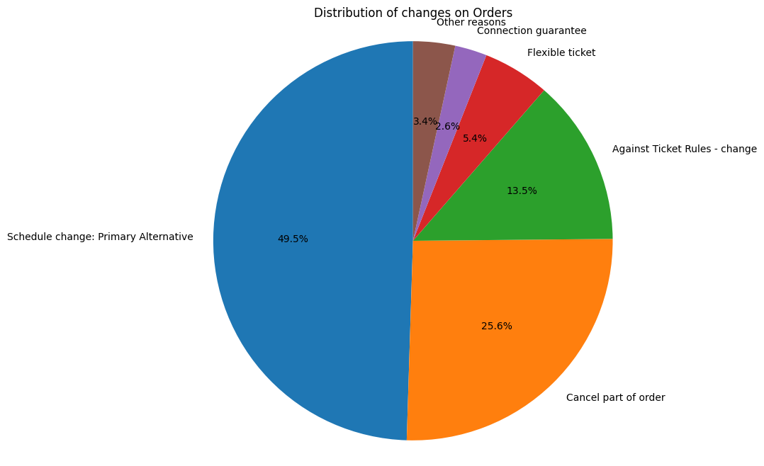
Changes and Cancelations
Based on our finding we can see 4.07% of orders are canceled and 5.98% of orders are changed.
The pie charts below show us the most reason for cancelation and changes (just based on order file)
The first action here maybe can be that we put some policies to reduce the percentage of 'Void' as a reason for cancelation/Changes. Knowing the reason can lead us to a solution.

Slide 3
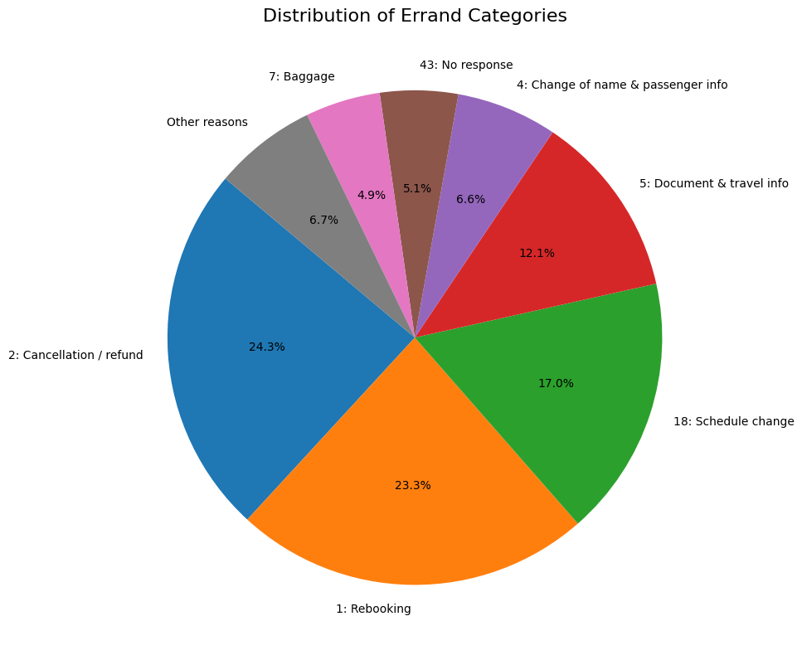
Errands
After combining Orders and Errands file, we can dive deeper into errands (Category and type)
"other reasons" is accumulation of all categories that occupy less than 2% of errands.

Slide 4
For top 3 errand categories, the type of errands they usually have:
For errand_category : Cancellation / refund
Errand Type | Count
Ask about cxnl rules | 450383
Already cxnl | 145943
Incorrect department-SC | 19587
Already handled | 16516
Incorrect department | 9005
Other reasons | 2039455

Slide 5
For errand_category : Rebooking
Errand Type | Count
No Flexible Ticket | 459075
Against Flexible Ticket | 112805
Incorrect department-SC | 33578
Incorrect department | 10989
Already handled | 7015
Other reasons | 2057427

Slide 6
For errand_category : Schedule change
Errand Type | Count
We have inf. about SC | 227403
Pax has discovered sc by themselves | 108063
Incorrect department | 87587
Against Connection Guarantee | 16347
Already handled | 12914
Other reasons | 2228575

Slide 7
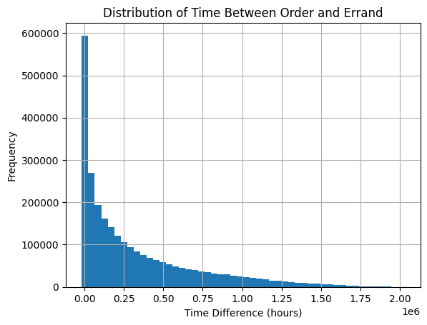
Comparing the time of order and when the errand happens, we can see most of them happen in the first hours after order.
Top 10 Errand Categories when time difference is more than 1 week: Rebooking
Top 10 Errand Categories when time difference is less 1 week: Cancellation / refund

Slide 8
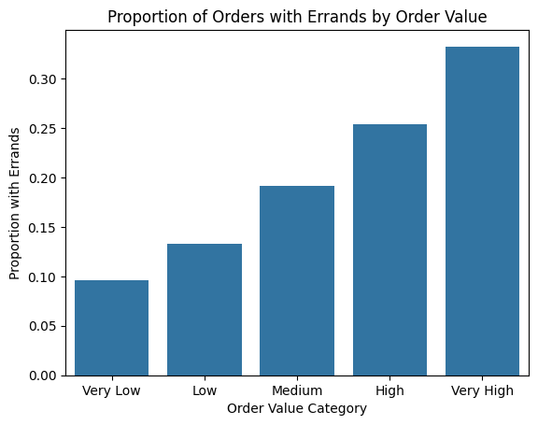
The next chart shows us that the higher the amount of order, we are going to have the higher probability of an errand on it.

Slide 9
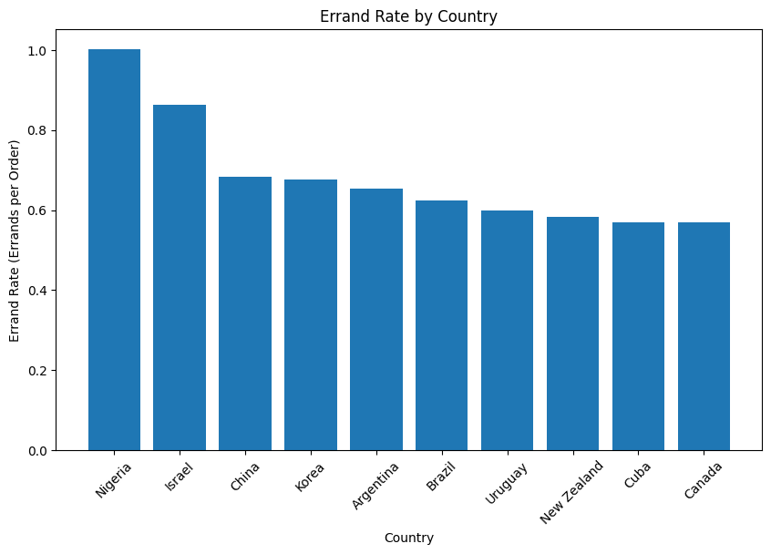
Following is the chart that shows us top 10 countries that have an errand.

Slide 10
Comparing journey type shows us, that multi stop orders are more probable to have errands:
Journey_Type_ID | Count
MultiStop | 8.991261
One-way | 5.887160
Round-trip | 6.756410

Slide 11
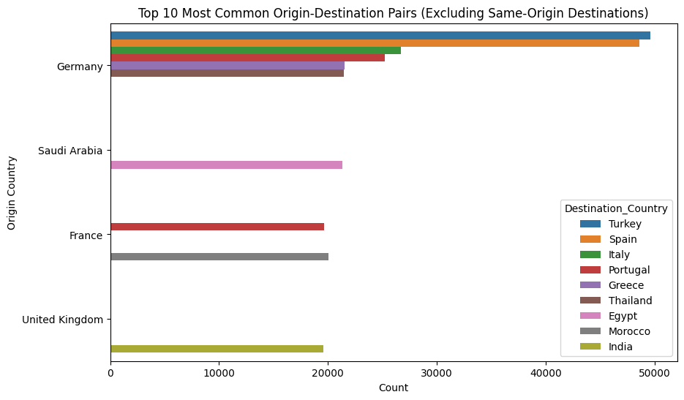
Origins and Destinations
Most travels start from: Germany with 526442 number
The most attractive destination is: Thailand with 411729 visits
The country with the highest average amount of payment is: Argentina with 6408.48USD
The country with the highest average revenue is: Argentina with an average revenue of 327.76USD
Most orders are for domestic flights but if we exclude them, we can see the result in the chart

Slide 12
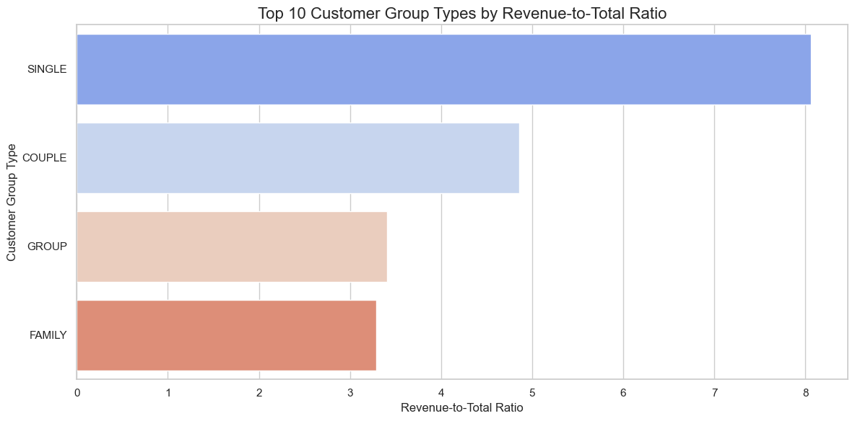
Revenue Analysis
Our single customers bring the most revenue

Slide 13
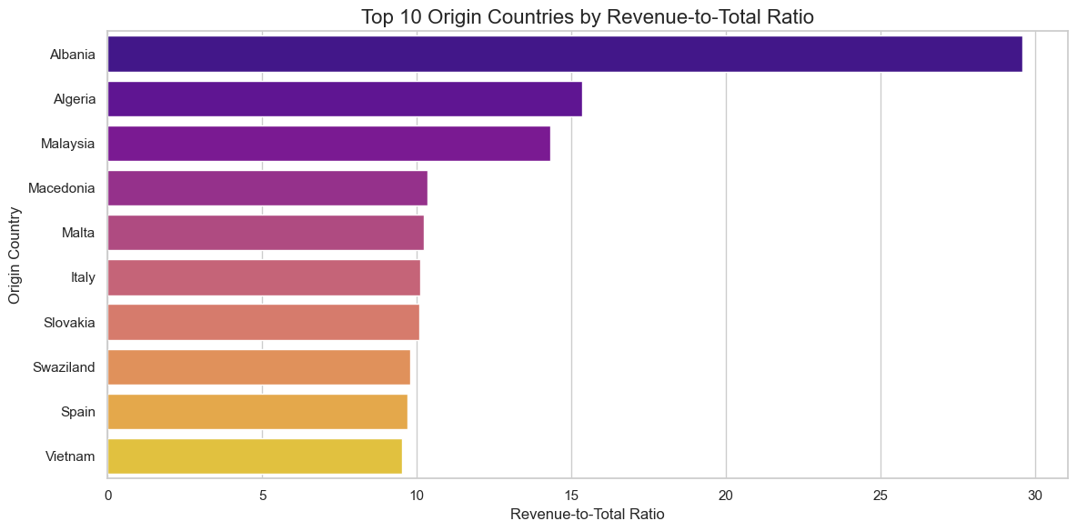
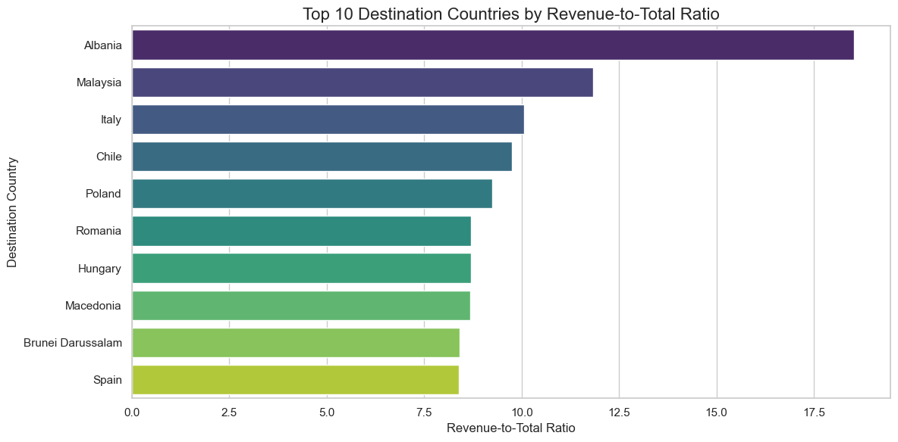
By comparing the revenue to total amount spent based on destination/origin countries, we can see if Albania is one of the countries we have the highest revenue

Slide 14
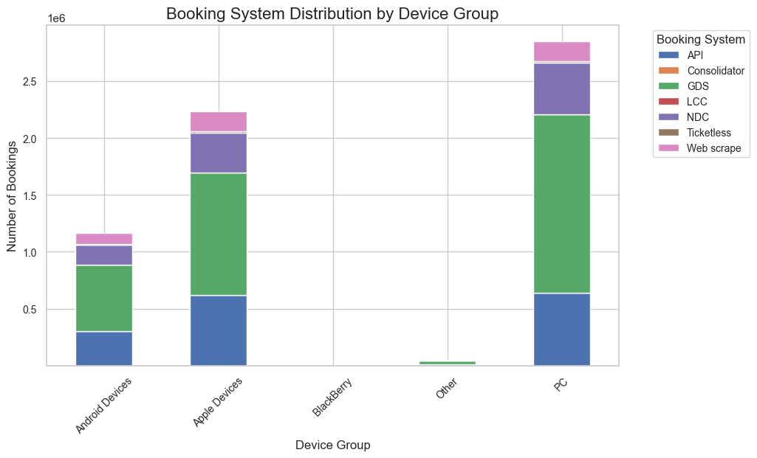
Devices Analysis
Devices that customers have contacted the company with alone wouldn't show anything concrete. We need information either they're using application or website, also type of browser they're using can be helpful. However, we can see the percentage of errands on PC is higher that other groups and we can say that using website is more prone to any kind of problem. Further analysis need more data on this part.
The chart below shows us the distribution of booking system source to devices
Here we can ensure support for PC-based GDS bookings.

Slide 15
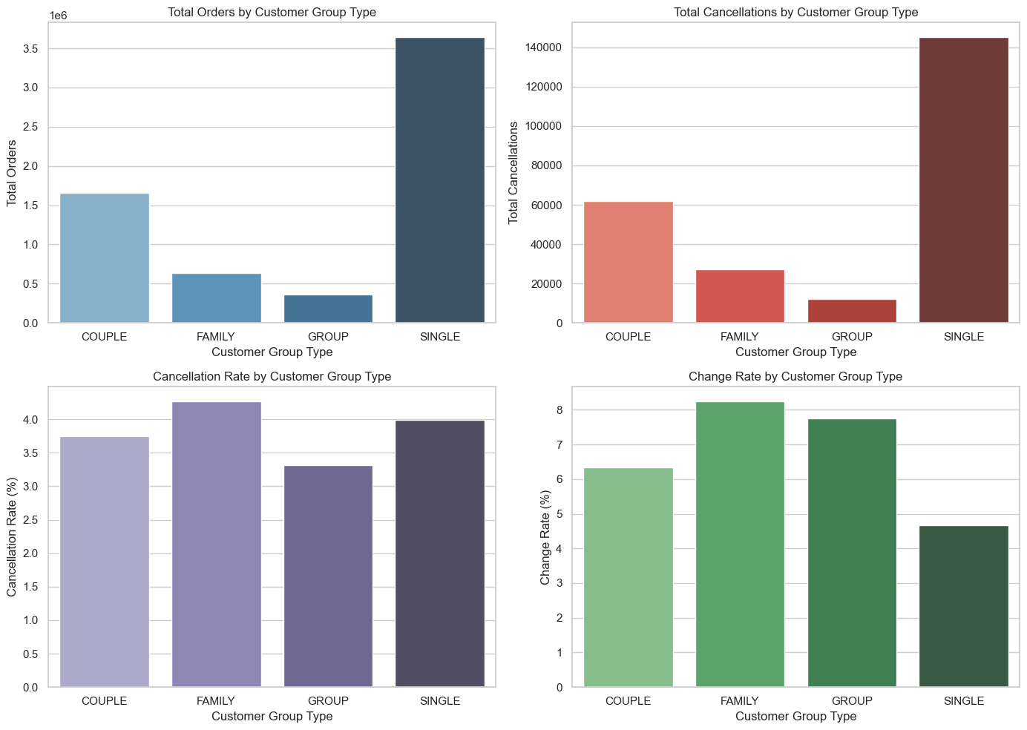
Customer type Analysis
Let's look at group type pattern on orders and errands

Slide 16
Focus on Families and Singles to Reduce Cancellations:
For Families we can provide more flexible cancellation policies tailored to family-specific concerns, such as unforeseen emergencies or child-related issues.
For singles:
we can offer easy rebooking options. Also, we can introduce fee waivers or reduced fees for changes to motivate these customers to adjust their plans rather than cancel.
For changes:
Assign customer support for Families and Groups, who are more likely to require changes.

Slide 17
our single customers bring the most revenue

Slide 18
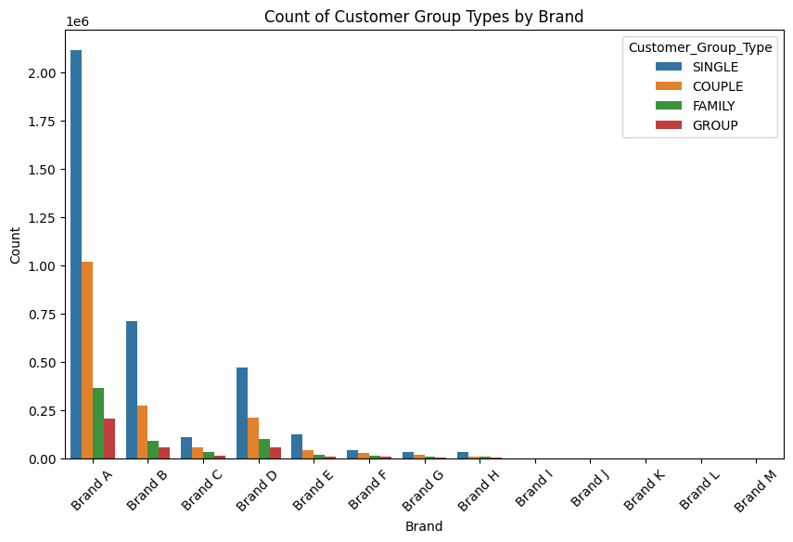
From the chart below we can see that our Brand A is the most popular one

Slide 19
Thank you!

