Slide 1
Case- Data Engineer in Fintech
BA Risk Solutions
Mina Badri

Slide 2
Overview
Small credit institution
Data management in the form of Excel document
Scale to include larger portfolios and more complex products

Slide 3
Requirement
The pipeline should be able to manage medium quantities of data, which is estimated to be in the range of millions of new rows of data per year.
The flexibility of the model.
Inconsistent data quality.
Business meaning.
Supported usage/query patterns.
Scalability of data pipeline. Due to typical business growth, the amount of ingested data is expected to grow organically at an average rate of 10% yearly for the coming 5 years.

Slide 4
Database
Snowflake
Relational (For transactions)
Snowflake is designed for scalability and can easily handle the growth with minimal operational overhead.
Snowflake offers elastic scaling, auto-scaling of compute resources
Snowflake’s separation of storage and compute
Highly compatible with ETL tools
Easily used with powerBI

Slide 5
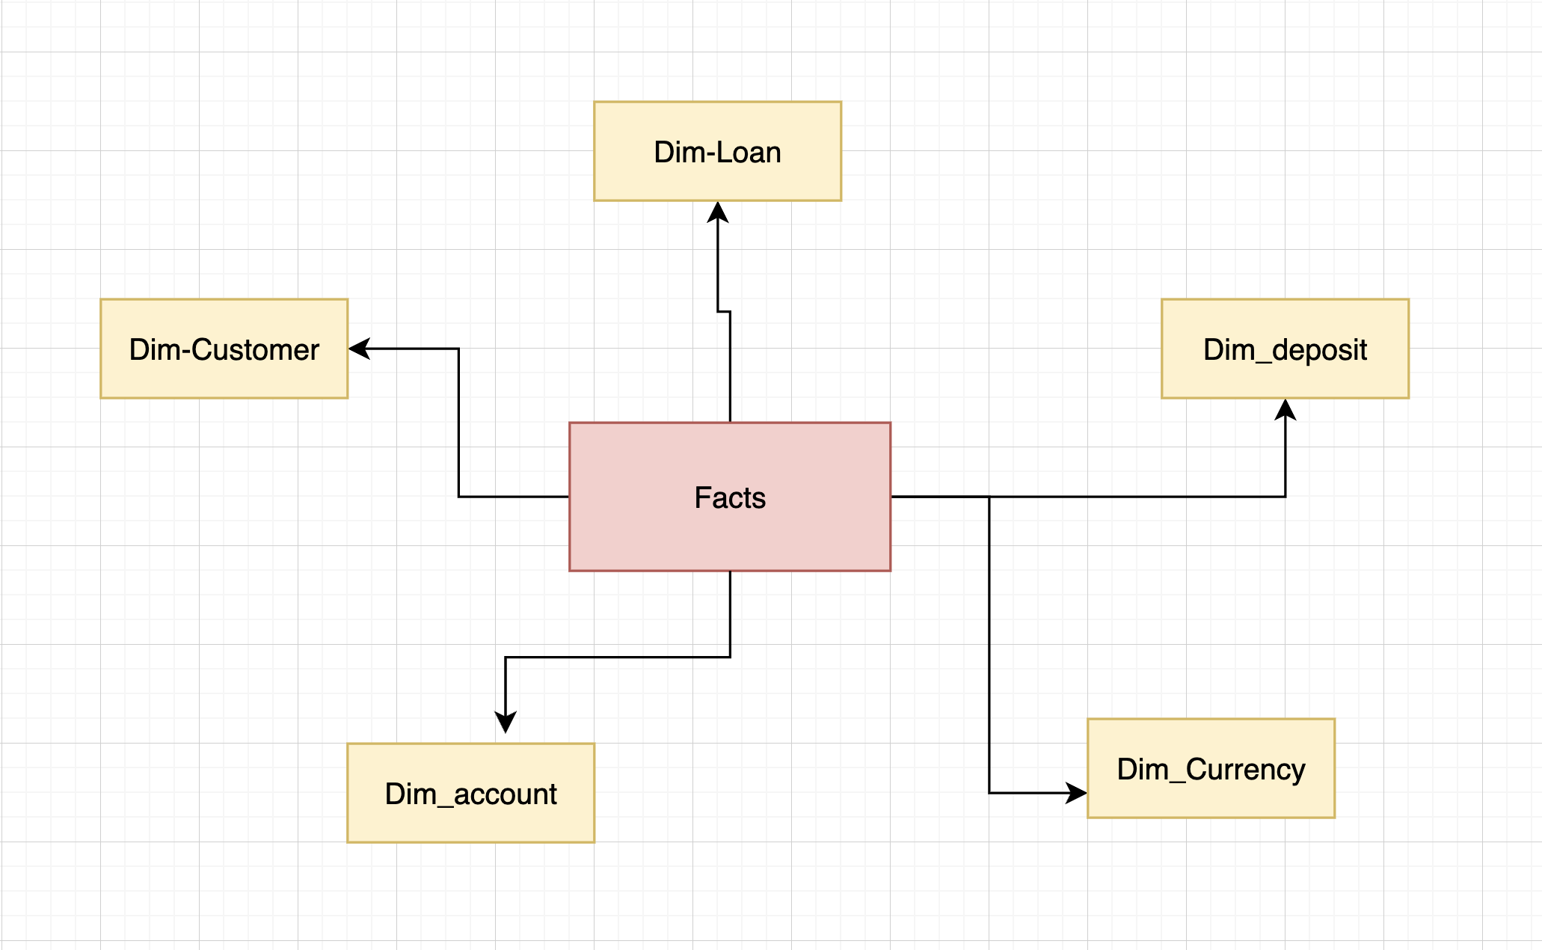
Data Modeling Proposal
Star schema
Not as strict as 3NF
Fast querying and reporting
Flexibility

Slide 6
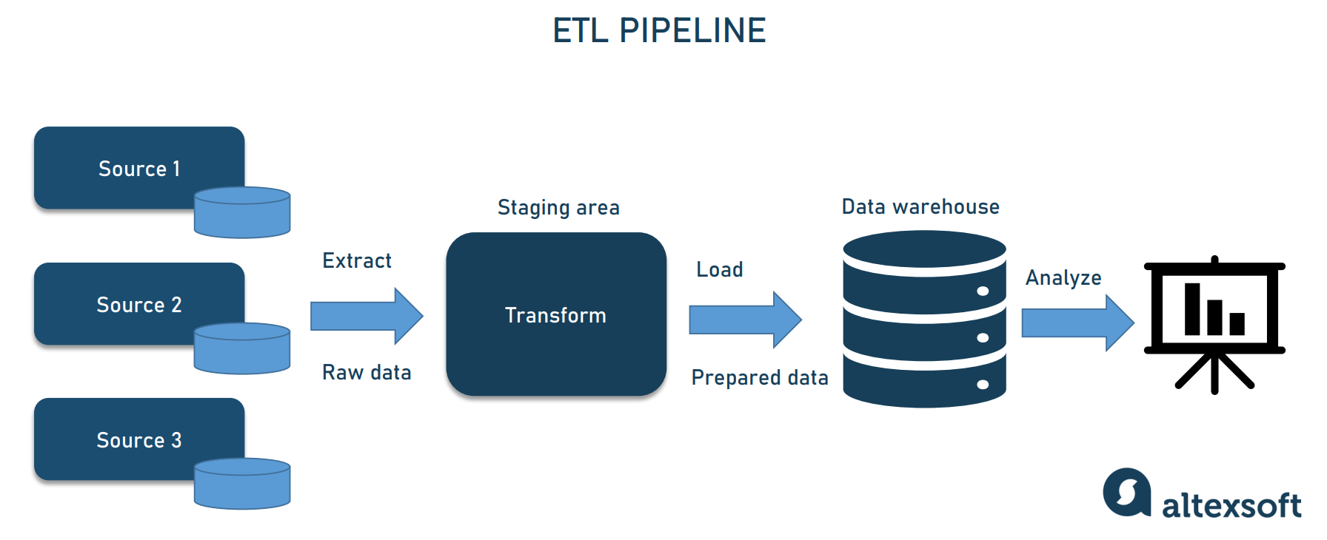
Data Pipeline

Slide 7
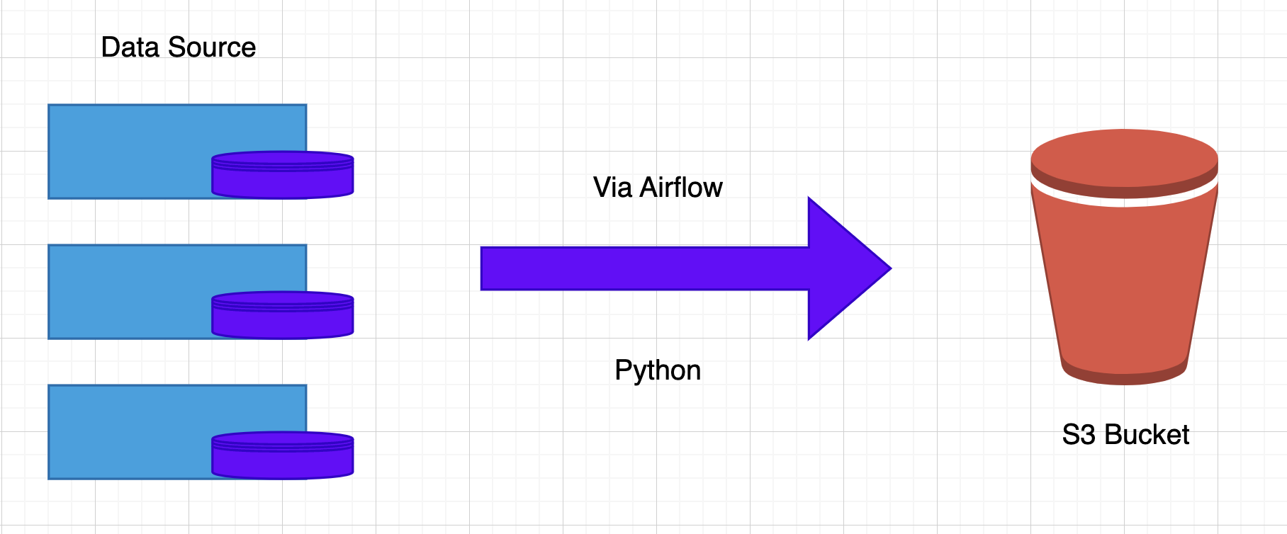
Load data to S3
Formats
Flexibility (ML operations)
Raw data on cloud
data quality management, cost optimization, and fault toleranc

Slide 8
External and Staging Tables
Data Quality and Cleansing
Separation of Raw and Transformed Data
Handling Data Integrity Issues
Data Transformation Flexibility
Error Handling and Data Recovery:
Isolation of Data Sources
Simplifying Data Governance:

Slide 9
Thank you

