Slide 1

Data Science Introduction to data-science:- Project 2
Ain-Shams university
Supervised by :- Dr. Asharf.S.Hussien
Student Name:- Mina Lion
Department :- Scientific Computing.
ID : 2016170455.
section :- 5.

Slide 2

Agenda
Part 1 (Data wrangling)
Part 2 (Exploratory Data Analysis) - Payroll distribution - Correlation between payroll and winning percentage
Part 3 (Data Transformations ) - Standardizing across year - Expected wins - Spending efficiency

Slide 3
Part 1 : Data Wrangling
In This Part we Use the SQL lite 3 to Get the Columns we need From the data Base
The Most Important Columns are W, G and Salary
G Stands for The number of Games the Team Played
W Stands for the number of Games the Team Won
Salary is the Salary Of Each Player In the Team
We use the salary to get the payroll (sum of salary)
We use the W and G to get the winning percentage
We get more columns like teamID and yearID for the Next Parts

Slide 4
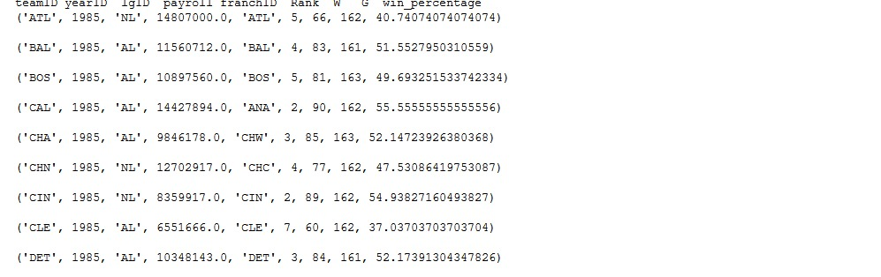
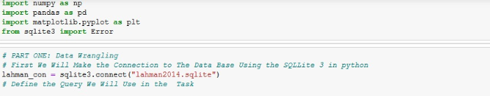
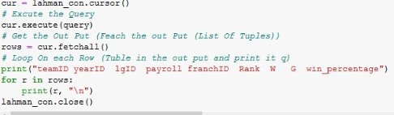
Part 1 : Data wrangling cont.
Result:-

Slide 5
Part 2 : Data Exploratory and Analysis
We Do The Data Exploratory and Analysis in Two Steps :
Payroll Distribution : - In This Step we get the total Payroll for All Teams in the years from 1990 to 2014 Then We plot the Total Payroll on y-axis and the years on the x-axis - Also In this Step We Get the Payroll For each team for all years from 1990 to 2014 then , we plot between the years on the x-axis and the payroll for this team on the y-axis Note that we have 35 team so we have 35 plots
Correlation between payroll and winning percentage : - In This step we want to know the correlation between the winning percentage of each team and the payroll , So we split the years to five periods (each one has six years) - for each period we get the payroll for all teams for the selected year divided by the number of teams (average payroll) - the same thing for the winning percentage (average winning percentage ) for all teams in the selected year
- the last thing we have five plots (each plot the average payroll on the x-axis and the winning percentage on the y-axis)

Slide 6
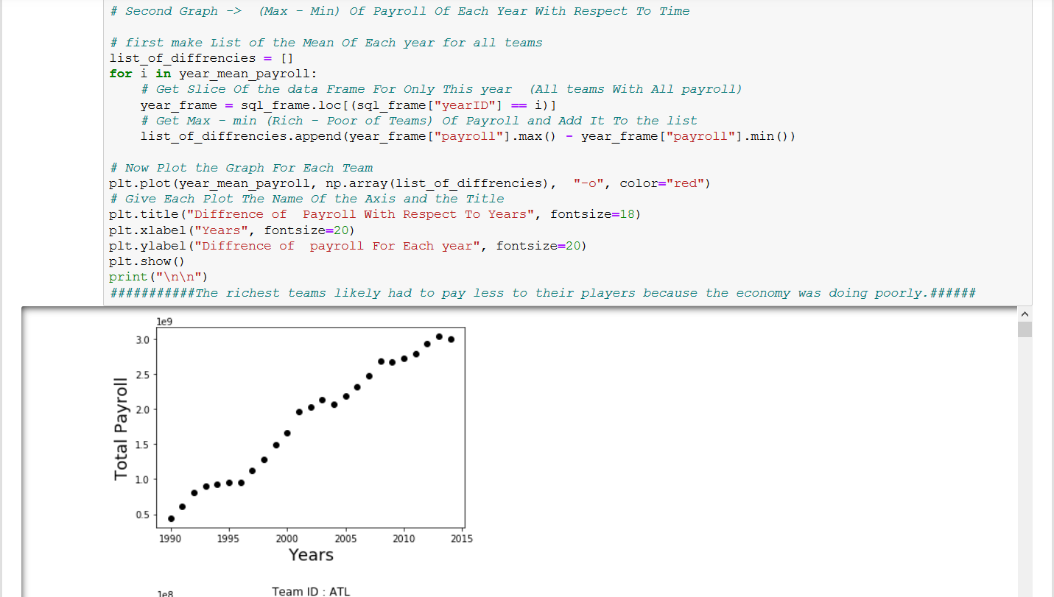
Part 2 : Data Exploratory and Analysis Cont.
Step 1 : Payroll Distribution :

Slide 7
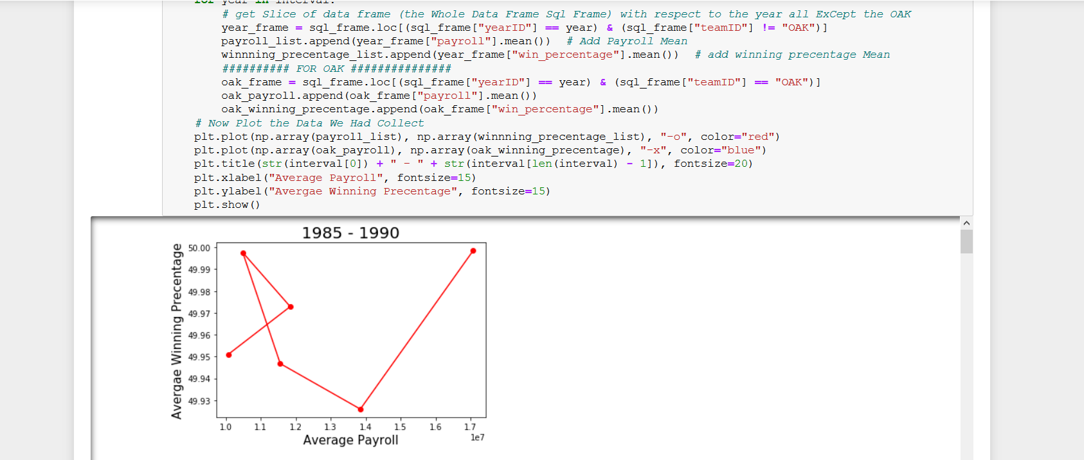
Part 2 : Data Exploratory and Analysis Cont.
Step 2 : Correlation Between Payroll and the Winning Percentage

Slide 8
Part 3 : Data Transformation
We Do The Data Transformation in Three Steps :
Standardizing across year : - In This Step for each year from 1985 to 2014 we get the payroll for all teams , then we get the standardized payroll and the winning percentage - After This We plot between the Standardized Payroll on the x-axis and the winning percentage on the y-axis
Expected wins : - In This Step we Get the Expected Wins For Each Team Through Equation Using the Standardized Payroll - The Expected Wins Is the Expected Number of Games the Team Should Win
Spending efficiency - In This Step We Get the efficiency For each team using the Expected wins and the Winning percentage for each team for years from 1985 to 2014

Slide 9
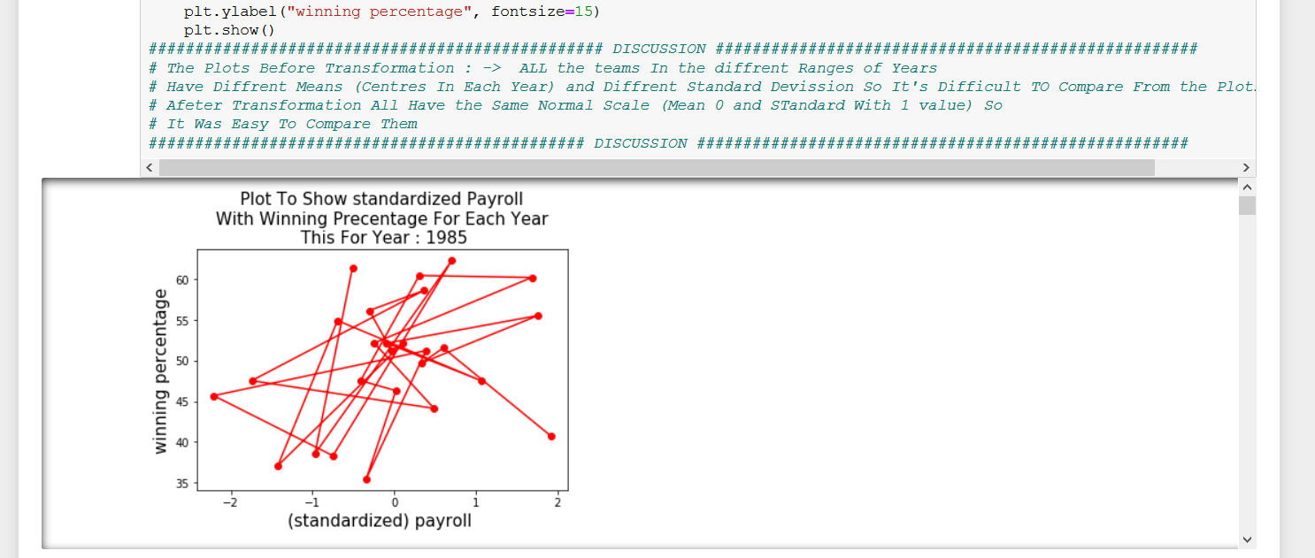
Part 3 : Data Transformation cont.
Step 1 : Standardizing across year :

Slide 10
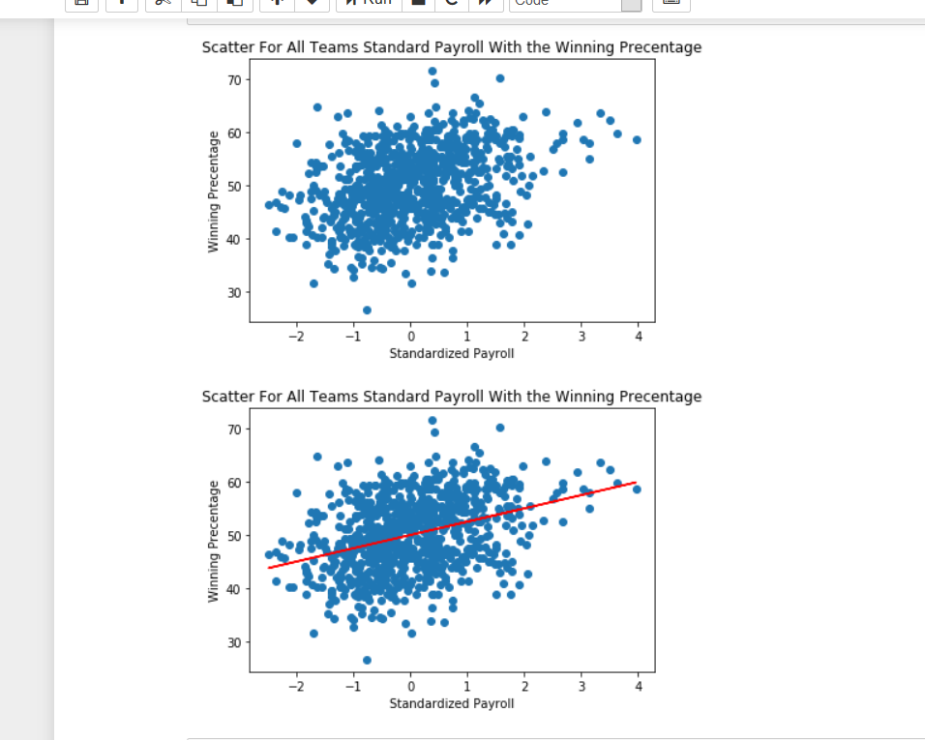
Part 3 : Data Transformation cont.
Step 2 : Expected wins :

Slide 11
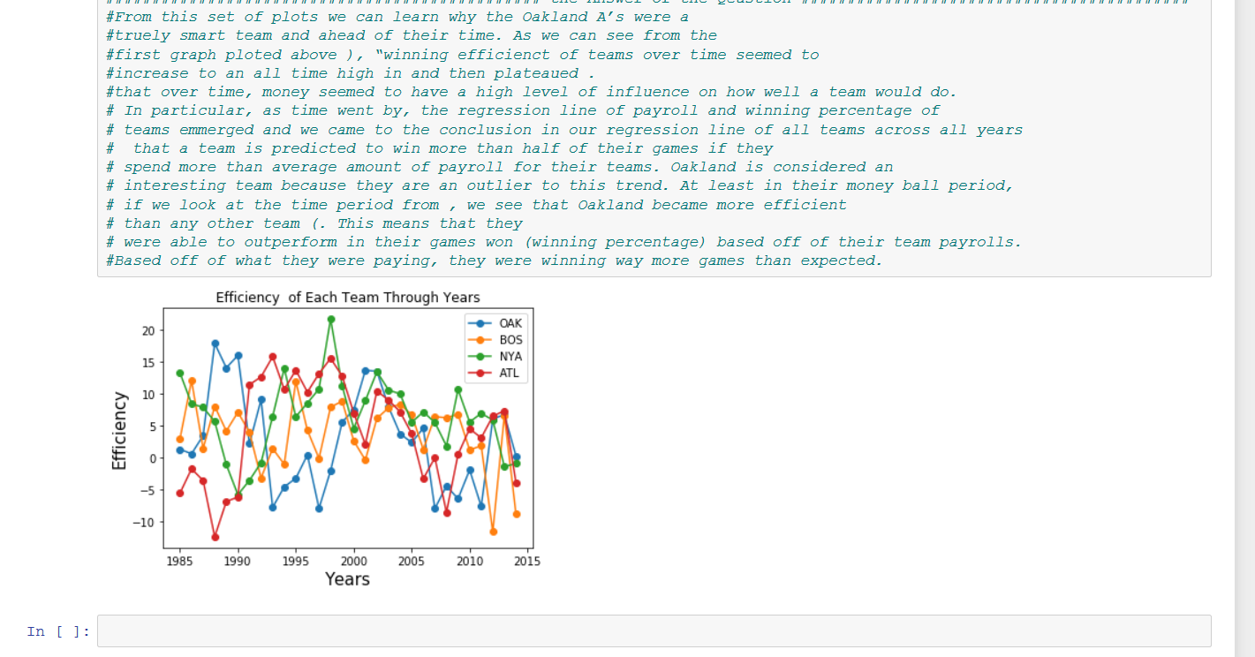
Part 3 : Data Transformation cont.
Step 3 : Spending efficiency

Slide 12
Thank You For Reading

