Slide 1
HR Data Analysis
Presented by:
Abdelrahman Mohamed
Hossam Mohamed Mohamed
Mohammed Adel Eltohamy
Mohamed Arafa
Mina Lion Fahmy

Slide 2
AGENDA
Introduction: case study Explanation
Parameters Analysis
Extracting Insights
Drawing Conclusions
Recommendations

Slide 3
Introduction: Case Study Explanation
Data about IBM employees
Data Contains 35 feature in 5 categories about employees:
Personal info
Educational info
Job Info
Experiences Info
Services Info
Main Case Study: Attrition rate of employees

Slide 4
Introduction: Case Study Explanation, Cont.
Some descriptive information about data:
Age Mean: 36.92380952
Age STD: 9.13330127101115
Salary Mean: 65029.31293
Salary STD: 47068.8885594734

Slide 5
Introduction: Case Study Explanation, Cont.

Slide 6
Assumptions
Low Monthly Income lead to high rate of leaving.
Services with high satisfaction have less leaving number.
Small age have high leaving because they have low level of education.
Employees that live away from work place have higher rate of leaving.
Expected linear relation between (Years At Company, Years With Current Manager).
Single employees may have the highest turn over rate in company.

Slide 7
Used KPI
Turn Over rate: The proportion of employees who left the company from total of employees in a period or category.
Turn Over Rate = (total no. of employees – Remaining employees ) / total no. of employees

Slide 8
Parameters Analysis
The most leaving employees live in small or medium distance from company place.
Employees that have the higher leaving rate had the smallest ages.

Slide 9
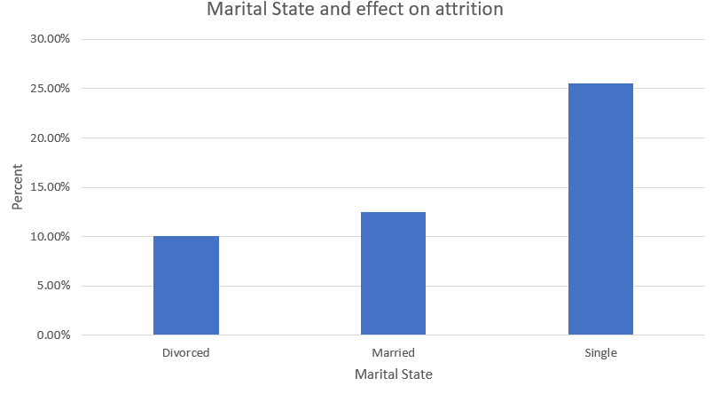
Parameters Analysis, Count.
Single Employees had the highest leaving rate.

Slide 10
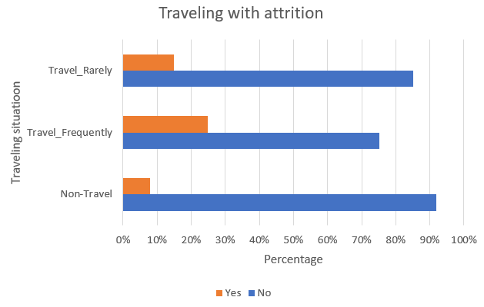
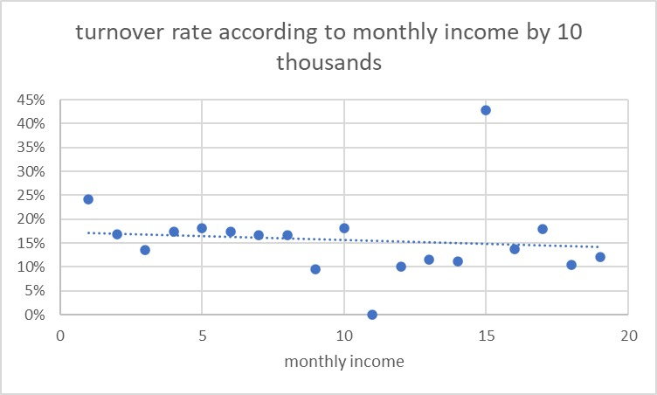
Parameters Analysis, Cont.
Employees who traveling frequently have high turn over.
The main trend that employees that take lower salaries have a higher turn over rate.

Slide 11
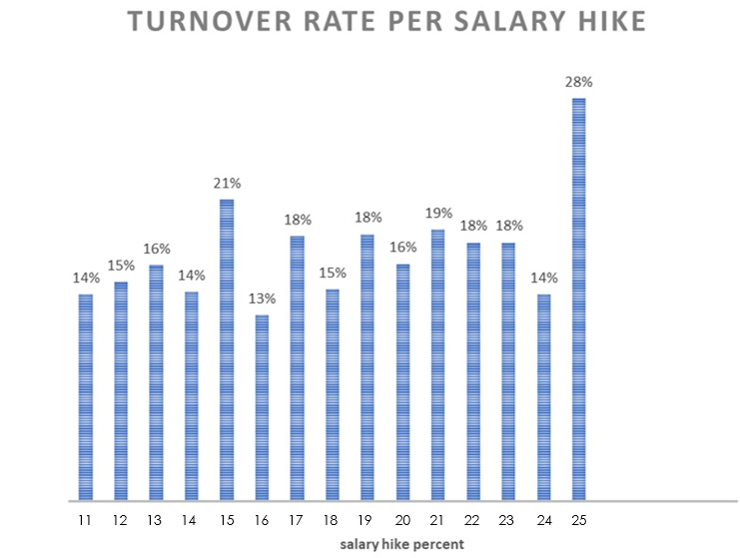
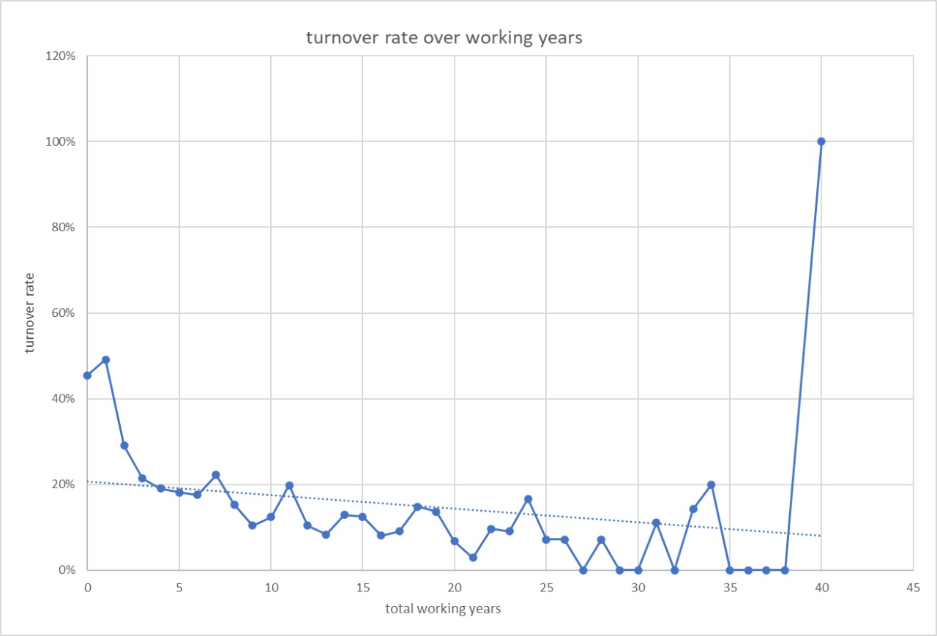
Parameters Analysis, Cont.
Employees that have the highest salary hike have a high turn over rate
Employees that have longer time in company have lower turn over rate
The 40 years point represent females over 58 years old working in research scientist rules.

Slide 12
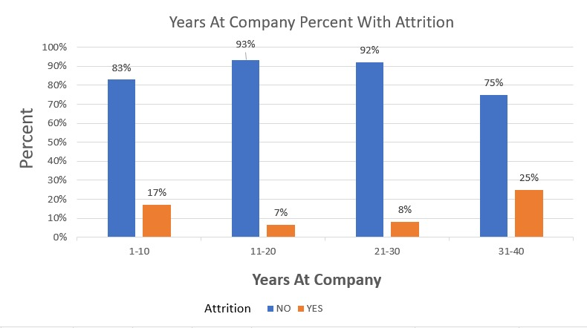
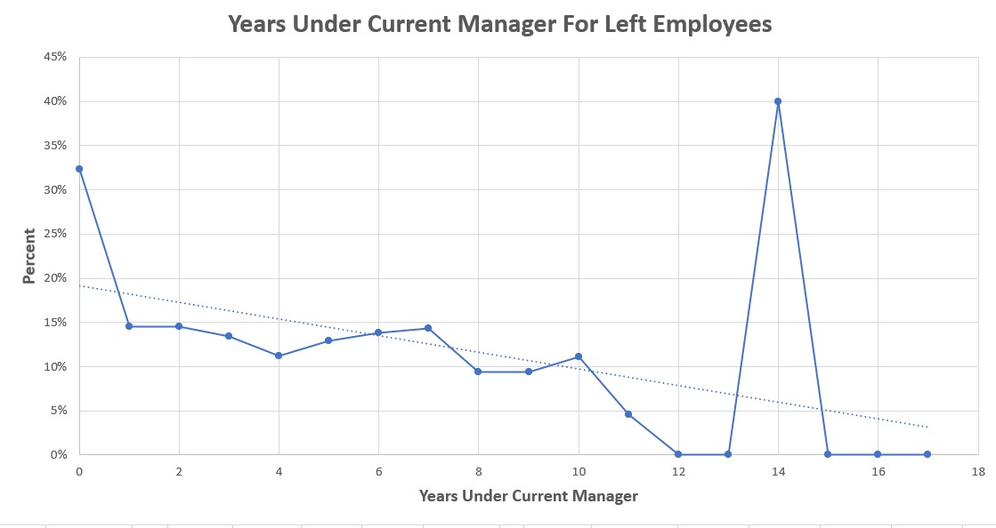
Parameters Analysis, Cont.
We discovered that when the number of years become higher that make the employee have a higher turn over rate.
There is no relationship between the total number of years under the current manager and the turn over rate for employees.

Slide 13
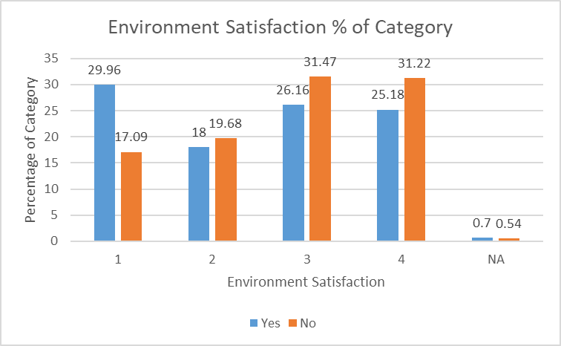
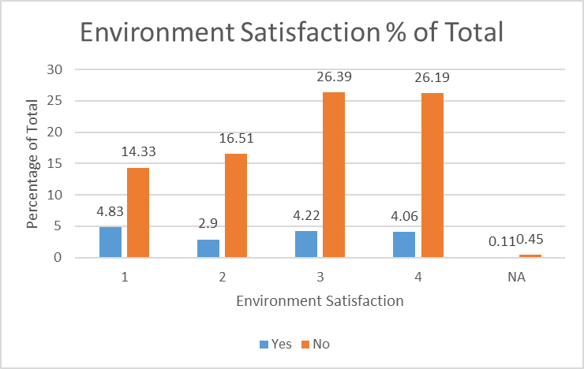
Parameters Analysis, Cont.
There is no difference between the opinions for those who left the company and those who stayed.
30% of the employees who left the company gave very low environment satisfaction rate.

Slide 14
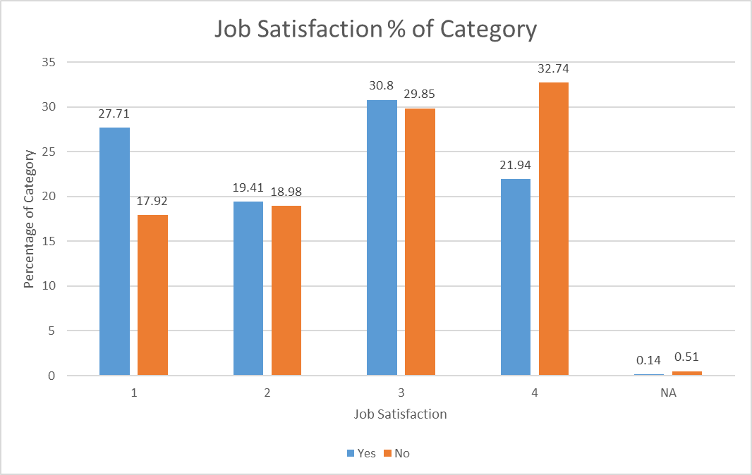
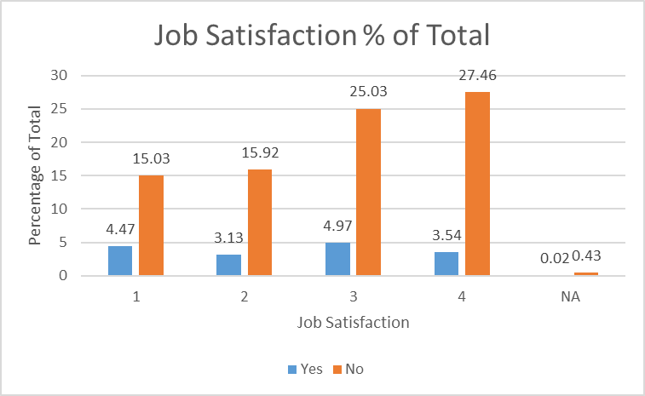
Parameters Analysis, Cont.
There is no major difference between the opinions for those who left the company and those who stayed.
Above 60% of employees gave job satisfaction rate higher than the average.

Slide 15
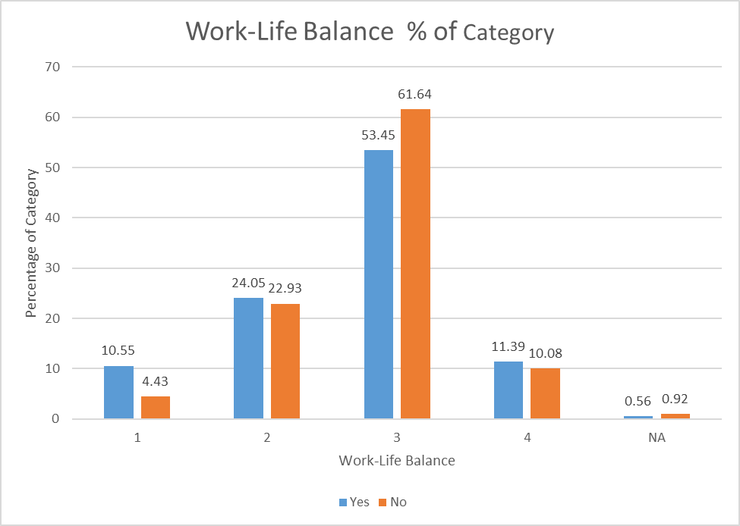
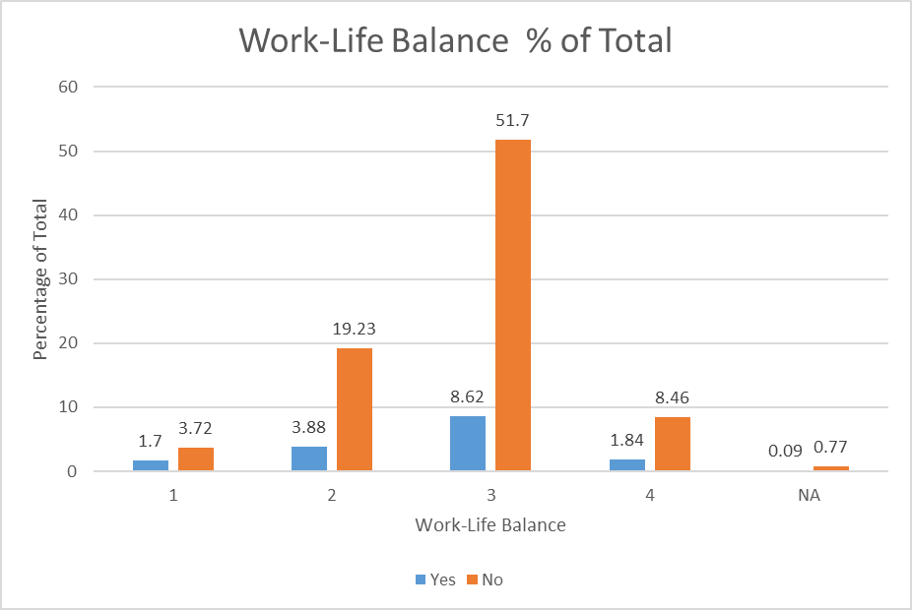
Parameters Analysis, Cont.
Majority of employees gave work life balance above the average rate.
According to employees' opinions work life balance at IBM was good but not great.

Slide 16
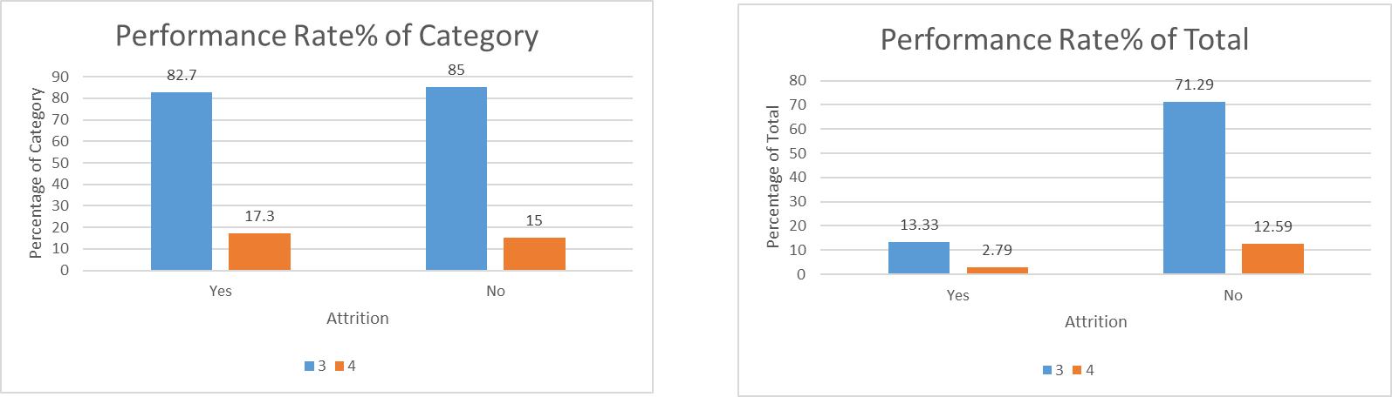
Parameters Analysis, Cont.
Most of employees received performance rates of three.
There was no big difference between employees rating (Ratings were between 3 and 4 only).

Slide 17
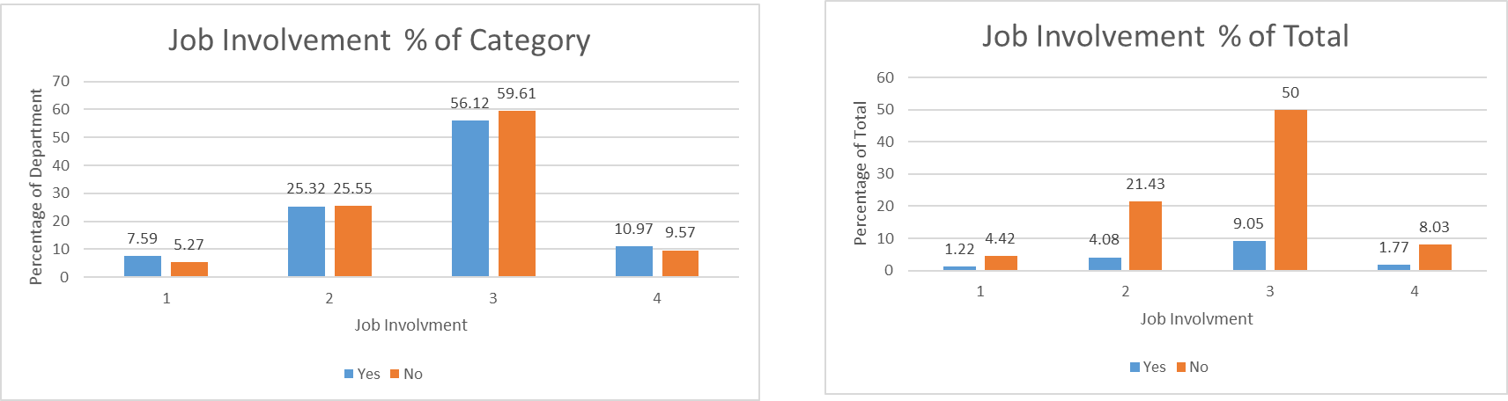
Parameters Analysis, Cont.
According to managers, high percentage of employees had job involvement above average whether they left or stayed.

Slide 18
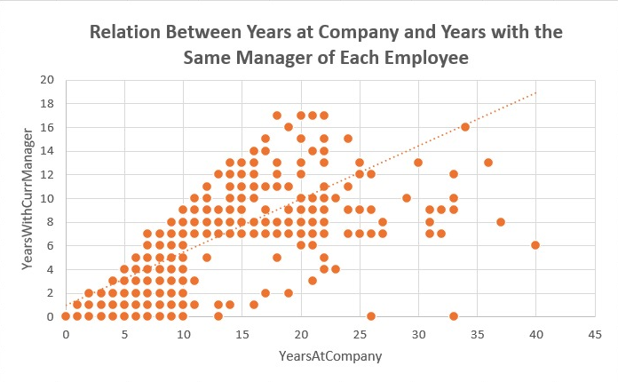
Extracting Insights
There is linear relationship between years at company & years with current manager for single employee.
There for linear relation ship between any of them and turning over rate.

Slide 19
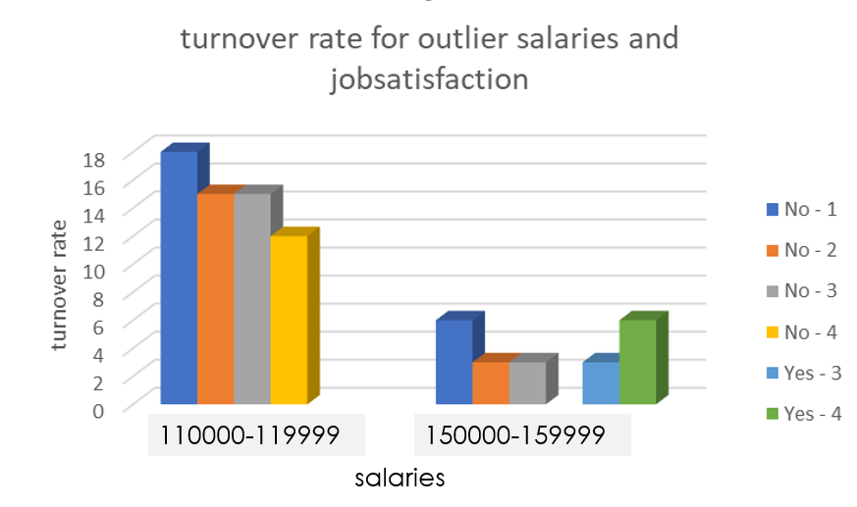
Extracting Insights
The employees with highest and lowest turn over rate according to salaries are represent the opposite of the assumptions sense the lowest turnover rate(0%) was for a lower salary than the one with the highest turnover rate(43%)
Also the people with lower satisfaction rate are more often to stay in the company than the employs with higher rates

Slide 20
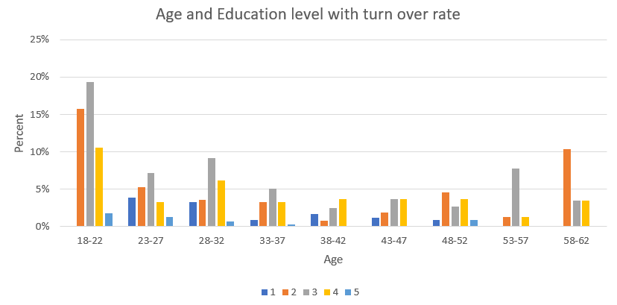
Extracting Insights
We notice that there are many employees that have very high education level and very young at the same time.
Most of these young employees have the highest turn over rate.

Slide 21
Validation
Regression was used to validate our findings and explain whether the parameters provided in the dataset have relation with people leaving or staying at the company
Dependan value | Independent Variables | R Squared | Adj. R Squared
Attertion | Income | 0.000971961 | 0.000745321
Attertion | Age | 0.025346234 | 0.025125124
Attertion | Distance | 9.46756E-05 | -0.000132163
Attertion | Enviroment Satisfaction | 0.010898379 | 0.010669685
Attertion | Job Satisfaction | 0.010650374 | 0.010421623
Attertion | Work-Life Balance | 0.003514736 | 0.003284335
Attertion | Enviroment & Job Satisfaction | 0.021635241 | 0.021182713
Years at the company | Years with Current manager | 0.591687755 | 0.591595125
Years at the company | Years with Current manager & years since last promotion | 0.660702425 | 0.660548444

Slide 22
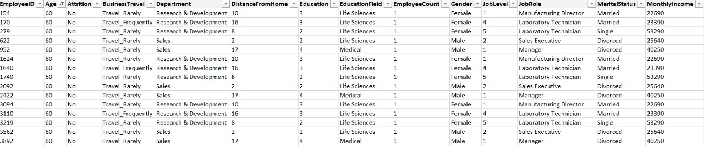
Drawing Conclusions
Data does not relate or effect to our KPI (Attrition) and results from relations are not reasonable.

Slide 23
Recommendations
Provide More Information (Provide more columns):
Manager changing
Increase in income from last promotion
Transportation afford
details of salary ( main salary, transportation, income Tax, Insurance )
Hire date
Make Exit Interviews for each leaving Employees and include these data in tables.
Remove useless data (Columns):
Employee count
Over18
Standard hours

Slide 24
Thank You

