Slide 1


Data science
Ain shams university
Supervised by:- Dr. ASHRAF .S. HUSSEIN
Student Name :-Mina Lion Fahmi
Department :-Scientific Computing
Section :- 5
Seat-ID:- 2016170455

Slide 2
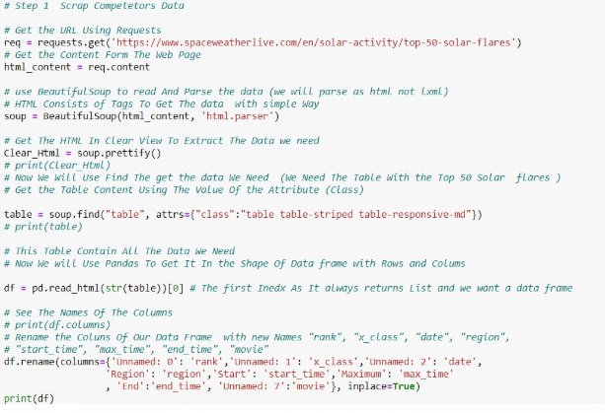
Data scraping and preparation
Scrape competitor's data using Python Library Conda “Numpy & Pandas” by Add it to Pandas Frame.

Slide 3
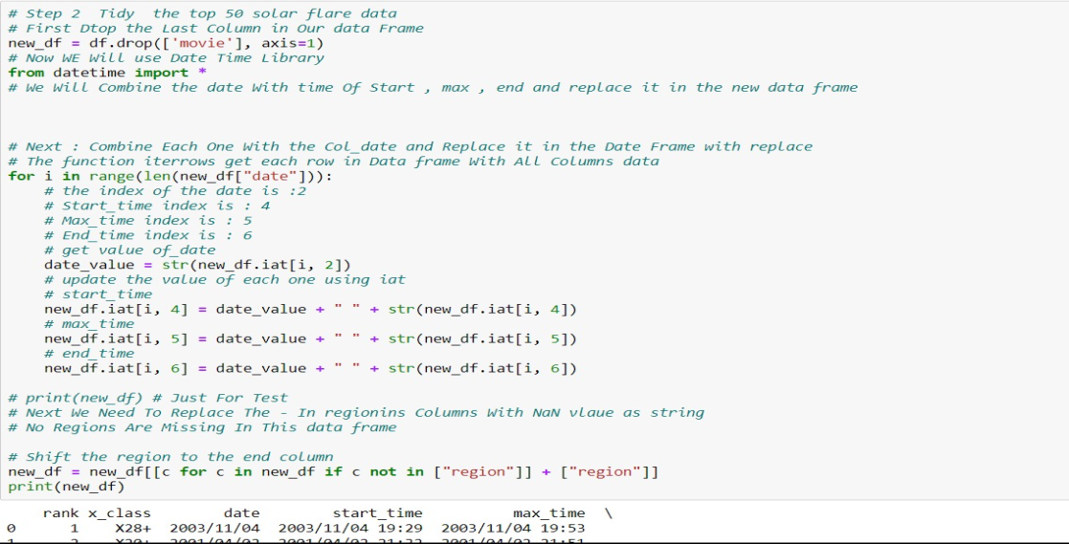
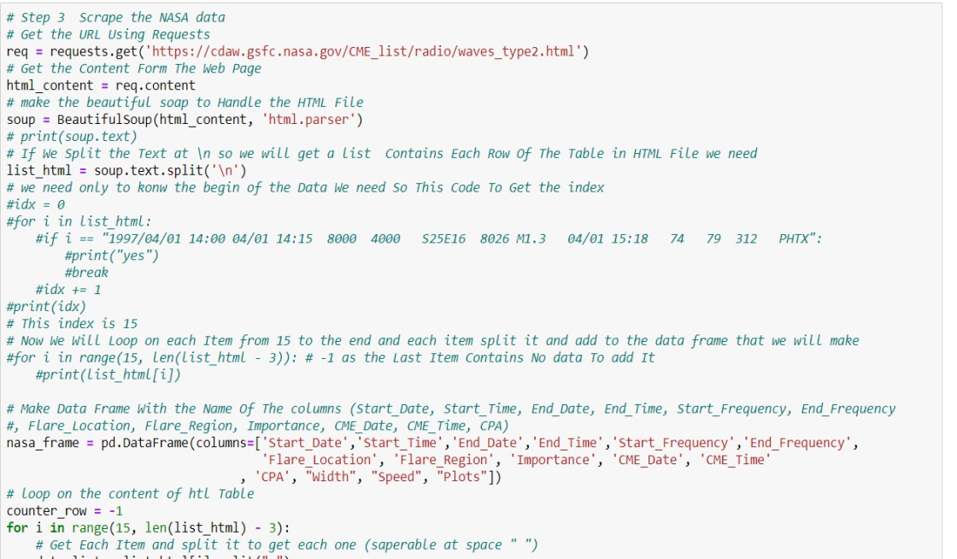
Data scraping and preparation
Tidy the top 50 solar flare data
By Applying Preprocessing on Data.
Scrape the NASA data by getting
a new additional data by Text not
Html.

Slide 4
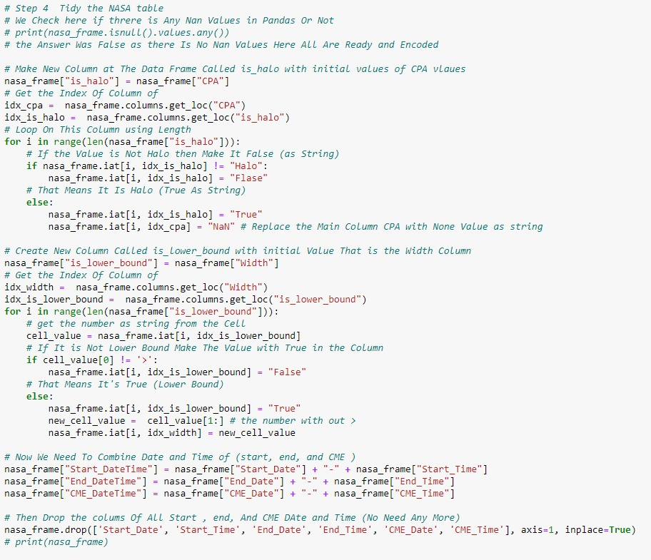
Data scraping and preparation
Tidy the NASA table
preprocessing by combining
columns of date and filling
the missing cells.

Slide 5
The End
Wish Slides be a good content for you

