Slide 1

Welcome

Slide 2

Python Basics
Working with Data
Practice
Basic Template for NLP Classification
Regular Expression
Natural Language Processing (NLP)
Cross Validation
Classification Project
List of Content
Basics Template for Classification and Regression
Taking Care Of Missing Data
Categorical Data
Regression Project

Slide 3
Python Basics
Data Types
Boolean Type: bool.
Set Types: set.
Mapping Type: dict.
Sequence Types: range, tuple, list.
Numeric Types: float, int.
Text Type: str.
String
Dictionary
Boolean Type
Set
Float and int
List
Tuple
>>> float_number = 18.65
>>> int_number = 5
my_set = {'apple', 'banana', 'orange'}
>>> bool = True
>>> bool = False
>>> bool = 1
>>> bool = 0
my_dict = {'food':'Pizza', 'drink': 'diet coke', 'price': 12}
>>> my_string = 'I love coding'
my_tuple = ('apple', 'banana', 'orange’, 18, 19.5)
my_list = ['apple', 'banana', 'orange']
>>> print(1 == 1)
True
>>> a = 1
>>> b = '1'
Print(a == b)
False
>>> a = 1
>>> b = 1
>>> if a == b:
>>> print('Equal')
Equal

Slide 4
Python Basics
Print
Python has a built-in help system:
>>> print('The number is', num)
The number is 19.8564
>>> Firstname = 'Rob'
>>> lastname = 'Green'
>>> print(firstname , lastname)
Rob Green
>>> help(print)
>>> num = 19.8564
Help on built-in function print in module builtins:
print(...)
print(value, ..., sep=' ', end='\n', file=sys.stdout, flush=False)
Prints the values to a stream, or to sys.stdout by default.
Optional keyword arguments:
file: a file-like object (stream); defaults to the current sys.stdout.
sep: string inserted between values, default a space.
end: string appended after the last value, default a newline.
flush: whether to forcibly flush the stream.
>>> print('Hello World!')
Hello World!
>>> print(firstname + lastname)
RobGreen
>>> print('Hello World!', 'Welcome to Python Tutorial!')
Hello World! Welcome to Python Tutorial!
>>> print('The number is {:.2f}'.format(num))
The number is 19.85
>>> print('Fullname is {}'.format(firstname +' '+ lastname))
Rob Green
>>> print('Hello World!\nWelcome to Python Tutorial!')
Hello World!
Welcome to Python Tutorial!

Slide 5
Python Basics
Type Conversion
>>> num = 4
>>> print(bool(num))
True
>>> num = 12
>>> print(float(num))
12.0
>>> num = '12'
>>> age = 30
>>> print('She is', age, 'years old.')
She is 30 years old.
>>> print(type(num))
<class 'str'>
>>> num = '12'
>>> print(float(num))
12.0
>>> print(num)
'12'
>>> age = 30
>>> print('She is'+ age+ 'years old.')
TypeError: can only concatenate str (not "int") to str
>>> new_num = int(num)
>>> print(new_num)
12
>>> age = 30
>>> print('She is '+ str(age)+ ' years old.')
She is 30 years old.
>>> num = 0
>>> print(bool(num))
False

Slide 6
Python Basics
String
Arithmetic Operations
>>> string = 'The weather is rainy.'
>>> print(10+3)
13
>>> print(string.upper())
THE WEATHER IS RAINY.
>>> print(10/3)
3.3333333333333335
>>> print(string.find('is'))
12
>>> print(10//3)
3
>>> print('weather' in string)
True
>>> print(10%3)
1
>>> string = string.replace('rainy', 'sunny')
>>> print(string)
'The weather is sunny.'
>>> print(10*3)
30
>>> print(string.count('is’))
1
>>> print(10**3)
1000

Slide 7
Python Basics
Lists
>>> print(*my_list, sep='\n')
5
4
6
3
>>> my_string = '5 4 6 3'
>>> my_list = my_string.split(' ')
>>> print(my_list)
['5', '4', '6', '3']
>>> my_list.append(6)
>>> print(my_list)
[5, 4, 6, 3, 6]
>>> my_list = list(map(int, my_list))
>>> print(my_list)
[5, 4, 6, 3]
>>> my_list.insert(0, 7)
>>> print(my_list)
[7, 5, 4, 6, 3, 6]
>>> print(my_list[0])
5
>>> print(my_list[1:3])
[4,6]
>>> print(my_list[1:])
[4,6,3]
>>> print(my_list[-1])
3
>>> new_list = [100, 200, 300]
>>> my_list += new_list
>>> print(my_list)
[7, 5, 4, 6, 3, 7, 6, 100, 200, 300]

Slide 8
Python Basics
Lists
>>> my_list = [5, 4, 6, 3]
>>> new_list = [100, 200, 300]
>>> my_list.extend(new_list)
>>> print(my_list)
[5, 4, 6, 3, 100, 200, 300]
>>> my_list.sort(reverse = True)
[5, 4, 3, 2, 1]
>>> print(my_list[::-1])
[5, 3, 4, 2, 1]
>>> my_list = [1, 2, 4, 3, 5]
>>> my_list.reverse()
>>> print(my_list)
[5, 3, 4, 2, 1]
>>> my_list.sort()
[1, 2, 3, 4, 5]
>>> my_list = ['I', 'love', 'coding!']
>>> my_string = ' '.join(my_list)
>>> print(my_string)
'I love coding!'
>>> sorted(my_list)
[1, 2, 3, 4, 5]

Slide 9
Python Basics
Dictionary
>>> car = {"brand": "Ford", "model": "Mustang", "year": 1964}
>>> car.clear()
>>> print(car)
{}
>>> print(car.keys())
dict_keys(['brand', 'model', 'year'])
>>> print(car['model'])
'Mustang'
>>> print(car.values())
dict_values(['Ford', 'Mustang', 1964])
>>> print(car.get('model'))
'Mustang'
>>> coppied = car.copy()
>>> print(coppied)
{"brand": "Ford", "model": "Mustang", "year": 1964}
>>> for key,values in car.items():
>>> print(key, ':' , values)
brand : Ford
model : Mustang
year : 1964
>>> car.update({'color': 'white'})
>>> print(car)
{'brand': 'Ford', 'model': 'Mustang', 'year': 1964, 'color': 'white'}

Slide 10
Python Basics
Loops and if statement
# if statement
>>> i = 1
>>> j = 1
>>> if i == j:
>>> print('Equal')
Equal
# for loop
>>> for i in range(10):
>>> print(i)
>>> if i == 4:
>>> break
0
1
2
3
4
# for loop
>>> for i in range(5):
>>> print(i)
0
1
2
3
4
# while loop
>>> while True:
>>> print(1)
1
1
1
1
1
# nested for loop
>>> for i in range(3):
>>> for j in range(100, 102):
>>> print(i, '+', j,'=', i+j)
0 + 100 = 100
0 + 101 = 101
1 + 100 = 101
1 + 101 = 102
2 + 100 = 102
2 + 101 = 103
# while loop
>>> i = 0
>>> while i < 5:
>>> print(i)
>>> i += 1
0
1
2
3
4
# if statement
>>> i = 1
>>> j = 0
>>> if i > j:
>>> print('Greater')
>>> elif i <= j:
>>> print('Smaller')
Greater
# if statement
>>> i = 1
>>> j = 0
>>> if i > j:
>>> pass
>>> elif I <= j:
>>> print('Smaller')

Slide 11
Python Basics
Logical Operations
>>> age = 18
>>> if(age > 18 and age < 30):
>>> print('The age is over 18 and under 30')
>>> else:
>>> print('The age is 18, under 18 or over 30’)
The age is 18, under 18 or over 30
>>> if(age > 18 or age < 30):
>>> print('The age is over 18 or under 30')
>>> else:
>>> print('The age is 18, under 18 or above 30’)
The age is over 18 or under 30
>>> if(age >= 18 and age <= 30):
>>> print('The age is between 18 to 30’)
The age is between 18 to 30
>>> if(not age > 18):
>>> print('The age is 18 or under 18')
>>> else:
>>> print('The age is over 18’)
The age is 18 or under 18
>>> if(18 <= age <= 30):
>>> print('The age is between 18 to 30’)
The age is between 18 to 30

Slide 12

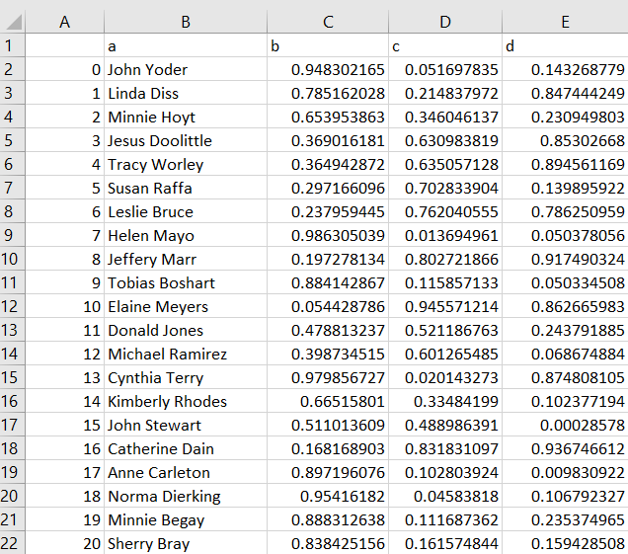
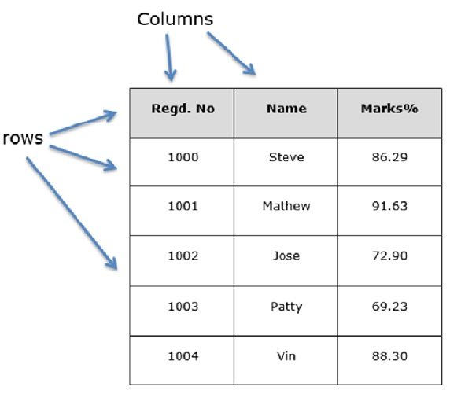
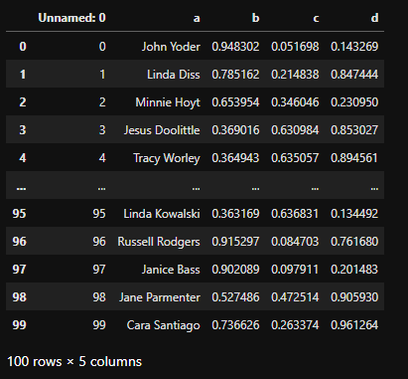
Working with Data
Series
DataFrame
Index | Age
0 | 18
1 | 35
2 | 22
. . . | . . .
n | 29
Index | Age | Salary
0 | 18 | 22K
1 | 35 | 50K
2 | 22 | 30K
. . . | . . . | . . .
n | 29 | 28K
DataFrame: Data structure that organizes data into a 2-dimensional table of rows and columns.
Pandas: A Python package providing fast, flexible, and expressive data structure.

Slide 13
Working with Data pandas
>>> import pandas as pd
>>> sid = [12547, 12548, 12549]
>>> name = ['John', 'Ben', 'Emily']
>>> field = ['Computer Science', 'Law', ‘Finance']
>>> num = [10, 20, 30, 40]
>>> df = pd.DataFrame(num, columns = ['X'])
>>> print(df)
X
0 10
1 20
2 30
3 40
>>> df['plus_2'] = df['X']+2
>>> print(df)
X plus_2
0 10 12
1 20 22
2 30 32
3 40 42
>>> df = df.drop('plus_2', 1)
>>> print(df)
X
0 10
1 20
2 30
3 40
# First Approach
>>> students = pd.DataFrame({'SID': sid, 'Name': names, 'Field': field})
print(students)
SID Name Field
0 1254 John Computer Science
1 1255 Ben Law
2 1256 Emily Finance
# Second Approach
>>> students = pd.DataFrame([sid, names, field], columns=['SID', 'Name', 'Field'])
print(students)

Slide 14
Working with Data
pandas
SID Name Field
0 1254 John Computer Science
1 1255 Ben Law
2 1256 Emily Finance
>>> print(students.iloc[:, 1:2])
Name
0 John
1 Ben
2 Emily
>>> print(students['Name'])
0 John
1 Ben
2 Emily
Name: Name, dtype: object
>>> print(students.iloc[:, [1, 2]])
Name Field
0 John Computer Science
1 Ben Law
2 Emily Finance
>>> print(students.iloc[:, :])
SID Name Field
0 1254 John Computer Science
1 1255 Ben Law
2 1256 Emily Finance
>>> print(students.iloc[:2, [1, 2]])
Name Field
0 John Computer Science
1 Ben Law

Slide 15
Working with Data
Numpy
first = [1, 2, 3]
second = [10, 20, 30]
third = [100, 200, 300]
numpy_array = np.array([first, second, third])
>>> print(numpy_array)
array([[ 1, 2, 3],
[ 10, 20, 30],
[100, 200, 300]])
>>> list2d = [[1,2,3],[4,5,6]]
>>> arr2d = np.aarray(list2d)
>>> arr2d
array([[1, 2, 3],
[4, 5, 6]])
import numpy as np
>>> arr = np.random.randint(10, size=(3,2))
>>> print(arr)
array([[9, 3],
[1, 4],
[2, 7]])
>>> np.arange(10)
array([0, 1, 2, 3, 4, 5, 6, 7, 8, 9])
>>> np.arange(1, 10, 2)
array([1, 3, 5, 7, 9])
>>> list2d = [[1,2,3],[4,5,6]]
>>> arr2d = np.array(list2d)
>>> print(arr2d.shape)
(2, 3)
>>> new_arr = arr.reshape(2,3)
>>> print(new_arr )
array([[9, 3, 1],
[4, 2, 7]])
>>> np.arange(1, 10, dtype='float64’)
array([1., 2., 3., 4., 5., 6., 7., 8., 9.])
>>> print(np.max(numpy_array, axis=1))
[ 3 30 300]
>>> arr = np.array([1,2,3,4,5])
>>> print(np.max(arr))
5
>>> print(np.max(numpy_array, axis=0))
[100 200 300]

Slide 16
Basic Template for NLP and Classification
Importing the libraries
Training the model on the Training set
Importing the dataset
Predicting the Test set results
Cleaning the texts
Evaluating the model
Vectorizing text
Creating confusion matrix
Splitting the dataset into the Training set and Test set

Slide 17
Cleaning the text
Regex
>>> sent = '22 years ago, he came to UK, when he was 28'
>>> sent = re.sub(r'^[0-9]{1,}', '', sent)
>>> print(sent)
years ago, he came to UK, when he was 28
import re
>>> sent = 'Alice was born in 1996'
>>> print(re.findall(r'[0-9]{1,}', sent))
['1996']
>>> sent = 'Alice was born in 1996'
>>> print(re.match(r'.*', sent))
<re.Match object; span=(0, 22), match='Alice was born in 1996'>
>>> sent = 'Alice was born in 1996'
>>> sent = re.sub(r'\d', '', sent)
>>> print(sent)
Alice was born in
>>> sent = '22 years ago, he came to UK, when he was 28'
>>> sent = re.sub(r'[0-9]{1,}$', '', sent)
>>> print(sent)
22 years ago, he came to UK, when he was
>>> sent = 'Alice was born in 1996'
>>> print(re.findall(r'alice', sent))
[]
>>> sent = 'Alice was born in 1996, in England.'
>>> sent = re.sub(r'[a-z]', '', sent)
>>> print(sent)
A 1996, E.
>>> date = '12.02.2022'
>>> if (re.match(r'[0-9]{2}(.|/)[0-9]{2}(.|/)[0-9]{2,4}', date)):
>>> print('Matched.')
>>> else:
>>> print('Not matched!')
Matched.
>>> sent = 'Alice was born in 1996, in England.'
>>> sent = re.sub(r'[^a-zA-Z]', ' ', sent)
>>> print(sent)
Alice was born in in England
>>> sent = 'Alice was born in 1996.'
>>> sent = re.sub(r'\s+', ' ', sent)
>>> print(sent)
Alice was born in 1996.
>>> sent = 'Alice was born in 1996'
>>> print(re.findall(r'alice', sent, flags=re.I))
['Alice']

Slide 18
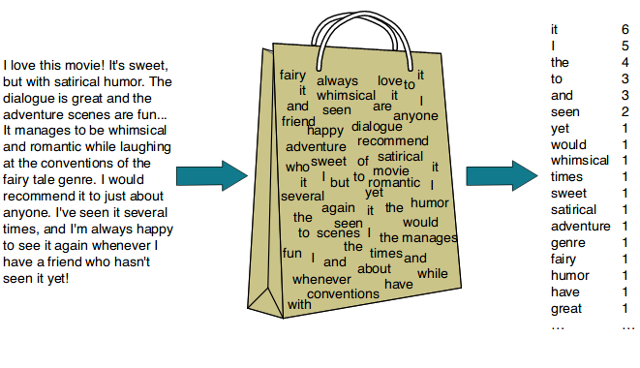
Natural Language Processing (NLP)
Natural Language Processing, or NLP for short, is broadly defined as the automatic manipulation of natural language, like speech and text, by software.
Examples:
Chatbots
Speech Recognition
Bag-of-words model

Slide 19
Bag-of-words model
>>> sent1 = "Joe waited for the train, but the train was late."
>>> sent2 = "Mary and Samantha took the bus."
>>> sent3 = "I looked for Mary and Samantha at the bus station."
>>> sent4 = "Mary and Samantha arrived at the bus station early."
['mary', 'joe', 'late', 'took', 'station', 'early', 'bus', 'arrived', 'samantha', 'looked', 'waited', 'train']
 | mary | joe | late | took | station | early | bus | arrived | samantha
Sent1 | 0 | 1 | 1 | 0 | 0 | 0 | 0 | 0 | 0
Sent2 | 1 | 0 | 0 | 1 | 0 | 0 | 1 | 0 | 1
Sent3 | 1 | 0 | 0 | 0 | 1 | 0 | 1 | 0 | 1
Sent4 | 1 | 0 | 0 | 0 | 1 | 1 | 1 | 1 | 1
looked | waited | train
0 | 1 | 2
0 | 0 | 0
1 | 0 | 0
0 | 0 | 0

Slide 20
TF-IDF model
Tf = (Number of occurrence of a word in a document) / (Number of words in that document)
IDF = log((Number of documents) / (Number of documents containing word))
TF-IDF = TF*IDF
Sent1 | 0 | 0 | 0 | 1 | 1 | 0 | 0 | 0 | 0
Sent2 | 0 | 1 | 0 | 0 | 0 | 0 | 1 | 1 | 0
Sent3 | 0 | 1 | 0 | 0 | 0 | 1 | 1 | 1 | 1
Sent4 | 1 | 1 | 1 | 0 | 0 | 0 | 1 | 1 | 1
0 | 2 | 1
1 | 0 | 0
0 | 0 | 0
0 | 0 | 0
Bag-of-words model
Sent1 | 0. | 0. | 0. | 0.377 | 0.377 | 0. | 0. | 0. | 0.
Sent2 | 0. | 0.428 | 0. | 0. | 0. | 0. | 0.428 | 0.428 | 0.
Sent3 | 0. | 0.378 | 0. | 0. | 0. | 0.592 | 0.378 | 0.378 | 0.467
Sent4 | 0.510 | 0.325 | 0.510 | 0. | 0. | 0. | 0.325 | 0.325 | 0.402
0. | 0.755 | 0.377
0.670 | 0. | 0.
0. | 0. | 0.
0. | 0. | 0.
Tf-idf model

Slide 21
Classification Model
Decision Tree
X2 < 50
NO
YES
X2
Split 2
X1 < 80
X1 < 60
50
Split 3
Split 4
Split 1
NO
YES
NO
YES
X1 < 90
80
X1
NO
YES
60
90

Slide 22

Classification
Random Forest
1. Picks a random K datapoints from the training set.
2. Build a decision tree associated to these K data points.
3. By choosing the number of trees, the model will repeat step 1 and 2.
4. For a new data point, makes each one of the trees to predict the class of the data point and assigns the new data point to a class that wins the majority vote.

Slide 23
Cross Validation
Training Set
Test Set
5 Fold
Fold 1
Accuracy1
Fold 2
Accuracy2
Fold 3
Accuracy3
Fold 4
Accuracy4
Fold 5
Accuracy5
Cross Validation Score = Average of all computed accuracies.

Slide 24
Basic Template for Classification and Regression
Importing the libraries
Training the model on the Training set
Importing the dataset
Predicting the Test set results
Taking Care of Missing Data
Evaluating the model
Encoding Categorical Data
Creating confusion matrix
Splitting the dataset into the Training set and Test set

Slide 25
Taking Care of Missing Data
Index | Age | Salary
0 | 25 | 22K
1 | 32 | 50K
2 | 29
… | … | …
n | 29 | 28K
Options:
Average of salaries
Median salary
Most frequent salary

Slide 26
Taking Care of Missing Data
To Encode the categorical data, we use One-Hot Encoding.
To Encode the categorical label, we use Label Encoder.
Italy | 18
England | 25
France | 32
Italy | 29
France | 45
England | 51
Yes
No
No
Yes
No
Yes
0 | 0 | 1 | 18
0 | 1 | 0 | 25
1 | 0 | 0 | 32
0 | 0 | 1 | 29
1 | 0 | 0 | 45
0 | 1 | 0 | 51
1
0
0
1
0
1
Dummy variables

Slide 27



Evaluating Regression Model
$$R^{2}=1−\frac{ss_{res}}{ss_{tot}}$$
R Squared:
$$SS_{res}=Sum\left(y_{i}−{\hat{y}}_{i}\right)²$$
$SS_{tot}$ = $Sum\left(y_{i}−y_{avg}\right)$²

