Slide 1

Titanic Survival Prediction Project
A Data Science Journey: EDA to Ensembling
Mina Alber Ibrahim

Slide 2
Agenda
Project Overview
Exploratory Data Analysis (EDA)
Data Cleaning & Feature Engineering
Data
Mining
Ensembling
Results & Conclusions

Slide 3



Project Overview
Goal: Predict survival on the Titanic using machine learning.
Dataset: Titanic passenger data (Kaggle)
Process: EDA, feature engineering, modeling, and ensembling.

Slide 4


Exploratory Data Analysis (EDA)
Explored distributions and relationships between features and survival.
Key findings: Age and Fare have wide distributions; survival rate ~38%.

Slide 5
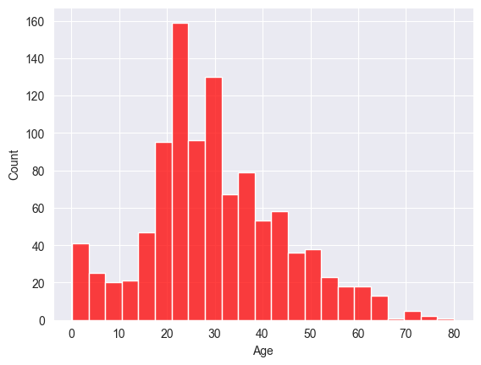
Ages Distribution
Most Titanic passengers were between 20 and 40 years old, with a noticeable number of children and older adults as well. This wide age range shows the ship carried families, young adults, and elderly people, which is important for understanding survival patterns—children and young adults had different survival rates compared to older passengers.

Slide 6
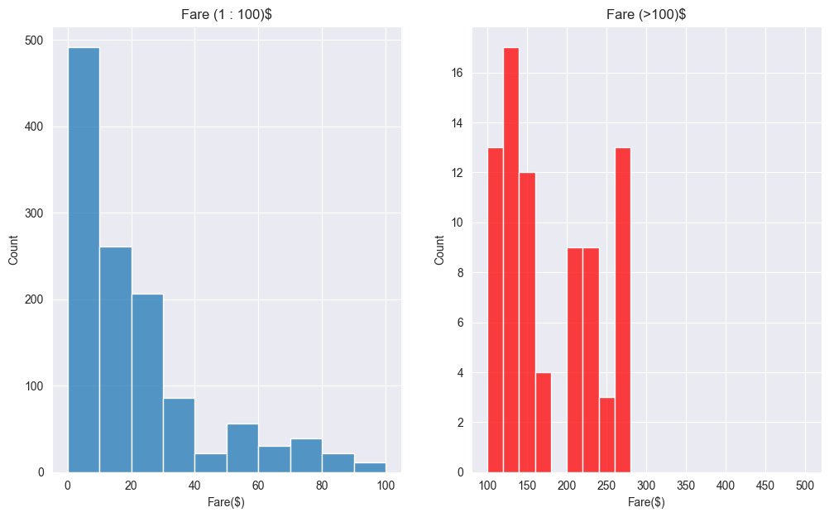
Fare Distribution
The majority of passengers paid lower fares, but a few paid much higher prices for first-class tickets. This uneven distribution highlights the social and economic diversity on board. Higher fare often meant better cabins and closer access to lifeboats, which influenced survival chances.

Slide 7
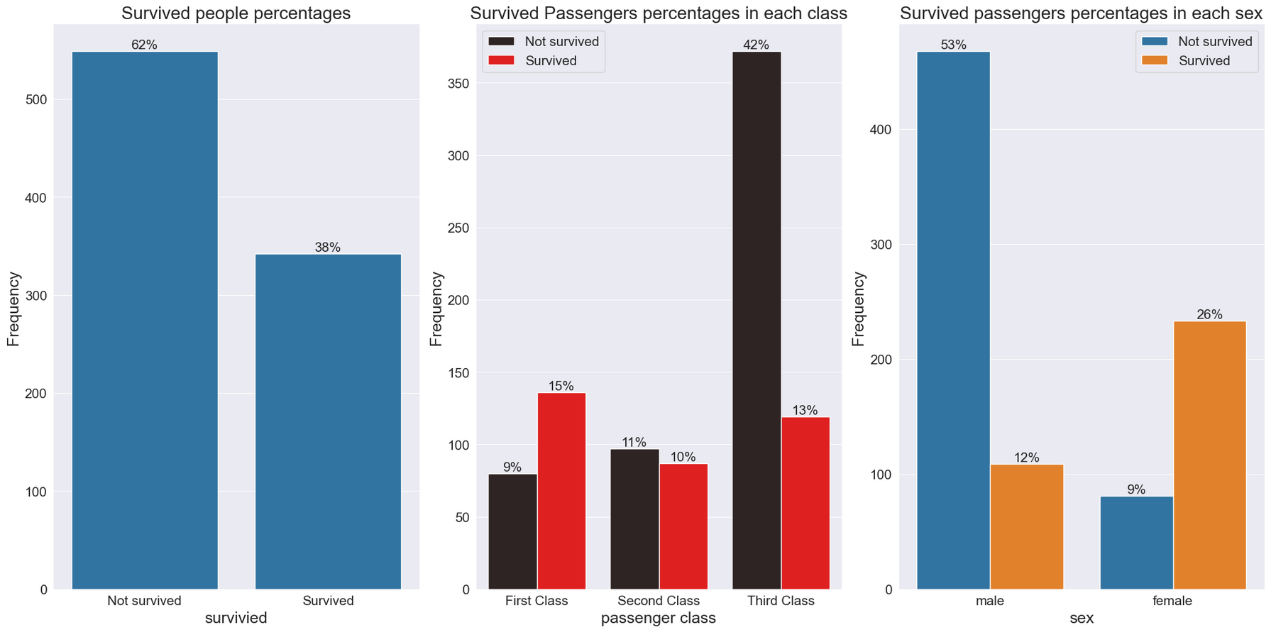
Survived People Percentages
About 38% of all passengers survived the disaster. This chart makes it clear that survival was not random—certain groups had a much higher chance of survival, which our models try to capture and explain.

Slide 8
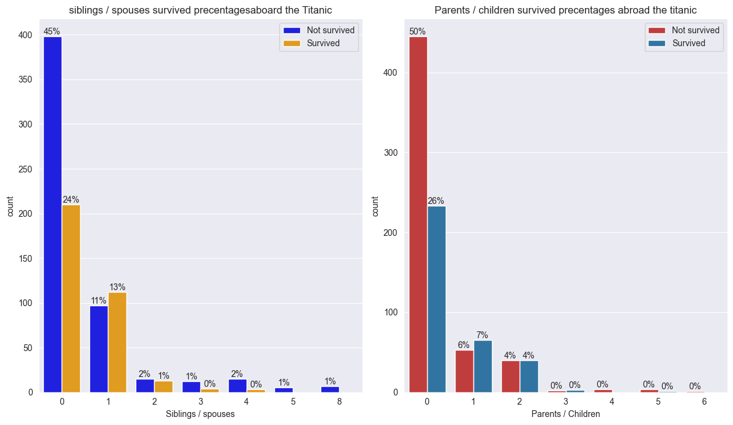
Survived People Percentages in Each Relatives People Count
Passengers traveling with a small number of relatives (like 1 or 2) had a higher chance of survival than those traveling alone or with large families. This suggests that having family nearby helped people find lifeboats and survive, but too many relatives may have made it harder to escape quickly.

Slide 9
Data Cleaning Insights:
We carefully filled in missing values for important columns like Age and Fare, so the models wouldn’t be confused by gaps in the data.
We checked for and removed duplicate records to make sure every passenger was counted only once.
Outliers (unusually high or low values) were handled, especially in Fare, to prevent them from skewing the results.
All data was standardized into a consistent format, making it easier for the computer to understand and compare.
Feature Engineering Insights:
We created new features from existing data, such as splitting the Cabin column into a letter (deck) and number (room), which helped the model learn about passenger location.
Titles (like Mr., Mrs., Miss) were extracted from names, giving clues about age, gender, and social status.
Ticket and family size information was transformed into new features, revealing patterns in group survival.
By engineering these features, we gave the models more useful information, which improved their ability to predict survival.
Data Cleaning & Feature Engineering

Slide 10
Data Modeling
Logistic Regression: This model looks for patterns in the data to predict who survived. It correctly predicted survival for 88 out of every 100 people.
Random Forest: This is like asking a group of decision-makers to vote on each prediction. It got 88 out of 100 predictions right.
Support Vector Machine: This model tries to draw the best possible line between those who survived and those who didn’t. It was correct 89% of the time.
The F1 score (a single number that tells us how good the model is at both finding survivors and not making too many mistakes) was 87% for Logistic Regression, 87% for Random Forest, and 88% for SVM.
Precision: Of all the people the model said would survive, how many actually did? (It’s about being careful not to give false hope.)
Recall: Of all the people who really survived, how many did the model find? (It’s about not missing anyone.)
The F1 score balances these two, so a high F1 means the model is good at both.
All models were tested carefully to make sure the results are reliable.

Slide 11




Combined predictions from Logistic Regression, Random Forest, and SVM.
Ensembling Approach
Applied model-specific probability thresholds for binarization.
Final prediction by majority voting (at least 2/3 models predict survival).
Ensembling improved robustness and overall accuracy.

Slide 12

Ensembling improved prediction robustness and accuracy.
Results & Conclusions
Majority voting combined strengths of individual models.
Project demonstrates a full data science workflow from EDA to deployment-ready predictions.

