Slide 1
Introduction to Functions and Limits
Mina Gabriel

Slide 2

A Summation
When an algorithm contains an iterative control construct such as a while or for loop, we can express its running time as the sum of the times spent on each execution of the body of the loop. For example insertion sort.
By adding up the time spent on each iteration, we obtained the summation (or series)
$$\sum_{i=2}^{n}{j}$$
When we evaluated this summation, we attained a bound of Θ($n^{2}$) on the worst-case running time of the algorithm. This example illustrates why you should know how to manipulate and bound summations

Slide 3
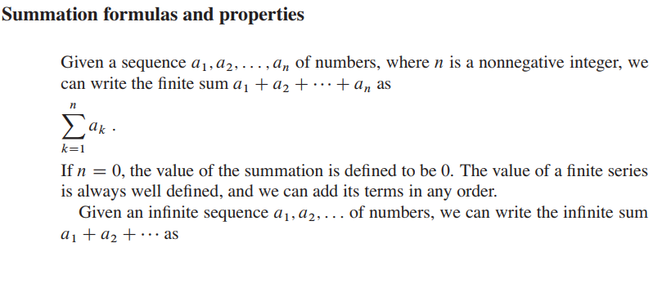

Slide 4
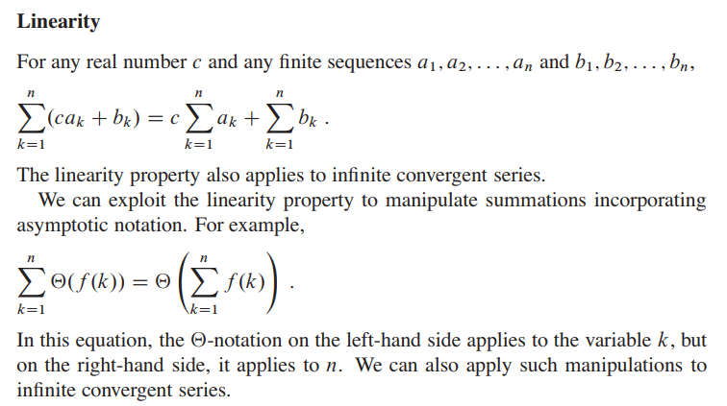

Slide 5
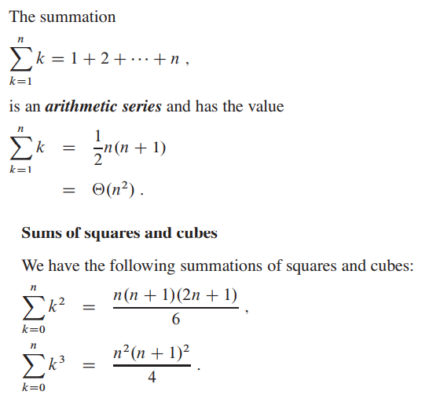

Slide 6
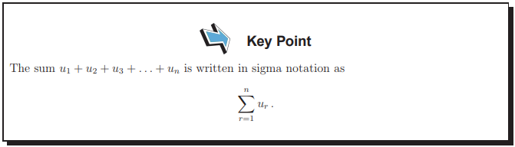

Slide 7
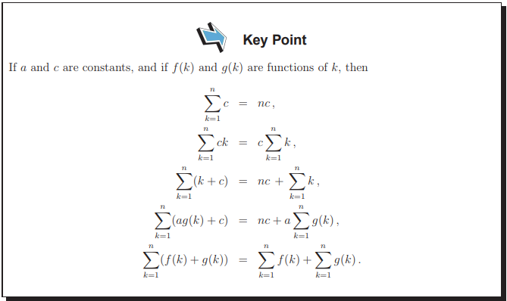

Slide 8
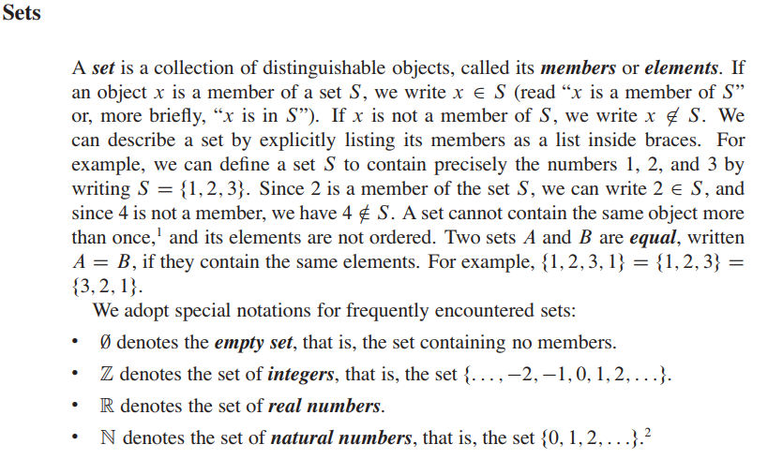

Slide 9
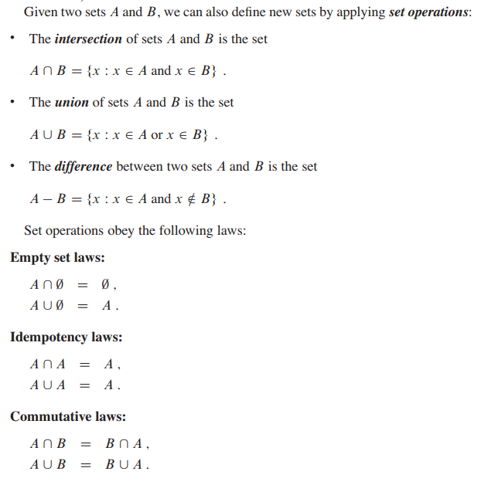

Slide 10
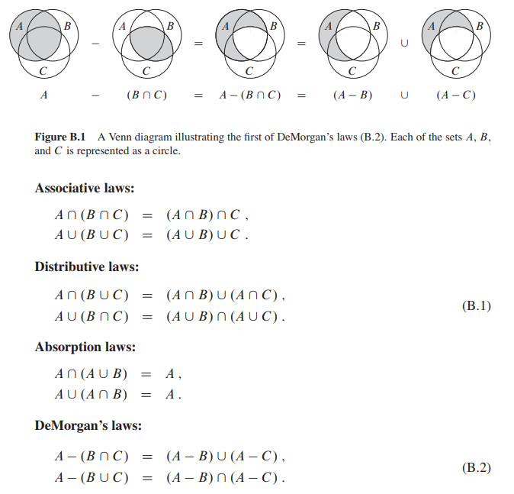

Slide 11

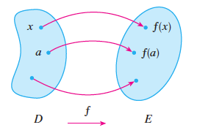
Another way to picture a function is by an arrow diagram. Each arrow connects an element of D to an element of E . The arrow indicates that f(x) is associated with x, f(a) is associated with a , and so on.
Functions and Limits

Slide 12
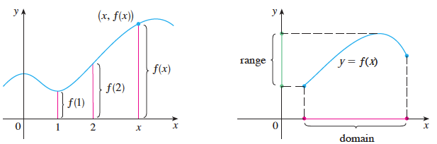
The graph of a function f gives us a useful picture of a function. Since the -coordinate of any point (x, y) on the graph is y = f(x) , we can read the value of f(x) from the graph as being the height of the graph above the point x. The graph of f also allows us to picture the domain of f on the x-axis and its range on the y-axis.

Slide 13
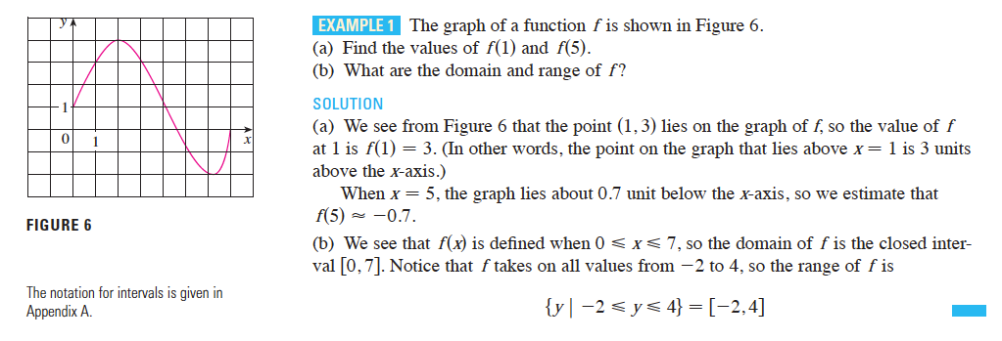

Slide 14
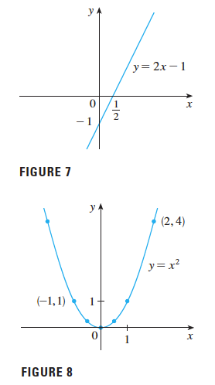
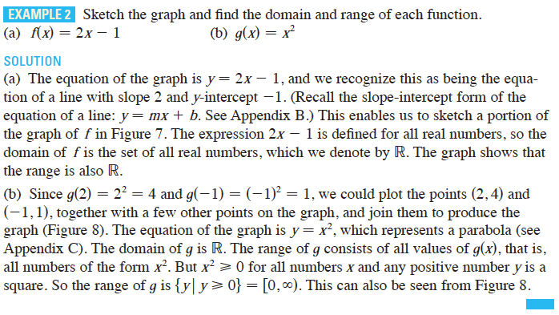

Slide 15
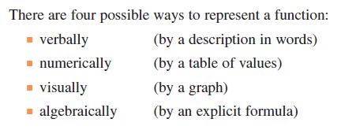
REPRESENTATIONS OF FUNCTIONS

Slide 16
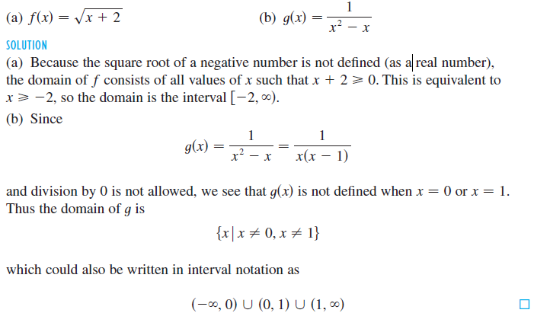
Find the domain of each function.

Slide 17
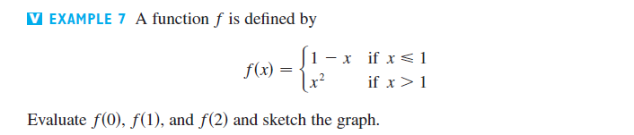
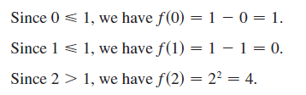
The functions in the following examples are defined by different formulas in different parts of their domains. Solution
PIECEWISE DEFINED FUNCTIONS

Slide 18
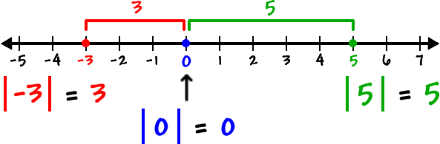
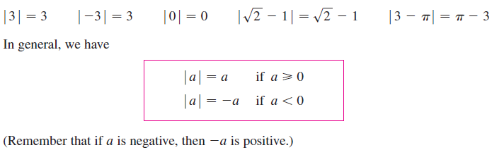

The next example of a piecewise defined function is the absolute value function. Recall that the absolute value of a number , denoted by |a| , is the distance from a to 0 on the real number line. Distances are always positive or 0, so we have $$\left|a\right|≥0 for every number a$$ for example
Absolute Value

Slide 19

Sketch the graph of the absolute value function $f\left(x\right)=\left|x\right|$
Exercise

Slide 20
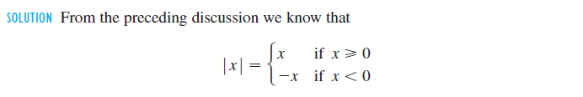
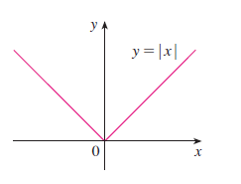
Sketch the graph of the absolute value function $f\left(x\right)=\left|x\right|$
Answer

Slide 21
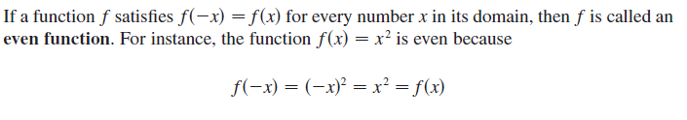
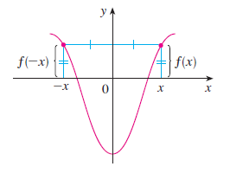
SYMMETRY

Slide 22
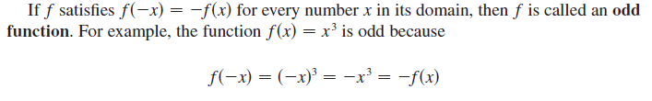
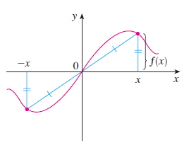

Slide 23

Exercise

Slide 24
A mathematical model is a mathematical description (often by means of a function or an equation) of a real-world phenomenon such as the size of a population, the demand for a product, the speed of a falling object, the concentration of a product in a chemical reaction, the life expectancy of a person at birth, or the cost of emission reductions. The purpose of the model is to understand the phenomenon and perhaps to make predictions about future behavior.
MATHEMATICAL MODELS: A CATALOG OF ESSENTIAL FUNCTIONS

Slide 25
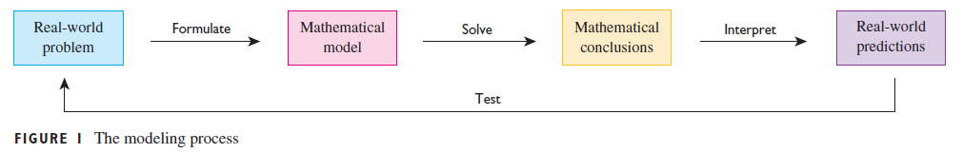
Given a real-world problem, our first task is to formulate a mathematical model by identifying and naming the independent and dependent variables and obtaining equations. Mathematical model: applying math knowledge Mathematical conclusion: produce information Real-word prediction: Testing against real data

Slide 26

When we say that y is a linear function of x, we mean that the graph of the function is a line, so we can use the slope-intercept form of the equation of a line to write a formula for the function as $$y=f\left(x\right)=mx+b$$ where m is the slope of the line and b is the y-intercept
LINEAR MODELS

Slide 27
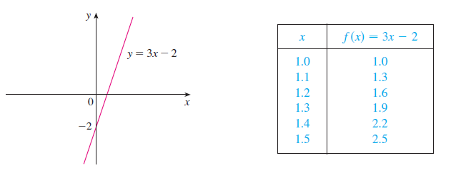

A characteristic feature of linear functions is that they grow at a constant rate. For instance, Figure 2 shows a graph of the linear function $f\left(x\right)=3x −2$ and a table of sample values. Notice that whenever x increases by 0.1, the value of $f\left(x\right)$ increases by 0.3. So increases three times as fast as x. Thus the slope of the graph $y=3x −2$ , namely 3, can be interpreted as the rate of change of y with respect to x.

Slide 28
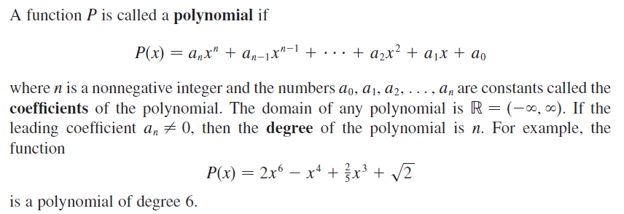
POLYNOMIALS

Slide 29
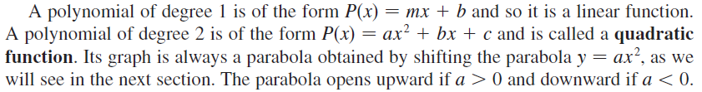
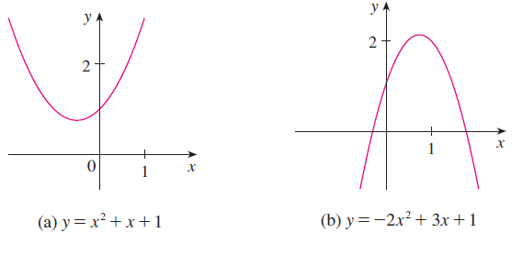

Slide 30
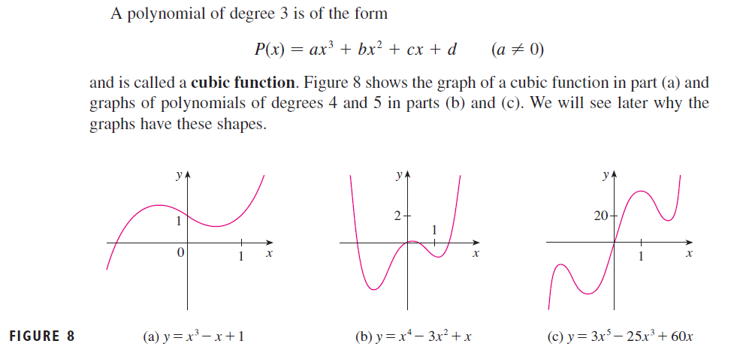

Slide 31
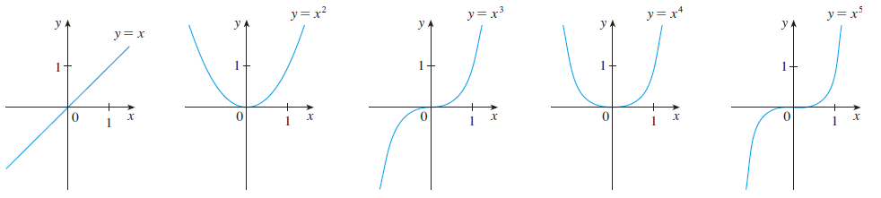

A function of the form $f\left(x\right)= x^{a}$ , where a is a constant, is called a power function. We consider several cases. The graph of $f\left(x\right)= x^{n}$ where n = 1, 2, 3, 4 and 5
POWER FUNCTIONS

Slide 32
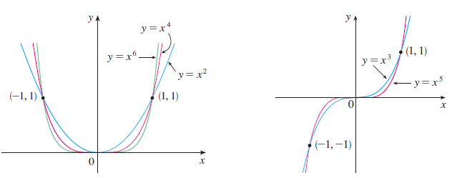


The general shape of the graph of $f\left(x\right)= x^{n}$ depends on whether is even or odd. If is even, then $f\left(x\right)= x^{n}$ is an even function and its graph is similar to the parabola $y= x^{2}$ If is odd, then $f\left(x\right)= x^{n}$ is an odd function and its graph is similar to that of $y= x^{3}$

Slide 33


A rational function is a ratio of two polynomials: $$f\left(x\right)= \frac{P(x)}{Q(x)}$$ where P and Q are polynomials. The function:
Rational Functions

Slide 34
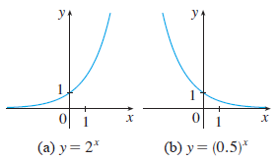

The exponential functions are the functions of the form $f\left(x\right)= a^{x}$ , where the base is a positive constant. The graphs of $y= 2^{x}$ and $y= {(0.5)}^{x}$ are shown in the figure below. In both cases the domain $(−∞,∞)$ is and the range is $(0,∞)$
Exponential Functions

Slide 35
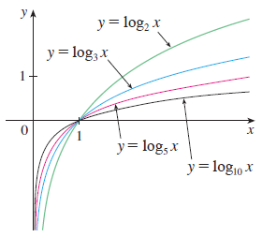

The logarithmic functions $f\left(x\right)= \log_{a}{x}$ , where the base is a positive constant, are the inverse functions of the exponential functions. Figure shows the graphs of four logarithmic functions with various bases. In each case the domain is $(0,∞)$ , the range is $(−∞,∞)$ , and the function increases slowly when $x>1$.

Slide 36

A function is called an algebraic function if it can be constructed using algebraic operations (such as addition, subtraction, multiplication, division, and taking roots) starting with polynomials. Any rational function is automatically an algebraic function. Here are two more examples:
Algebraic Functions

Slide 37

Classify the following functions as one of the types of functions that we have discussed.
Exercise

Slide 38
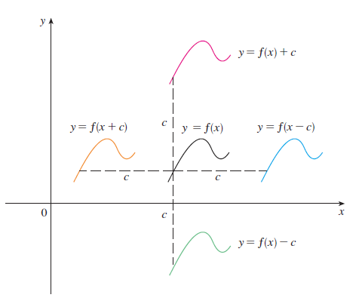
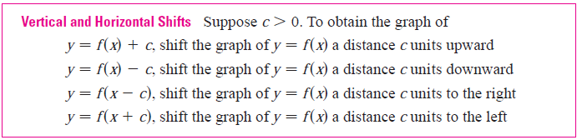
By applying certain transformations to the graph of a given function we can obtain the graphs of certain related functions. This will give us the ability to sketch the graphs of many functions quickly by hand. It will also enable us to write equations for given graphs. Let’s first consider translations.
Transformations of Functions

Slide 39
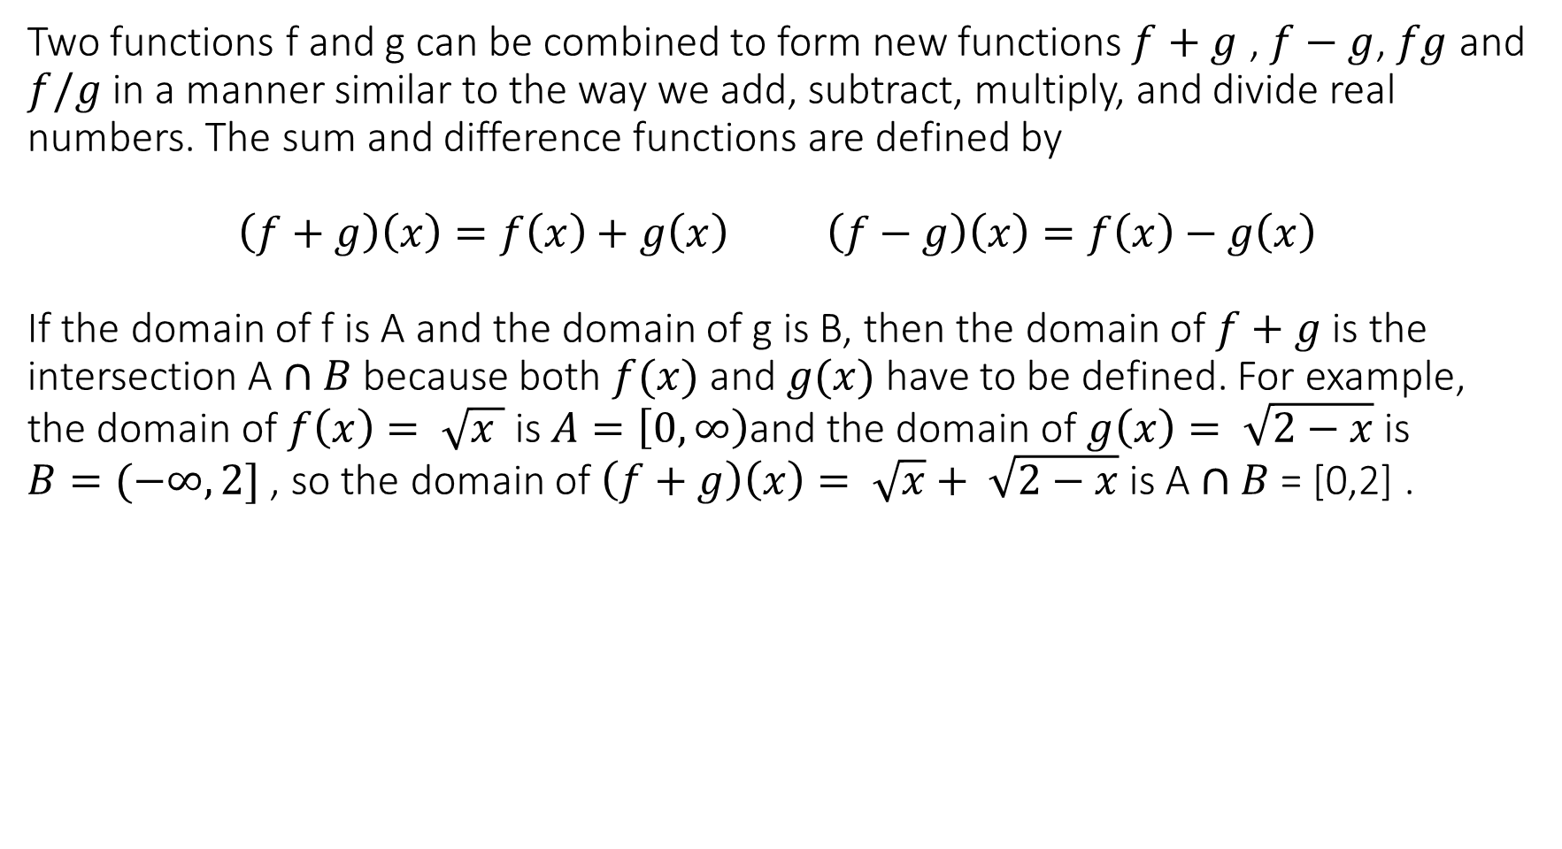
Two functions f and g can be combined to form new functions$f+g$ , $f−g$, $fg$ and $f/g$ in a manner similar to the way we add, subtract, multiply, and divide real numbers. The sum and difference functions are defined by $$\left(f+g\right)\left(x\right)=f\left(x\right)+g\left(x\right) \left(f−g\right)\left(x\right)=f\left(x\right)−g\left(x\right)$$ If the domain of f is A and the domain of g is B, then the domain of $f+g$ is the intersection A $∩B$ because both $f(x)$ and $g(x)$ have to be defined. For example, the domain of $f\left(x\right)= \sqrt{x }$ is $A=\left[0, ∞\right)$and the domain of $g\left(x\right)= \sqrt{2−x}$ is $B=(−∞,2]$ , so the domain of$\left(f+g\right)\left(x\right)= \sqrt{x}+ \sqrt{2−x}$ is A $∩B$ = [0,2] .
Combinations of Functions

Slide 40
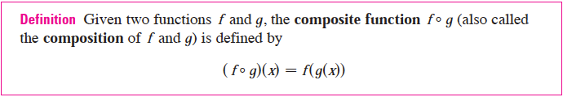
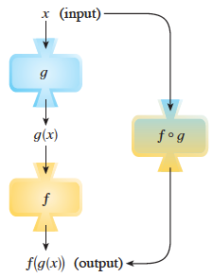
The output of the first function is used as the input of the second function
Another way is the composition function

Slide 41


If $f\left(x\right)= x^{2}$ and $g\left(x\right)=x −3$find the composite functions $f ° g and g ° f$
Example

Slide 42

If $f\left(x\right)= \sqrt{x }$and $g\left(x\right)= \sqrt{2 −x}$ find each function and its domain a. $f ° g$ b. $g ° f$ c. $f ° f$ d. $g ° g$
Exercise

Slide 43
The word tangent is derived from the Latin word tangens, which means “touching.” Thus a tangent to a curve is a line that touches the curve. In other words, a tangent line should have the same direction as the curve at the point of contact. How can this idea be made precise?
The Tangent Problem

Slide 44


Slide 45


Find an equation of the tangent to the parabola $y= x^{2}$ at the point $P\left(1,1\right)$ solution first we have to find the slope (identify two point on the curve, one is P($x_{1},y_{1 })$the other is Q($x_{2},y_{2 })$, use the slope equation) = $$m_{PQ}= \frac{y_{2} −y_{1}}{x_{2} − x_{1}}$$ Now let’s select another point from the curve Q(1.5,2.25) we have $m_{PQ}= \frac{2.25 − 1}{1.5 −1}=2.5$
Example

Slide 46



The Q closer is to P, the closer X is to 1 and, it appears from the tables, the closer $m_{PQ}$ is to 2. This suggests that the slope of the tangent line t should be $m=2$ . We say that the slope of the tangent line is the limit of the slopes of the secant lines, and we express this symbolically by writing

Slide 47



From the table and the graph of (a parabola) shown in Figure 1 we see that when x is close to 2 (on either side of 2), f(x) is close to 4.
We express this by saying “the limit of the function $f\left(x\right)= x^{2} −x+2$ as approaches 2 is equal to 4.” The notation for this is
$$\lim_{x→2}=\left(x^{2} −x+2\right)={4}$$

Slide 48

In general, we use the following notation.

Slide 49

Guess the value of $$\lim_{x→0}{ \frac{\sin{x }}{x}}$$
Exercise

Slide 50

Solution

Slide 51



The Heaviside function H is defined by [This function is named after the electrical engineer Oliver Heaviside (1850–1925) and can be used to describe an electric current that is switched on at time t = 0.] Its graph is shown in Figure 8. As approaches 0 from the left, H(t) approaches 0. As t approaches 0 from the right, H(t) approaches 1. There is no single number that H(t) approaches as approaches 0. Therefore $\lim_{t→0}{H(t)}$ does not exist.
The Heaviside function

Slide 52

We noticed in the previous example, that H(t) approaches 0 as t approaches 0 from the left and H(t) approaches 1 as t approaches 0 from the right. We indicate this situation symbolically by writing
One-Sided Limits

Slide 53


Slide 54


The symbol ${x→a}^{+ }$means that we consider only $x>a$ these definitions are illustrated as

Slide 55


Slide 56




Example

Slide 57
Derivatives

Slide 58


Slide 59


Slide 60


Slide 61



Slide 62



Slide 63


Slide 64


Slide 65
Integrals

Slide 66



Slide 67



Slide 68


Slide 69

As n increases, both and become better and better
approximations to the area of S. Therefore we define the area A to be the limit of the
sums of the areas of the approximating rectangles, that is,

Slide 70



Slide 71



Slide 72


Slide 73
Matrices

Slide 74



Slide 75


Slide 76


Slide 77


Slide 78


