Slide 1
ASP.Net Project
Mina Sameh Wadie Zaki – 2018 030 160
Supervised By Eng Hadeer

Slide 2
Technologies Used
HTML, CSS, JavaScript And ASP.Net .
Jquery
DataTables
Template from BootStrapMade
Cypress for testing.

Slide 3
Website Idea
Free ebooks website
Spread Knowledge
Easy to use
Collect user info for reuse in advertising

Slide 4
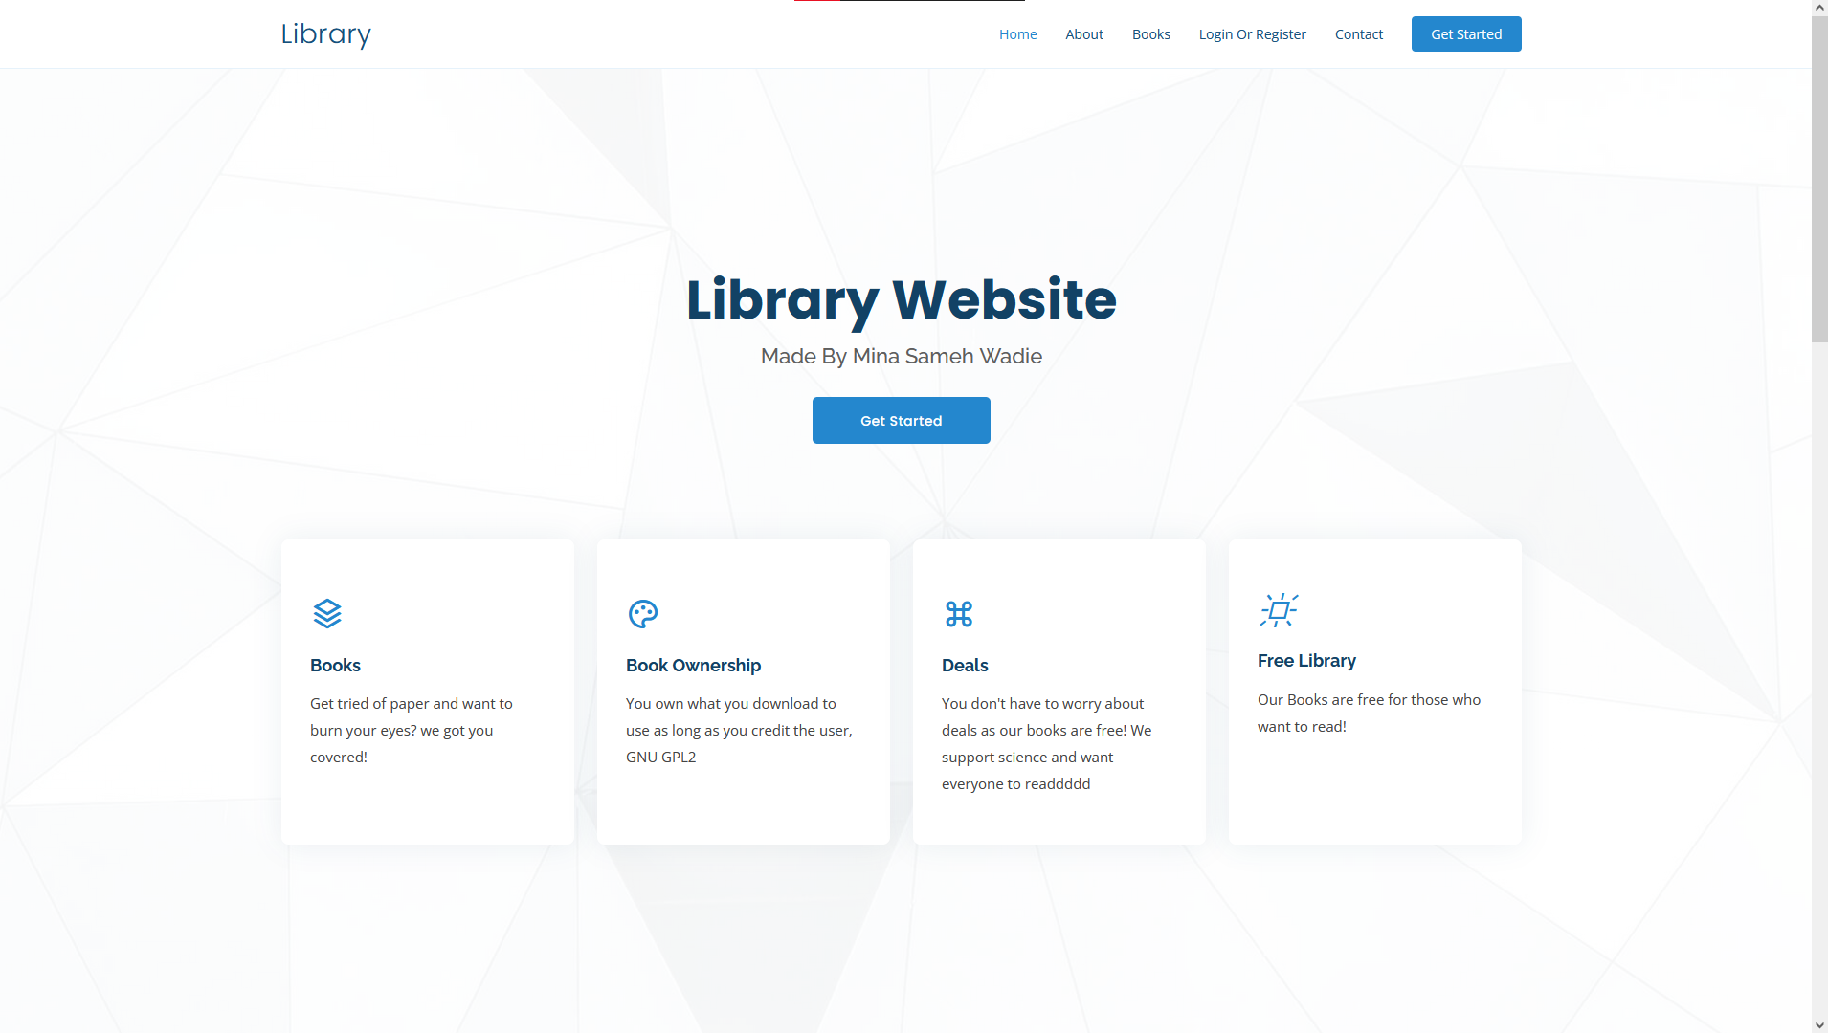
Project Run main Page

Slide 5
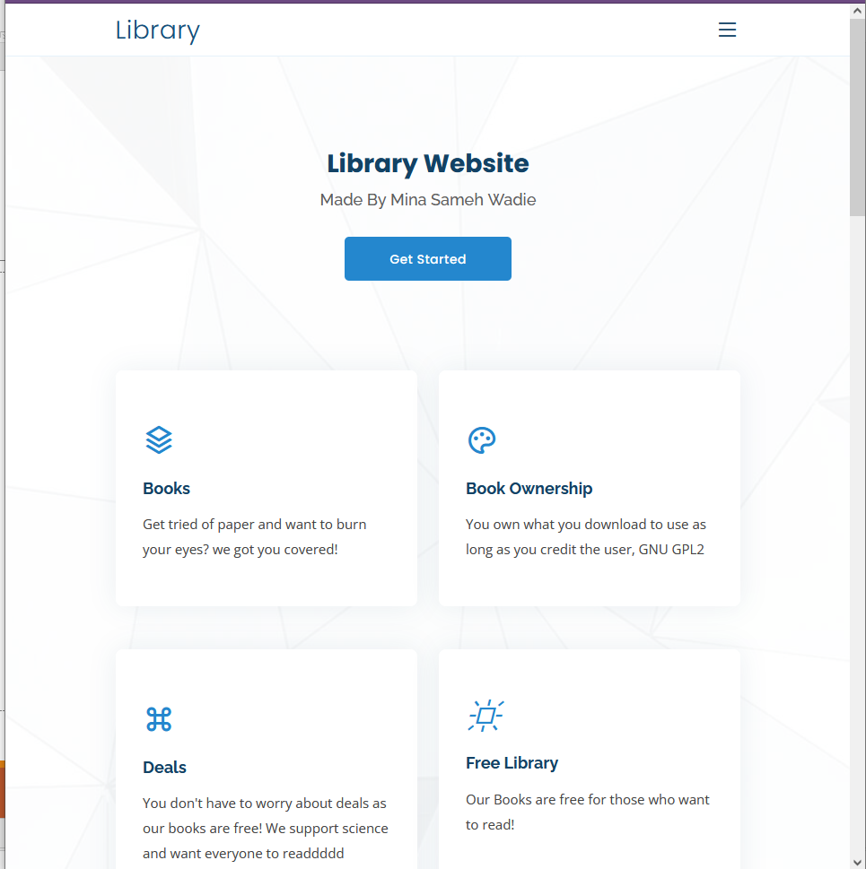
Project Run main Page compact

Slide 6
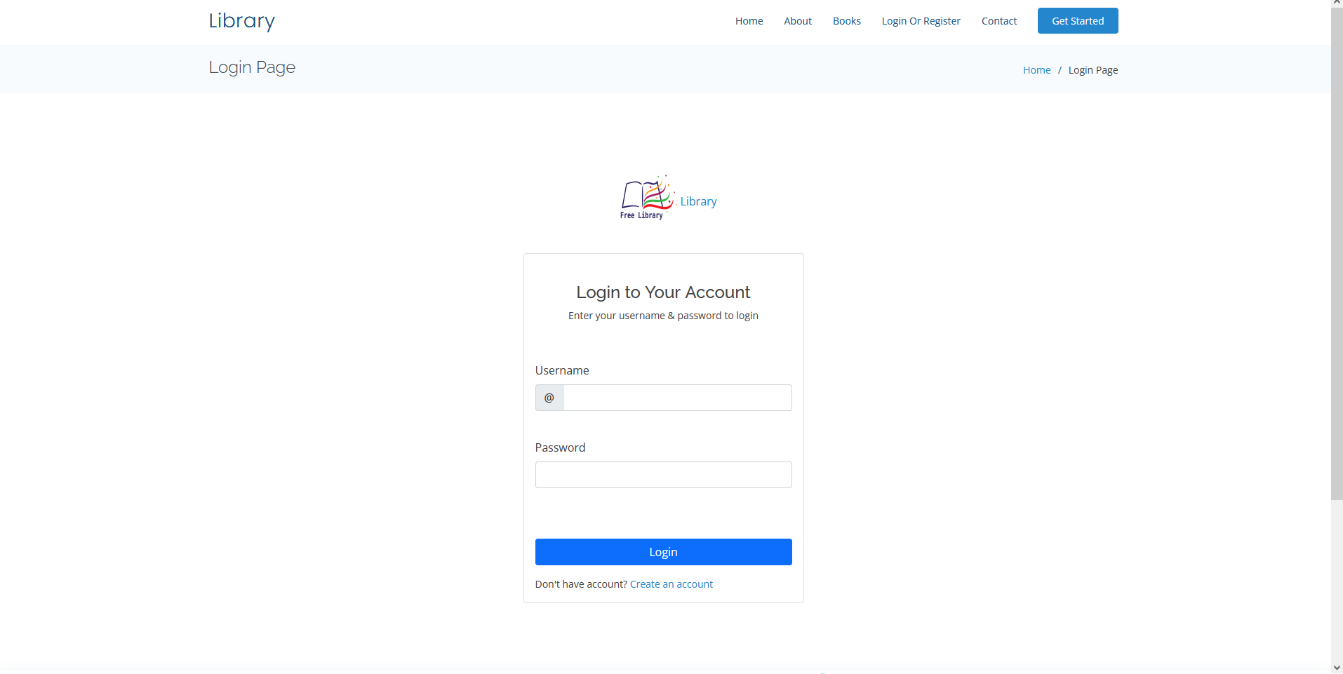
Project Run Login Page

Slide 7
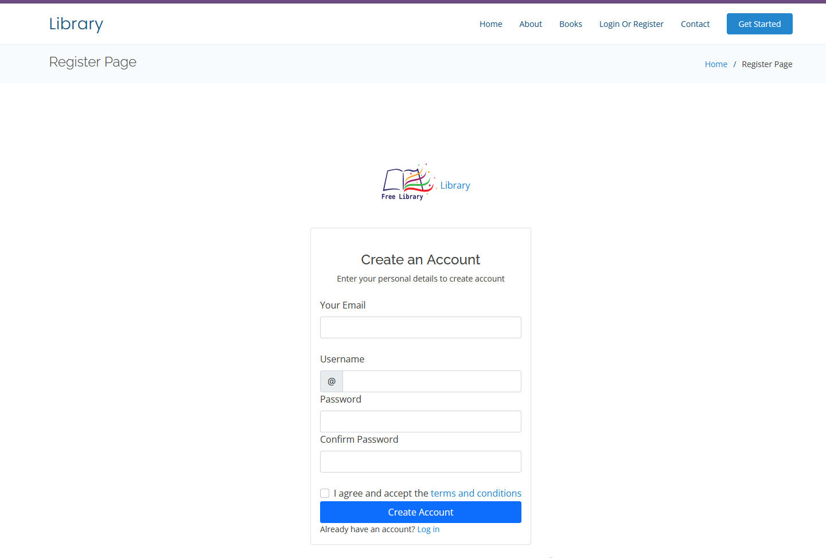
Project Run Register Page

Slide 8
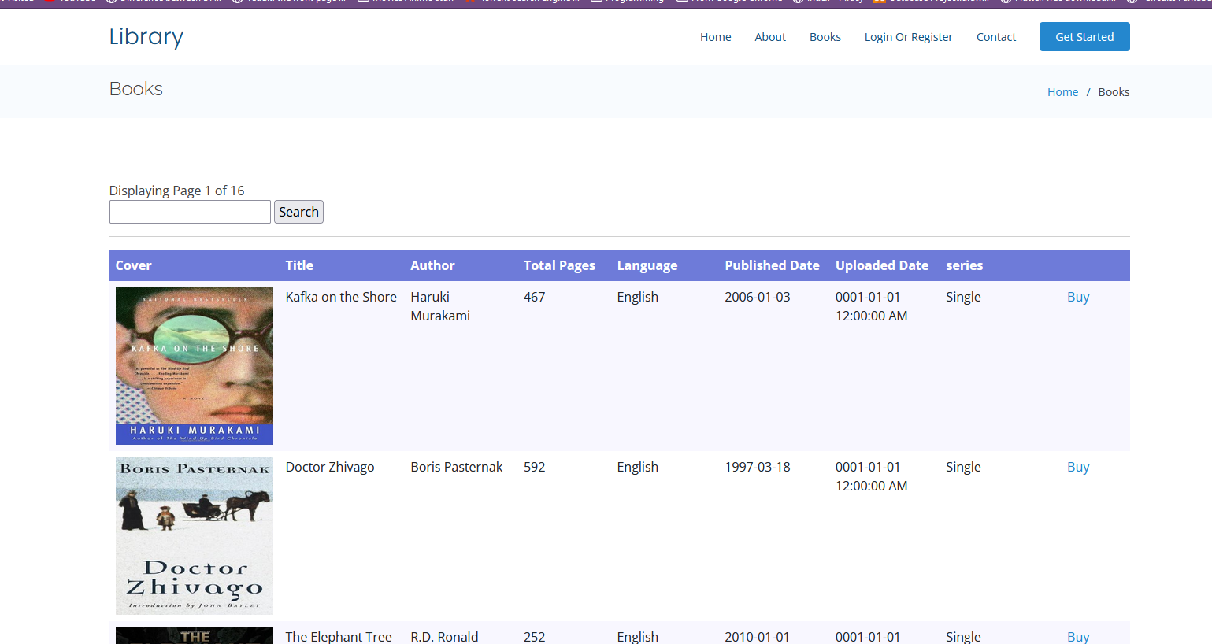
Project Run Books Page

Slide 9
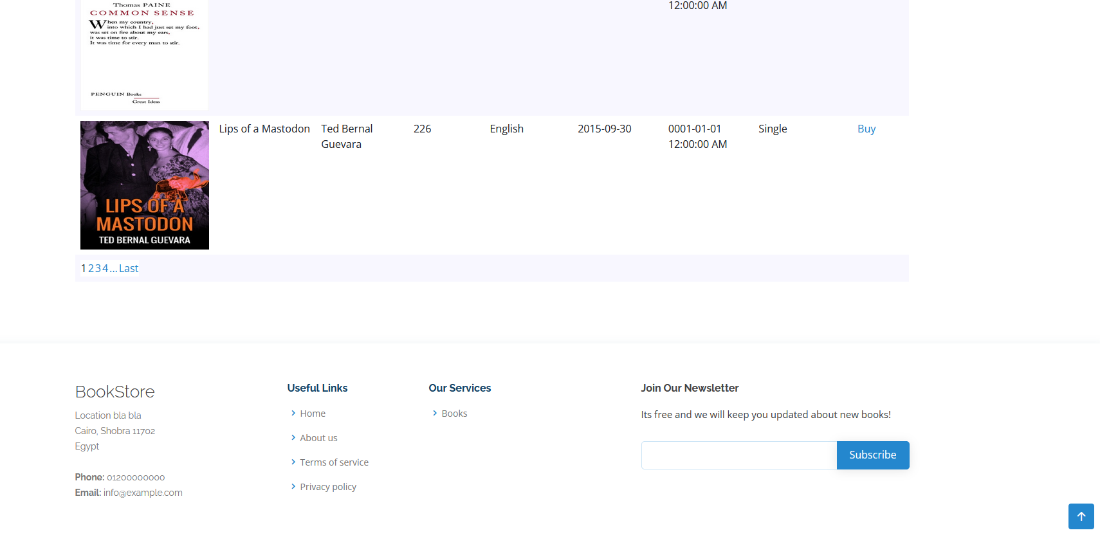
Project Run Bottom of Books Page

Slide 10
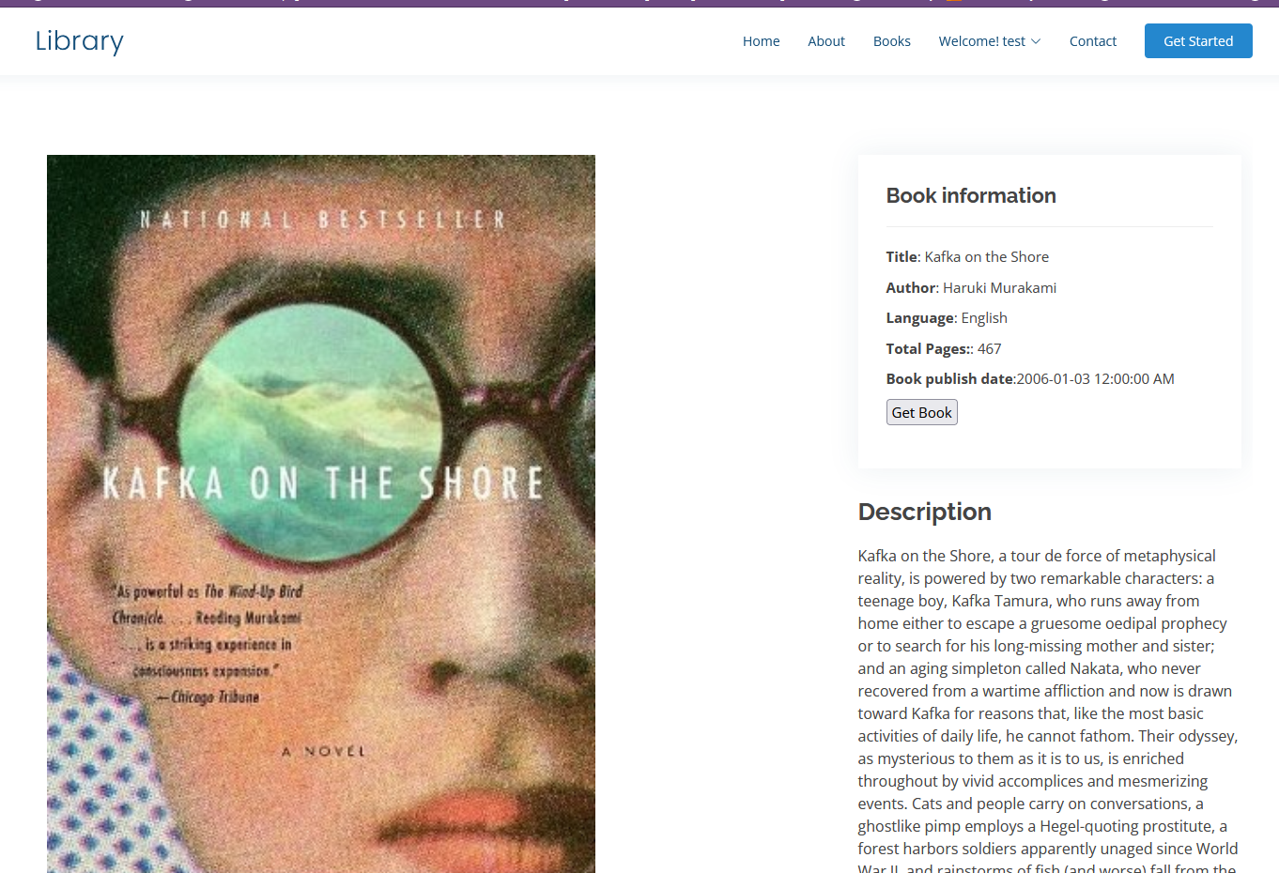
Project Run Book details Page

Slide 11
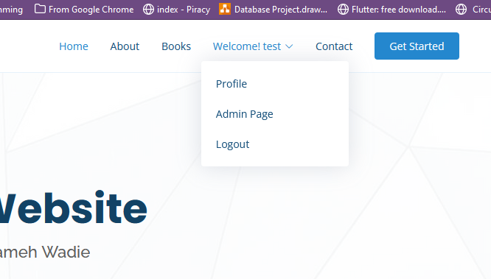
Project Run Admin Logged in Page

Slide 12
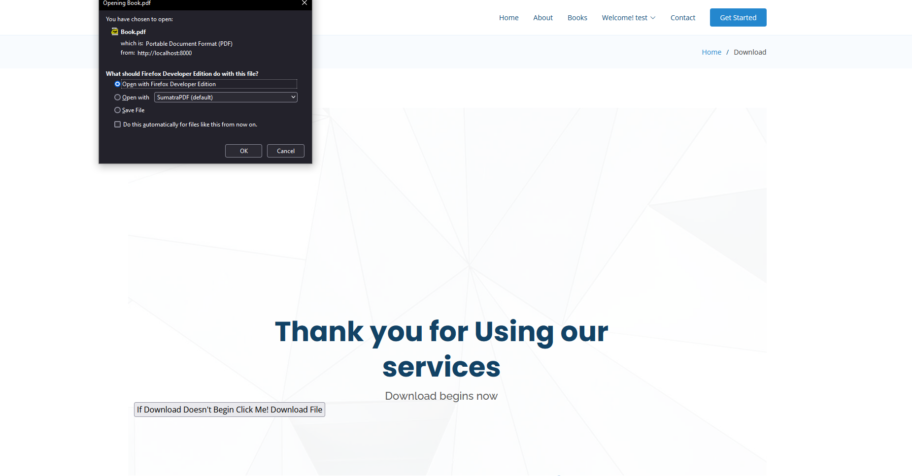
Project Run Book Download Page

Slide 13
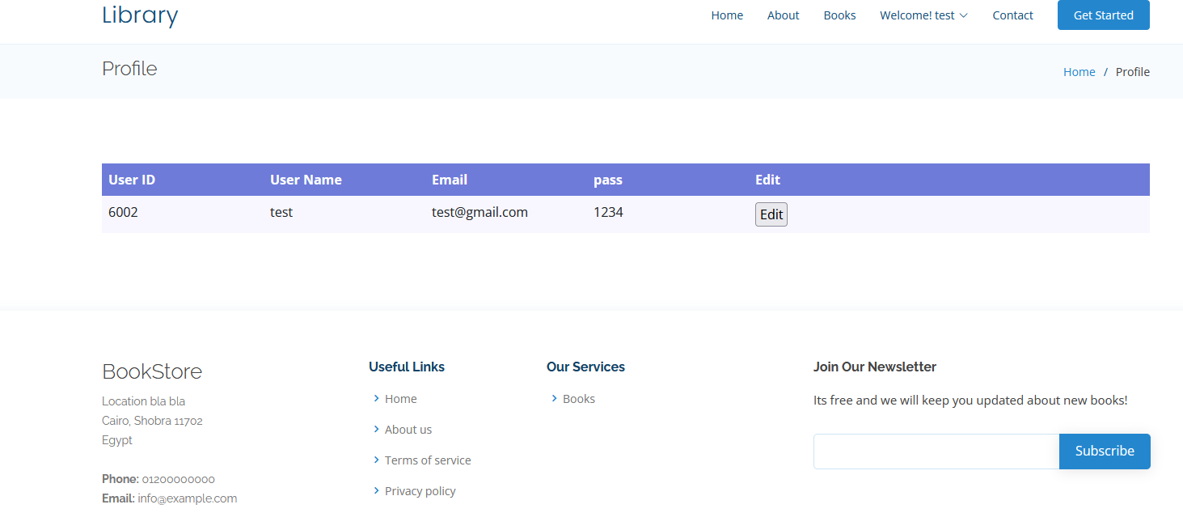
Project Run Profile Page

