Slide 1
Airbnb

Slide 2

Data Collection :
https://www.kaggle.com/datasets/kritikseth/us-airbnb-open-data?select=AB_US_2023.csv

Slide 3
Introduction
Airbnb is an online platform that connects hosts offering accommodations with travelers seeking unique places to stay. it operates in over 27 city, providing diverse lodging options like apartments, houses, and unique spaces such as treehouses and castles. Airbnb promotes cultural exchange, local tourism, and immersive travel experiences while ensuring safety and trust through secure payments and user reviews. It has transformed the hospitality industry by blending technology with the sharing economy.

Slide 4
Table of contents
∙ 01 ∙
∙ 02 ∙
∙ 03 ∙
∙ 04 ∙
Read& Understanding Data
Exploratory Data Analysis (EDA)
Pre-Processing
Modeling

Slide 5
∙ 01 ∙
Read& Understanding Data

Slide 6
Explain my column:
neighbourhood: The specific area or neighborhood where the property is located.
latitude: The geographic coordinate indicating the north-south position of the property.
longitude: The geographic coordinate indicating the east-west position of the property.
room_type: The type of room available for booking (e.g., Entire home/apt, Private room, Shared room).
price: The nightly rental price for the property.
minimum_nights: The minimum number of nights required to book the property.
last_review: The date when the property was last reviewed by a guest.
calculated_host_listings_count: The number of listings managed by the same host.
availability_365: The number of days the property is available for booking in a year.
number_of_reviews_ltm: The number of reviews received in the last 12 months.
city: The city where the property is located.
distance_to_city_center (extract): The distance of the property from the city center, often in kilometers or miles.
distance_category (extract): A categorized version of distance_to_city_center (e.g., "Close", "Moderate", "Far").
reviews_category (extract): A classification of properties based on the number or quality of reviews (e.g., "Highly reviewed", "Moderately reviewed").
host_listings_category (extract): A categorization based on the number of listings a host manages (e.g., "Single property host", "Multi-property host").
availability_category (extract): A classification of properties based on their availability (e.g., "High availability", "Low availability").
season (extract): The season (e.g., Summer, Winter) during which the data is relevant or the property is analyzed.
price_per_distance (extract): The price normalized by the distance to the city center (price per unit of distance).
price_per_room_type (extract): The average price normalized based on the type of room.
price_relative_to_room_type (extract): The property's price compared to the average price for its room_type.

Slide 7
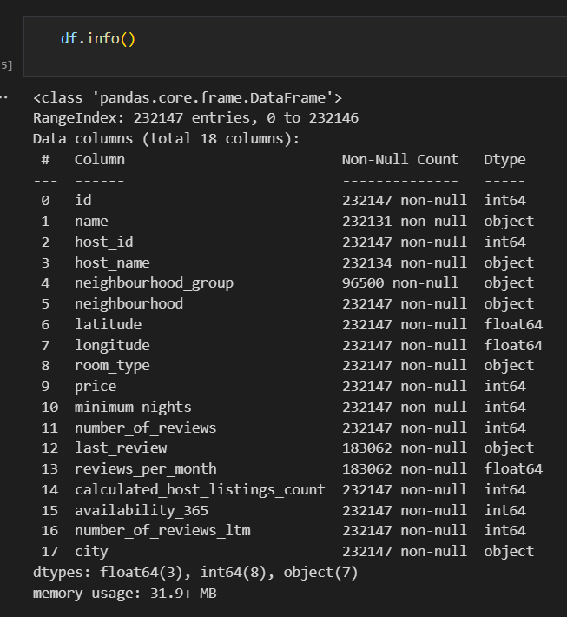
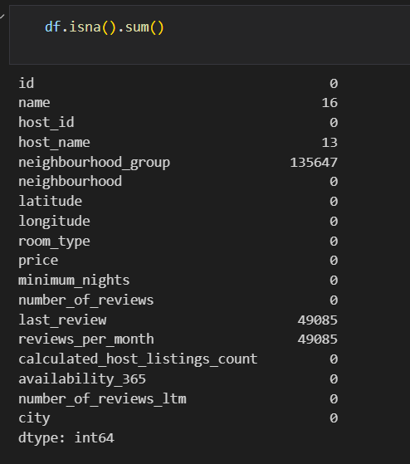

Slide 8
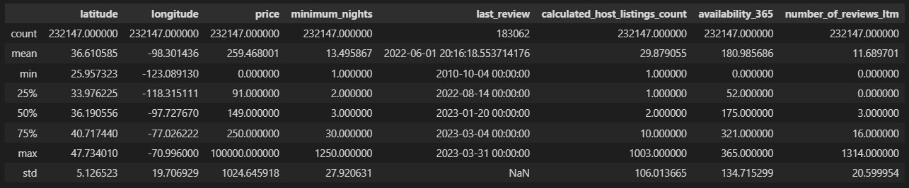
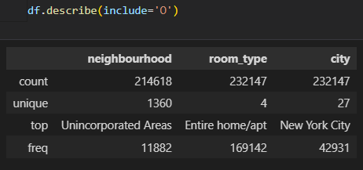
First step: show data unique , nunique for every cat, num second step : is describe data num, cat:

Slide 9
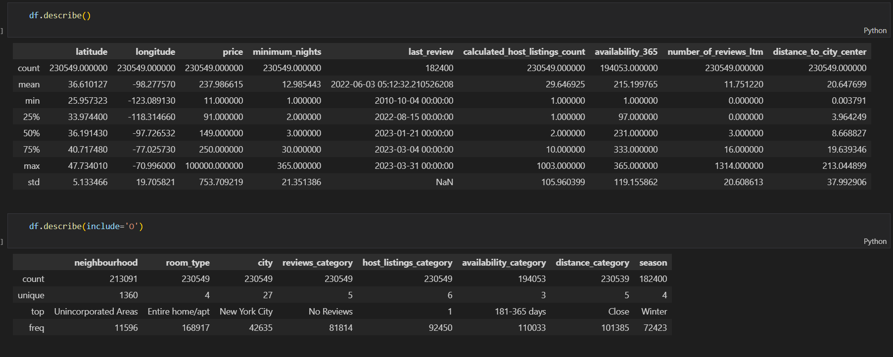
Check neighborhood if have numeric in and handle . Drop unimportant data. Check if range price room type is correct Check min number night can book for each room type extract feature: distance_to_city_center, reviews_category, host_listings_category, availability_category, distance_category, season

Slide 10
∙ 02 ∙
Exploratory Data Analysis (EDA)

Slide 11
Visualization: uni-variate num uni-variate cat and make some business question to show data What is the average price per room type? How does the price vary over time across different seasons? How does the price of properties correlate with their availability for the year (availability_365)? Which are the top 10 neighborhoods with the highest number of listings, and how do the room types vary across these neighborhoods? What is the relationship between minimum nights and room type across different seasons? What is the distribution of room types across cities? How does the price of accommodations vary over time by room type?

Slide 12
∙ 03 ∙
Pre-Processing

Slide 13
I do in preprocessing in pipeline :
a) Detect & Handle Duplicates
b) train_test_split
c) Detect & Handle NaNs use KNN & Simpleimputer
d) Detect & Handle Outliers use Log & lu_ub
e) Encoding: (Ordinal:[OrdinalEncoder, LabelEncoder] - Nominal: [< 7 uniques(OneHotEncoding), > 7 uniques (BinaryEncoder)])
f) Scaling: RobustScaler

Slide 14
∙ 04 ∙
Modeling

Slide 15
after perprocessing I do modeling and make grid search every model:
Make Simple Model
2) Get validation accuracy to invstigate (Underfitting vs Overfitting)
3) Hyperparameters tunning (using GridSearchCV)
I used linearregression and used poly but accuracy is low:
Lasso and I make grid :
Ridge:
ElasticNet:
KNeighborsRegressor:
DecisionTreeRegressor:
RandomForestRegressor:
XGBRegressor:
GradientBoostingRegressor:
I use in gride search neg_mean_squared_error the best score will be negative but if abs for score is positive score
4) Get Test Score & confidence interval
This grid search GB :
This model before grid search:
5) save model
I saved model json and saved pkl used dill

Slide 16
Thanks!
https://github.com/MinaTharwat93/MinaTharwat93-Airbnb_Project_Regression.git

