Slide 1
CPSC 481
Artificial Intelligence
Dr. Anand Panangadan
apanangadan@fullerton.edu

Slide 2
What we will cover today
Reasoning with uncertainty
  Probability
  Conditional probability
  Bayes rule
  Naïve Bayes classifier

Slide 3
Applications with uncertainty
Medical diagnosis
  Not always an obvious cause/effect relationship between the symptoms presented by the patient and the causes of these symptoms
  The same sets of symptoms from multiple causes
Natural language understanding
  A word can have multiple meanings
  Meaning becomes clearer when we look at multiple words
Planning
  When an agent forms a plan (e.g., a vacation trip by car), often no deterministic sequence of operations is guaranteed to succeed
  Car can break down, a hotel is fully booked even though a reservation was made, …
Learning
  Gaining knowledge about the world is getting more certain about what to expect

Slide 4
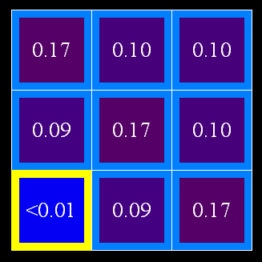
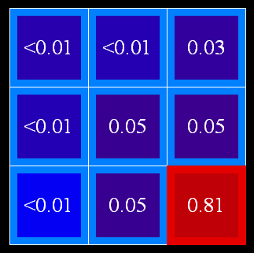
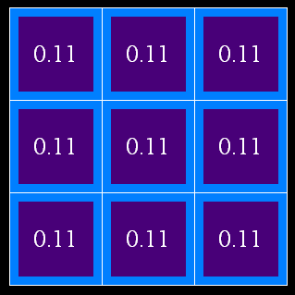
Uncertainty
General situation:
  Observed variables (evidence/fact): Agent knows certain things about the state of the world (e.g., symptoms or today’s weather)
  Unobserved variables: Agent needs to reason about other aspects (e.g. what disease is present or tomorrow’s weather)
  Model: Agent knows something about how the known variables relate to the unknown variables
Probabilistic reasoning gives us a framework for managing our beliefs and knowledge

Slide 5

Random Variables
A random variable is some aspect of the world about which we are uncertain
  R = Is it raining?
  T = Is it hot or cold?
  D = How long will it take to drive to work?
  L = Where is the ghost (Pacman)?
We denote random variables with capital letters
Random variables have domains
  R in {true, false} also written as {+r, -r}
  T in {hot, cold}
  D in [0, ∞)
  L in possible locations, maybe {(0,0), (0,1), …}

Slide 6

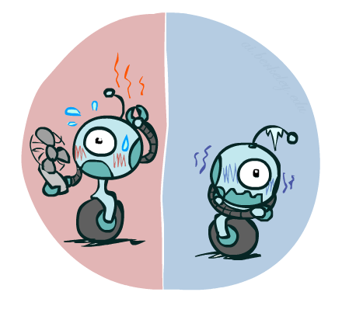
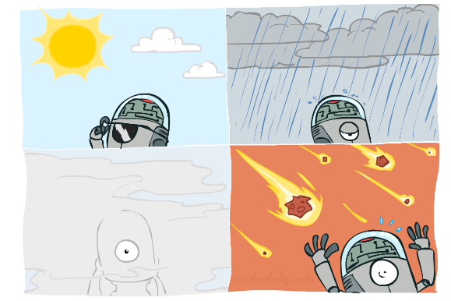



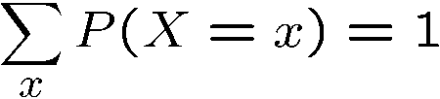
Probability Distributions
Associate a single number, probability, with each value
  Temperature:
A distribution is a TABLE of probabilities of values, such that
  Weather:
W | P
sun | 0.6
rain | 0.1
fog | 0.3
meteor | 0.0
T | P
hot | 0.5
cold | 0.5

Slide 7




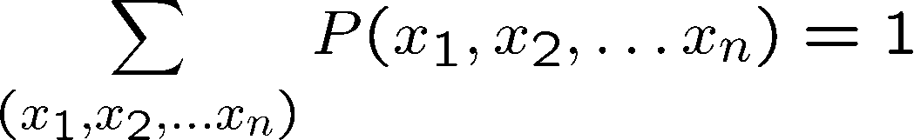
Joint Distributions
A joint distribution over a set of random variables:
specifies a real number for each outcome:
  Must obey:
Size of distribution of n variables with domain size d?
  For all but the smallest distributions, impractical to write out!
T | W | P
hot | sun | 0.4
hot | rain | 0.1
cold | sun | 0.2
cold | rain | 0.3
P(a,b)
P(a)
P(b)
Notes:
A probabilistic model is a joint distribution over a set of random variables
Probabilistic models:
(Random) variables with domains
Joint distributions: say whether outcomes are likely
Normalized: sum to 1.0
Ideally: only certain variables directly interact
d^n

Slide 8
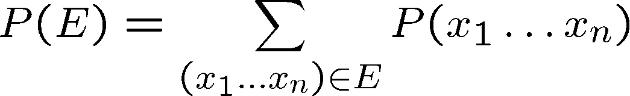
Events and Sample Space
An event is a set E of outcomes
From a joint distribution, we can calculate the probability of any event
  Probability that it’s hot AND sunny?
  Probability that it’s hot OR sunny?
  Probability that it’s hot?
T | W | P
hot | sun | 0.4
hot | rain | 0.1
cold | sun | 0.2
cold | rain | 0.3

Slide 9
Class work
C: a woman aged 40-50 has breast Cancer
M: result of a Mammogram
P(+c, +m) ?
P(+c) ?
P(-m OR +c) ?
C | M | P(C,M)
+c | +m | 0.009
+c | -m | 0.001
-c | +m | 0.099
-c | -m | 0.891
Notes:
0.2
0.5
0.6

Slide 10
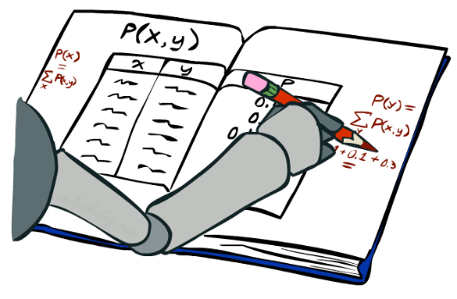
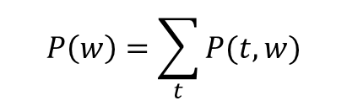
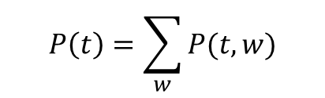
Marginal Distributions
Typically, the events we care about are partial outcomes, like P(T=hot)
The set of all possible outcomes of an event E is its sample space
  The sample space for it’s hot = {it’s hot and sun, it’s hot and rain}
Marginal distributions are sub-tables which eliminate variables
Marginalization (summing out): Combine collapsed rows by adding
T | P
hot | 0.5
cold | 0.5
T | W | P
hot | sun | 0.4
hot | rain | 0.1
cold | sun | 0.2
cold | rain | 0.3
$$P\left(t\right)=\sum_{w}{P(t,w)}$$
$$P\left(w\right)=\sum_{t}{P(t,w)}$$
W | P
sun | 0.6
rain | 0.4

Slide 11
Class work
C | P(C)
+c
-c
C | M | P(C,M)
+c | +m | 0.009
+c | -m | 0.001
-c | +m | 0.099
-c | -m | 0.891
M | P(M)
+m
-m
Notes:
0.5
0.5
0.6
0.4

Slide 12
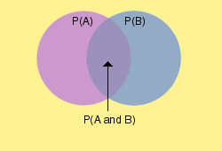
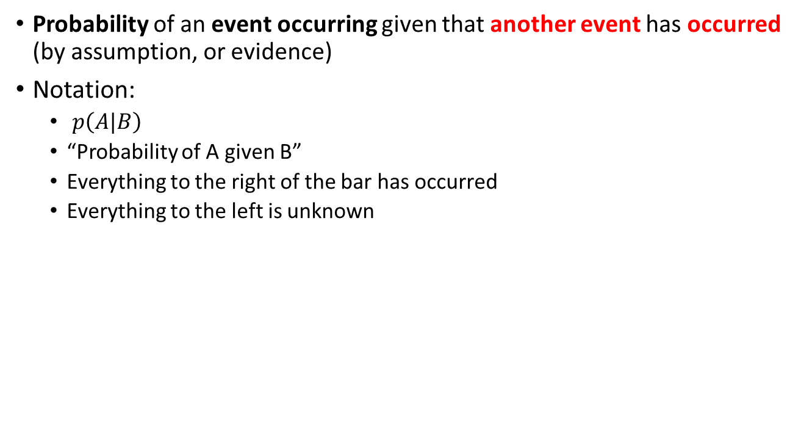
Conditional Probability
Probability of an event occurring given that another event has occurred (by assumption, or evidence)
Notation:
  $p\left(A|B\right)$
  “Probability of A given B”
  Everything to the right of the bar has occurred
  Everything to the left is unknown

Slide 13
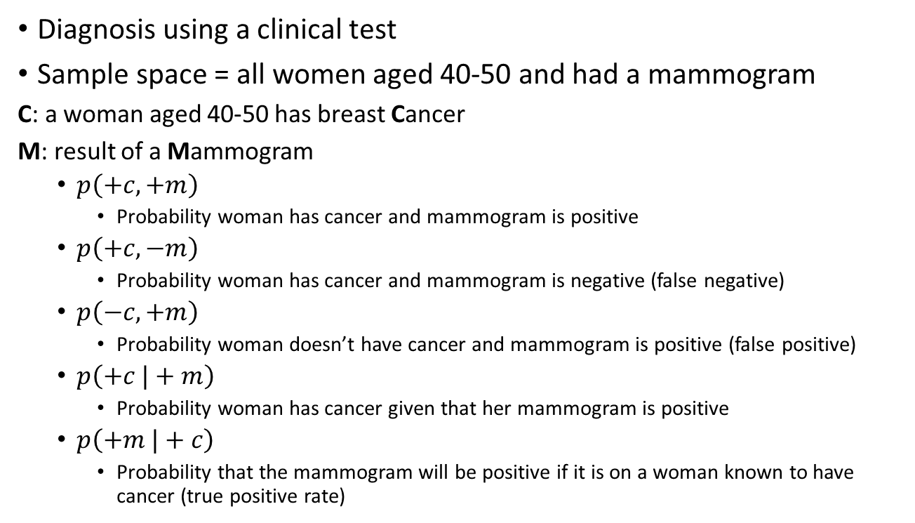
Conditional Probability Example
Diagnosis using a clinical test
Sample space = all women aged 40-50 and had a mammogram
C: a woman aged 40-50 has breast Cancer
M: result of a Mammogram
  $p\left(+c,+m\right)$
    Probability woman has cancer and mammogram is positive
  $p\left(+c,−m\right)$
    Probability woman has cancer and mammogram is negative (false negative)
  $p\left(−c,+m\right)$
    Probability woman doesn’t have cancer and mammogram is positive (false positive)
  $p\left(+c |+m\right)$
    Probability woman has cancer given that her mammogram is positive
  $p\left(+m |+c\right)$
    Probability that the mammogram will be positive if it is on a woman known to have cancer (true positive rate)

Slide 14
Conditional Probability Applications
Medical diagnosis
  Probability of disease, given medical test is true
Robot localization
  Probability robot is at a specific location, given sensor values
Spam filtering
  Probability email is spam, given email contains URLs and has spelling mistakes …

Slide 15
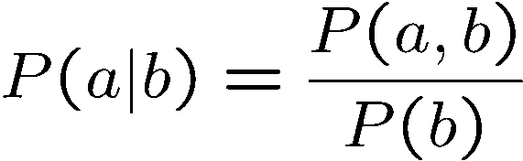
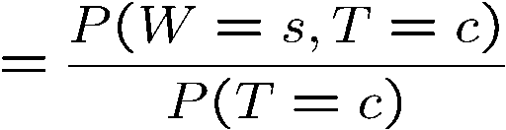
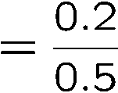



Conditional Probabilities
A simple relation between joint and conditional probabilities
  In fact, this is the definition of a conditional probability
P(a,b)
P(a)
P(b)
T | W | P
hot | sun | 0.4
hot | rain | 0.1
cold | sun | 0.2
cold | rain | 0.3

Slide 16









Normalization Trick
T | W | P
hot | sun | 0.4
hot | rain | 0.1
cold | sun | 0.2
cold | rain | 0.3
W | P
sun | 0.4
rain | 0.6

Slide 17

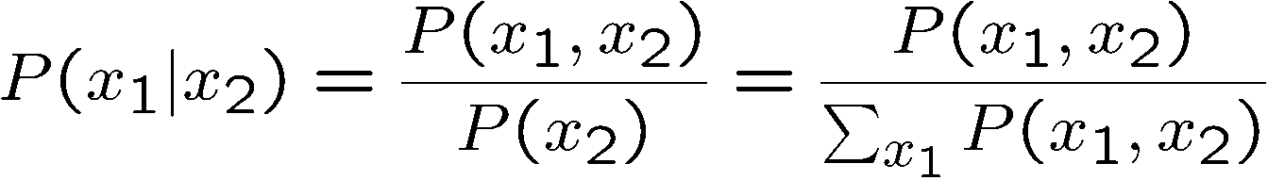
Normalization Trick
  SELECT the joint probabilities matching the evidence
  NORMALIZE the selection
  (make it sum to one)
T | W | P
hot | sun | 0.4
hot | rain | 0.1
cold | sun | 0.2
cold | rain | 0.3
T | W | P
cold | sun | 0.2
cold | rain | 0.3
W | P
sun | 0.4
rain | 0.6
Why does this work? Sum of selection is P(evidence)! (P(T=c), here)

Slide 18

Student Participation: Normalization Trick
P(X= +x | Y=-y) ?
X | Y | P
+x | +y | 0.2
+x | -y | 0.3
-x | +y | 0.4
-x | -y | 0.1
Notes:
+x 0.3/(0.3+0.1)=0.75
-x 0.1/(0.3+0.1)=0.25

Slide 19
Student Participation: Normalization Trick
P(X | Y=-y) ?
  SELECT the joint probabilities matching the evidence
  NORMALIZE the selection
  (make it sum to one)
X | Y | P
+x | +y | 0.2
+x | -y | 0.3
-x | +y | 0.4
-x | -y | 0.1
0.3/0.4
0.1/0.4
0.3
0.1
---
0.4 = P(-y)
Notes:
+x 0.3/(0.3+0.1)=0.75
-x 0.1/(0.3+0.1)=0.25

Slide 20
Class work
C | M | P(C,M)
+c | +m | 0.009
+c | -m | 0.001
-c | +m | 0.099
-c | -m | 0.891
P(+c | +m) ?
P(-c | +m) ?
P(-m | +c) ?
Notes:
0.2/(0.2+0.4)= 1/3
0.4/(0.2+0.4)=2/3
0.3/(0.2+0.3)=0.6

Slide 21
Exercise Questions for Probability
Scenario:
  We toss a fair coin three successive times. What is the probability of seeing more heads than tails coming up when the first toss is a head?
Q1: What is the sample space?
Q2: What are the random variables?
Q3: What are the events and the probabilities of each event?
Q4: What are the conditional probabilities?
Notes:
Q1:What is the sample space?
S = {HHH, HHT, HTH, HTT, THH, THT, TTH, TTT}
Q2: What are the events and the probabilities of each event?
A = {more heads than tails coming up} and B = {1st toss is a head}
P(A) = 4/8, P(B) = 4/8
Q3: What are the random variables?
Measurements of interest for any coin tossing event, e.g., A and B.
Q4: What is the conditional probability and how can we compute it?
P(A|B) = P(A∩B)/P(B) = (3/8)/(4/8) = ¾
Or P(A|B) can be simply calculated by dividing the number of elements for A∩B by the number of elements for B.
When the first toss is H.
The rest are HH, HT, TH, TT. So 3/4

Slide 22
Exercise Questions for Probability
Scenario:
  We toss a fair coin three successive times. What is the probability of seeing more heads than tails coming up when the first toss is a head?
Q1: What is the sample space?
  {(HHH),(HHT),(HTT),(THH),(TTH),(THT),(HTH),(TTT)}
Q3: What are the random variables?
  seeing more heads than tails coming up: A
  the first toss is a head :B
Q2: What are the events and the probabilities of each event?
  (HHH): A=true, B=true +a, +b
  (HHT): A=true, B=true +a, +b
  (HTT): -a, +b
  (THH): +a, -b
  (TTH): -a, -b
  (THT): -a, -b
  (HTH): +a, +b
  (TTT): -a, -b
Q4: What are the conditional probabilities?
  P(A=+a|B=+b) = ?
A | B | prob
+a | +b | 3/8
+a | -b | 1/8
-a | +b | 1/8
-a | -b | 3/8
Notes:
Q1:What is the sample space?
S = {HHH, HHT, HTH, HTT, THH, THT, TTH, TTT}
Q2: What are the events and the probabilities of each event?
A = {more heads than tails coming up} and B = {1st toss is a head}
P(A) = 4/8, P(B) = 4/8
Q3: What are the random variables?
Measurements of interest for any coin tossing event, e.g., A and B.
Q4: What is the conditional probability and how can we compute it?
P(A|B) = P(A∩B)/P(B) = (3/8)/(4/8) = ¾
Or P(A|B) can be simply calculated by dividing the number of elements for A∩B by the number of elements for B.
When the first toss is H.
The rest are HH, HT, TH, TT. So 3/4

Slide 23
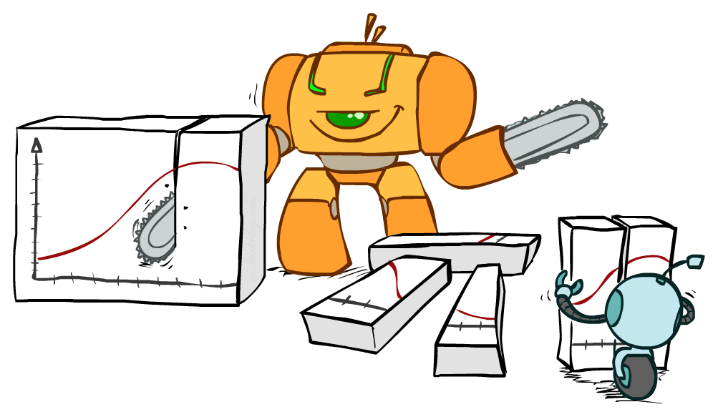
Bayes Rule

Slide 24
Calculating conditional probabilities
In the real world, conditional probabilities are much more common than joint probabilities
Given one type of conditional prob, p(A|B), want to calculate another type of conditional prob, p(B|A)
  Get one conditional from its reverse
Often one conditional is tricky but the other one is simple
  Easier to know effect given cause, p(effect|cause)
  Harder: cause given effect, p(cause|effect)
Joint probabilities
?
p(A|B)
p(B|A)

Slide 25


Calculating conditional probabilities
$p\left(+c | +m\right)=\frac{p(+c,+m)}{p(+m)}$
$=\frac{p(+c,+m)}{p\left(+c,+m\right)+p(−c,+m)}$
$p\left(+c,+m\right)=p\left(+m | +c\right)×p(+c)$
 | C | M | P(C,M)
✓ | +c | +m | 0.009
 | +c | -m | 0.001
✓ | -c | +m | 0.099
 | -c | -m | 0.891
Joint distribution table
C | P(+m|C) | P(-m|C)
+c | 0.9 | 0.1
-c | 0.1 | 0.9
P(+c) | P(-c)
0.01 | 0.99
$$×$$
A priori distribution
Conditional distribution table
of M conditioned on C

Slide 26


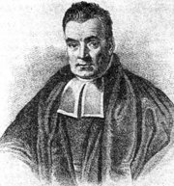
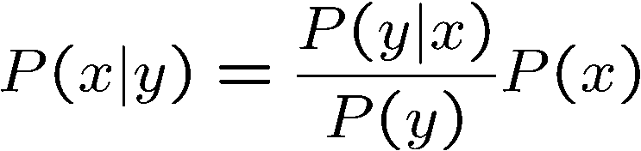
Bayes’ Rule
Two ways to factor a joint distribution over two variables: p(x, y) = p(y, x)
Dividing, we get:
Lets us build one conditional from its reverse
Foundation of many systems
In the running for most important AI equation!

Slide 27
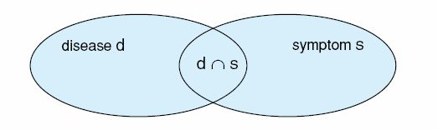

Interpretation of Bayes rule
Cause
Effect
Medical diagnosis system: study the relationship between disease and symptom
d,s
p(d|s) means the probability of the disease d given symptom s.
In many cases, it is difficult to know p(d|s)
If we know what the disease (or cause) is, telling those symptoms (or effect) of the disease, is much easier than figuring out a disease based on symptoms
s can be the result of a medical test
p(s|+d) is test’s sensitivity
p(s|-d) is test’s false positive rate
Sensitivity and false positive rate are given by the test’s manufacturer
p(d) is occurrence of disease
Bayes’ rule
Notes:
P(s|d): via medical tests and observation
Example: common cold and fever; running nose, cough, ear infe
So we can change the calculations of p(d|s) as a function of p(s|d), $p\left(d | s\right)= \frac{p\left(s | d\right)p(d)}{p(s)}$ction

Slide 28
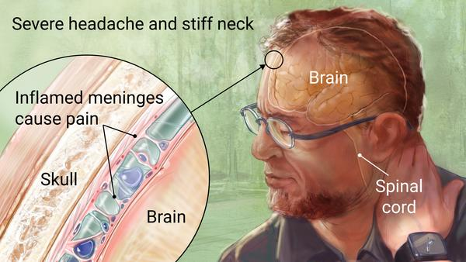
Inference with Bayes’ Rule
Example: Diagnostic probability from causal probability:
Example:
  M: meningitis, S: stiff neck
  Note: posterior probability of meningitis still very small
  Note: you should still get stiff necks checked out! Why?
Example
givens

Slide 29
Example Application of Bayes’ Theorem
Consider a manufacturing firm that receives shipment of parts from two suppliers.
Let A=A₁ denote the event that a part is received from supplier 1
A= A₂ is the event the part is received from supplier 2

Slide 30

We get 65% of our parts from supplier 1 and 35% from supplier 2.
Thus:
P(A=A₁) = .65 and P(A=A₂) = .35
Prior probabilities

Slide 31
Quality levels differ between suppliers
 | Percentage Good Parts | Percentage Bad Parts
Supplier 1 | 98 | 2
Supplier 2 | 95 | 5
Let Q=good denote that a part is good and Q=bad denote that a part is bad.
Thus, the conditional probabilities are
Conditional probabilities
P(Q=good | A₁ ) = .98 and P(Q=bad | A₁ ) = .02
P(Q=bad | A₂ ) = .95 and P(Q=bad | A₂ ) = .05

Slide 32

2-Supplier Problem
A bad part broke one of our machines
What is the probability the part came from supplier 1?
$p\left(A=A_{1} \right| Q=bad) ?$
Posterior probabilities?

Slide 33
2-Supplier Problem
(1) Events A_{i} | (2) Prior Probabilities P(A_{i}) | (3) Conditional Probabilities P(Q=bad | A_{i} ) | (4) Joint Probabilities P(A_{i} , Q=bad) | (5) Posterior Probabilities P(A_{i} | Q=bad)
A₁ | .65 | .02 | .0130 | .0130/.0305=.4262
A₂ | .35 | .05 | .0175 | .0175/.0305 =.5738
 | 1.0 |  | P(Q=bad) =.0305 | 1.0

Slide 34
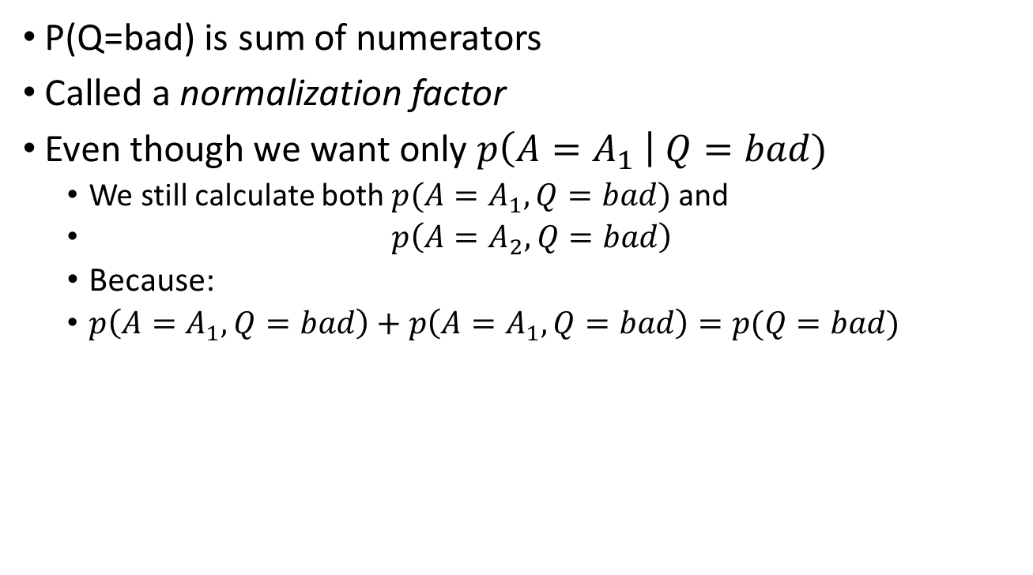

How do we get $p\left(Q=bad\right)?$
P(Q=bad) is sum of numerators
Called a normalization factor
Even though we want only $p\left(A=A_{1} \right| Q=bad)$
  We still calculate both $p(A=A_{1},Q=bad)$and
  $p\left(A=A_{2},Q=bad\right)$
  Because:
  $p\left(A=A_{1},Q=bad\right)+p\left(A=A_{1},Q=bad\right)=p(Q=bad)$

Slide 35
Classwork: Numerical Example: “Cancer”
Only 1 in 1000 people have cancer
The True Positive Rate for a cancer test is 0.99
  Probability that a test conducted on a cancer patient is positive
The False Positive Rate for a cancer test is 0.02
  Probability that a test conducted on a healthy person is positive
If one randomly tested individual is positive, what is the probability they have cancer?

Slide 36
Numerical Example
Given
  Cancer: +c, -c
  “Only 1 in 1000 people have cancer”
    P(Cancer = +c) = 1/1000
    P(+c) = 0.001
  Test: +t, -t
  “The True Positive Rate for a cancer test is 0.99”
    P(+t|+c) = 0.099
  “The False Positive Rate for a cancer test is 0.02”
    P(+t|-c) = 0.02
Want?
  P( +c| +t)?

Slide 37
Numerical Example
Label events:
  A = has disease A_{o} = no disease
  B = Positive test result
Examine probabilities
  p(A) = .001
  p(A_{o})= .999
  p(B|A) = .99
  p(B|A_{o})= .02

Slide 38
Tabular Approach to Bayes’ Theorem—
Cancer
(1) Events A_{i} | (2) Prior Probabilities P(A_{i}) | (3) Conditional Probabilities P(B | A_{i} ) | (4) Joint Probabilities P(A_{i} , B) | (5) Posterior Probabilities P(A_{i} | B)
A
A₀

Slide 39
Tabular Approach to Bayes’ Theorem—
Cancer
(1) Events A_{i} | (2) Prior Probabilities P(A_{i}) | (3) Conditional Probabilities P(B | A_{i} ) | (4) Joint Probabilities P(A_{i} , B) | (5) Posterior Probabilities P(A_{i} | B)
A | .001 | .99
A₀ | .999 | .02
 | 1.00

Slide 40
Tabular Approach to Bayes’ Theorem—
Cancer
(1) Events A_{i} | (2) Prior Probabilities P(A_{i}) | (3) Conditional Probabilities P(B | A_{i} ) | (4) Joint Probabilities P(A_{i} , B) | (5) Posterior Probabilities P(A_{i} | B)
A | .001 | .99 | .00099
A₀ | .999 | .02 | .01998
 | 1.00 |  | P(B)=.02097

Slide 41
Tabular Approach to Bayes’ Theorem—
Cancer
(1) Events A_{i} | (2) Prior Probabilities P(A_{i}) | (3) Conditional Probabilities P(B | A_{i} ) | (4) Joint Probabilities P(A_{i} , B) | (5) Posterior Probabilities P(A_{i} | B)
A | .001 | .99 | .00099 | .00099/.02097=.0472
A₀ | .999 | .02 | .01998 | .01998/.02097 =.9528
 | 1.00 |  | P(B)=.02097 | 1.0000

Slide 42


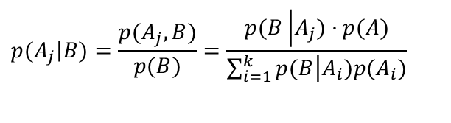
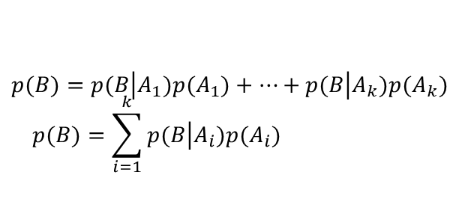



Law of Total Probability
$$A_{1}$$
$$A_{2}$$
$$A_{3}$$
Take events A_{i} for i = 1 to k to be:
  Mutually exclusive: $A_{i}∩A_{j}=0, i≠j$
  Exhaustive: $A_{i}∪…∪A_{k}=S$
For any event B on S
Bayes rule
$$B$$
$$p(B)=p(B\left|A_{1}\right.)p(A_{1})+⋯+p(B\left|A_{k}\right.)p(A_{k}) \\ p(B)=\sum_{i=1}^{k}{p(B\left|A_{i}\right.)p(A_{i})}$$
$$p(A_{j}\left|B\right.)=\frac{p(A_{j},B)}{p(B)}=\frac{p(B\left|A_{j}\right.)⋅p(A)}{\sum_{i=1}^{k}{p(B\left|A_{i}\right.)p(A_{i})}}$$

Slide 43
Naïve bayes classifier

Slide 44
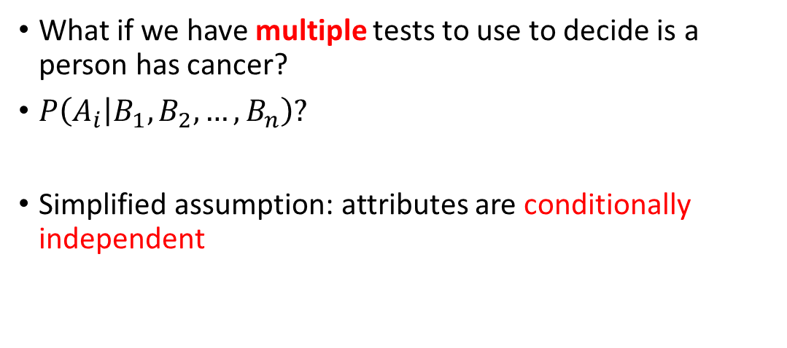
Naïve Bayes Classifier
What if we have multiple tests to use to decide is a person has cancer?
$P\left(A_{i} | B_{1},B_{2},…,B_{n}\right)?$
Simplified assumption: attributes are conditionally independent

Slide 45
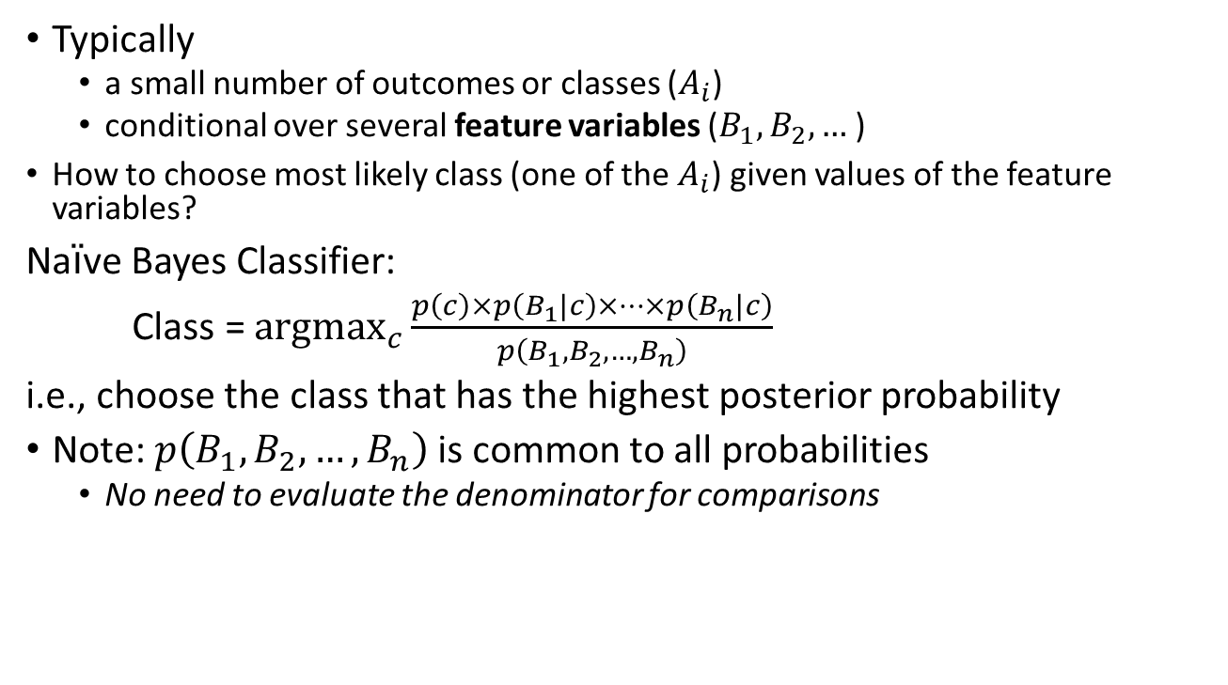
Naïve Bayes Classifier
Typically
  a small number of outcomes or classes ($A_{i}$)
  conditional over several feature variables ($B_{1},B_{2},…$)
  How to choose most likely class (one of the $A_{i}$) given values of the feature variables?
Naïve Bayes Classifier:
Class = ${argmax}_{c}{\frac{p\left(c\right)×p\left(B_{1}|c\right)×…×p\left(B_{n}|c\right)}{p\left(B_{1},B_{2},…,B_{n}\right)}}$
i.e., choose the class that has the highest posterior probability
Note: $p\left(B_{1},B_{2},…,B_{n}\right)$ is common to all probabilities
  No need to evaluate the denominator for comparisons

Slide 46
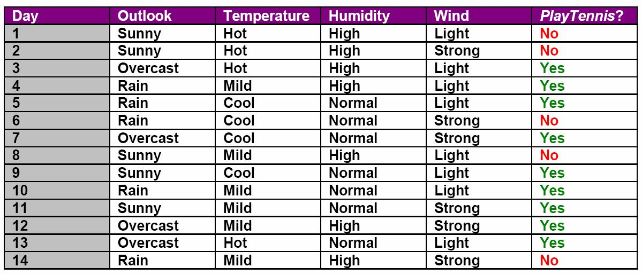
Naïve Bayes Classifier: Example

Slide 47
Naïve Bayes Classifier Example
Problem: will I play tennis today given that it is:
  Outlook=sunny
  Temperature=cool
  Humidity=high
  Wind=strong
P(PlayTennis | sunny, cool, high, strong)?

Slide 48
Naïve Bayes Classifier Example
What are the events?
  PlayTennis = yes
  PlayTennis = no
What are the features?
  Outlook
  Temperature
  Humidity
  Wind

Slide 49
Naïve Bayes Classifier
Use training data to calculate the conditional probabilities
P(PlayTennis=yes) = 9/14 = 0.64
P(PlayTennis=n) = 5/14 = 0.36
P(Outlook=sunny|PlayTennis=yes) = 2/9 = 0.22
P(Outlook=sunny|PlayTennis=no) = 3/5 = 0.60
P(Temperature=cool|PlayTennis=yes) = 3/9 = 0.33
P(Temperature=cool|PlayTennis=no) = 1/5 = .20
P(Humidity=high|PlayTennis=yes) = 3/9 = 0.33
P(Humidity=high|PlayTennis=no) = 4/5 = 0.80
P(Wind=strong|PlayTennis=yes) = 3/9 = 0.33
P(Wind=strong|PlayTennis=no) = 3/5 = 0.60

Slide 50
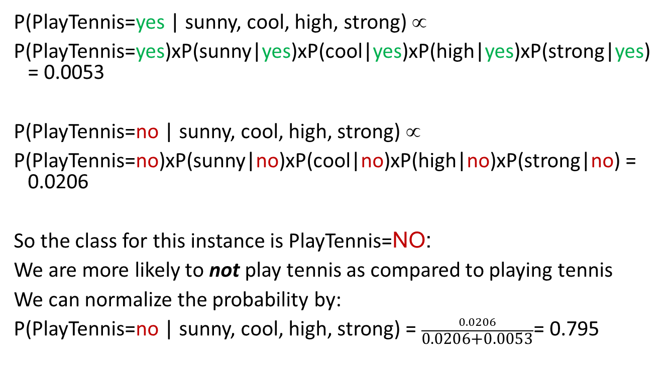
Naïve Bayes Classifier
P(PlayTennis=yes | sunny, cool, high, strong) ∝
P(PlayTennis=yes)xP(sunny|yes)xP(cool|yes)xP(high|yes)xP(strong|yes) = 0.0053
P(PlayTennis=no | sunny, cool, high, strong) ∝
P(PlayTennis=no)xP(sunny|no)xP(cool|no)xP(high|no)xP(strong|no) = 0.0206
So the class for this instance is PlayTennis=NO:
We are more likely to not play tennis as compared to playing tennis
We can normalize the probability by:
P(PlayTennis=no | sunny, cool, high, strong) = $\frac{0.0206}{\text{0.0206+0.0053}}$= 0.795

Slide 51
Classwork: Naïve Bayes Classifier
Will I play tennis today given that it is:
  Outlook=sunny
  Temperature=hot
  Humidity=normal
  Wind=strong

Slide 52
Naïve Bayes Classifier Example
Problem: will I play tennis today given that it is:
  Outlook=overcast
  Temperature=cool
  Humidity=high
  Wind=strong

Slide 53
Naïve Bayes Classifier
P(PlayTennis=yes) = 9/14 = 0.64
P(PlayTennis=no) = 5/14 = 0.36
P(Outlook=overcast|PlayTennis=yes) = 4/9 = 0.44
P(Outlook=overcast|PlayTennis=no) = 0/5 = 0
P(Temperature=cool|PlayTennis=yes) = 3/9 = 0.33
P(Temperature=cool|PlayTennis=no) = 1/5 = .20
P(Humidity=high|PlayTennis=yes) = 3/9 = 0.33
P(Humidity=high|PlayTennis=no) = 4/5 = 0.80
P(Wind=strong|PlayTennis=yes) = 3/9 = 0.33
P(Wind=strong|PlayTennis=no) = 3/5 = 0.60

Slide 54
Naïve Bayes Classifier
Estimating Probabilities:
In the previous example, P(overcast|no) = 0 which causes the formula-
P(no)xP(overcast|no)xP(cool|no)xP(high|no)xP(strong|no) = 0.0
This causes problems in comparing because the other probabilities are not considered.
There are methods to avoid this.

Slide 55
Naïve Bayes Classifier in practice
Classification is efficient
The conditional probability values of all the attributes with respect to the class are pre-computed and stored on disk.
No need to re-compute the conditional probabilities for a new problem instance

Slide 56
Application: Email spam filtering
Spam: unsolicited bulk email
Large fraction of all email sent
  Estimates 64-77%
Spam filtering
  Feature-based
  Applied at receiver
  Email client, mail server, or ISP

Slide 57


Slide 58


Slide 59


Classification for Spam Filtering
Define classes:
vs.
Extract features from header, content
Train Naïve Bayes classifier
Classify message:
  Spam or not

Slide 60
Features
Convert message to feature vector
Where do we get features?
  From header
    sender, recipient, routing,…
    Possibly break up domain names
  From content
    Words, phrases, character strings
    Become binary or numeric features
  Presence/absence of URLs, HTML tags, images,…

Slide 61
Conditional probabilities
From a collection of known spam/genuine emails, calculate:
  p(senderName=A|spam)
  p(senderDomainName=aol.com|spam)
  p(usernameContainsNumbers=true|spam)
  p(contentContainsExclamation=true |spam)
Also, need to calculate prior probabilities
  p(spam) = 0.7

Slide 62
Classifying as spam
Given a new email message, calculate:
  senderDomainName=aol.com?
  usernameContainsNumbers=true?
  contentContainsExclamation=true?
  …
The feature vector
Calculate
  p(spam|feature vector)=p(spam)p(F1|spam)p(F2|spam)…p(Fn|spam)
  If p(spam|feature vector) > p(not_spam|feature vector) then Spam

Slide 63
Numerical example for spam filtering
A Naïve Bayes classifier is used for detecting if email is spam or not using the following three features:
Feature 1: Sender domain is aol.com
Values = yes, no
p(F1 = yes | email=spam) = 0.4
p(F1 = yes | email=not spam) = 0.2
Feature 2: Sender username contains numbers
Values = yes, no
p(F2 = yes | email=spam) = 0.8
p(F2 = yes | email=not spam) = 0.4
Feature 3: Subject contains exclamation points (contains “!”)
Values = yes, no
p(F3 = yes | email=spam) = 0.8
p(F3 = yes | email= not spam) = 0.1
The prior probability that an email is spam is 70% (p(email=spam) = 0.70)

Slide 64
Numerical example for spam filtering
Consider the following two email segments:
Give the feature vectors for the above two emails.
Email 1:
To: apanangadan@fullerton.edu
From: george123@aol.com
Subject: Congratulations!!! you have won the state lottery!
Date: 1 Oct 2015, 23:27:09 +0000 (UTC)
Email 2:
To: apanangadan@fullerton.edu
From: alan.ng@aol.com
Subject: Meeting at 2pm
Date: 12 Nov 2015, 05:23:49 +0000 (UTC)

Slide 65
Numerical example for spam filtering
Consider the following two email segments:
Give the feature vectors for the above two emails.
Email 1:
To: apanangadan@fullerton.edu
From: george123@aol.com
Subject: Congratulations!!! you have won the state lottery!
Date: 1 Oct 2015, 23:27:09 +0000 (UTC)
Email 2:
To: apanangadan@fullerton.edu
From: alan.ng@aol.com
Subject: Meeting at 2pm
Date: 12 Nov 2015, 05:23:49 +0000 (UTC)
 | Feature 1 | Feature 2 | Feature 3
Email 1 | yes | yes | yes
Email 2

Slide 66
Email 1
Spam
  P(spam)*p(+f1|spam)*p(+f2|spam)*p(+f3|spam)
  =0.7 * 0.4 * 0.8 * 0.8 = 0.1792
Not Spam
  P(-spam)*p(+f1|-spam)*p(+f2|-spam)*p(+f3|-spam)
  =(1-0.7) * 0.2 * 0.4 * 0.1 = 0.0024
Spam
P(Spam|+f1,+f2,+f3) = 0.1792/(0.1792+0.0024) = 0.986 = 98.6%

Slide 67
Naïve Bayes advantages
Independence allows parameters to be estimated on different data sets, e.g.
  Estimate content features from messages with headers omitted
  Estimate header features from messages with content missing

Slide 68
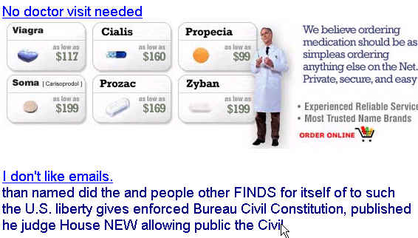
Randomly generated name and email
From: Sam Elegy <aj6xfdou7@yahoo.com>
To: ddlewis4@att.net
Subject: you can buy V!@gra
Typographic
variations
Spamlike content in image form
Irrelevant content

Slide 69
Defeating Feature Extraction
Misspellings, character set choice, HTML games: mislead extraction of words
Put content in images
Forge headers (to avoid identification, but also interferes with classification)
Non-spam content to mimic distribution in nonspam
“Hashbusters”
  Try to defeat Bayesian spam filtering by making each individual spam look as different as possible

Slide 70
References
Russel and Norvig, Artificial Intelligence: A Modern Approach, 4th edition, Pearson, 2020. Chapter 12-12.6
George F. Luger, Artificial Intelligence: Structures and Strategies for Complex Problem Solving, 6th edition, Addison Wesley, 2009. Chapters 4.1.1, 12.1.

