Slide 1
code
XinZhi Yao

Slide 2
准备工作
Java 1.8+
pip install stanfordcorenlp
Download CoreNLP3.9.2 stanford-corenlp-full-2018-10-05.zip

Slide 3
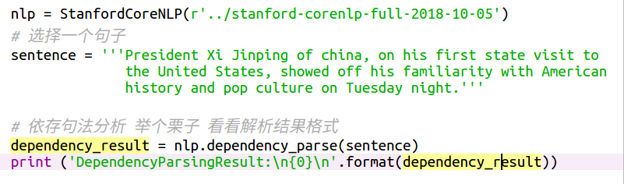
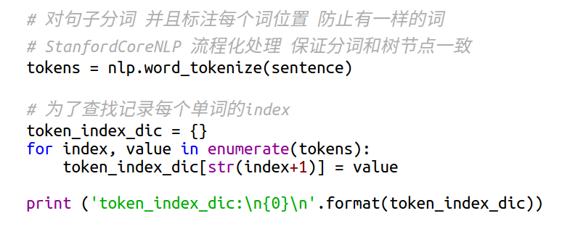
加载 StanfordCoreNLP 模型 解析句子
计算每个单词位置

Slide 4
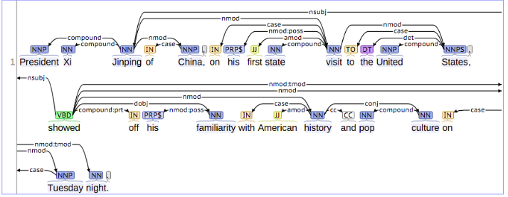
解析结果
DependencyParsingResult:
[('ROOT', 0, 17), ('compound', 3, 1), ('compound', 3, 2), ('nsubj', 17, 3), ('case', 5, 4),
('nmod', 3, 5), ('punct', 17, 6), ('case', 11, 7), ('nmod:poss', 11, 8), ('amod', 11, 9),
('compound', 11, 10), ('nmod', 17, 11), ('case', 15, 12), ('det', 15, 13), ('compound', 15, 14),
('nmod', 11, 15), ('punct', 17, 16), ('compound:prt', 17, 18), ('nmod:poss', 20, 19),
('dobj', 17, 20), ('case', 23, 21), ('amod', 23, 22), ('nmod', 20, 23), ('cc', 23, 24),
('compound', 26, 25), ('conj', 23, 26), ('case', 29, 27), ('compound', 29, 28), ('nmod', 17, 29),('punct', 17, 30)]
token_index_dic:
{'15': 'States', '7': 'on', '18': 'off', '29': 'night', '27': 'on', '28': 'Tuesday',
'20': 'familiarity', '13': 'the', '10': 'state', '9': 'first', '6': ',', '24': 'and',
'1': 'President', '21': 'with', '26': 'culture', '22': 'American', '5': 'china', '14': 'United',
'16': ',', '23': 'history', '17': 'showed', '25': 'pop', '2': 'Xi', '11': 'visit', '19': 'his',
'12': 'to', '4': 'of', '3': 'Jinping', '30': '.', '8': 'his'}

Slide 5
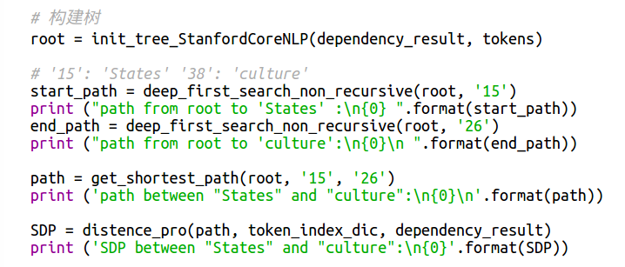
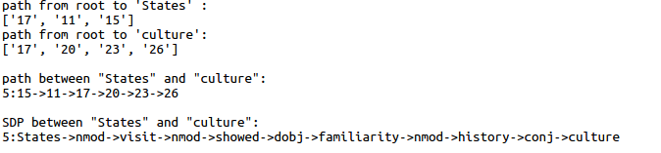
构建树 & 计算根节点到目标节点路径 & 计算最短依存路径
结果

Slide 6
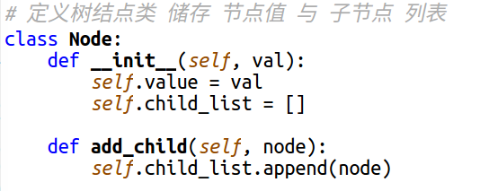
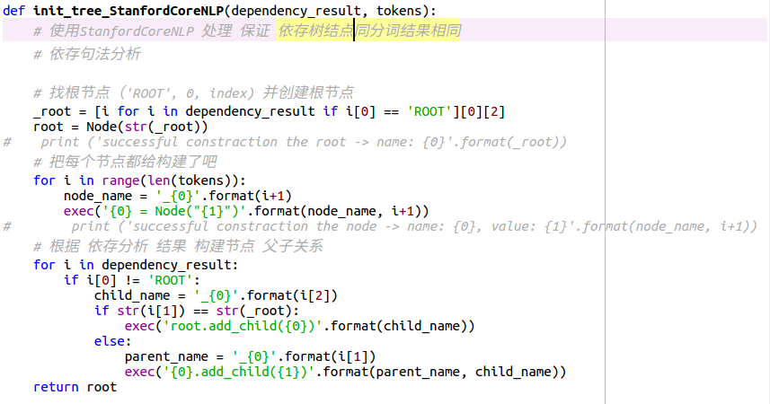
建树代码

Slide 7
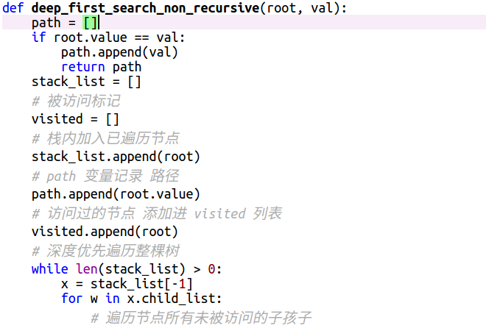
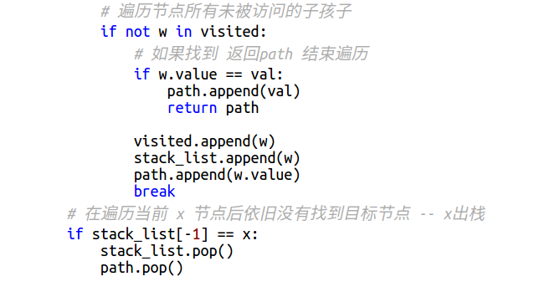
深度优先查找

Slide 8
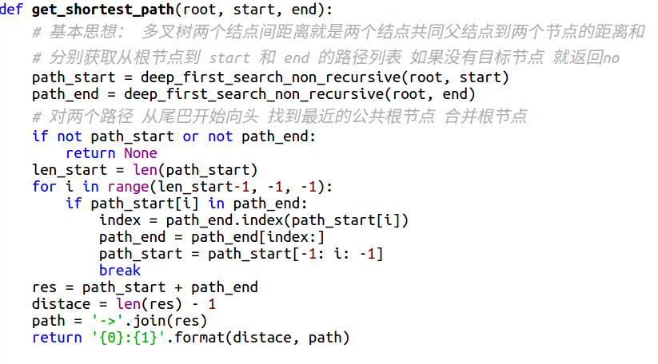
获得最短路径

