Slide 1
RMI

Slide 2
RMI (Remote Method Invocation)
The RMI (Remote Method Invocation) is an API that provides a mechanism to create distributed application in java.
The RMI allows an object to invoke methods on an object running in another JVM.
The RMI provides remote communication between the applications using two objects stub and skeleton.

Slide 3
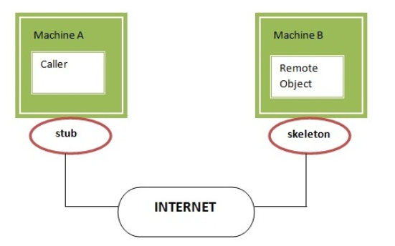
Understanding stub and skeleton
RMI uses stub and skeleton object for communication with the remote object.
A remote object is an object whose method can be invoked from another JVM.

Slide 4
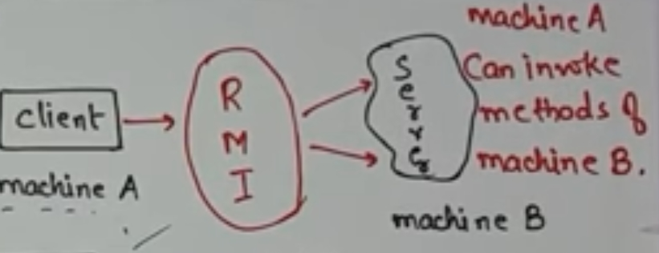

Slide 5
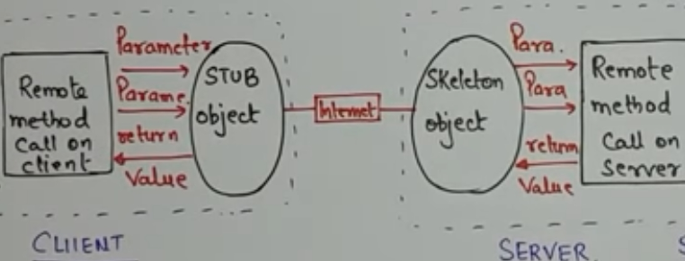
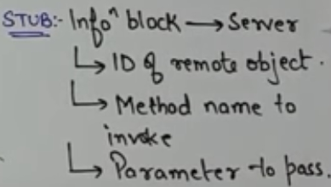
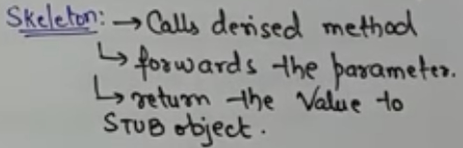

Slide 6
stub
The stub is an object, acts as a gateway for the client side.
All the outgoing requests are routed through it.
It resides at the client side and represents the remote object.
When the caller invokes method on the stub object, it does the following tasks:
It initiates a connection with remote Virtual Machine (JVM),
It writes and transmits (marshals) the parameters to the remote Virtual Machine (JVM),
It waits for the result
It reads (unmarshals) the return value or exception, and
It finally, returns the value to the caller.

Slide 7
skeleton
The skeleton is an object, acts as a gateway for the server side object.
All the incoming requests are routed through it.
When the skeleton receives the incoming request, it does the following tasks:
It reads the parameter for the remote method
It invokes the method on the actual remote object, and
It writes and transmits (marshals) the result to the caller.

Slide 8
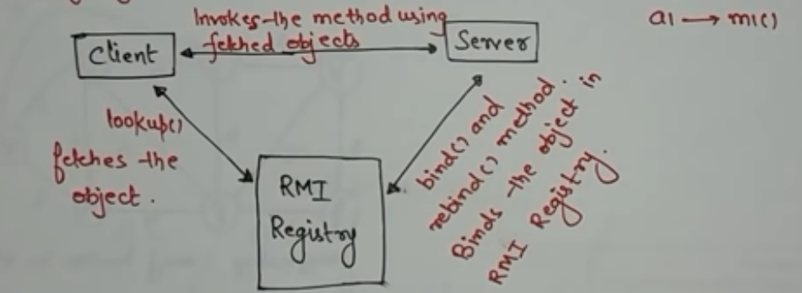
RMI Registry :- It is a namespace on which all server objects are placed

Slide 9
Understanding requirements for the distributed applications
If any application performs these tasks, it can be distributed application.
The application need to locate the remote method
It need to provide the communication with the remote objects, and The application need to load the class definitions for the objects.
The RMI application have all these features, so it is called the distributed application.

Slide 10
Java RMI Example
The is given the 6 steps to write the RMI program.
Create the remote interface
Provide the implementation of the remote interface
Compile the implementation class and create the stub and skeleton objects using the rmic tool
Start the registry service by rmiregistry tool
Create and start the remote application
Create and start the client application

Slide 11
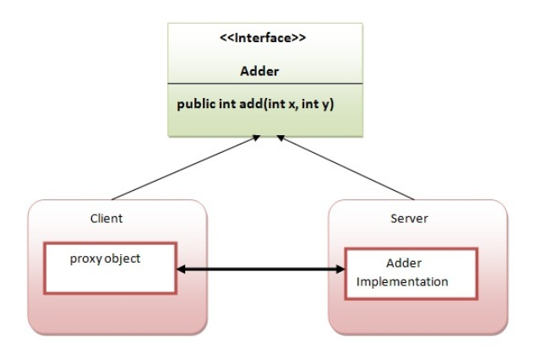
RMI Example
In this example, we have followed all the 6 steps to create and run the rmi application.
The client application need only two files, remote interface and client application.
In the rmi application, both client and server interacts with the remote interface.
The client application invokes methods on the proxy object, RMI sends the request to the remote JVM.
The return value is sent back to the proxy object and then to the client application.

Slide 12
create the remote interface
For creating the remote interface, extend the Remote interface and declare the RemoteException with all the methods of the remote interface.
Here, we are creating a remote interface that extends the Remote interface.
There is only one method named add() and it declares RemoteException.
import java.rmi.*;
public interface Adder extends Remote
{
public int add(int x,int y)throws RemoteException;
}

Slide 13
2) Provide the implementation of the remote interface
Now provide the implementation of the remote interface.
For providing the implementation of the Remote interface, we need to
Either extend the UnicastRemoteObject class,
or use the exportObject() method of the UnicastRemoteObject class
In case, you extend the UnicastRemoteObject class, you must define a constructor that declares RemoteException.
import java.rmi.*;
import java.rmi.server.*;
public class AdderRemote extends UnicastRemoteObject implements Adder{
AdderRemote()throws RemoteException{
super();
}
public int add(int x,int y){return x+y;}
}

Slide 14
3) create the stub and skeleton objects using the rmic tool.
Next step is to create stub and skeleton objects using the rmi compiler. The rmic tool invokes the RMI compiler and creates stub and skeleton objects.
rmic AdderRemote
4) Start the registry service by the rmiregistry tool
Now start the registry service by using the rmiregistry tool. If you don't specify the port number, it uses a default port number. In this example, we are using the port number 5000.
rmiregistry 5000

Slide 15
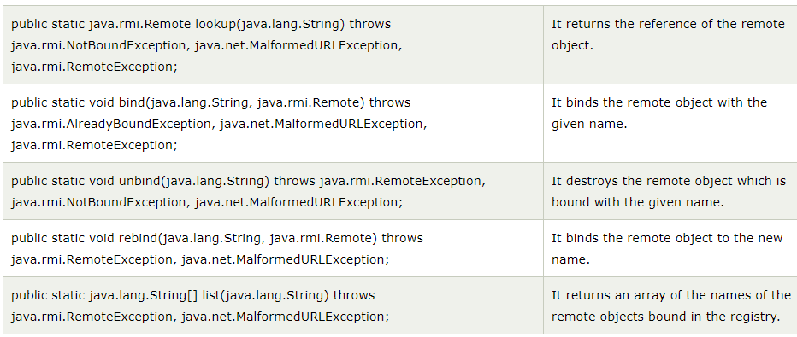
5) Create and run the server application
Now rmi services need to be hosted in a server process. The Naming class provides methods to get and store the remote object. The Naming class provides 5 methods.

Slide 16
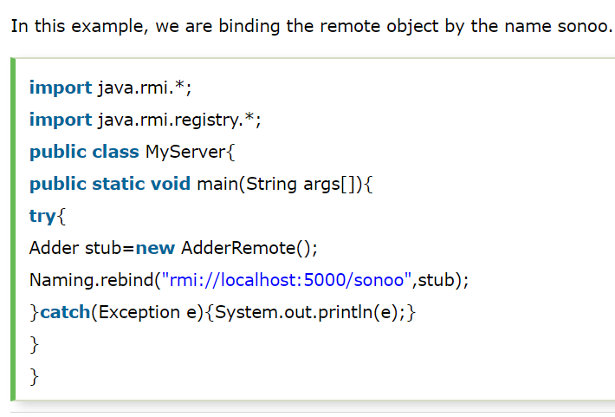

Slide 17
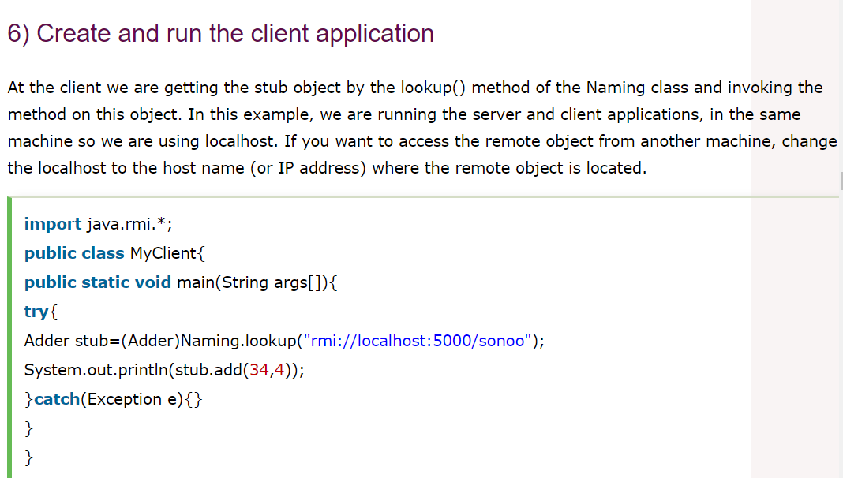

Slide 18
For running rmi example,
1) compile all the java files
javac *.java
2)create stub and skeleton object by rmic tool
rmic AdderRemote
3)start rmi registry in one command prompt
rmiregistry 5000
4)start the server in another command prompt
java MyServer
5)start the client application in another command prompt
java MyClient

