Slide 1
Unit -VI Servlets

Slide 2
Contents
6.1 The Life cycle of servlet
6.2 Creating simple Servlet: The Servlet API, javax.servlet Package, Servlet Interface, Servlet Config Interface, ServletContex Interface, Servlet Request Interface, Servlet response Interface, Generic Servlet class
6.3 The java. Servlet.httpPackage: HttpServlet Request Interface, Http Servlet Response Interface, Http Session Interface, Cookie class, Http Servlet class, Http Session Event class, Http Session binding Event class.
6.4 Handling HTTP Requests and Responses Handling HTTP GET Request Handling HTTP POST Requests.
6.5 Cookies and session Tracking.

Slide 3
Introduction
Servlets are small programs that execute on the server side of a web connection.
Just as applets dynamically extend the functionality of a web browser, servlets dynamically extend the functionality of a web server and act as a middle layer between a requests coming from a Web browser or other HTTP client and databases or applications on the HTTP server.

Slide 4
Difference between Applets and Servlets
Applets | Servlet
Applets are executed on client-side i.e applet runs within a Web browser on the client machine | Servlets on other hand executed on the server-side i.e servlet runs on the web Page on server.
Parent package of Applet includes java.applet.* and java.awt.* | Parent package of Servlet includes javax.servlet.* and java.servlet.http.*
Important methods of applet includes init(), stop(), paint(), start(), destroy(). | Lifecycle methods of servlet are init( ), service( ), and destroy( ).
For the execution of the applet, a user interface is required such as AWT or swing. | No such interface is required for the execution of servlet.
The applet requires user interface on the client machine for execution so it requires more bandwidth. | On the other hand, Servlets are executed on the servers and hence require less bandwidth.
Applets are more prone to risk as execution is on the client machine | Servlets are more secure as execution is under server security.

Slide 5
The Life Cycle of a Servlet
A servlet life cycle can be defined as the entire process from its creation till the destruction.
Three methods are central to the life cycle of a servlet. These are init( ), service( ), and destroy( ).
They are implemented by every servlet and are invoked at specific times by the server.
The servlet is initialized by calling the init() method.
The servlet calls service() method to process a client's request.
The servlet is terminated by calling the destroy() method.
Finally, servlet is garbage collected by the garbage collector of the JVM.

Slide 6
The init() Method :
The init method is called only once. It is called only when the servlet is created.
It is used for one-time initializations.
Syntax:
public void init() throws ServletException { // Initialization code... }
The service() Method
The service() method is the main method to perform the actual task.
The servlet container (i.e. web server) calls the service() method to handle requests coming from the client( browsers) and to write the formatted response back to the client.
Each time the server receives a request for a servlet, the server spawns a new thread and calls service.
The service() method checks the HTTP request type (GET, POST, PUT, DELETE, etc.) and calls doGet, doPost, doPut, doDelete, etc. methods as appropriate.

Slide 7
Syntax:
public void service(ServletRequest request, ServletResponse response) throws ServletException, IOException { }
The service () method is called by the container and service method invokes doGet, doPost, doPut, doDelete, etc. methods as appropriate.
So you have nothing to do with service() method but you override either doGet() or doPost() depending on what type of request you receive from the client.
The doGet() and doPost() are most frequently used methods with in each service request. Here is the signature of these two methods.
The doGet() Method
A GET request results from a normal request for a URL or from an HTML form that has no METHOD specified and it should be handled by doGet() method.
Syntax:
public void doGet(HttpServletRequest request, HttpServletResponse response) throws ServletException, IOException { // Servlet code }

Slide 8
The doPost() Method
A POST request results from an HTML form that specifically lists POST as the METHOD and it should be handled by doPost() method.
Syntax:
public void doPost(HttpServletRequest request, HttpServletResponse response) throws ServletException, IOException { // Servlet code }
The destroy() Method
The destroy() method is called only once at the end of the life cycle of a servlet. This method gives your servlet a chance to close database connections, halt background threads, write cookie lists or hit counts to disk, and perform other such cleanup activities.
After the destroy() method is called, the servlet object is marked for garbage collection.
Syntax:
public void destroy() { // Finalization code... }

Slide 9
First, assume that a user enters a Uniform Resource Locator (URL) to a web browser.
The browser then generates an HTTP request for this URL. This request is then sent to the appropriate server.
Second, this HTTP request is received by the web server. The server maps this request to a particular servlet.
The servlet is dynamically retrieved and loaded into the address space of the server.
Third, the server invokes the init( ) method of the servlet. This method is invoked only when the servlet is first loaded into memory.
It is possible to pass initialization parameters to the servlet so it may configure itself.
Fourth, the server invokes the service( ) method of the servlet. This method is called to process the HTTP request. It is possible for the servlet to read data that has been provided in the HTTP request. It may also formulate an HTTP response for the client.

Slide 10
The servlet remains in the server’s address space and is available to process any other HTTP requests received from clients. The service( ) method is called for each HTTP request.
Finally, the server may decide to unload the servlet from its memory.
The server calls the destroy( ) method to relinquish any resources such as file handles that are allocated for the servlet.

Slide 11
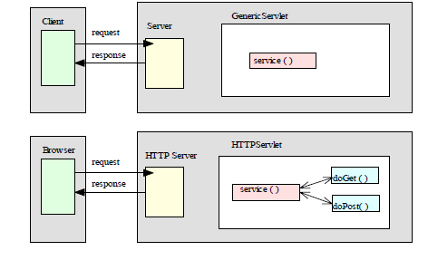
Servlet Application Architecture

Slide 12
Steps to Run Servlet
• Write the servlet source code. We need to import the javax.servlet package and the javax.servlet.http package in your source file.
• Compile your source code.
• Create a deployment descriptor.
• Run Tomcat.
• Call your servlet from a web browser.

Slide 13
//TestingServlet.java
import javax.servlet.*;
import javax.servlet.http.*;
import java.io.*;
import java.util.*;
public class TestingServlet extends HttpServlet
{
public void doGet(HttpServletRequest request,
HttpServletResponse response)
throws ServletException, IOException
{

Slide 14
PrintWriter out = response.getWriter();
out.println("<HTML>");
out.println("<HEAD>");
out.println("<TITLE>Servlet Testing</TITLE>");
out.println("</HEAD>");
out.println("<BODY>");
out.println("Welcome to the Servlet Testing Center");
out.println("</BODY>");
out.println("</HTML>");
}
}

Slide 15
6.2 Creating simple Servlet:
The basic steps are the following:
1. Create and compile the servlet source code. Then, copy the servlet’s class file to the proper directory, and add the servlet’s name and mappings to the proper web.xml file.
2. Start Tomcat.
3. Start a web browser and request the servlet.

Slide 16
Using Tomcat for Servlet Development
To create servlets, you will need access to a servlet development environment.
The one we are going to use is Tomcat.
Tomcat is an open-source product of the Apache Software Foundation. It contains the class libraries, documentation, and runtime support that you will need to create and test servlets.
The default location for Tomcat (Version) is
C:\Program Files\Apache Software Foundation\Tomcat (Version) \
If you load Tomcat in a different location, you will need to make appropriate changes to the examples. You may need to set the environmental variable JAVA_HOME to the top-level directory in which the Java Development Kit is installed.
To start Tomcat, select Configure Tomcat in the Start | Programs menu, and then press Start in the Tomcat Properties dialog.
When you are done testing servlets, you can stop Tomcat by pressing Stop in the Tomcat Properties dialog.
The directory
C:\Program Files\Apache Software Foundation\Tomcat (version) \common\lib\
contains servlet-api.jar.

Slide 17
This JAR file contains the classes and interfaces that are needed to build servlets.
To make this file accessible, update your CLASSPATH environment variable so that it includes
C:\Program Files\Apache Software Foundation\Tomcat 5.5\common\lib\servlet-api.jar

Slide 18
<html>
<body>
<center>
<form name="Form1"
action="http://localhost:8080/servletsexamples/servlet/ColorGetServlet">
<B>Color:</B>
<select name="color" size="1">
<option value="Red">Red</option>
<option value="Green">Green</option>
<option value="Blue">Blue</option>
</select>
<br><br>
<input type=submit value="Submit">
</form>
</body>
</html>

Slide 19
import java.io.*;
import javax.servlet.*;
import javax.servlet.http.*;
public class ColorGetServlet extends HttpServlet {
public void doGet(HttpServletRequest request, HttpServletResponse response)
throws ServletException, IOException {
String color = request.getParameter("color");
response.setContentType("text/html");
PrintWriter pw = response.getWriter();
pw.println("<B>The selected color is: ");
pw.println(color);
pw.close();
}
}

Slide 20
<html>
<body>
<center>
<form name="Form1"
method="post"
action="http://localhost:8080/servletsexamples/servlet/ColorPostServlet">
<B>Color:</B>
<select name="color" size="1">
<option value="Red">Red</option>
<option value="Green">Green</option>
<option value="Blue">Blue</option>
</select>
<br><br>
<input type=submit value="Submit">
</form>
</body>
</html>

Slide 21
import java.io.*;
import javax.servlet.*;
import javax.servlet.http.*;
public class ColorPostServlet extends HttpServlet {
public void doPost(HttpServletRequest request, HttpServletResponse response)
throws ServletException, IOException {
String color = request.getParameter("color");
response.setContentType("text/html");
PrintWriter pw = response.getWriter();
pw.println("<B>The selected color is: ");
pw.println(color);
pw.close();
}
}

Slide 22
Program to demonstrate the use of HttpServlet as a parameterized Servlet.
import javax.servlet.http.HttpServlet;
import javax.servlet.http.HttpServletRequest;
import javax.servlet.http.HttpServletResponse;
import javax.servlet.ServletException;
import java.io.PrintWriter;
import java.io.IOException;
public class HelloHttp extends HttpServlet
{
public void service(HttpServletRequest request, HttpServletResponse response) throws ServletException,IOException
{
System.out.println("Http Servlet Program under Execution");
response.setContentType("text/html");
PrintWriter pw = response.getWriter();
pw.close();
}
}

Slide 23
index.html
<html>
<head>
<title>login form</title>
</head>
<body>
<form method="post" action="login">
User ID:<input type="text" name=“userid" /><br/>
Password:<input type="text" name="pass" /><br/>
<input type="submit" value="login" />
</form>
</body>
</html>

Slide 24
import java.io.*;
import javax.servlet.*;
import javax.servlet.http.*;
public class Login extends HttpServlet {
protected void doPost(HttpServletRequest request, HttpServletResponse response) throws ServletException, IOException {
response.setContentType("text/html;");
PrintWriter out = response.getWriter();
String uid = request.getParameter(“user");
String pass = request.getParameter("pass");
If(uid.equals(“abc”)&&pass.equals(“123”))
{out.println(“Welcome User"); }
else { out.println("Username or Password incorrect");}
} }

Slide 25
The Cookie Class
The Cookie class encapsulates a cookie. A cookie is stored on a client and contains state information.
Cookies are valuable for tracking user activities. For example, assume that a user visits an online store. Acookie can save the user’s name, address, and other information.
The user does not need to enter this data each time he or she visits the store.
A servlet can write a cookie to a user’s machine via the addCookie( ) method of the HttpServletResponse interface.
The data for that cookie is then included in the header of the HTTP response that is sent to the browser.
The names and values of cookies are stored on the user’s machine. Some of the information that is saved for each cookie includes the following:
• The name of the cookie
• The value of the cookie
• The expiration date of the cookie
• The domain and path of the cookie

Slide 26
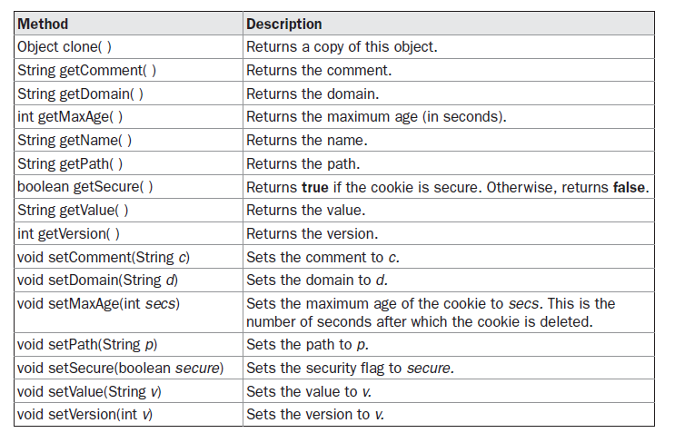
There is one constructor for Cookie. It has the signature shown here:
Cookie(String name, String value)
Here, the name and value of the cookie are supplied as arguments to the constructor.
The methods of the Cookie class are summarized in Table

Slide 27
A servlet program that illustrates how to use cookies.
The servlet is invoked when a form on a web page is submitted. The example contains three files as summarized here:
AddCookie.htm → Allows a user to specify a value for the cookie named MyCookie.
AddCookieServlet.java→ Processes the submission of AddCookie.htm.
GetCookiesServlet.java→ Displays cookie values.

Slide 28
AddCookie.htm
<html>
<body>
<center>
<form name="Form1"
method="post"
action="http://localhost:8080/servlets-examples/servlet/AddCookieServlet">
<B>Enter a value for MyCookie:</B>
<input type=text name="data" size=25 value="">
<input type=submit value="Submit">
</form>
</body>
</html>

Slide 29
AddCookieServlet.java
import java.io.*;
import javax.servlet.*;
import javax.servlet.http.*;
public class AddCookieServlet extends HttpServlet {
public void doPost(HttpServletRequest request, HttpServletResponse response) throws ServletException, IOException {
// Get parameter from HTTP request.
String data = request.getParameter("data");
// Create cookie.
Cookie cookie = new Cookie("MyCookie", data);
// Add cookie to HTTP response.
response.addCookie(cookie);
// Write output to browser.
response.setContentType("text/html");
PrintWriter pw = response.getWriter();
pw.println("<B>MyCookie has been set to");
pw.println(data);
pw.close();
}
}

Slide 30
GetCookiesServlet.java
import java.io.*;
import javax.servlet.*;
import javax.servlet.http.*;
public class GetCookiesServlet extends HttpServlet {
public void doGet(HttpServletRequest request, HttpServletResponse response) throws ServletException, IOException {
// Get cookies from header of HTTP request.
Cookie[] cookies = request.getCookies();
// Display these cookies.
response.setContentType("text/html");
PrintWriter pw = response.getWriter();
pw.println("<B>");
for(int i = 0; i < cookies.length; i++) {
String name = cookies[i].getName();
String value = cookies[i].getValue();
pw.println("name = " + name + "; value = " + value);
}
pw.close();
}
}

Slide 31
Session Tracking
HTTP is a stateless protocol. Each request is independent of the previous one.
However, in some applications, it is necessary to save state information so that information can be collected from several interactions between a browser and a server. Sessions provide such a mechanism.
A session can be created via the getSession( ) method of HttpServletRequest. An HttpSession object is returned. This object can store a set of bindings that associate names with objects.
The setAttribute( ), getAttribute( ), getAttributeNames( ), and removeAttribute( ) methods of HttpSession manage these bindings.
It is important to note that session state is shared among all the servlets that are associated with a particular client.

Slide 32
import java.io.*;
import java.util.*;
import javax.servlet.*;
import javax.servlet.http.*;
public class DateServlet extends HttpServlet {
public void doGet(HttpServletRequest request, HttpServletResponse response)
throws ServletException, IOException {
// Get the HttpSession object.
HttpSession hs = request.getSession(true);
// Get writer.
response.setContentType("text/html");
PrintWriter pw = response.getWriter();
pw.print("<B>");
// Display date/time of last access.
Date date = (Date)hs.getAttribute("date");
if(date != null) {
pw.print("Last access: " + date + "<br>");
}
// Display current date/time.
date = new Date();
hs.setAttribute("date", date);
pw.println("Current date: " + date);
}
}

Slide 33
When you first request this servlet, the browser displays one line with the current date and time information.
On subsequent invocations, two lines are displayed.
The first line shows the date and time when the servlet was last accessed.
The second line shows the current date and time.

