Slide 1
JDBC

Slide 2
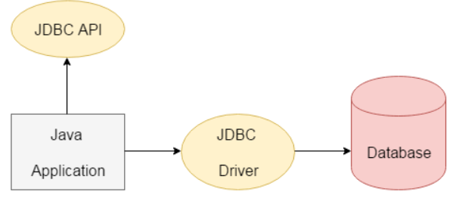
JDBC
JDBC stands for Java Database Connectivity. It is a part of JavaSE (Java Standard Edition).
JDBC is a part of JDK software so no need to install separate software for JDBC API.
JDBC is a Java API to connect and execute the query with the database.
JDBC is an API (Application programming interface) used to communicate Java application to database in database independent and platform independent manner. It provides classes and interfaces to connect or communicate Java application with database.
It enables Java programs to execute SQL statements. JDBC works with Java on a variety of platforms, such as Windows, Mac OS, and the various versions of UNIX.
There are four types of JDBC drivers:
JDBC-ODBC Bridge Driver
Native Driver
Network Protocol Driver
Thin Driver
JDBC API consists of two packages
java.sql package
javax.sql package

Slide 3
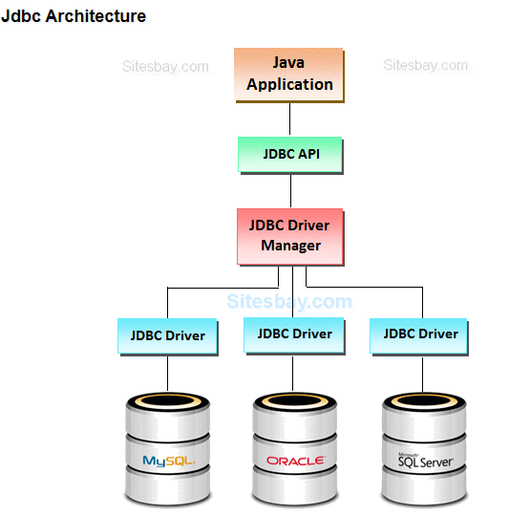

Slide 4
Why Should We Use JDBC
Before JDBC, ODBC API was the database API to connect and execute the query with the database.
But, ODBC API uses ODBC driver which is written in C language (i.e. platform dependent and unsecured).
That is why Java has defined its own API (JDBC API) that uses JDBC drivers (written in Java language).
JDBC API to handle database using Java program and can perform the following activities:
Connect to the database
Execute queries and update statements to the database
Retrieve the result received from the database.
Microsoft
Sun Microsystem
Any language
Any language
ODBC
ODBC
Any database
JDBC
Any database
Only for Windows
Any Platform

Slide 5
What is API
API (Application programming interface) is a document that contains a description of all the features of a product or software.
It represents classes and interfaces that software programs can follow to communicate with each other.
An API can be created for applications, libraries, operating systems, etc.

Slide 6
ODBC | JDBC
Open Database connectivity | Java Database Connectivity
Introduced by Microsoft in 1992 | Introduced by Sun Microsystem in 1997
For any Language like C,C++,Java etc. | For JAVA Language only
Many ODBC drivers implemented in native language like C/C++ | Mostly JDBC drivers implemented in JAVA Language
Only for Windows | For any platform
Odbc is platform dependent and database independent | Jdbc is both platform and database independent.
For JAVA application it is not recommended to use ODBC because performance will be down due to internal conversation and application will be platform dependent. | For JAVA application it is highly recommended to Jdbc because there is no performance and platform dependent problem

Slide 7
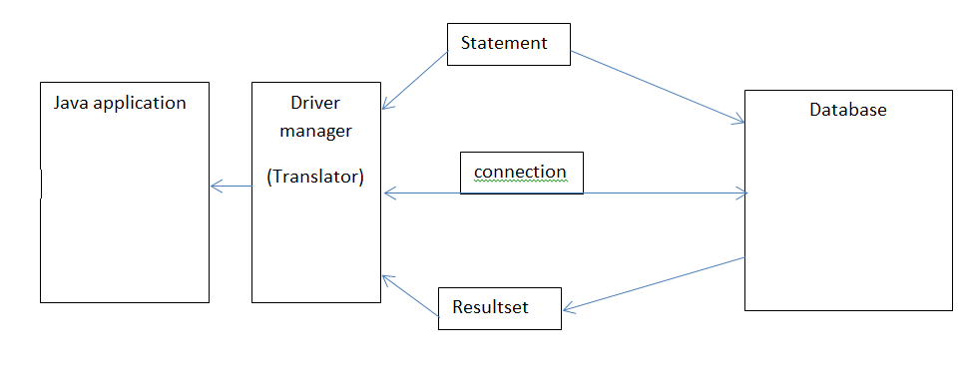

Slide 8
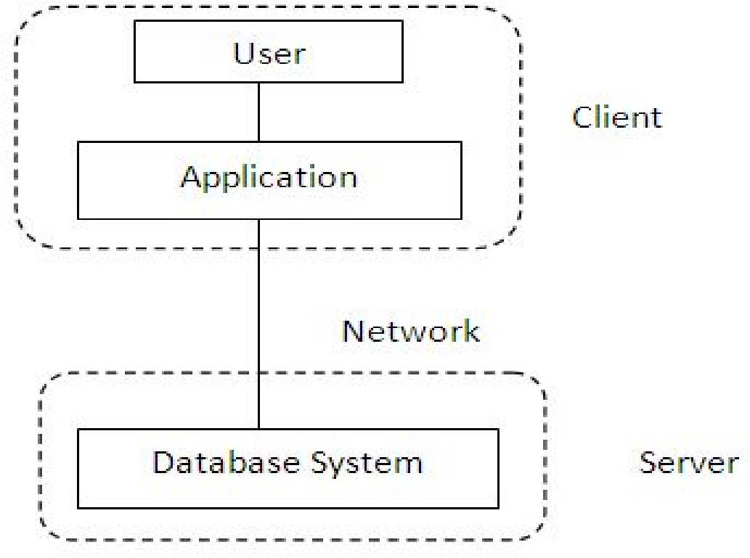
Two tier architecture

Slide 9
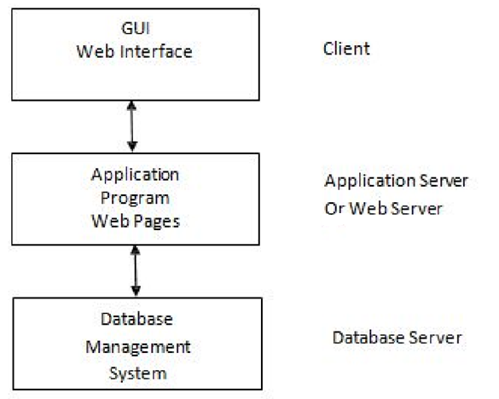
Three tier architecture

Slide 10
JDBC Driver
JDBC Driver is a software component that enables java application to interact with the database.
There are 4 types of JDBC drivers:
JDBC-ODBC bridge driver
Native-API driver (partially java driver)
Network Protocol driver (fully java driver)
Thin driver (fully java driver)

Slide 11
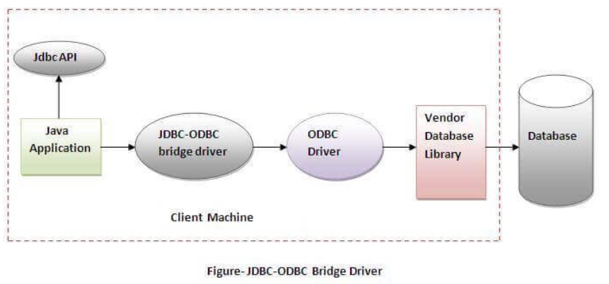
JDBC-ODBC bridge driver
The JDBC-ODBC bridge driver uses ODBC driver to connect to the database.
The JDBC-ODBC bridge driver converts JDBC method calls into the ODBC function calls. This is now discouraged because of thin driver.
Advantages:
easy to use.
can be easily connected to any database.
Disadvantages:
Performance degraded because JDBC method call is converted into the ODBC function calls.
The ODBC driver needs to be installed on the client machine.

Slide 12
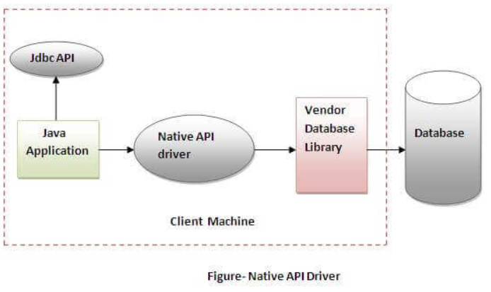
Native-API driver
The Native API driver uses the client-side libraries of the database.
The driver converts JDBC method calls into native calls of the database API. It is not written entirely in java.
Advantage:
performance upgraded than JDBC-ODBC bridge driver.
Disadvantage:
The Native driver needs to be installed on the each client machine.
The Vendor client library needs to be installed on client machine.

Slide 13
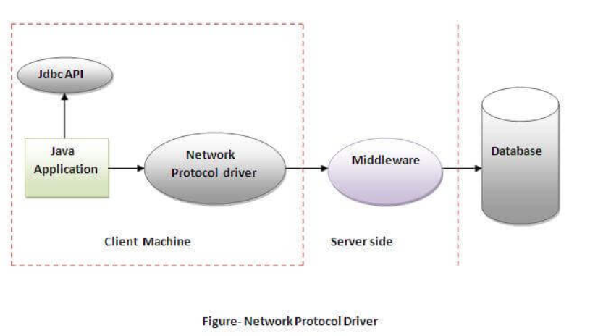
Network Protocol driver
The Network Protocol driver uses middleware (application server) that converts JDBC calls directly or indirectly into the vendor-specific database protocol.
It is fully written in java.
Advantage:
No client side library is required because of application server that can perform many tasks like auditing, load balancing, logging etc.
Disadvantages:
Network support is required on client machine.
Requires database-specific coding to be done in the middle tier.
Maintenance of Network Protocol driver becomes costly because it requires database-specific coding to be done in the middle tier.

Slide 14
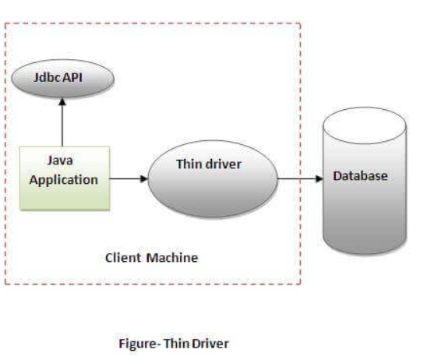
Thin driver
The thin driver converts JDBC calls directly into the vendor-specific database protocol. That is why it is known as thin driver.
It is fully written in Java language.
Advantage:
Better performance than all other drivers.
No software is required at client side or server side.
Disadvantage:
Drivers depend on the Database.

Slide 15
It is based on the X/Open SQL Call Level Interface.
The java.sql package contains classes and interfaces for JDBC API.
A list of popular interfaces of JDBC API are given below:
Driver interface
Connection interface
Statement interface
PreparedStatement interface
CallableStatement interface
ResultSet interface
ResultSetMetaData interface
DatabaseMetaData interface
RowSet interface
A list of popular classes of JDBC API are given below:
DriverManager class
Blob class
Clob class
Types class

Slide 16
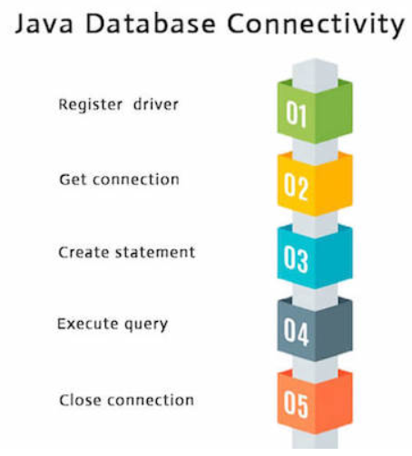
Java Database Connectivity with 5 Steps
There are 5 steps to connect any java application with the database using JDBC.
These steps are as follows:
Register the Driver class
Create connection
Create statement
Execute queries
Close connection

Slide 17
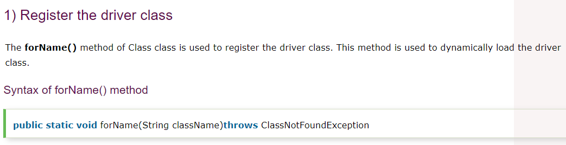
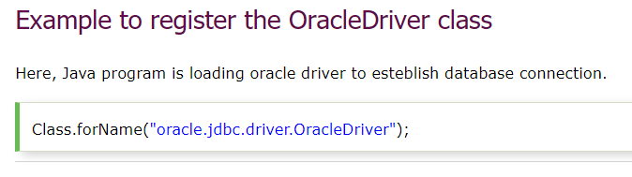

Slide 18
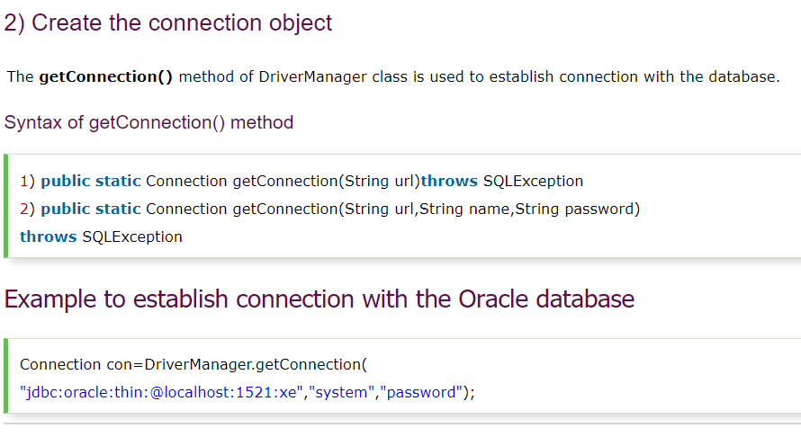

Slide 19
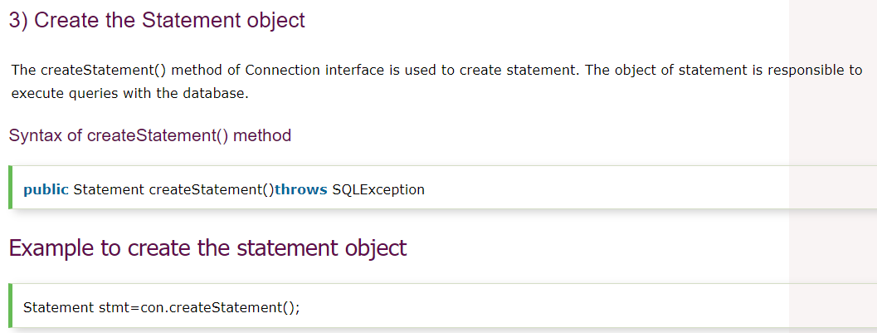

Slide 20
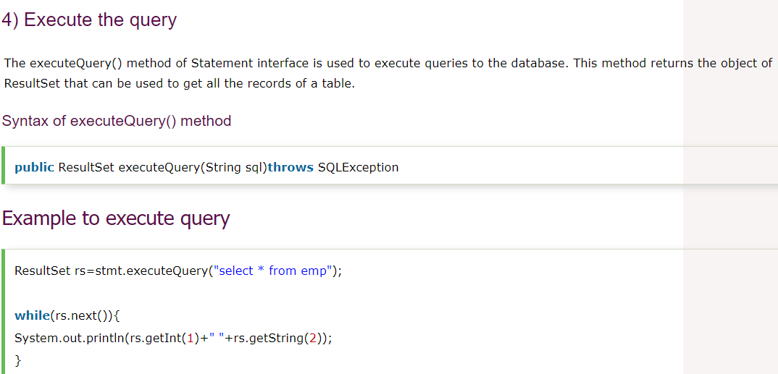

Slide 21
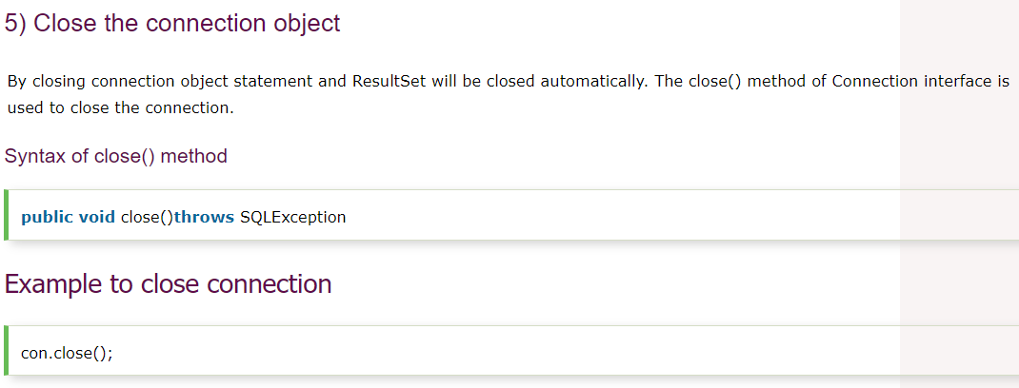

Slide 22
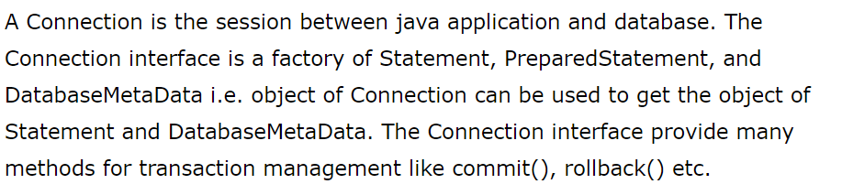
Connection interface

Slide 23
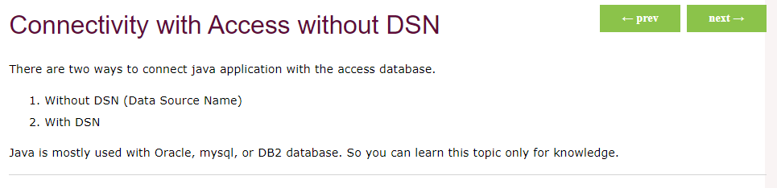

Slide 24
Example to Connect Java Application with access without DSN
In this example, we are going to connect the java program with the access database. In such case, we have created the login table in the access database. There is only one column in the table named name. Let's get all the name of the login table.
import java.sql.*;
class Test{
public static void main(String ar[]){
try{
String database="student.mdb";//Here database exists in the current directory
String url="jdbc:odbc:Driver={Microsoft Access Driver (*.mdb)};
DBQ=" + database + ";DriverID=22;READONLY=true";
Class.forName("sun.jdbc.odbc.JdbcOdbcDriver");
Connection c=DriverManager.getConnection(url);
Statement st=c.createStatement();
ResultSet rs=st.executeQuery("select * from login");
while(rs.next()){
System.out.println(rs.getString(1));
}
}catch(Exception ee){System.out.println(ee);}
}}

Slide 25
Example to Connect Java Application with access with DSN
Connectivity with type1 driver is not considered good. To connect java application with type1 driver, create DSN first, here we are assuming your dsn name is mydsn.
import java.sql.*;
class Test{
public static void main(String ar[]){
try{
String url="jdbc:odbc:mydsn";
Class.forName("sun.jdbc.odbc.JdbcOdbcDriver");
Connection c=DriverManager.getConnection(url);
Statement st=c.createStatement();
ResultSet rs=st.executeQuery("select * from login");
while(rs.next()){
System.out.println(rs.getString(1));
}
}catch(Exception ee){System.out.println(ee);}
}}

Slide 26
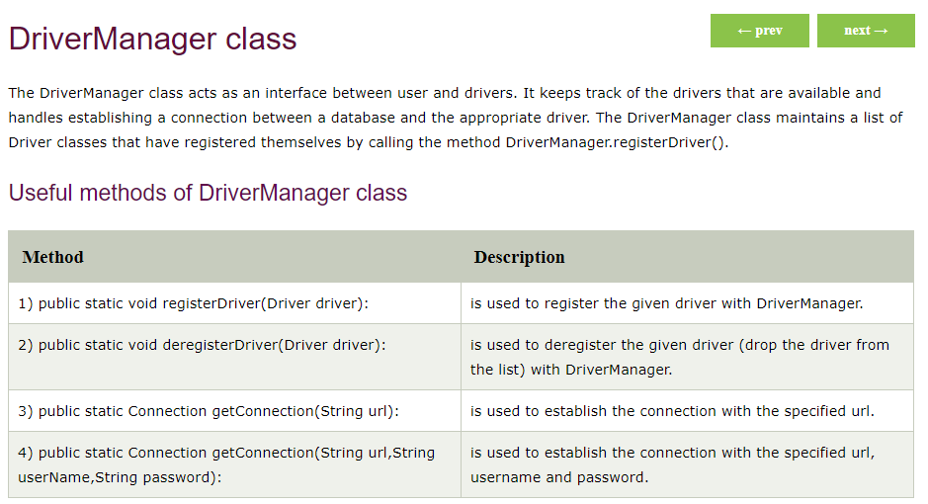

Slide 27
JDBC - Statements, PreparedStatement and CallableStatement
Once a connection is obtained we can interact with the database.
TheJDBC Statement,CallableStatement, and PreparedStatement interfaces define the methods and properties that enable you to send SQL or PL/SQL commands and receive data from your database.
They also define methods that help bridge data type differences between Java and SQL data types used in a database.

Slide 28
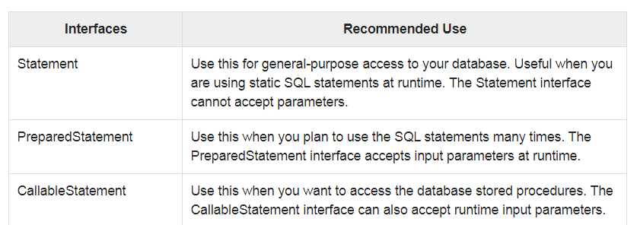
The following table provides a summary of each interface's purpose to decide on the interface to use.

Slide 29
Statement interface
The Statement interface provides methods to execute queries with the database. The statement interface is a factory of ResultSet i.e. it provides factory method to get the object of ResultSet.
The important methods of Statement interface are as follows:
public ResultSet executeQuery(String sql):
is used to execute SELECT query. It returns the object of ResultSet.
public int executeUpdate(String sql):
is used to execute specified query, it may be create, drop, insert, update, delete etc.
public boolean execute(String sql):
is used to execute queries that may return multiple results.
public int[] executeBatch():
is used to execute batch of commands.

Slide 30
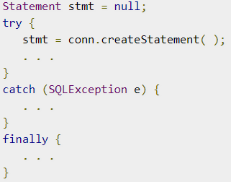
The Statement Objects
Before you can use a Statement object to execute a SQL statement, you need to create one using the Connection object's createStatement( ) method, as in the following example −

Slide 31
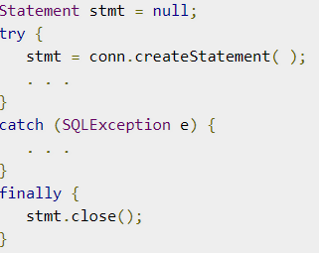
Closing Statement Object
Just as you close a Connection object to save database resources, for the same reason you should also close the Statement object.
A simple call to the close() method will do the job. If you close the Connection object first, it will close the Statement object as well. However, you should always explicitly close the Statement object to ensure proper cleanup.

Slide 32
PreparedStatement interface
The PreparedStatement interface is a sub interface of Statement.
It is used to execute parameterized query.
Let's see the example of parameterized query:
String sql="insert into emp values(?,?,?)";
As you can see, we are passing parameter (?) for the values. Its value will be set by calling the setter methods of PreparedStatement.

Slide 33
Why use PreparedStatement?
Improves performance:
The performance of the application will be faster if you use PreparedStatement interface because query is compiled only once.
How to get the instance of PreparedStatement?
The prepareStatement() method of Connection interface is used to return the object of PreparedStatement.
Syntax:
public PreparedStatement prepareStatement(String query)throws SQLException{}

Slide 34
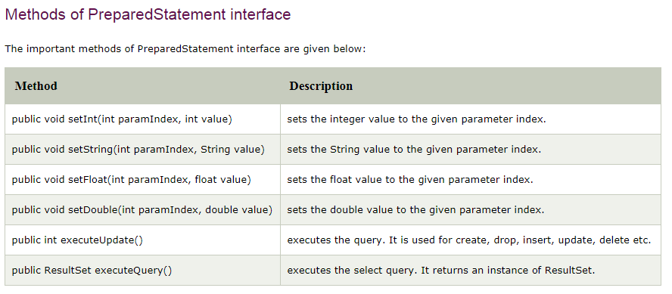

Slide 35
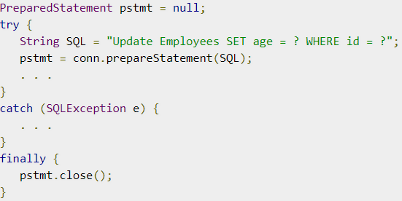
Closing PreparedStatement Object
Just as you close a Statement object, for the same reason you should also close the PreparedStatement object.
A simple call to the close() method will do the job. If you close the Connection object first, it will close the PreparedStatement object as well. However, you should always explicitly close the PreparedStatement object to ensure proper cleanup.

Slide 36
CallableStatement
CallableStatement interface is used to call the stored procedures and functions.
We can have business logic on the database by the use of stored procedures and functions that will make the performance better because these are precompiled.
Suppose you need the get the age of the employee based on the date of birth, you may create a function that receives date as the input and returns age of the employee as the output.

Slide 37
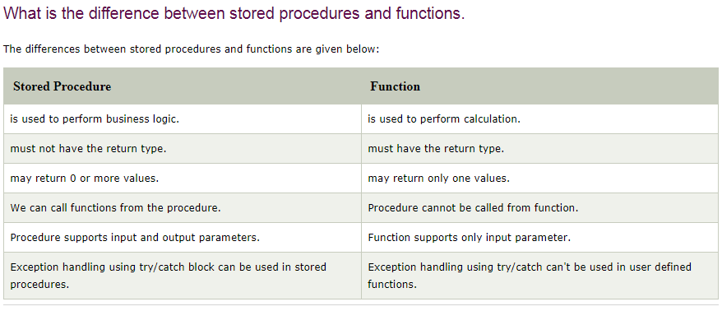

Slide 38
Make sure stored procedure available in the database
create or replace function sum4
(n1 in number,n2 in number)
return number
is
temp number(8);
begin
temp :=n1+n2;
return temp;
end;
/
Create a callable Statements with the procedure call.
Syntax: CallableStatement cst = con.prepareCall ("{ call procedurename(?,?...?)}");
Example: CallableStatement cst = con .prepareCall ("{ call sum4 (?,?...?)}");

Slide 39
3. Provide values for every IN Parameter by using corresponding setter method
cst.setInt (1, 100);
cst.setInt (2, 200);
↓ ↓
Index value
4. If stored procedure has OUT parameter then to hold that output we should register every OUT parameter by using the following methods.
Syntax : Public void registerOutParameter (int index, int jdbctype)
Example : cst. registerOutParameter(3, Types.INTEGER);
5. EXECUTE Procedure call
cst.execute();
6..Get the result from OUT parameter by using that corresponding getXXX() method.
Example: int result =cst.getInt(3);
7. Close connection.

Slide 40
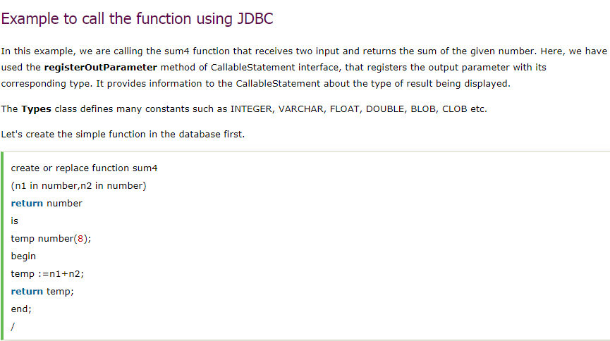

Slide 41
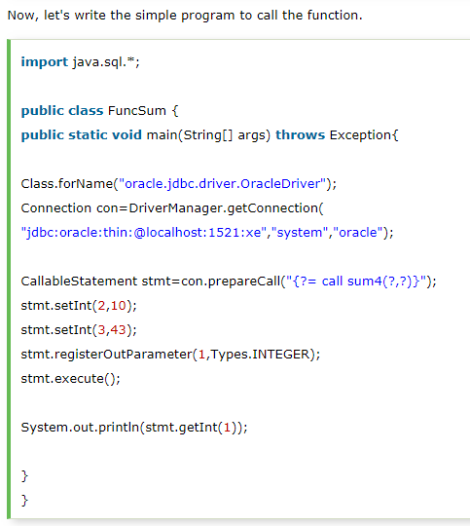

Slide 42
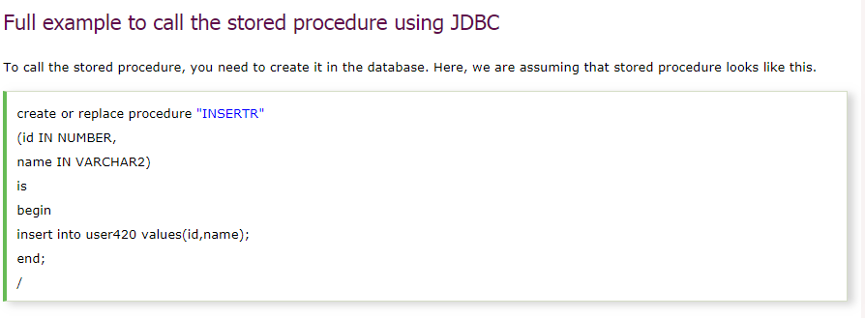

Slide 43
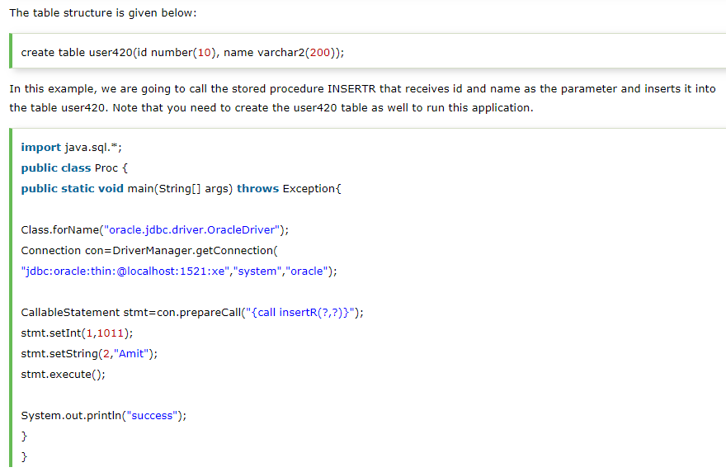

Slide 44
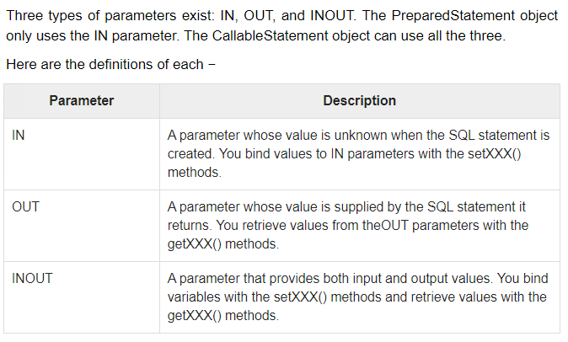

Slide 45
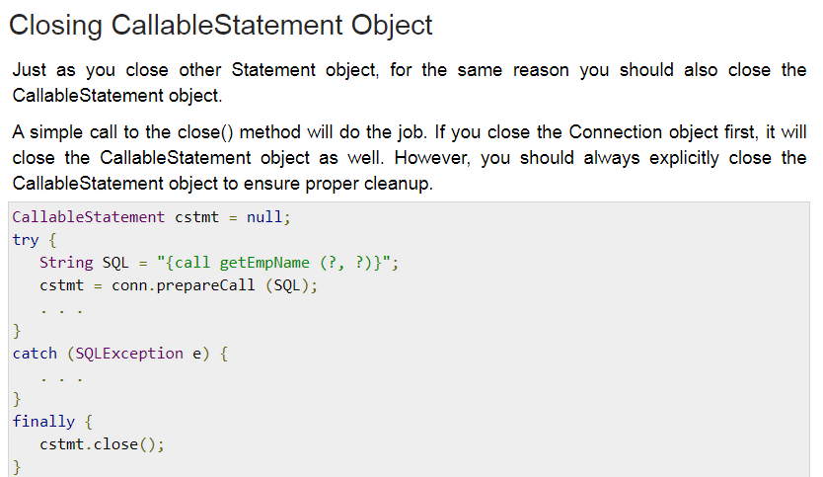

Slide 46
Result Sets
The SQL statements that read data from a database query, return the data in a result set.
The SELECT statement is the standard way to select rows from a database and view them in a result set. The java.sql.ResultSet interface represents the result set of a database query.
A ResultSet object maintains a cursor that points to the current row in the result set. The term "result set" refers to the row and column data contained in a ResultSet object.
The methods of the ResultSet interface can be broken down into three categories −
Navigational methods: Used to move the cursor around.
Get methods: Used to view the data in the columns of the current row being pointed by the cursor.
Update methods: Used to update the data in the columns of the current row. The updates can then be updated in the underlying database as well.
The cursor is movable based on the properties of the ResultSet. These properties are designated when the corresponding Statement that generates the ResultSet is created
JDBC provides the following connection methods to create statements with desired ResultSet −
createStatement(int RSType, int RSConcurrency);
prepareStatement(String SQL, int RSType, int RSConcurrency);
prepareCall(String sql, int RSType, int RSConcurrency);
The first argument indicates the type of a ResultSet object and the second argument is one of two ResultSet constants for specifying whether a result set is read-only or updatable.

Slide 47
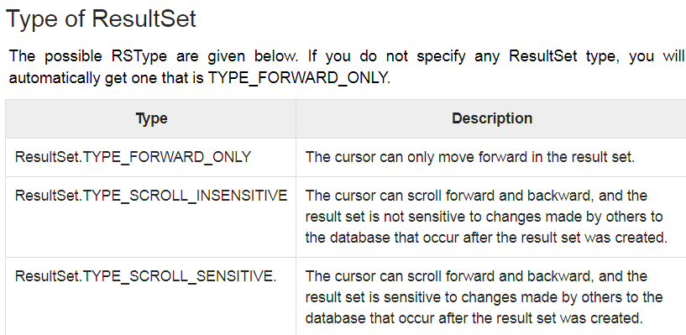

Slide 48
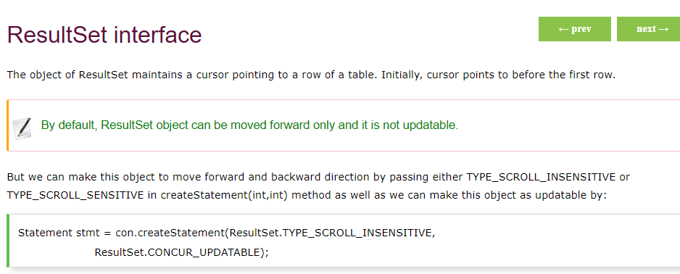

Slide 49
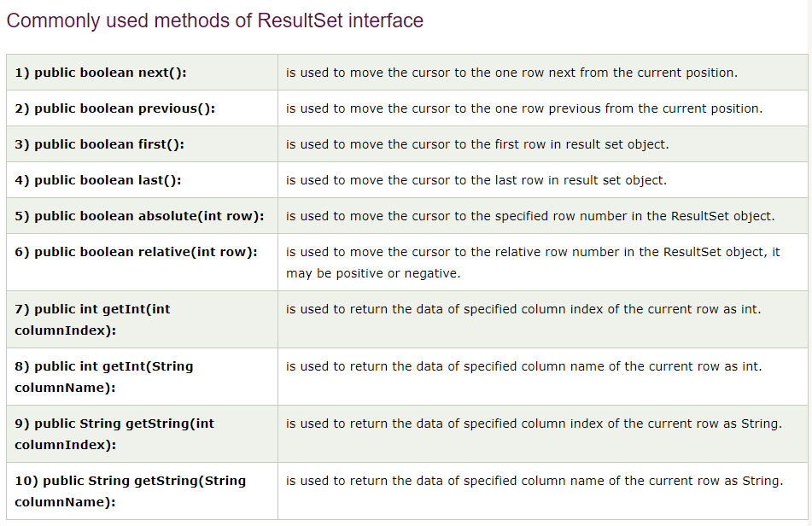

Slide 50
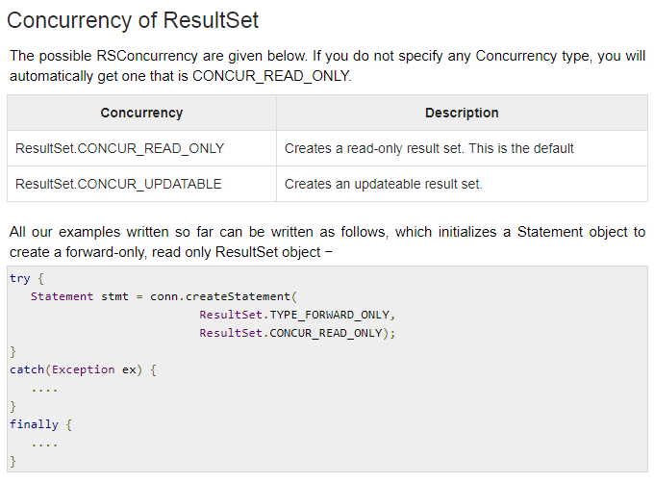

Slide 51
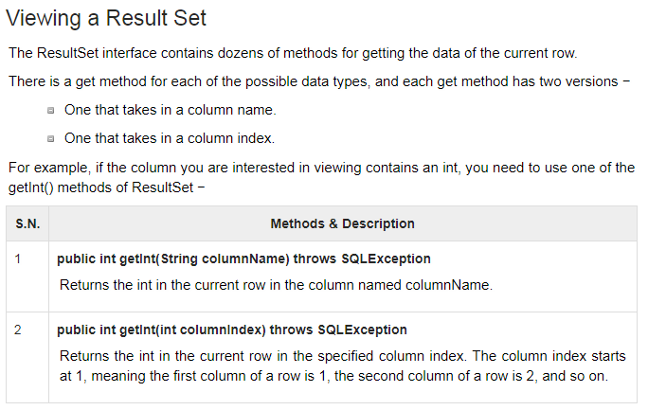

Slide 52
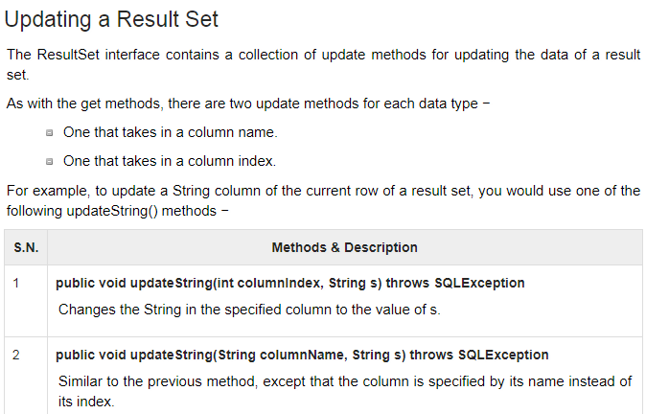

Slide 53
For Ms-acess
Create database
Go to MS-office - Access- select blank database - save to java program location -ok
Create table login
Add some records to te table
Create DSN
Go to → C:\Windows\SysWOW64\ odbcad32.exe then configure
Create DSN
Browse created database and mapped with DSN
Required 32 bit jdk (i.e. jdk 1.7 32 bit) because we r using 32 bit odbc driver

Slide 54
For mysql
Requierd mysqlconnnector
C:\Program Files (x86)\Java\jre7\lib\ext\mysql-connector-java-5.1.40-bin.jar
open mysql prompt
mysql> Give password : root
mysql> create database student
mysql> use student
mysql> create table login( id integer(10),name varchar(20));
mysql> desc login
mysql> insert into login (1,'reshma');
mysql> insert into login (2,'rama');
mysql> select * from login;

Slide 55
For oracle
Copy ojdbc6.jar file to c:\oracle\ folder…\lib\ojdbc6.jar
C:\oraclexe\app\oracle\product\11.2.0\server\jdbc\lib\ojdbc6.jar
OR
Set classpath= C:\oraclexe\app\oracle\product\11.2.0\server\jdbc\lib\ojdbc14.jar;.;
open command prompt
on cmd write sqlplus
SQL>create table login( id integer(10),name varchar(20),age integer(10));
SQL>desc login
SQL>insert into login (1,'reshma',10);
SQL>insert into login (2,'rama',20);
SQL>select * from login;

