Slide 1
ViE2D: Visual Analysis of Economic Decision-making Behaviors in Experimental Economics
Notes:
Economic Decision-making Behavior

Slide 2
Introduction
General background and motivation
假设你处在这样的一个游戏场景中：刚开始身无分文，然后….（描述大致的实验流程）…
通过游戏场景引出实验经济学的介绍，包括研究的背景、方法、目的和意义等，论述其重要性
借助游戏场景介绍实验经济学数据的特点（多维、时变、不确定性等），简述以往的实验经济学数据分析手段，例如统计回归等传统方法，阐述这些方法的缺点，进而点出利用可视化技术进行分析和探索的优势
介绍本文的工作和贡献

Slide 3
Introduction
The specific problem you want to address
Experimental-Data-level
T1: What is the overview of dynamic processes in an economic experiment?
T2: How do the wealth and economic bahaviors of an individual subject evolve over time?
Decision-Behavior-level
T3: Can we identify any behavior patterns based on decision sequences of subjects, and how are they generally distributed?
T4: What are the charicteristics and transitions for different behavior patterns?

Slide 4
Introduction
The specific problem you want to address
Decision-Wealth-Correlation-level
T5: Which behavior decisions have an important impact on subjects’ wealth in a round of experiment?
T6: How to summarize the effects of behavior decisions on the wealth change covering all experimental rounds?

Slide 5
Introduction
Is it a new problem or old problem?
New problem；
This is an interdisciplinary science, i.e. how to apply visualization, data mining and interaction to address the domain problem of experimental economics.

Slide 6
Contributions
The major contributions of this paper are
  To the best of our knowledge, the first interactive visual analytics system which allows economists to explore dynamic experimental processes and further analyze correlations between decision behaviors and wealth change.
  A noval parallel-coordinate like visualization combined with glyphs that show sequential, multi-dimensional decision behavior features for comparison between subjects
  Case studies based on real datasets provide valuable insights for experts to understand economic theories, explain regularities in economic behaviors and make poverty-relief policies.

Slide 7
Related Work
User Behavior Analysis
Sequence Data Visualization
Multivariate data Visualization

Slide 8
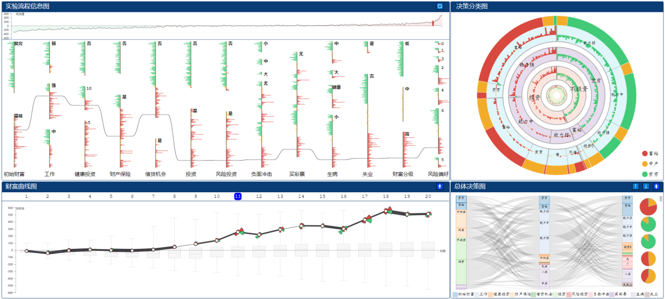
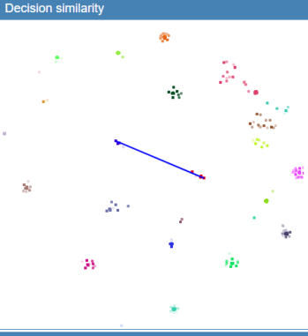
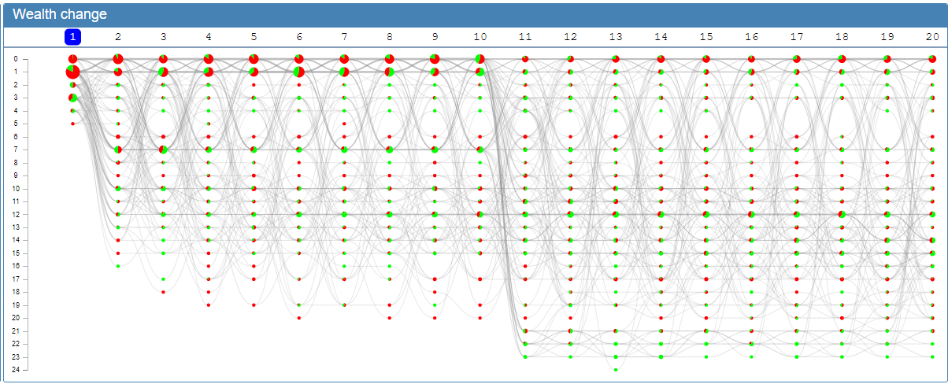
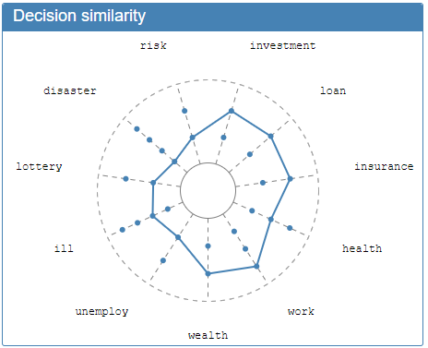
Our Methods
Your concrete 2-4 novel visual encoding, layout, interaction methods.

Slide 9
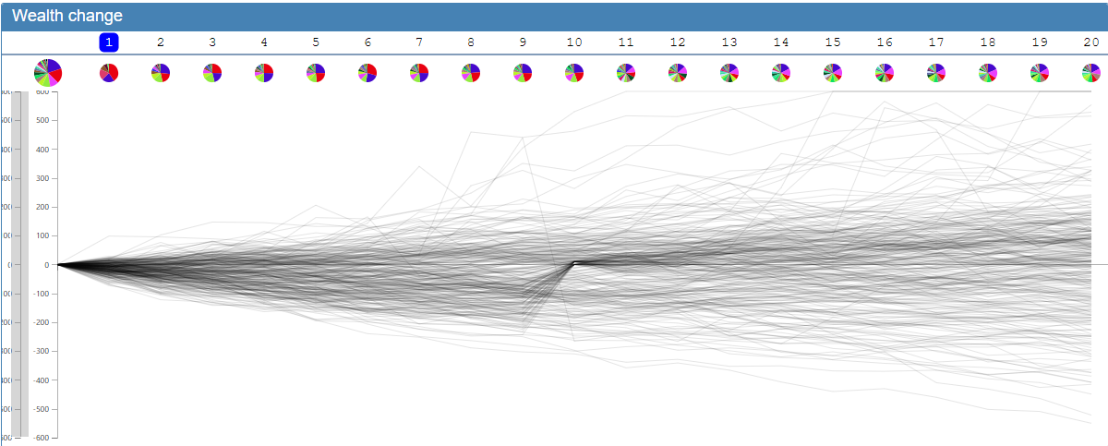
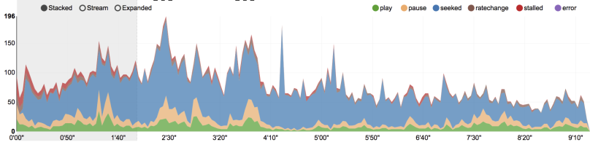
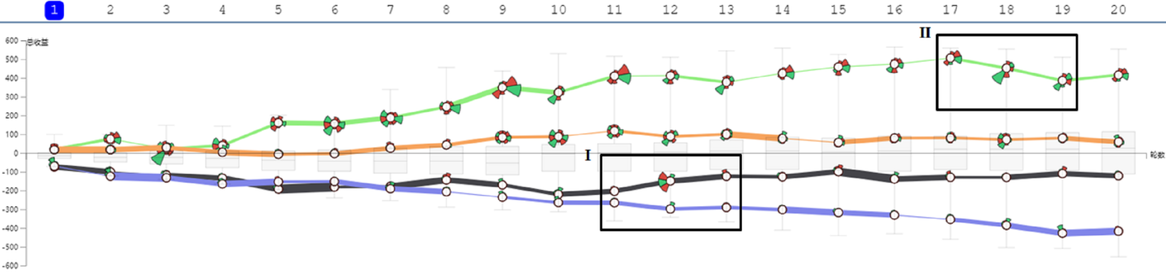
View1 Design
财富累积折线图

Slide 10
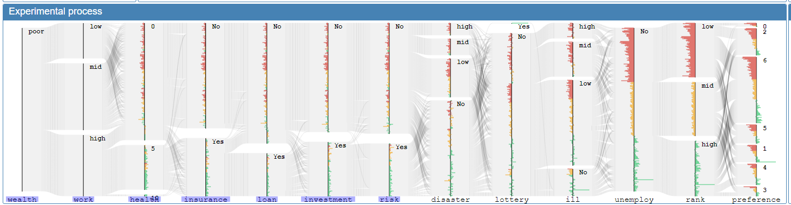
View2
实验流程信息图

Slide 11
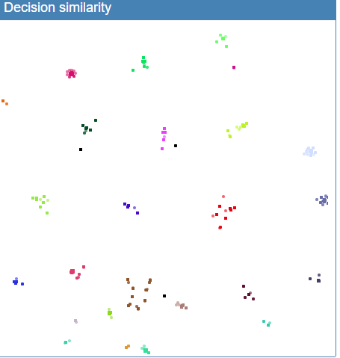
View3
行为模式散点图
无doc2vec
doc2vec

Slide 12
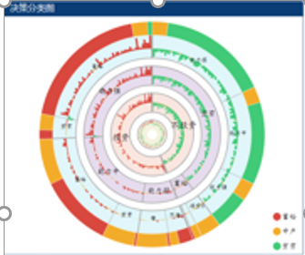
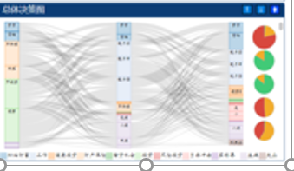
View4
决策分类图 + 总体决策图 （重新设计）

Slide 13
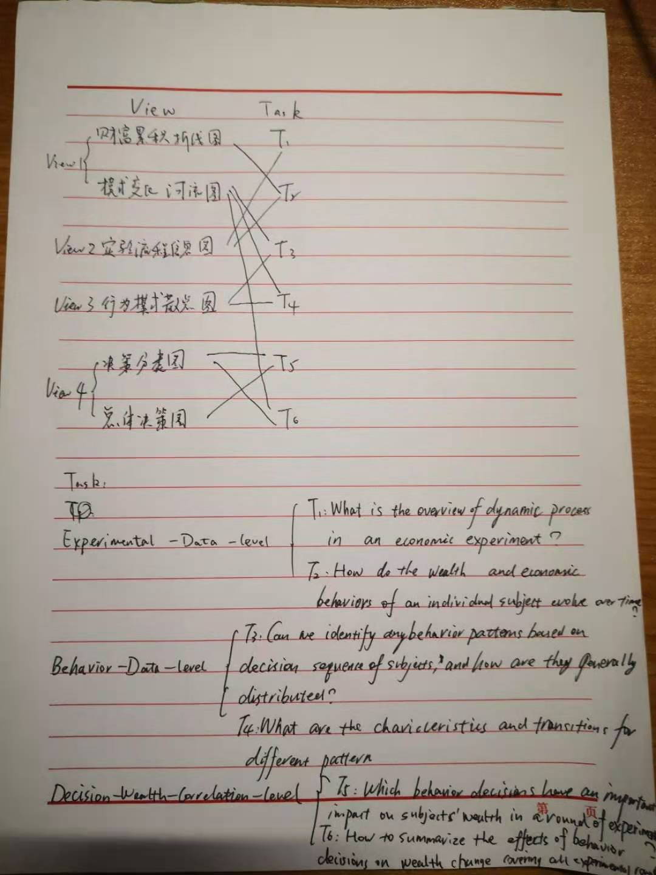

Slide 14
Expected Results
Dataset(s) to use:
Platform, language, and software to use:
  Java
  Eclipse
  Processing

Slide 15
Expected Results
Evaluation
– User study :given the visualization
Q1:宏观概览、集群行为、财富总体变化
Q2:用户行为模式的共性特征和对财富的影响
Q3:针对某一用户，分析其行为的起因和影响
– Interview with domain experts

Slide 16
Discussions
What are the limitations of your methods?
Can your methods be used to solve other problems?

Slide 17
Remaining Tasks
Unsolved major problems
  颜色及系统交互需要进一步优化
-Some layout problem
-Evaluation
-Paper writing
Workload (e.g., coding; algorithm design, user study)
-data processing and integration, coding should be finished at the end of Sep.
-Finish user study and writing in two weeks.

