Slide 1
DBMS
Week#09

Slide 2
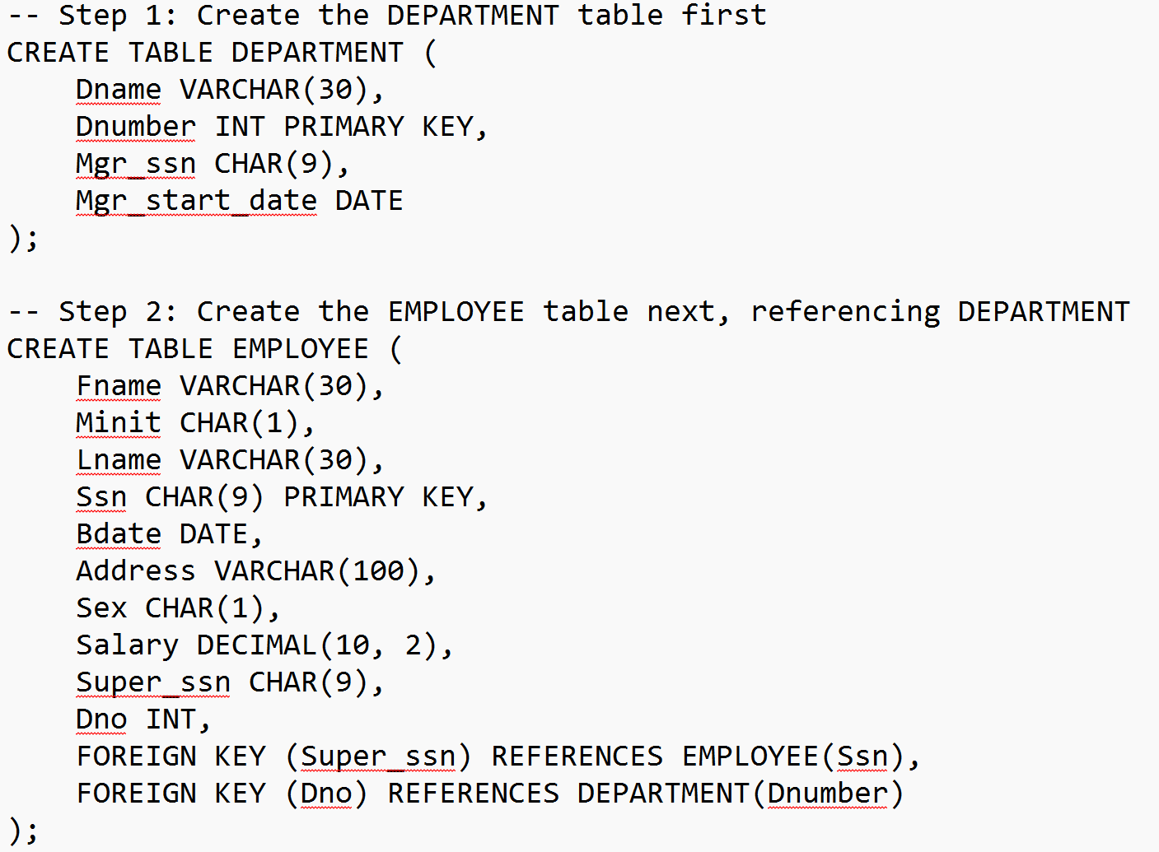

Slide 3
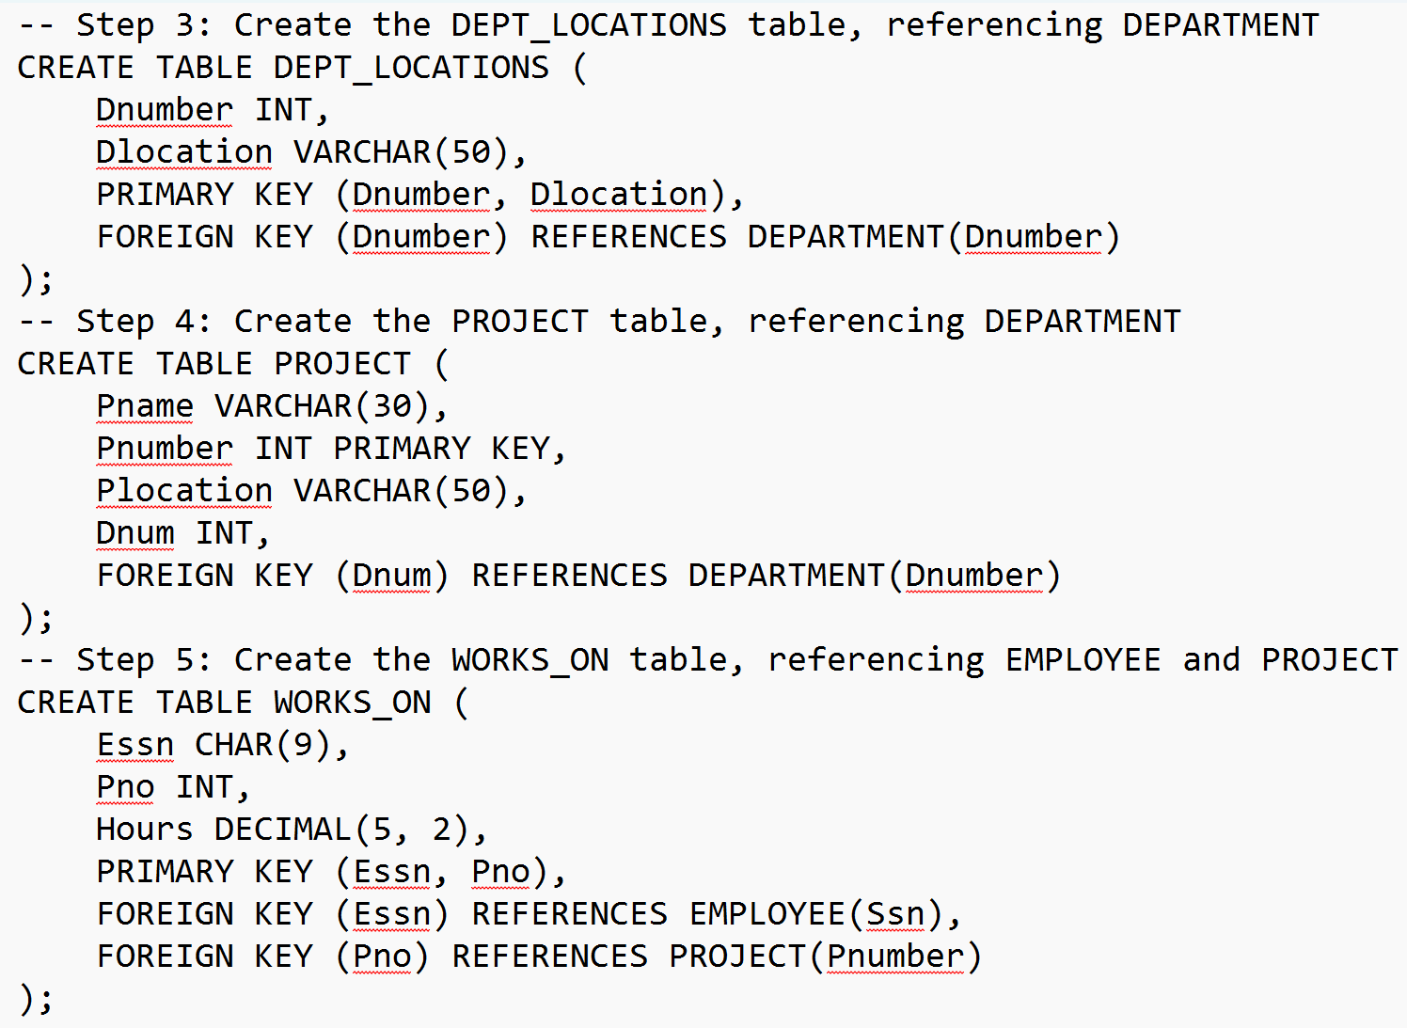

Slide 4
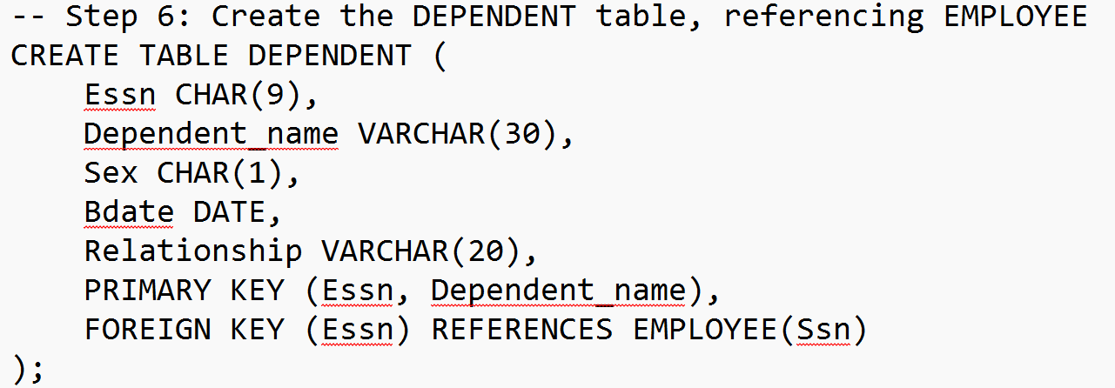
SHOW databases;
show schemas;
SHOW databases LIKE 's%';
SELECT schema_name
FROM information_schema.SCHEMATA
WHERE schema_name LIKE 'c%';
SHOW TABLES;
DESCRIBE WORKS_ON;

Slide 5
The WORKS_ON table can be considered a weak entity.
A weak entity is one that does not have a primary key on its own and instead depends on a foreign key to another table (or a combination of foreign keys) to uniquely identify its records.
WORKS_ON has a composite primary key made up of Essn (employee's SSN) and Pno (project number), both of which are foreign keys referencing EMPLOYEE and PROJECT, respectively.
This structure indicates a dependency on both the EMPLOYEE and PROJECT entities, which aligns with the concept of a weak entity.
Explanation of Constraints
Primary Key (PRIMARY KEY): Each table has a primary key constraint, ensuring unique identification of each record.
For example, Ssn in EMPLOYEE and Dnumber in DEPARTMENT.
Foreign Key (FOREIGN KEY): Used to enforce referential integrity between tables:
Super_ssn in EMPLOYEE references Ssn in the same table.
Dno in EMPLOYEE, Dnumber in DEPT_LOCATIONS, and Dnum in PROJECT reference Dnumber in DEPARTMENT.
Essn in WORKS_ON references Ssn in EMPLOYEE, and Pno in WORKS_ON references Pnumber in PROJECT.
Composite Primary Key: In tables like WORKS_ON, DEPT_LOCATIONS, and DEPENDENT, a composite primary key is used to ensure uniqueness based on a combination of two columns.

Slide 6
INSERT INTO EMPLOYEE (Fname, Minit, Lname, Ssn, Bdate, Address, Sex, Salary, Super_ssn, Dno)
VALUES
('John', 'B', 'Smith', '123456789', '1970-01-15', '731 Fondren, Houston, TX', 'M', 30000, NULL, 5),
('Franklin', 'T', 'Wong', '333445555', '1955-12-08', '638 Voss, Houston, TX', 'M', 40000, '888665555', 5),
('Alicia', 'J', 'Zelaya', '999887777', '1968-01-19', '3321 Castle, Spring, TX', 'F', 25000, '987654321', 4),
('Jennifer', 'S', 'Wallace', '987654321', '1941-06-20', '291 Berry, Bellaire, TX', 'F', 43000, '888665555', 4),
('Ramesh', 'K', 'Narayan', '666884444', '1962-09-15', '975 Fire Oak, Humble, TX', 'M', 38000, '333445555', 5),
('Joyce', 'A', 'English', '453453453', '1972-07-31', '5631 Rice, Houston, TX', 'F’, 125000, '333445555', 5);
INSERT INTO DEPARTMENT (Dname, Dnumber, Mgr_ssn, Mgr_start_date)
VALUES
('Research', 5, '333445555', '1988-05-22'),
('Administration', 4, '987654321', '1995-01-01'),
('Headquarters', 1, '888665555', '1981-06-19');
INSERT INTO DEPT_LOCATIONS (Dnumber, Dlocation)
VALUES
(5, 'Houston'),
(5, 'Bellaire'),
(4, 'Stafford'),
(1, 'Houston');

Slide 7
INSERT INTO PROJECT (Pname, Pnumber, Plocation, Dnum)
VALUES
('ProductX', 1, 'Bellaire', 5),
('ProductY', 2, 'Sugarland', 5),
('ProductZ', 3, 'Houston', 5),
('Computerization', 10, 'Stafford', 4),
('Reorganization', 20, 'Houston', 1),
('Apollo', 30, 'Houston', 1);
INSERT INTO WORKS_ON (Essn, Pno, Hours)
VALUES
('123456789', 1, 32.5),
('123456789', 2, 7.5),
('333445555', 2, 10),
('333445555', 3, 10),
('999887777', 10, 35),
('987654321', 20, 20),
('666884444', 30, 30),
('453453453', 30, 5);

Slide 8
INSERT INTO DEPENDENT (Essn, Dependent_name, Sex, Bdate, Relationship)
VALUES
('123456789', 'Alice', 'F', '1986-04-05', 'Daughter'),
('333445555', 'Michael', 'M', '1988-05-05', 'Son'),
('987654321', 'Elizabeth', 'F', '1967-05-05', 'Spouse'),
('999887777', 'Joy', 'F', '1958-05-03', 'Spouse'),
('666884444', 'Raj', 'M', '1986-01-05', 'Son');
Adding more projects and employees
INSERT INTO PROJECT (Pname, Pnumber, Plocation, Dnum) VALUES (‘LLMs in Healthcare’, 14, ‘Nanchong', 5);
INSERT INTO WORKS_ON (Essn, Pno, Hours) VALUES ('333445555', 40, 15), ('123456789', 40, 20);

Slide 9
Query | Solution
Show the name, department number, and salary of each employee. | SELECT Fname, Lname, Dno, Salary FROM EMPLOYEE;
List all employee names and their SSNs. | SELECT Fname, Lname, Ssn FROM EMPLOYEE;
Get the DEPT names and locations of all departments. | SELECT Dname, (SELECT Dlocation FROM DEPT_LOCATIONS WHERE DEPT_LOCATIONS.Dnumber = DEPARTMENT.Dnumber) AS Dlocation FROM DEPARTMENT LIMIT 2;
Retrieve the details of employees who are male (Sex = 'M'). | SELECT * FROM EMPLOYEE WHERE Sex = 'M';

Slide 10
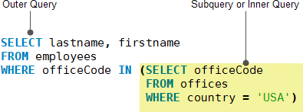
SELECT
lastName, firstName
FROM
employees
WHERE
officeCode IN (SELECT
officeCode
FROM
offices
WHERE
country = 'USA');
In this example:
The subquery returns all office codes of the offices located in the USA.
The outer query selects the last name and first name of employees who work in the offices whose office codes are in the result set returned by the subquery.
When executing the query, MySQL evaluates the subquery first and uses the result of the subquery for the outer query.

Slide 11
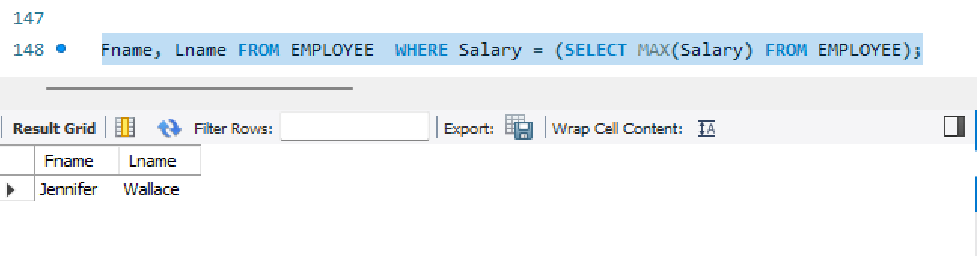
Single-Row Subquery:
Returns only one row.
Typically used with comparison operators such as =, >, <, etc.
Example:
Who are the employees earning the highest salary?
Here, the subquery returns a single value (the highest salary), which the outer query uses to filter employees.

Slide 12
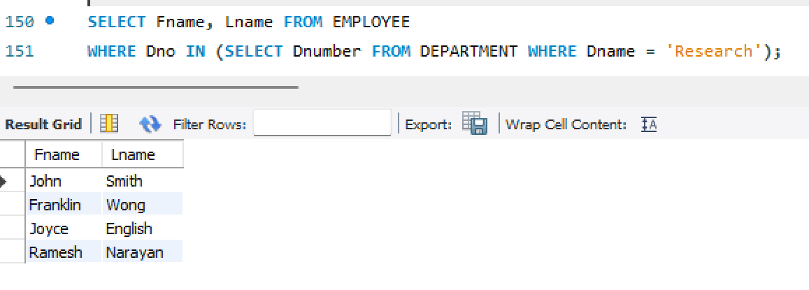
Multi-Row Subquery:
Returns multiple rows.
Often used with operators like IN, ANY, or ALL.
Example:
What are the names of employees who work in the "Research" department?
This subquery returns all department numbers where the department name is "Research." The outer query then checks if the employee’s department matches one of these.

Slide 13
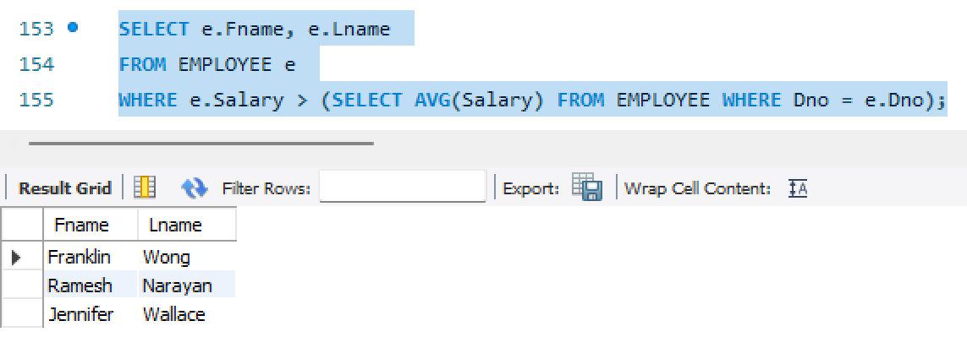
Corelated-Row Subquery:
Refers to columns in the outer query.
Executes once for each row processed by the outer query.
Which employees earn more than the average salary of their respective departments?
Here, the subquery uses a column from the outer query (e.Dno) to calculate the average salary for that specific department for each employee.

Slide 14
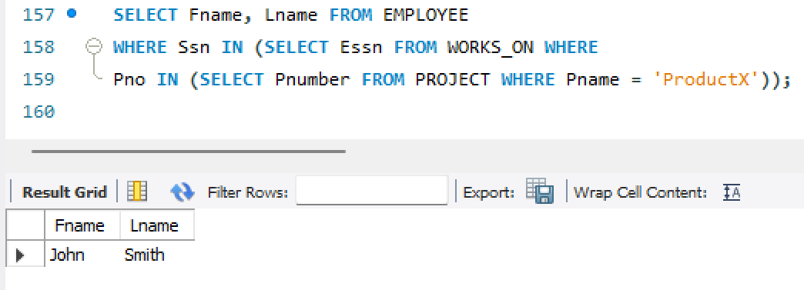
Nested Subquery:
A subquery within another subquery.
Often used in complex conditions.
Which employees work on the project named "ProductX"?

Slide 15
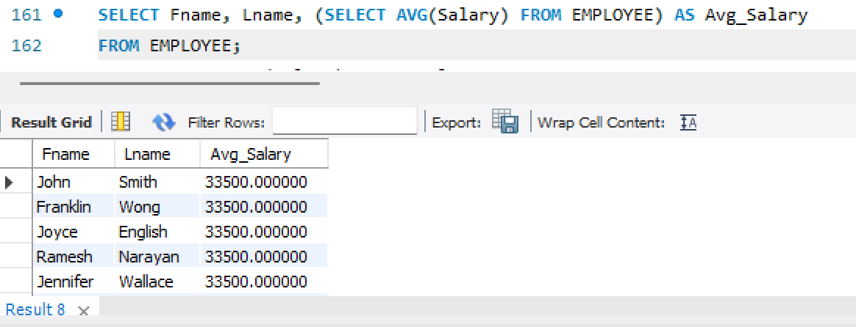
Scaler Subquery
A subquery that returns a single value.
Used in SELECT, WHERE, or HAVING clauses.
What is the average salary of all employees, and can you list each employee’s name alongside it?
The scalar subquery calculates the average salary across all employees. The outer query lists each employee’s name along with the average salary value.

Slide 16
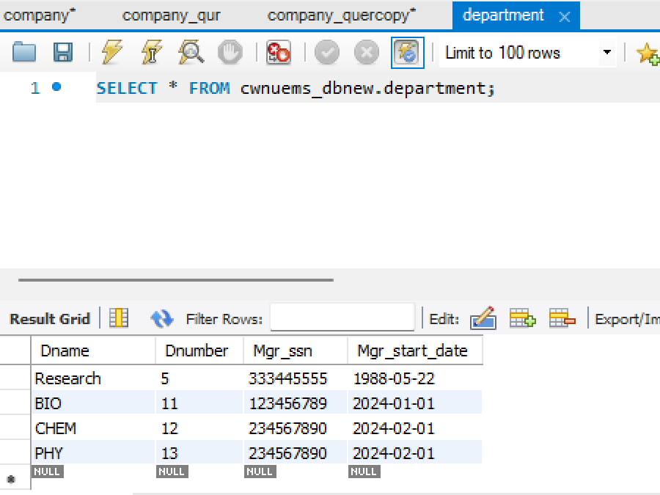
INSERT INTO DEPARTMENT (Dname, Dnumber, Mgr_ssn, Mgr_start_date) VALUES
('BIO', 11, '123456789', '2024-01-01’),
('CHEM', 12, '234567890', '2024-02-01’),
('PHY', 13, '234567890', '2024-02-01');

Slide 17
INSERT INTO DEPARTMENT (Dname, Dnumber, Mgr_ssn, Mgr_start_date) VALUES ('BIO', 11, '123456789', '2024-01-01'),('CHEM', 12, '234567890', '2024-02-01'),('PHY', 13, '234567890', '2024-02-01’);
select * from department;
INSERT INTO EMPLOYEE (Fname, Minit, Lname, Ssn, Bdate, Address, Sex, Salary, Super_ssn, Dno) VALUES ('Awais', 'A', 'Ahmed', '123', '1985-06-15', '123 Elm St', 'M', 50000, NULL, 1),('Basit', 'A', 'Ali', '345', '1990-07-20', '456 Oak St', 'F', 60000, '123', 1);
INSERT INTO DEPT_LOCATIONS (Dnumber, Dlocation) VALUES (11, 'New York’),(12, 'Los Angeles’);
INSERT INTO PROJECT (Pname, Pnumber, Plocation, Dnum) VALUES ('ProductX', 101, 'New York', 1),('ProductY', 102, 'Los Angeles', 5);
INSERT INTO WORKS_ON (Essn, Pno, Hours) VALUES ('123', 101, 20.5),('345', 102, 35.0);
INTO DEPENDENT (Essn, Dependent_name, Sex, Bdate, Relationship) VALUES ('123', 'Aiza', 'F', '2021-09-23', 'Daughter'),('345', 'Bob', 'M', '2018-03-10', 'Son');

Slide 18
Delete a employee with ssn '123456789 DELETE FROM EMPLOYEE WHERE Ssn = '123456789';
Delete all dependents of a specific employee
Removes all dependents of the employee with SSN '123456789'.
DELETE FROM DEPENDENT
WHERE Essn = '123456789’;
Delete department if no employee references it If you want to delete a department, make sure no foreign key constraints are violated. First, delete all employees linked to that department number in EMPLOYEE.
DELETE FROM EMPLOYEE
WHERE Dno = 5;
DELETE FROM DEPARTMENT
WHERE Dnumber = 5;

Slide 19
Update the salary of an employee
UPDATE EMPLOYEE SET Salary = 125000 WHERE Ssn = '123’;
Increase the salary of the employee with SSN '123456789' by 10%.
UPDATE EMPLOYEE
SET Salary = Salary * 1.1
WHERE Ssn = '123456789';
Change a department’s manager
Update the Mgr_ssn and Mgr_start_date in the DEPARTMENT table for department number 3.
UPDATE DEPARTMENT
SET Mgr_ssn = '987654321', Mgr_start_date = '2024-01-01'
WHERE Dnumber = 3;

Slide 20
Update project location
Change the location of the project ProductX in the PROJECT table.
UPDATE PROJECT
SET Plocation = 'New York'
WHERE Pname = 'ProductX’;
Update employee supervisor
Set the supervisor of an employee with SSN '123456789' to a new supervisor with SSN '987654321'.
UPDATE EMPLOYEE
SET Super_ssn = '987654321'
WHERE Ssn = '123456789';
Update dependent information
Change the relationship of a dependent named 'John' for an employee with SSN '123456789' to 'Son'.
UPDATE DEPENDENT
SET Relationship = 'Son'
WHERE Essn = '123456789' AND Dependent_name = 'John';
These DELETE and UPDATE examples illustrate how to modify and remove records in your database.

Slide 21
Practice ER Diagram Question
Suppose you are given the following requirements for a simple database for the CWNU’s Hockey League (CHL):
the CHL has many teams, each team has a name, a city, a coach, a captain, and a set of players,
each player belongs to only one team,
each player has a name, a position (such as left wing or goalie), a skill level, and a set of injury records,
a team captain is also a player,
a game is played between two teams (referred to as host_team and guest_team) and has a date (such as OCT 24, 2024) and a score (such as 4 to 2).
Construct a clean and concise ER diagram for the NHL database using the Chen notation as of your textbook. List your assumptions and clearly indicate the cardinality mappings as well as any role indicators in your ER diagram.

Slide 22
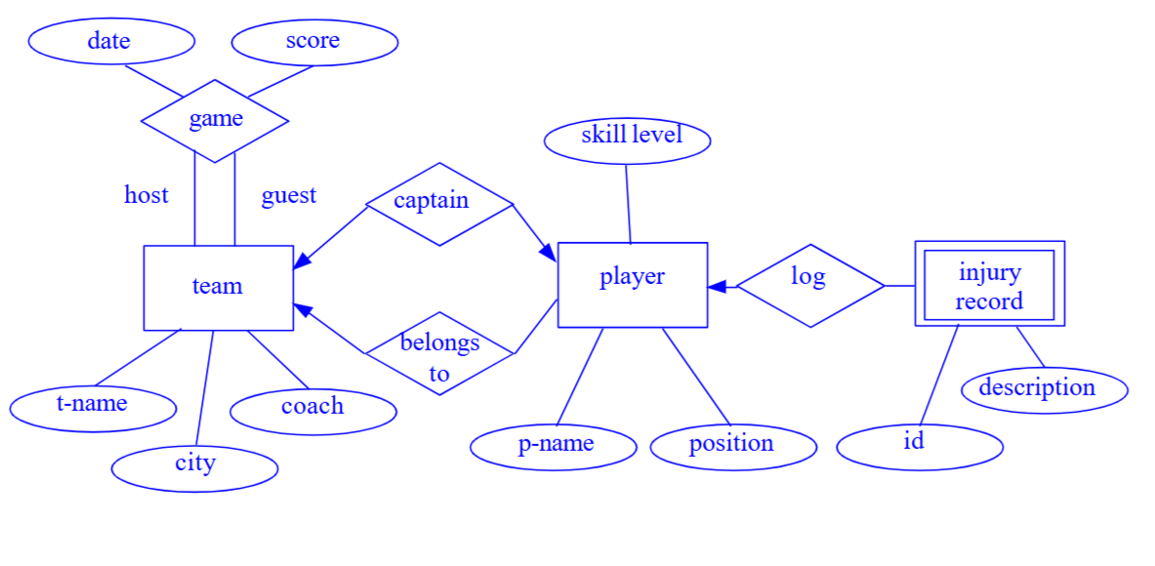
ONE POSSIBLE SOLUTION

Slide 23
Find the names of employees who have a salary greater than 50,000. | SELECT Fname, Lname FROM EMPLOYEE WHERE Salary > 50000;
Display the details of departments managed by employees whose SSNs are known. | SELECT * FROM DEPARTMENT WHERE Mgr_ssn IS NOT NULL;
List the locations where the "Research" department operates. | SELECT Dlocation FROM DEPT_LOCATIONS WHERE Dnumber = (SELECT Dnumber FROM DEPARTMENT WHERE Dname = 'Research');

Slide 24
Get the names and addresses of employees in department 5. | SELECT Fname, Lname, Address FROM EMPLOYEE WHERE Dno = 5;
Find the names of all projects located in "Houston". | SELECT Pname FROM PROJECT WHERE Plocation = 'Houston';
Count the total number of departments in the company. | SELECT COUNT(*) AS Total_Departments FROM DEPARTMENT;

Slide 25
Get the names and addresses of employees in department 5. | SELECT Fname, Lname, Address FROM EMPLOYEE WHERE Dno = 5;
Find the names of all projects located in "Houston". Whose salary >150000 | SELECT Pname FROM PROJECT WHERE Plocation = 'Houston';
Count the total number of departments in the company. | SELECT COUNT(*) AS Total_Departments FROM DEPARTMENT;

Slide 26
List employees who work on more than one project. | SELECT Essn FROM WORKS_ON GROUP BY Essn HAVING COUNT(Pno) > 1;
Retrieve the average salary of employees in each department. | SELECT Dno, AVG(Salary) AS Avg_Salary FROM EMPLOYEE GROUP BY Dno;
Find the department with the highest average salary. | SELECT Dno FROM EMPLOYEE GROUP BY Dno ORDER BY AVG(Salary) DESC LIMIT 1;

Slide 27
Next class assignment – You should learn why and how they are working
Find the names of all projects located in "Houston". Whose salary >150000
Find the department with the highest average salary.

Slide 28
List employees who work on more than one project. | SELECT Essn FROM WORKS_ON GROUP BY Essn HAVING COUNT(Pno) > 1;
Retrieve the average salary of employees in each department. | SELECT Dno, AVG(Salary) AS Avg_Salary FROM EMPLOYEE GROUP BY Dno;
Display the names of employees who work on the project "ProductX". | Don’t attempt JOIN (lets attempt alternative)
Find the department with the highest average salary. | SELECT Dno FROM EMPLOYEE GROUP BY Dno ORDER BY AVG(Salary) DESC LIMIT 1;
List employees and their dependents' names if they have any. | Don’t attempt JOIN (lets attempt alternative)
Find the total number of hours each employee worked across all projects. | SELECT Essn, SUM(Hours) AS Total_Hours FROM WORKS_ON GROUP BY Essn;
Get the name and salary of each employee, along with the name of their supervisor. | Don’t attempt JOIN (lets attempt alternative)
Display the names of employees who work in the same department as their supervisors. | Don’t attempt JOIN (lets attempt alternative)
List the projects and the total hours worked on each project. | Don’t attempt JOIN (lets attempt alternative)
Count the number of male and female employees in each department. | SELECT Dno, Sex, COUNT(*) AS Count FROM EMPLOYEE GROUP BY Dno, Sex;

Slide 29
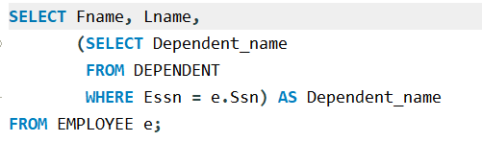
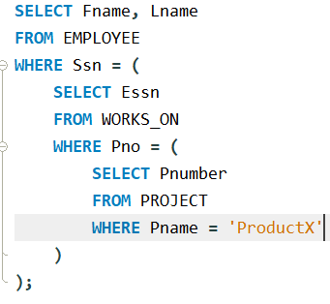
List employees and their dependents' names if they have any.
Display the names of employees who work on the project "ProductX".

Slide 30
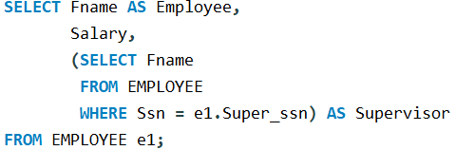
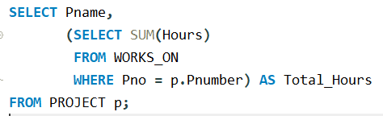
Get the name and salary of each employee, along with the name of their supervisor.
List the projects and the total hours worked on each project.

