Slide 1
CI 453
Ben Highgate, Ahmed El-Hawat, Michael Ugwumba, Minas Fakhori

Slide 2
Agenda
The website
Project management
Group Communication
Legal & ethical considerations

Slide 3
The Website
Subtitle

Slide 4
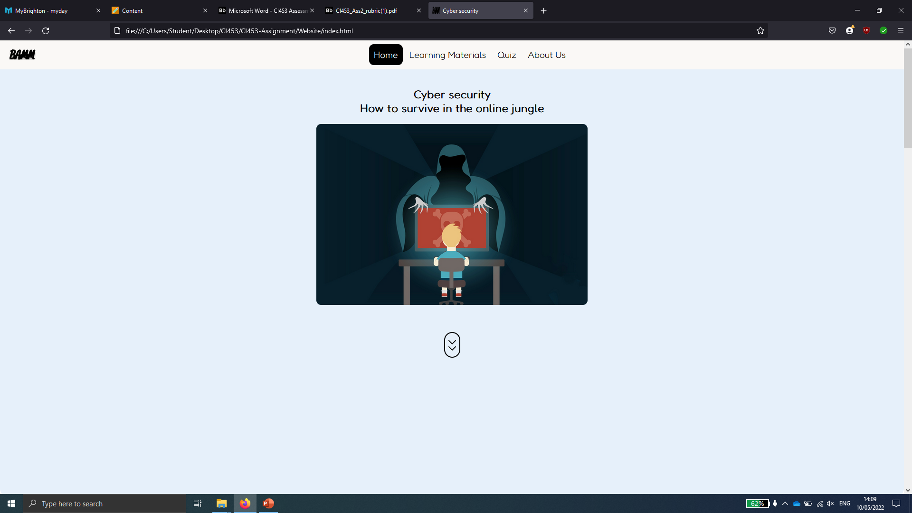
Our website
Features
Interactive quiz
Navigation
Page previews
Accessibility features
***The contact page (best)
Responsive

Slide 5
Project Management
Brainstorming, design, planning, and research on target audience.
1
Delegation of tasks, research on topics.
2
Development of html, CSS and JavaScript for website features.
3
Testing, reviewing and editing.
4
Testing, reviewing and editing.
5

Slide 6
Group communication
Tools
Subtitle
Subtitle
Discord
GitHub
Open the Design Ideas pane for instant slide makeovers.
When we have design ideas, we’ll show them to you right there.
This PowerPoint theme uses its own unique set of colors, fonts, and effects to create the overall look and feel of these slides.
PowerPoint has tons of themes to give your presentation just the right personality.

Slide 7
Legal & ethical considerations

Slide 8


Summary
With PowerPoint, you can create presentations and share your work with others, wherever they are. Type the text you want here to get started. You can also add images, art, and videos on this template. Save to OneDrive and access your presentations from your computer, tablet, or phone.

Slide 9
Thank you
Presenter name
Email address
Website

